Slide 1
Earthquake

Slide 2
An earthquake (also known as a quake, tremor or temblor) is the shaking of the surface of the Earth resulting from a sudden release of energy in the Earth’s lithosphere that creates seismic waves. Earthquakes can range in intensity, from those that are so weak that they cannot be felt, to those violent enough to propel objects and people into the air, damage critical infrastructure, and wreak destruction across entire cities. The seismic activity of an area is the frequency, type, and size of earthquakes experienced over a particular time. The seismicity at a particular location in the Earth is the average rate of seismic energy release per unit volume. The word tremor is also used for non-earthquake seismic rumbling.

Slide 3
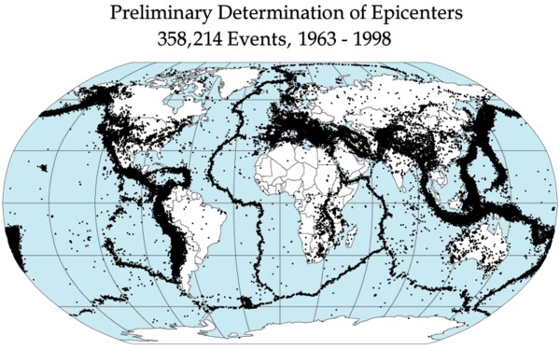

Slide 4
At the Earth’s surface, earthquakes manifest themselves by shaking and displacing or disrupting the ground. When the epicenter of a large earthquake is located offshore, the seabed may be displaced sufficiently to cause a tsunami. Earthquakes can also trigger landslides. In its most general sense, the word earthquake is used to describe any seismic event—whether natural or caused by humans—that generates seismic waves. Earthquakes are caused mostly by rupture of geological faults but also by other events such as volcanic activity, landslides, mine blasts, and nuclear tests. An earthquake’s point of initial rupture is called its hypocenter or focus. The epicenter is the point at ground level directly above the hypocenter.

Slide 5
An earthquake is what happens when two blocks of the earth suddenly slip past one another. The surface where they slip is called the fault or fault plane. The location below the earth’s surface where the earthquake starts is called the hypocenter, and the location directly above it on the surface of the earth is called the epicenter.
Sometimes an earthquake has foreshocks. These are smaller earthquakes that happen in the same place as the larger earthquake that follows. Scientists can’t tell that an earthquake is a foreshock until the larger earthquake happens. The largest, main earthquake is called the mainshock. Mainshocks always have aftershocks that follow. These are smaller earthquakes that occur afterwards in the same place as the mainshock. Depending on the size of the mainshock, aftershocks can continue for weeks, months, and even years after the mainshock!

Slide 6
