Slide 1
Detection and Analysis of Silent Decision Degradation in AI-Assisted Inventory Systems
A Preliminary Project Report
Under the guidance of: Dr R Mohan Assistant Professor Department of Computer Science NIT Tiruchirappalli
Presented By:
N Naga Neelesh(114122064)
Shreshtha Rai(114122097)

Slide 2
Project Overview & Motivation
Motivation
AI-based decision systems are widely used in inventory, logistics, and operations
Evaluation is usually based on:
Accuracy
Cost
Average service level
These metrics assume:
Stable environments
Immediate failure visibility
Core Concern
In real operational settings:
Demand evolves gradually
Signals are delayed or incomplete
Structural dependencies exist
Under such conditions:
Systems may continue to operate
Decisions appear plausible
Decision quality degrades silently
Key Question
How can we identify and analyze gradual, silent degradation in AI-assisted decision systems before overt failure occurs?

Slide 3
Problem Statement & Objectives
Problem Statement
Existing research focuses on:
Prediction accuracy degradation
Cost or service-level optimization
There is limited focus on:
Decision behavior over time
Gradual degradation without metric collapse
Silent degradation is dangerous because:
It is hard to detect
It accumulates over time
It leads to delayed operational failure
Project Objectives
Model a realistic inventory decision environment
Build a transparent baseline decision system
Systematically inject controlled failures
Observe how decision behavior degrades
Prepare a framework for degradation detection and correction

Slide 4
Methodology (Overall Structure)
The project follows a multi-phase experimental framework
Phase 0 – Environment Characterization
Analyze demand structure, variability, and coupling
Study store–department relationships
Identify behavioral patterns (e.g., holidays)
Phase 1 – Baseline Decision System
Define a single core decision:
Weekly inventory allocation (store × department)
Use simple, interpretable rules
Establish baseline performance metrics
Phase 2 – Failure Injection
Introduce controlled violations of assumptions
Observe gradual degradation (not immediate failure)
Future Phases
Phase 3: Degradation detection
Phase 4: Correction and recovery
Phased Methodology
Inventory is used as a testbed, not the final objective.

Slide 5
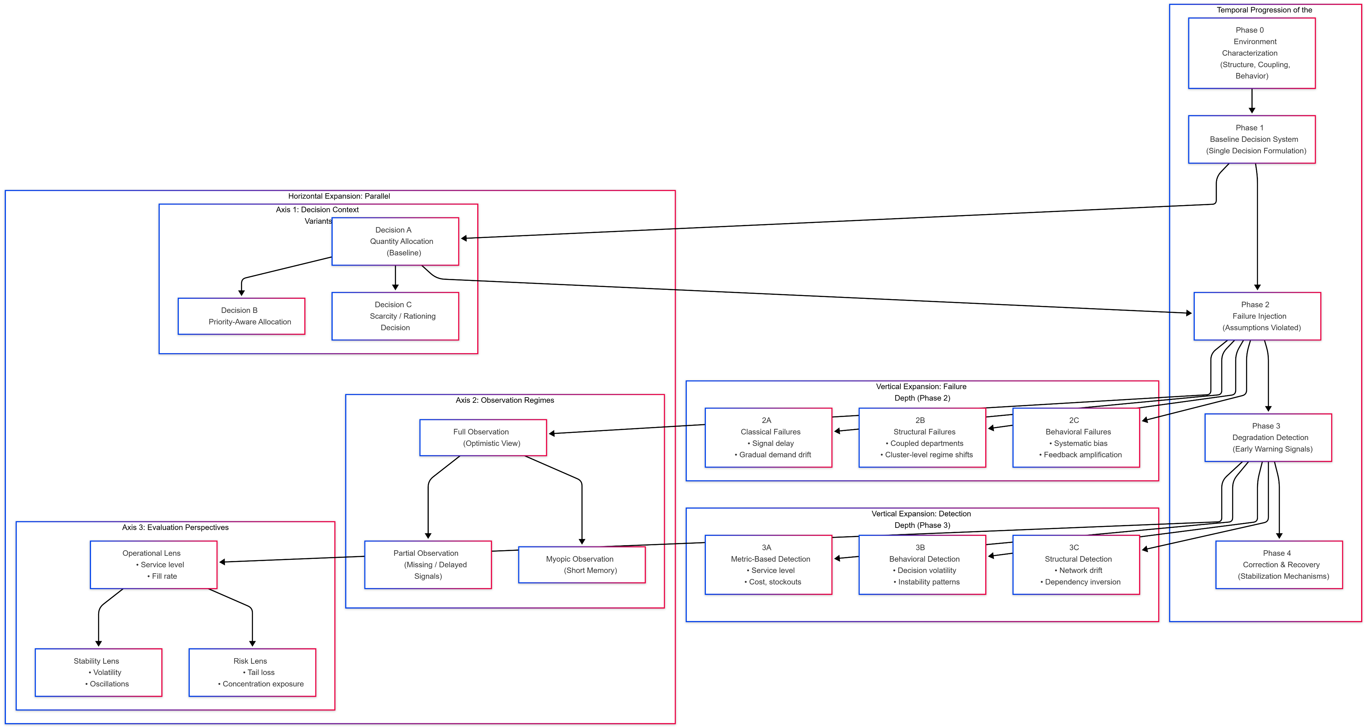
System Architecture Overview

Slide 6
Failure Design & Research Axes
Vertical Expansion (Failure Depth)
Failures are introduced progressively:
Classical failures:
Demand drift
Signal delays
Structural failures:
Coupled departments
Regime shifts across store clusters
Behavioral failures:
Bias
Feedback amplification
Purpose:
Study how degradation accumulates, not how systems crash
Horizontal Expansion (Generalization)
To avoid single-case conclusions, analysis expands across:
Decision variants
Quantity-based
Priority-aware
Scarcity-aware
Observation regimes
Full
Partial
Myopic
Evaluation perspectives
Operational performance
Stability & volatility
Risk & tail exposure

Slide 7
Work Completed & Preliminary Observations
Preliminary Observations
Demand shows strong:
Seasonality
Store-level heterogeneity
Baseline system:
Achieves high average service level
Still exhibits high unmet demand and overstock
Aggregate metrics:
Mask early degradation
Structural coupling suggests:
Local failures can propagate system-wide
These observations validate the existence of silent degradation conditions.
Work Completed
Walmart sales data has been successfully integrated and preprocessed.
Phase 0: Environment Characterization is complete, including demand heterogeneity and network-based structural analysis.
Phase 1: Baseline inventory decision system is established, with full metric computation and validation.
Phase 2: Failure concepts and detailed injection design are initiated.

Slide 8
Future Plan, Timeline & Significance
Future Plan
Complete Phase 2:
Execute structural and behavioral failure injections
Phase 3:
Design degradation detection signals
Compare against traditional metrics
Phase 4:
Explore correction and recovery mechanisms
Extend analysis across decision variants
Significance
Shifts focus from model accuracy to decision integrity
Addresses a realistic, under-studied failure mode
Provides a reusable experimental framework
Applicable beyond inventory systems
Feb–Mar: Failure injection & analysis
Mar–Apr: Detection signal design
Apr: Recovery mechanisms
May: Final consolidation & thesis submission
Goal: Detect decision degradation before performance collapse.

