Slide 1
Detection and Analysis of Silent Decision Degradation in AI-Assisted Inventory Systems
A Preliminary Project Report
Under the guidance of: Dr R Mohan Assistant Professor Department of Computer Science NIT Tiruchirappalli
Presented By:
N Naga Neelesh(114122064)
Shreshtha Rai(114122097)

Slide 2
Project Overview & Motivation
Motivation
AI-based decision systems are widely used in inventory, logistics, and operations
Evaluation is usually based on:
Accuracy
Cost
Average service level
These metrics assume:
Stable environments
Immediate failure visibility
Core Concern
In real operational settings:
Demand evolves gradually
Signals are delayed or incomplete
Structural dependencies exist
Under such conditions:
Systems may continue to operate
Decisions appear plausible
Decision quality degrades silently
Key Question
How can we identify and analyze gradual, silent degradation in AI-assisted decision systems before overt failure occurs?

Slide 3
Problem Statement & Objectives
Problem Statement
Existing research focuses on:
Prediction accuracy degradation
Cost or service-level optimization
There is limited focus on:
Decision behavior over time
Gradual degradation without metric collapse
Silent degradation is dangerous because:
It is hard to detect
It accumulates over time
It leads to delayed operational failure
Project Objectives
Model a realistic inventory decision environment
Build a transparent baseline decision system
Systematically inject controlled failures
Observe how decision behavior degrades
Prepare a framework for degradation detection and correction

Slide 4
Methodology (Overall Structure)
Phase 0 – Environment Characterization
Analyze demand structure, variability, and coupling
Study store–department relationships
Identify behavioral patterns (e.g., holidays)
Phase 1 – Baseline Decision System
Define a single core decision:
Weekly inventory allocation (store × department)
Use simple, interpretable rules
Establish baseline performance metrics
Phase 2 – Failure Injection
Introduce controlled violations of assumptions
Observe gradual degradation (not immediate failure)
Phase 3: Degradation detection
Phase 4: Correction and recovery
Analyze system behaviour to identify early indicators of decision performance degradation.
Develop monitoring metrics that capture instability and inefficiencies beyond traditional performance measures.
Design mechanisms to stabilize the decision system when degradation signals are detected.
Evaluate recovery strategies to restore allocation performance under disrupted conditions.
Inventory is used as a testbed, not the final objective.

Slide 5
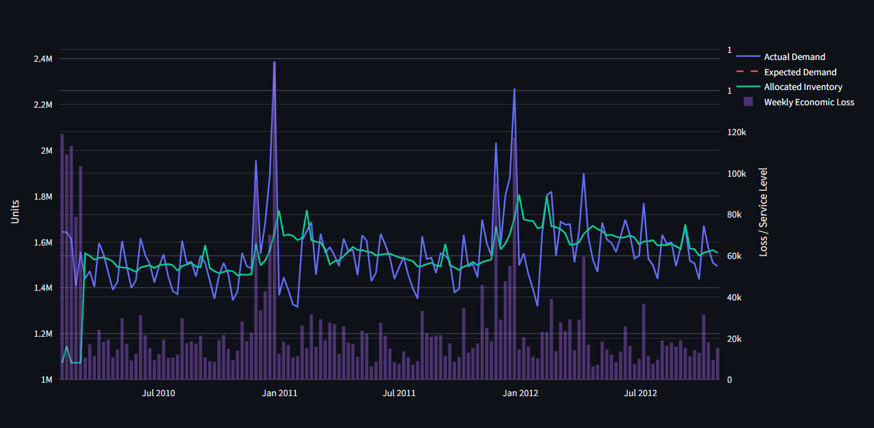
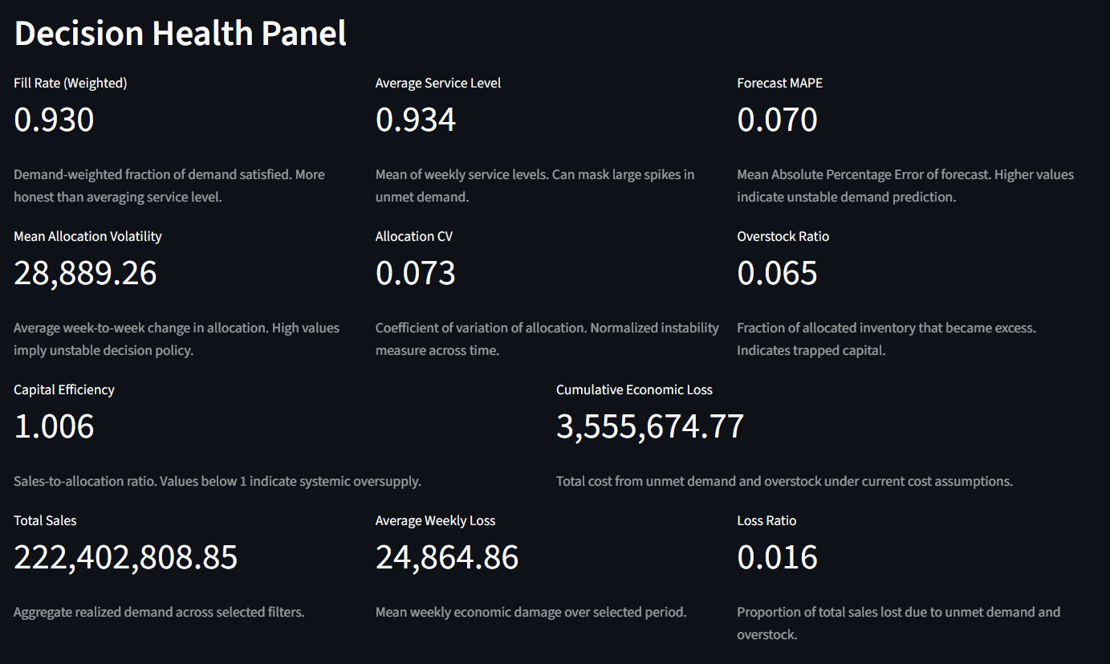
System Setup & Baseline Model
Phase 0
Walmart Store Sales dataset used for modeling inventory demand
Phase 1
Developed baseline inventory allocation decision system
Results
Data preprocessing, exploratory analysis, and demand variability assessment
Identification of store-department demand patterns and seasonal effects
Defined performance metrics: service level, unmet demand, overstock
Baseline system establishes reference behaviour under stable conditions
Baseline service level ≈ 0.92
Demand heterogeneity observed across stores
Holiday periods cause strong demand volatility

Slide 6
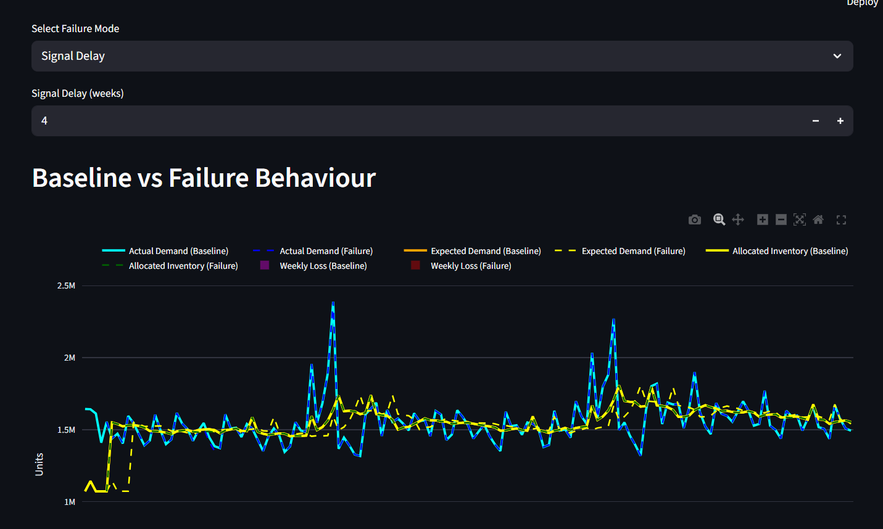
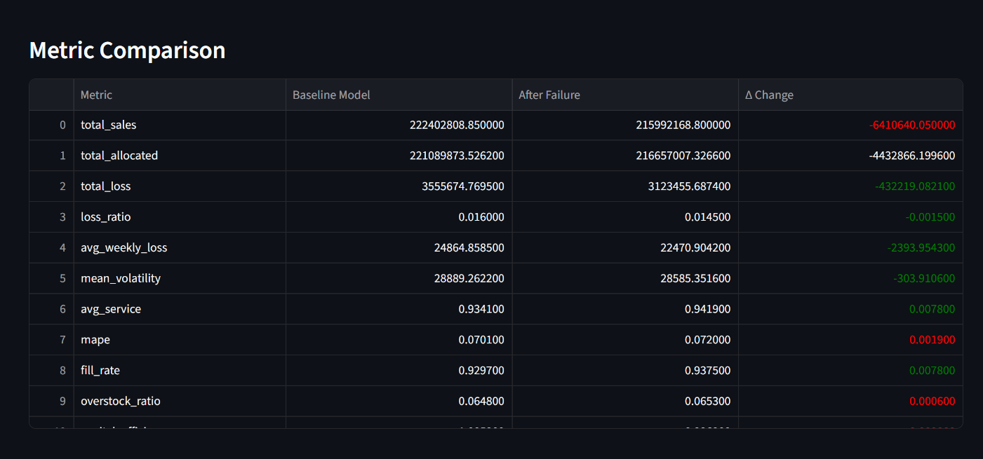
Failure Experiments & Experimental Dashboard
Phase 2 work
Introduced controlled disruptions to simulate real operational conditions
Observations
Allocation behaviour becomes unstable under disrupted conditions
Dashboard
Developed an interactive Streamlit experimental dashboard
Inefficiencies appear despite stable aggregate metrics
Indicates possibility of silent degradation in decision performance
Enables visualization of allocation performance and degradation behaviour
Used to monitor metrics, compare scenarios, and analyze system response
Implemented failure scenarios such as demand drift and delayed information
Evaluated how allocation decisions change under disturbed environments

Slide 7
Future Plan, Timeline & Significance
Future Plan
Phase 3:
Design degradation detection signals
Compare against traditional metrics
Phase 4:
Explore correction and recovery mechanisms
Extend analysis across decision variants
Significance
Shifts focus from model accuracy to decision integrity
Addresses a realistic, under-studied failure mode
Provides a reusable experimental framework
Applicable beyond inventory systems
Mar–Apr: Detection signal design
Apr: Recovery mechanisms
May: Final consolidation & thesis submission
Goal: Detect decision degradation before performance collapse.

