Slide 1
MACHINE LEARNING AND SENTIMENT BASED INVESTMENT ANALYSIS Presented By Neelesh Nagpal

Slide 2
INDEX
Introduction
Investment analysis journey
Literature Review
Data Visualization
Machine Learning Model: Ridge Regression with L2 Regularization
Data Split Visualized
Regression Output: Predictions vs Original
Deep Learning Strategy Discussion
LSTM Model Output: Predictions vs Original
Future Work

Slide 3
INTRODUCTION
Financial markets have been a topic of great intrigue and innovation since their inception. People get involved in investment analysis for a variety of reasons ranging from making quick profits to ensuring a safe return in the future long run.
Investment analysis is the tool through which people make these decisions. Investment analysis forms the backbone of financial services industry. It is the process of evaluating the potential profitability and risk of an investment opportunity. It involves examining financial and other relevant data to determine the viability of an investment opportunity and to make informed investment decisions. All investments are subject to market risk and investors should be cautious in making smart and calculated decisions.

Slide 4
INVESTMENT
ANALYSIS JOURNEY
Objective
Risk Assessment
Market Analysis
Financial Analysis
Investment Strategy
Monitoring

Slide 5
Literature review:
Nan Jing et al. (2021) proposed a hybrid model that combines deep learning with investor sentiment analysis for predicting stock prices. CNN was used to classify investor sentiments and LSTM was used to capture temporal dependencies in stock prices and a sentiment analysis algorithm to extract sentiment from financial news articles about the SSE (Shanghai Stock Exchange). The sentiment score generated was used as an input feature to the LSTM.
Ashish Pathak et al. (2019) proposed a hybrid approach by combining sentiment analysis and neural networks to develop a robust model that aims to predict financial markets behavior better than when these techniques are used independently. The results were experimentally verified by applying the model on some top stocks in the Indian Stock market scenario.

Slide 6
Ramkrishna Patel et al. (2021) developed a two-model approach that combined NLP for feature extraction and LSTM for prediction of stock prices. They used Text Blob and Vader sentiment packages for feature extraction and converting textual data to numerical data. Then these values were fed into the LSTM RNN for predicting the closing price after 90 days.
Kristian Bondo Hansen et al. (2022) developed an approach to analyze alternate data besides just the investor sentiment. According to them, alternative data is something that is not easily available, is expensive to gather and is outside the market. Some examples of alternative data include satellite imagery, GPS data, social media commentary. These factors may seem irrelevant to investment analysis, but they have an indirect impact on the financial market.

Slide 7
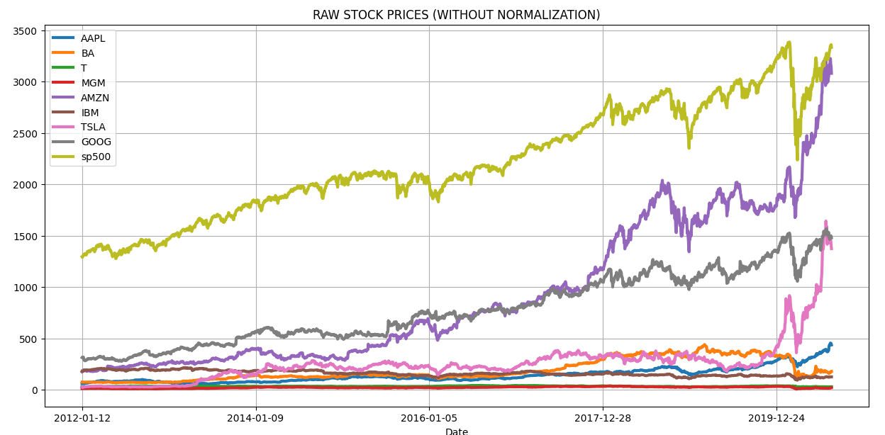
EXPLORATORY ANALYSIS OF RAW DATA
8 Stocks and Stock Index. Time period 2012-2020.
DATA VISUALIZATION

Slide 8
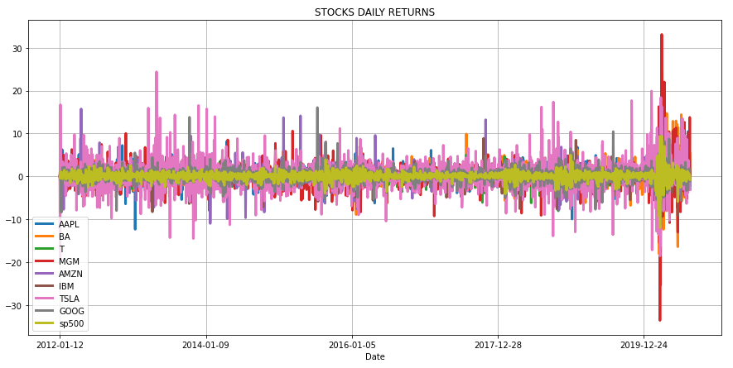
DAILY RETURNS VISUALISED.
MAJOR FLUCTUATION IN MGM Resorts Stock DURING MARCH 2020 (COVID-19) IMPACT ON HOTEL INDUSTRY.
DATA VISUALIZATION

Slide 9
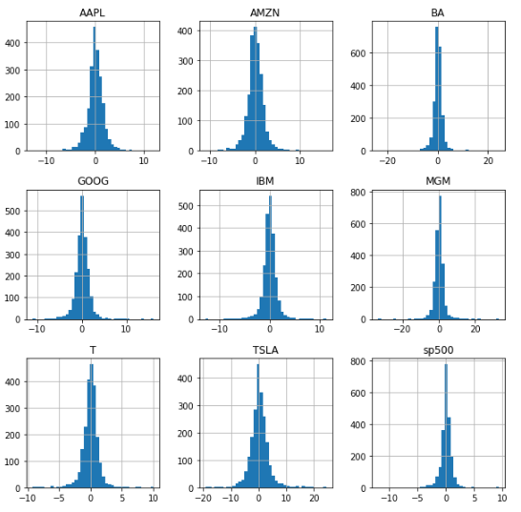
RISK VISUALIZATION USING HISTOGRAM.
BROADER BOTTOM IMPLIES HIGHER FLUCTUATION OF RETURNS WHICH MEANS IT IS A RISKY STOCK TO INVEST IN.
DATA VISUALIZATION

Slide 10
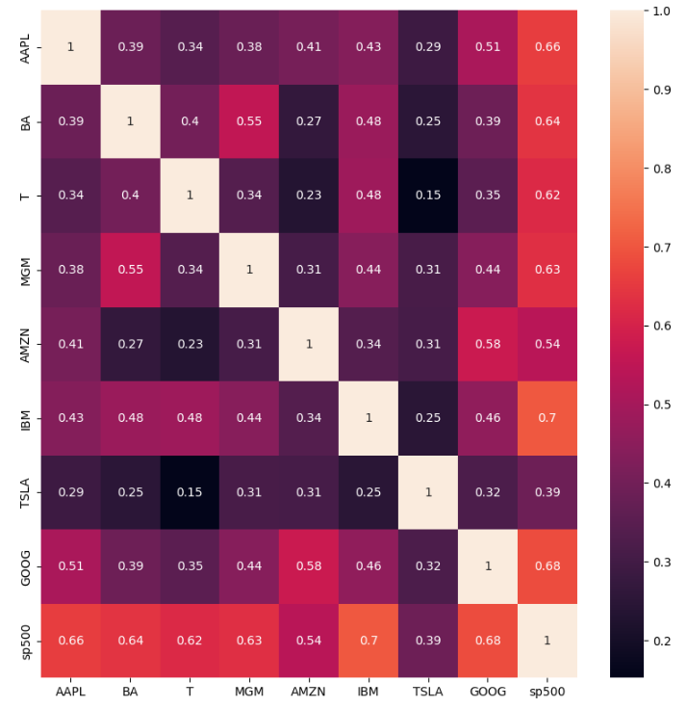
CORRELATION MATRIX TO DEFINE RELATIONS BETWEEN STOCK PERFORMANCES.
MOSTLY UNRELATED. BUT HIGH CORRELATION BETWEEN MGM AND BOEING.(HOTEL AND TRAVEL INDUSTRIES ARE INTER-RELATED).
DATA VISUALIZATION

Slide 11
REGRESSION ANALYSIS IS PERFORMED.
SPECIFICALLY: RIDGE REGRESSION WITH L2 REGULARISATION.
DATA PREPARATION: STOCK PRICE AND STOCK VOLUME DATASETS.
DATASETS CONCATENATED TO MAKE 1 MASTER DATAFRAME WITH DATE , CLOSING PRICE, VOLUME AND TARGET PRICE(NEXT DAY PRICE).
DATA SPLIT 65:35 TRAIN-TEST RATIO.
FEATURES(INPUT): CLOSE AND VOLUME.
TARGET(OUTPUT): PREDICTED PRICE(TARGET).
STOCK IN CONSIDERATION: AAPL.
MACHINE LEARNING MODEL

Slide 12
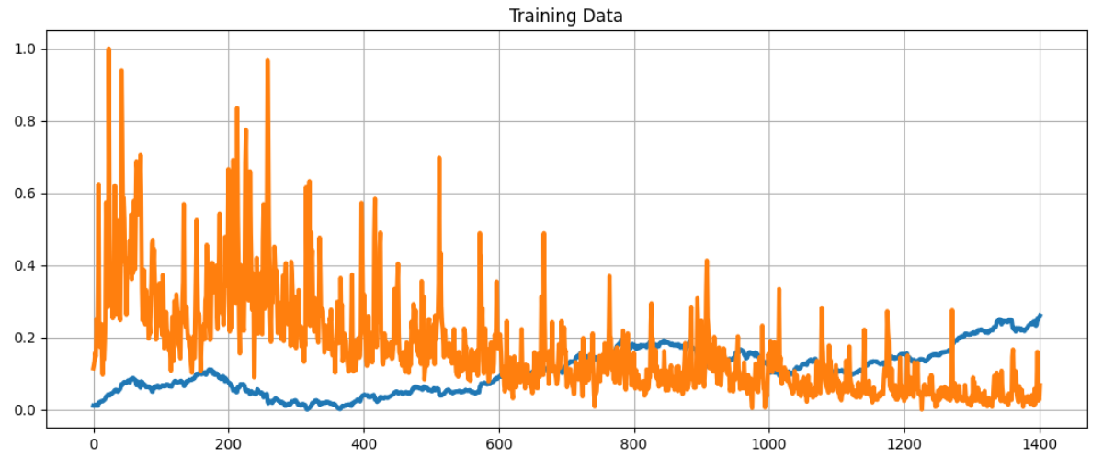
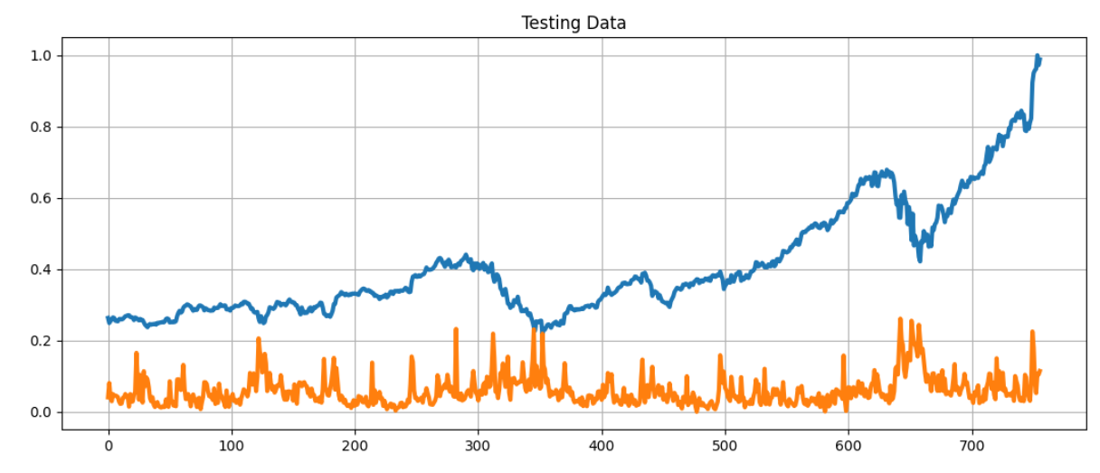
DATA SPLIT VISUALISED

Slide 13
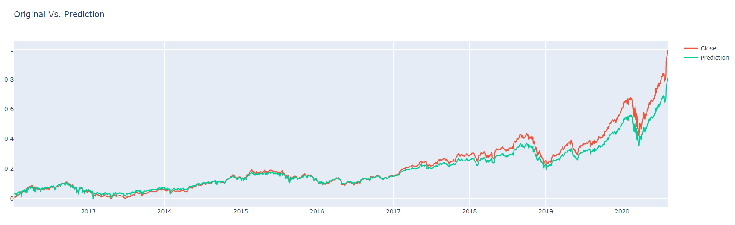
PREDICTED REGRESSION MODEL OUTPUT
TESTING ACCURACY : 79.5%

Slide 14
DEEP LEARNING BASED STRATEGY
DEEP NEURAL NETWORK OPTIONS:
Feedforward NNs => No temporal component.
RNNs => Vanishing Gradient Problem.
Hence, LSTM is the right choice.
Create a 70:30 Train : Test Split.
3 Layers tested. 150 Neurons each. Linear activation function.
Adam optimization function. Loss is minimum squared error.

Slide 15
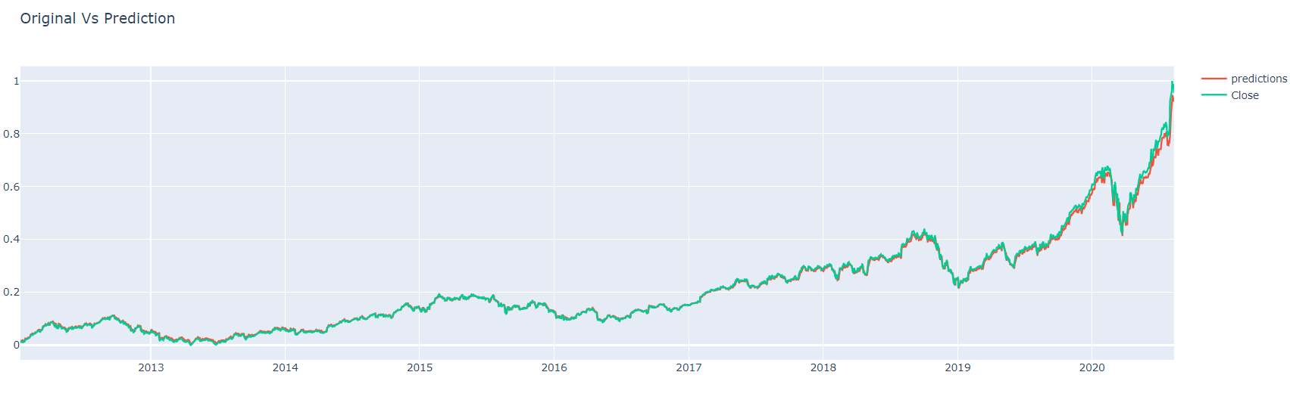
LSTM PREDICTIONS

Slide 16
SENTIMENT ANALYSIS IN STOCK PRICE PREDICTION
Sentiment analysis plays a role in stock prediction by analyzing and interpreting the emotions, opinions, and attitudes expressed in online content such as news articles, social media posts, and forums.
It helps determine whether the overall sentiment is positive, negative, or neutral towards a particular stock or company.
STEPS:
Data Cleaning
Tokenization and padding
LSTM Model
Model Assessment

Slide 17
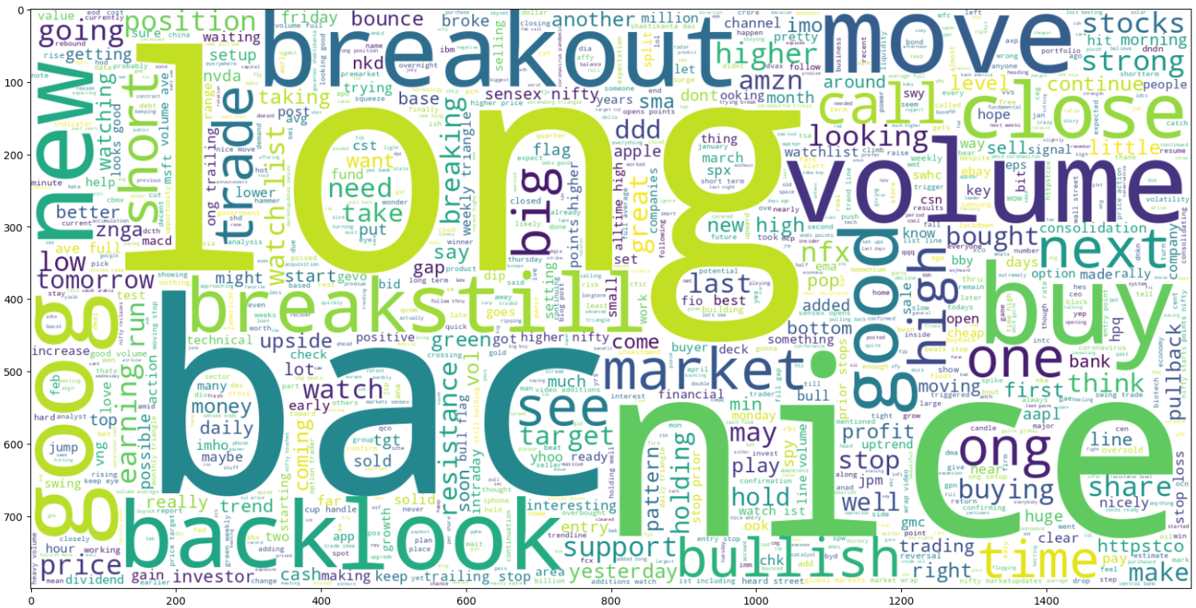
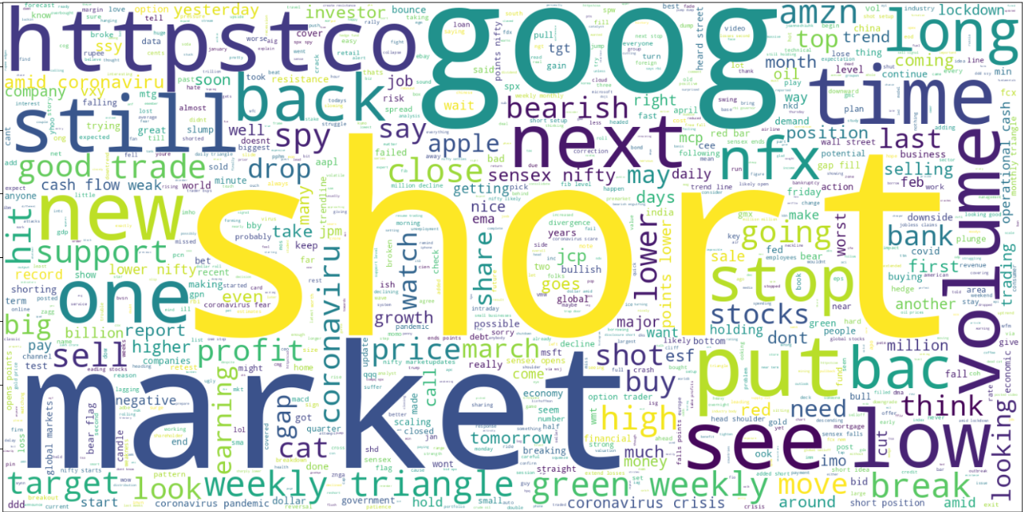
PLOTTING WORD CLOUD FOR EACH SENTIMENT

Slide 18
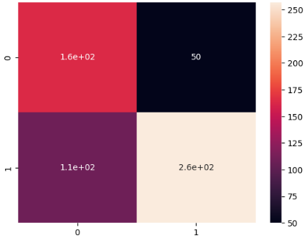
MODEL ASSESSMENT
:CONFUSION MATRIX
1600 True Positive and 2600 True Negative.
1100 False Negative and 50 False Positive.

Slide 19
The integration of AI and machine learning in stock price analysis and portfolio management is gaining momentum due to its potential for accurately predicting market direction.
Traditional mathematical models are being replaced by machine learning techniques such as ridge regression with L2 regularization and deep learning models like LSTM for stock price prediction.
Ridge regression performed reasonably well with an accuracy of around 83%, while LSTM models showed even closer predictions, benefiting from deep learning's ability to generalize patterns.
The hypothesis explored in this report suggests that investor sentiment plays a crucial role in stock price analysis, which can be gathered from social media channels like Twitter or news feeds.
While sentiment analysis using NLP models is powerful, it should not be the sole basis for investment decisions. Combining the insights from machine learning, deep learning, and sentiment analysis provides a more comprehensive view of the stock.
CONCLUSION

Slide 20
The integration of computational AI in investment analysis has vast potential, with robo-advisers capable of processing millions of calculations per second.
The scope includes developing faster machine learning algorithms for more accurate predictions.
While this report focused on spot price and stock volume, numerous other factors like geographic location, company profile, and domain can impact stock prices.
The deep learning model used in this report was LSTM, but its performance can be enhanced through adjustments in hidden layers, activation functions, and additional input features.
High-Frequency Trading (HFT) is a growing field that leverages real-time data analysis for rapid decision-making. The future of AI in investment analysis is promising, but combining AI with human instincts and judgment can further improve portfolio decision-making.
FUTURE SCOPE

Slide 21
Thank you

