Slide 1
Project: SQL Data Analysis and Visualization with Power BI for FDA
Soumyaneel Mandal
ABADS Batch 8A
iVision

Slide 2
THE STATEMENT
The U.S. Food and Drug Administration (FDA) is a federal agency responsible for safeguarding public health in the United States. It oversees various areas, including food safety, pharmaceuticals, medical devices, cosmetics, tobacco, and veterinary products.
The FDA evaluates the safety and efficacy of drugs, biological products, and medical devices, conducts inspections, and enforces regulations. It also regulates food production and distribution, conducts research, provides public health education, and monitors and responds to emerging health risks.
The FDA's mission is to protect and promote public health by ensuring the safety and effectiveness of a wide range of products and substances.
iVision is collaborating with FDA to perform Data analysis on FDA’s dataset. FDA has provided iVision with SQL script of their dataset. As an analyst at iVision your role is to create informative reports by conducting a thorough analysis of the data using powerful tools like MySQL and Power BI.

Slide 3
Part 1 – SQL Queries
Task 1 – Identifying approval trends
Determining the number of drugs approved each year and provide insights into the yearly trends.
Identifying the top three years that got the highest and lowest approvals, in descending and ascending order, respectively.
Exploring approval trends over the years based on sponsors
Ranking sponsors based on the total number of approvals they received each year between 1939 and 1960.

Slide 4
 | Best years |  |  | Worst years
 | Year | Approvals |  | Year | Approvals
 | 2002 | 5661 |  | 1945 | 5
 | 2000 | 5204 |  | 1943 | 6
 | 2001 | 5098 |  | 1944 | 9

Slide 5
Segmenting Analysis Based on Drug Marketing Status
Grouping products based on Marketing Status. Provide meaningful insights into the segmentation patterns.
Calculating the total number of applications for each Marketing Status year-wise after the year 2010.
Identifying the top Marketing Status with the maximum number of applications and analyze its trend over time.

Slide 6
 | SUM WISE APPLICATIONS OF EACH MARKETING STATUS YEAR WISE

Slide 7
Analysing Products
Categorizing Products by dosage form and analyze their distribution
Calculating the total number of approvals for each dosage form and identify the most successful forms
Investigating yearly trends related to successful forms

Slide 9
Exploring Therapeutic Classes and Approval Trends
Analysing drug approvals based on therapeutic evaluation code (TE_Code).
Determining the therapeutic evaluation code (TE_Code) with the highest number of Approvals in each year.

Slide 11
Part 2 – Power BI Visualisations
Visualizing the yearly approval trends of drugs. Highlight any significant patterns and/or fluctuations, if any.
Exploring approval trends over the years based on different sponsors. Uncover patterns and changes in approval rates among sponsors.
Visualizing the segmentation of products based on Marketing Status.
Showing the total number of applications for each Marketing Status. Enable users to filter by years and Marketing Status for detailed analysis
Analyzing the grouping of drugs by dosage form. Visualize the distribution of approvals across different forms. Identify the most successful dosage form.
Visualizing drug approvals based on therapeutic classes. Identify classes with the highest number of approvals.

Slide 12
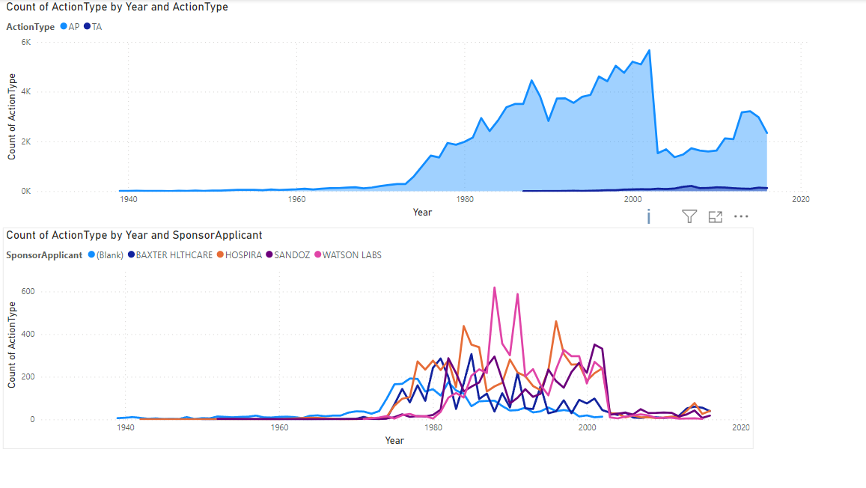

Slide 13
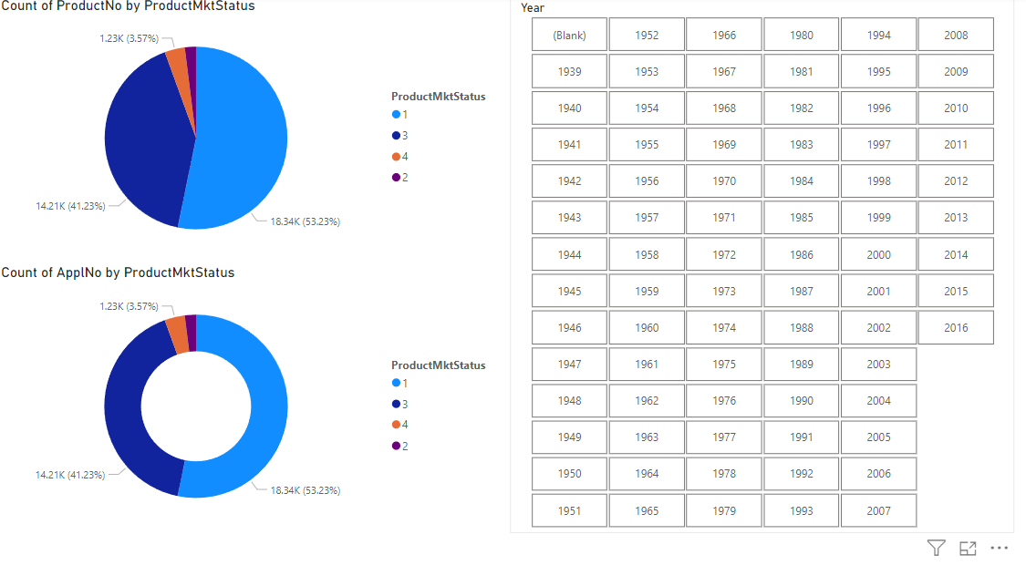

Slide 14
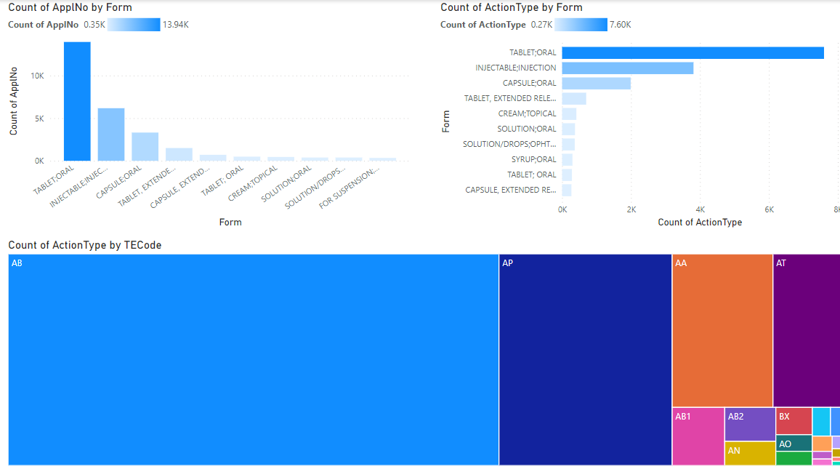

Slide 15
THANK YOU THE END

