Slide 1
Analysis of AirBnB Data using Power BI

Slide 2
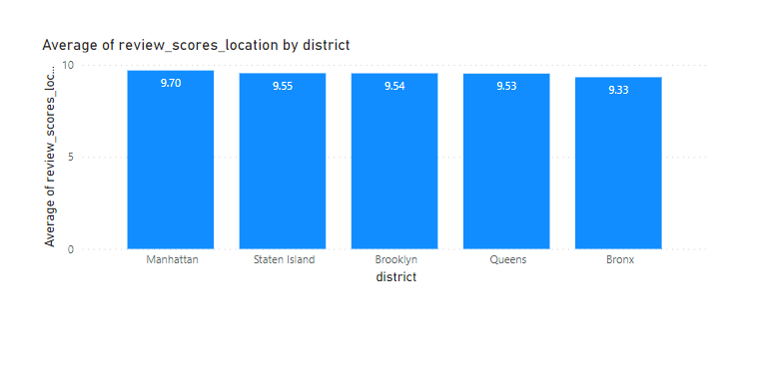
District location score Assessment
From the graph provided, we can say that, the review scores of the various districts in New York provided by customers were found to be fairly similar.
This is due to the fact that, the districts analysed in question are all higher end localities, which provide similar standards and scope towards quality of life and global opportunities for industrialisation and digitalisation, for companies and workers, alike.

Slide 3
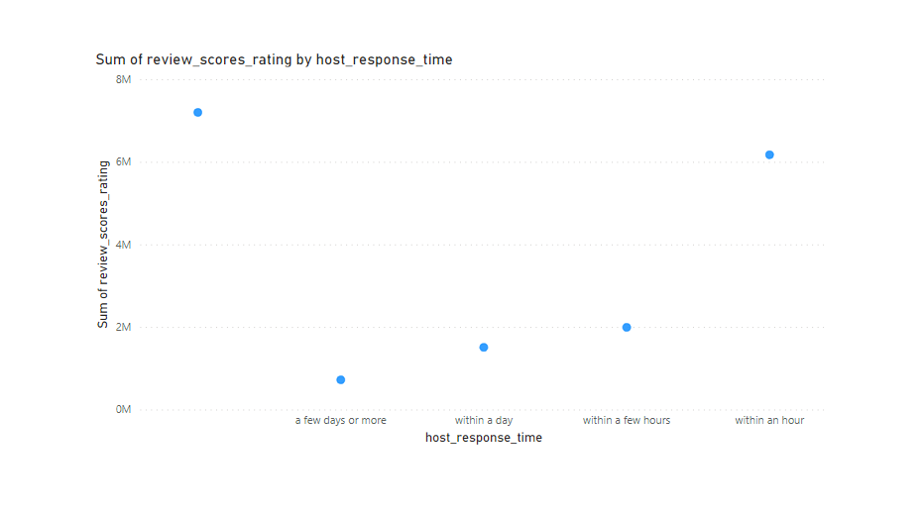
Host response time Impact Analysis
It can assessed from the scatter chart that, an almost linear relationship has been established between host response time and percentage of positive reviews.
The shorter the time taken to provide feedback, the higher the rating score.
Therefore, we can thus infer that, when an individual is residing in a happy situation, then most of the things seem to be excellent, due to dopamine effect kicking in.
However, once that individual gets back to the real world and encounters the familiar struggles, cynicism sets in, and the flaws and shortcomings of services, where money has/had been involved, starts to become prominent.

Slide 4
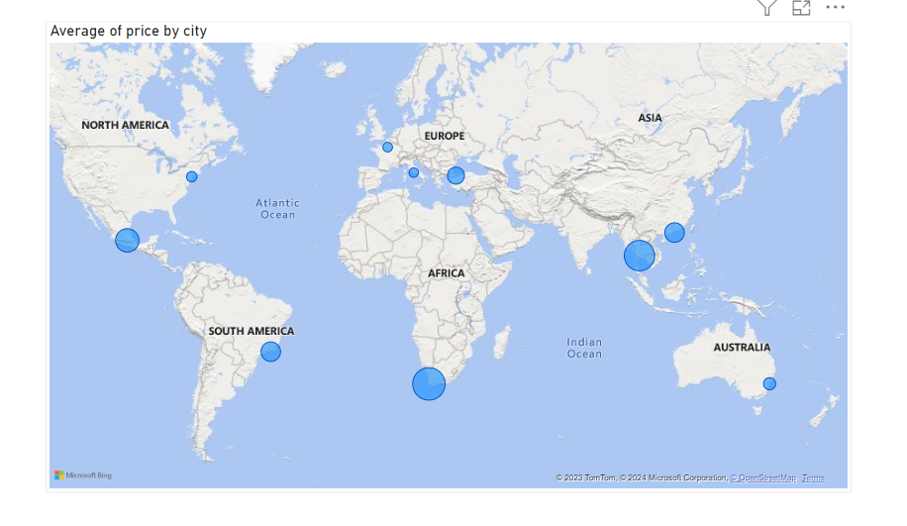
AirBnB listing price analysis
Cape Town and Bangkok can be seen from the map to have the highest AirBnB average price.
Paris, Rome and New York can be seen to have recorded the lowest average price.
The more exotic and sole-tourism focused cities had higher pricing, whereas mainland European cities with focus on work, education, primarily and historical tourism, as a secondary alternative, as places of importance, recorded lower average prices

Slide 5
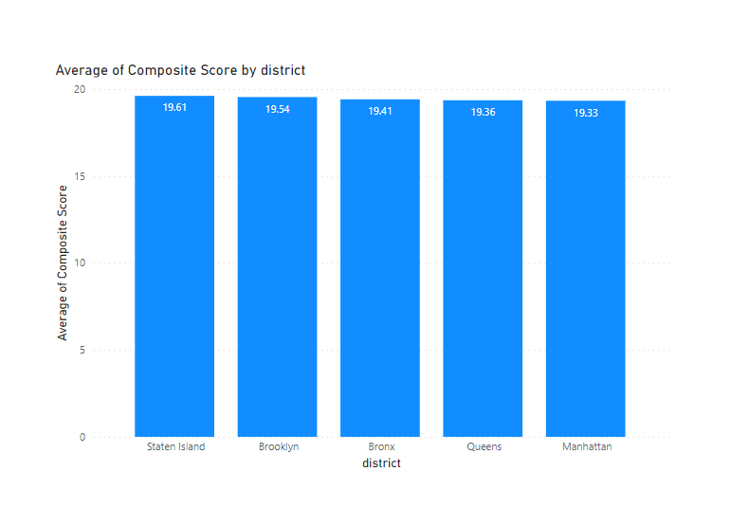
Composite scores analysis
The average of composite scores of the districts of New York in question were found to have almost similar scores owing to the fact that, all the districts provided similar standard of life.

Slide 6
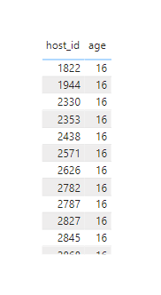
Listing age and host tenure calculation
All the AiRBnB listings identified were calculated to have more than 10 years of hosting experience.
The host_id along with the tenure of hosting has been shown.

Slide 7
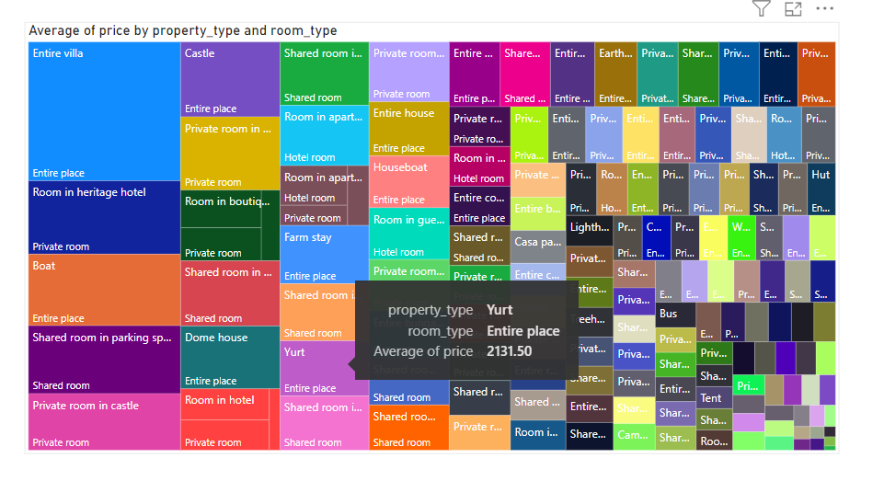
Property type price analysis
Greater the size of the square, higher the price of the property
Entire villa or heritage hotel stay, with room type being personal or the entire place were recorded to be the most luxurious of all other category of property and room type type stays.

Slide 8
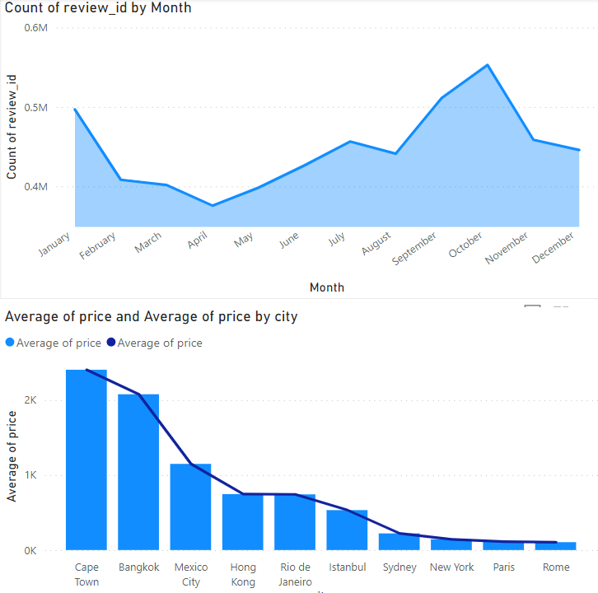
City Insights report
From the first graph we can analyse that the reviews have been highest in the months of October. This can be due to the fact that, CoVid ruled the headlines during that period. As a result, we can see a dip in March from previous, and April being the lowest. It is around this time that lockdowns were starting to take prevalence around most of the world.
However, due to a slight relaxation of rules around September-October there can be seen a spike in visitors, which again dipped during the later months, due to restrictions again tightening on account of an increase in the number of cases.
CoVid was the primary reason for the discrepancy in statistic amongst visitor trends in the year 2020, compared to the other years.

Slide 9
THE END

