Slide 1
CryptoSafe: Secure text exchange through RSA,
Diffie-Hellman key exchange, and AES-256 using GMP Library
CPE-593 Algorithms & Data Structures - Final Project presentation
Ghaith Arar
Neel Haria
Amanda Ly

Slide 2
Agenda
Cryptography: Symmetric vs. Asymmetric
RSA and Asymmetric Cryptography
Diffie-Hellman key exchange
AES-256 and Symmetric Cryptography

Slide 3
Terminology
Cryptography
The practice and study of techniques for secure communication in the presence of third parties called adversaries.
Cryptography referred almost exclusively to encryption.
Encryption
process of converting ordinary information (called plaintext) into unintelligible form (called ciphertext) - Decryption is the reverse.
Cipher
is a pair of algorithms that create the encryption and the reversing decryption.

Slide 4
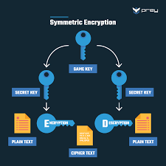
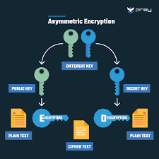
Modern cryptography - Symmetric vs. Asymmetric
Symmetric
encryption methods in which both the sender and receiver share the same key
All cryptography from ancient times until 1976 was exclusively based
on symmetric methods.
A significant disadvantage of symmetric ciphers is the key management necessary to use them securely.
Asymmetric (or Public-Key)
Two keys. One public and one private (secret).
The public key may be freely distributed, while its paired private key must remain secret.
public key is used for encryption, while the private or secret key is used for decryption.

Slide 5
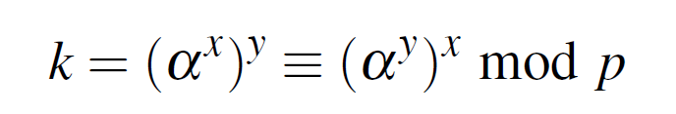
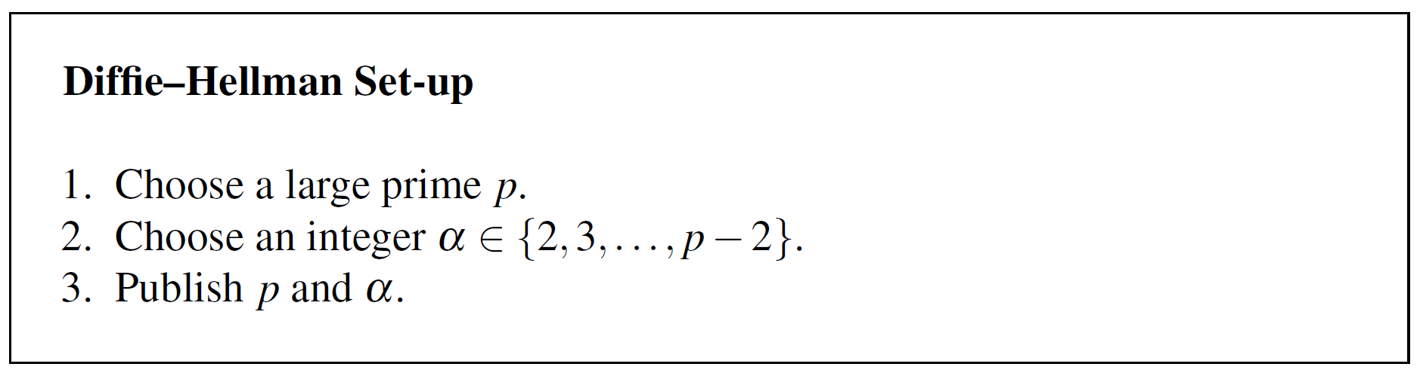
Diffie–Hellman Key Exchange
Enables two parties to derive a common secret key by communicating over an insecure channel.
The basic idea behind the DHKE is that exponentiation in Z∗p, p prime, is a one-way function and that exponentiation is commutative, i.e.,

Slide 6
