Slide 1
Covid Data Live
Created by: Garrett Allen
Notes:
Intro self and project

Slide 2
Covid-19 Timeline
Countries with confirmed cases: 25
Cases Confirmed Globally: 31,484
Deaths Worldwide: 638
First case of reinfection reported. Europe sees case numbers at March level (2nd Wave)
Feb 2020
Aug 2020
Dec 2019 - Jan 2020
May 2020
Nov 2020
First cases reported in China. Outbreak spreads to other countries
Global cases top 4 million. China flattens the curve. U.S. deaths pass 100, 000
Global cases: 55,243,538
Deaths: 1,330,930
Countries with cases: 214
Source: https://www.thinkglobalhealth.org/article/updated-timeline-coronavirus
Notes:
Give a brief timeline of events
Outbreak began in Dec 2019
By Feb it had spread to 25 countries
By May, worldwide cases had surpassed 4 million
By Aug, Europe was seeing a “second wave” of infections
By Nov, more than 55 million cases confirmed worldwide
In 9 months, the number of cases jumped from 31k to 55 MILLION

Slide 3
“Knowledge is of two kinds. We know a subject ourselves, or we know where we can find information on it.”
-- Samuel Johnson
Notes:
Most media reporting talks primarily about “cases” and “deaths” for various nations. I don’t know these pieces of information myself, so I decided to make something where you can find it. Nevermind the fact there are countless pre-existing similar sites already.

Slide 4
What is Covid Data Live?
1
Notes:
So, what is Covid Data Live?
Simply put: a dashboard that displays valuable information on the current state of Covid-19 in the world
Let’s take a look at what visualizations are included

Slide 5
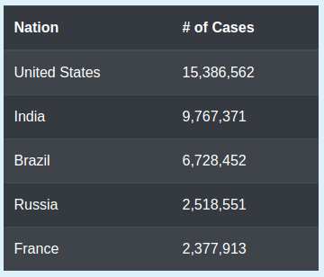
Leaderboards
Boards for cases, deaths, and tests
Show Top 5 for each board
Notes:
Highlights
Data for each board is pulled from the CSV on load (sorting occurs every reload)
Each board ignores an entry called “World” that is the sum of everything. Didn’t feel it brought the necessary value to what I wanted to display
Rows inserted programmatically using JavaScript and Jquery

Slide 6
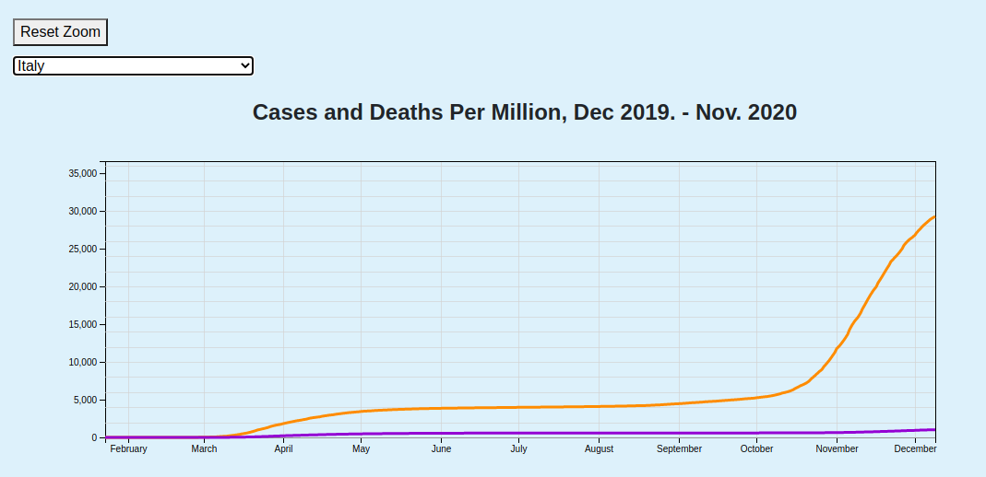
Line Chart
Orange line for cases
Purple line for deaths
Displays per nation
Dates range from Dec 2019 to current day
Notes:
Highlights
Drop down filters the data by nation dynamically
Supports zoom and pan, with a reset button that will return it to original render
Data scaled to per millions to keep axes values somewhat “smaller”

Slide 7
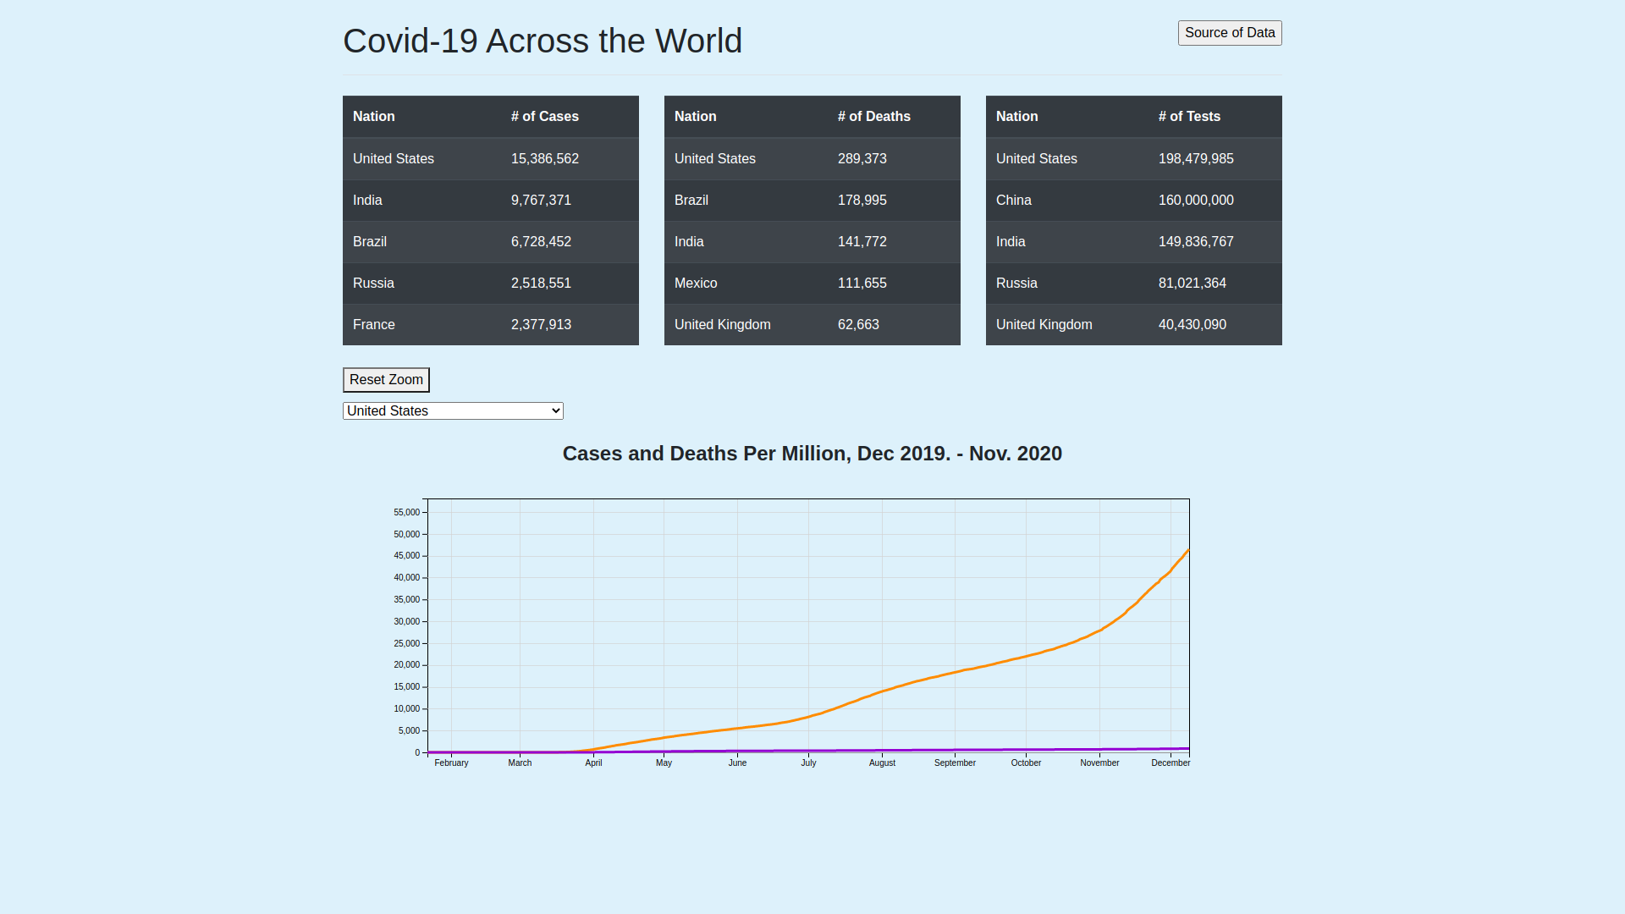
ALL TOGETHER
Place your screenshot here
Notes:
This is just a screenshot of what the full page looks like at the moment. It’s not the most awe-inspiring, and it’s missing some functionality.
Still a work in progress, though

Slide 8
What’s Next?
2
Notes:
Now that you’ve seen the project and its various parts. What’s the next step?
Adding some additional features!

Slide 9
Pending Features
Multi-nation select
Legend for line chart
Stretch goal of selecting data point (change from case and death)

Slide 10
How Was It built?
3
Notes:
So, what will power those new features, and what went into building Covid Data Live?

Slide 11
Technology Used
JavaScript
D3
Bootstrap
Spin
Markup
HTML
CSS
Hosting
Git
GitHub
Heroku
Notes:
Project is a simple webpage that uses HTML and CSS for the display markup
For the functionality side of things, I use three JavaScript libraries
D3, which you all are familiar with by now
Bootstrap, which provides some very clean and simple to use pre-built classes for consistent display of webpages
Spin a library that adds a spinner. Since I’m loading a large file from an external source, it takes time
Spin allows me to show that something is happening via a spinner instead of displaying a broken webpage with missing data
As an extra challenge to myself, I decided to learn how to host this sort of simple website on Heroku. I now have my GitHub repo connected to Heroku so any time I push to the main branch, it automatically redeploys on Heroku.
It was as simple as connecting my Heroku account to my GitHub and telling a Heroku app which repository it needed to pay attention to. I also have a simple Discord bot hosted the same way, which is what sparked the idea for hosting this project.

Slide 12
Challenges Faced
4
Notes:
Getting the Spin.js library to work correctly was a challenge in itself. Initially, I couldn’t import it, so I had to do some digging to learn how JavaScript handles imports.
I struggled with determining a “clean” way to draw multiple lines on a chart. In its current state, it’s still not the most flexible. Adding multi-nation is going to prove a challenge in this area again
Learning what it took to set up automatic deploys to Heroku was also a fun challenge, that involved more reading and following documentation that problem solving on my end. Shoutout to Heroku for having intuitive documentation!

Slide 13

THANKS!
Any questions?
You can find the project at
https://covid-data-live.herokuapp.com
https://github.com/Neelik/covid-data-live
Notes:
And that’s my journey to making Covid Data Live, and what’s left for the project. Any questions?

Slide 14
CREDITS
Special thanks to all the people who made and released these awesome resources for free:
Presentation template by SlidesCarnival
Photographs by Unsplash

