Slide 1

Dynamic Player Transfer Value Prediction
using AI and Multi-source Data
AN INFOSYS SPRINGBOARD
VIRTUAL INTERNSHIP 6.0 PROJECT
PRESENTED BY:
NAME : CH.NEELIMA
PRESENTED TO:
Infosys Springboard Mentor

Slide 2

Problem Statement:
High and growing spending in football transfer markets.​
Subjective, intuition-based player valuations with limited transparency.​
Multiple hidden factors influence value: performance, injuries, sentiment, market trends.​
Need for a unified, data-driven AI model to estimate realistic transfer values.

Slide 3

Project Objectives:
Accurate AI-based transfer value prediction to support club decision-making.​
Multi-source data integration: performance stats, injury history, social media sentiment, market values.​
Time-series forecasting using LSTM (univariate and multivariate) for value trends.​
Simple, intuitive web dashboard to view player-wise actual vs predicted values.

Slide 4

Data Sources Used:
Player statistics and performance metrics: matches played, goals, assists, minutes.​
Injury history and records: major injuries and days injured last season.​
Sentiment data: fan and media sentiment scores derived from social media analysis.​
Market trends and past transfer values from historical market value data.

Slide 5

System Architecture
Data collection and preprocessing: merge multi-source datasets, clean, handle missing and duplicate values.​
Feature engineering and model training: create goals per 90, assists per 90, injury risk score, sentiment features; train LSTM and ensemble models.​
Model evaluation and UI integration: evaluate with RMSE, MAE, R² and expose final predictions through a web UI.​

Slide 6

Data Preprocessing:
Handling missing and duplicate data to ensure accurate and reliable training input.​
Feature scaling and normalization to improve model stability and convergence.​
Deriving advanced features such as goal contributions per 90 and injury risk scores.​
Models Used:
LSTM models (univariate and multivariate) for time-series forecasting of market values.​
Gradient Boosting / XGBoost ensemble on engineered features for final transfer value prediction.​

Slide 7
Model Performance:
Evaluation metrics: RMSE, MAE, and R² score used for assessing model accuracy.​
Final tuned model achieves very low RMSE and MAE with R² ≈ 1.0 on the constructed dataset.​
Predictions closely match actual market values for players like Messi, Ronaldo, Mbappé, Haaland, etc.​
Final Output:
Web UI displays player name, actual market value, predicted transfer value, and prediction error.​
Enables quick comparison and clear understanding of AI-based valuations for each player.​

Slide 8
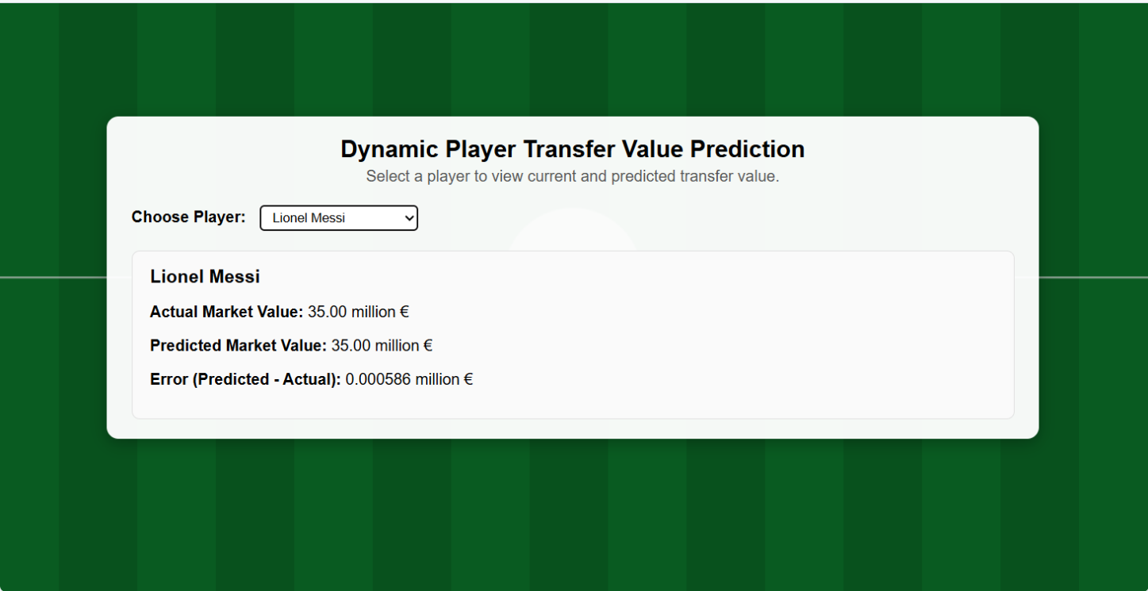
MODEL OUTPUT

Slide 9
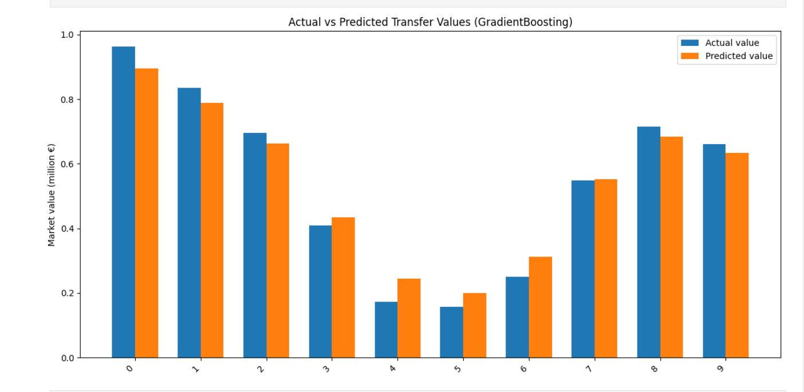
Execution Output

Slide 10
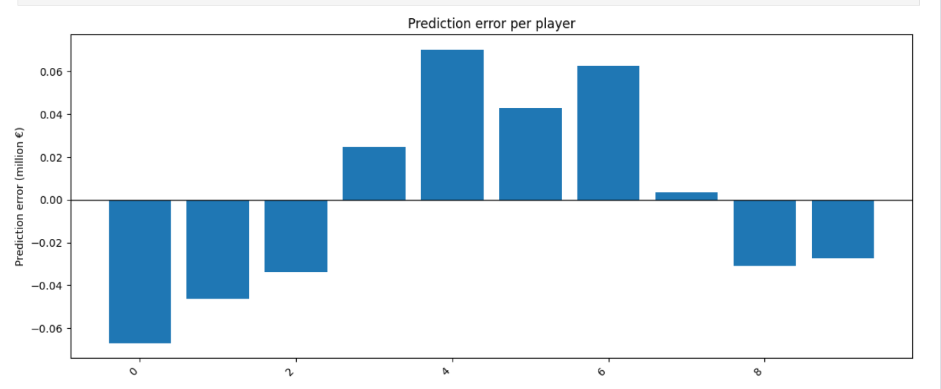

Slide 11
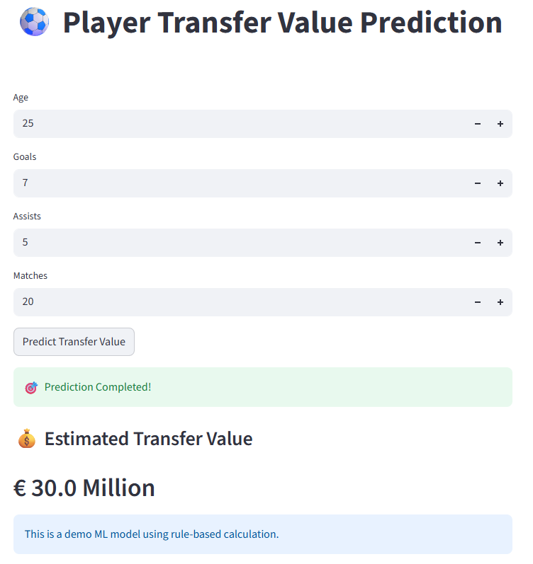

Slide 12

Conclusion:
Built an end-to-end AI pipeline: data collection, preprocessing, LSTM + ensemble modeling, and interactive UI.​
Multi-source AI integration improves transparency and consistency in player transfer value estimation.​
Future Scope:
Extend to larger real-world datasets with live APIs and real-time news integration.​
Incorporate more advanced deep learning models and explainability tools (e.g., feature importance, SHAP).​

Slide 13


