Slide 1
Project Title: Web Scraping on Flipkart Mobiles
Problem Statement:
Which TV Brand is providing better product for better value .

Slide 2
ABOUT ME :
M.SC(Statistics).
I wanted to do Data Science to get job in technical field.
The thing I like about Innomatics is that they explain everything well.
-G.Neelima

Slide 3
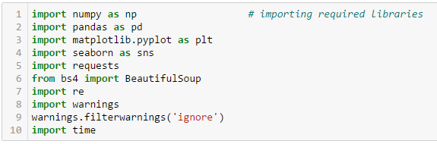
Data Extraction
Importing all the necessary libraries for extracting data
Here we are using Beautiful Soup to extract data from Flipkart Website

Slide 4
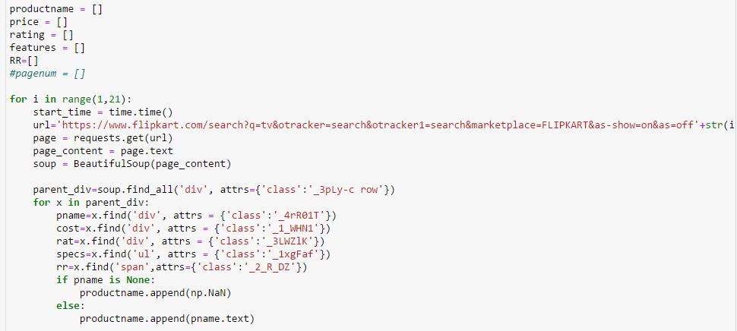
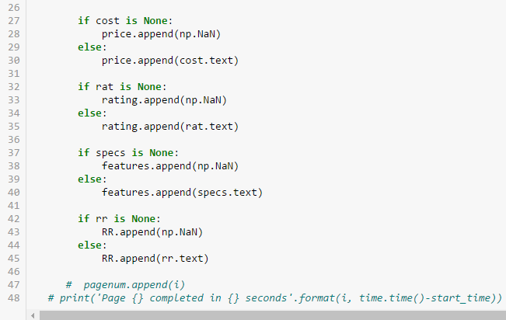
Data Extraction
- We are gathering the information of TV’s present in different pages and storing the information in lists.

Slide 5
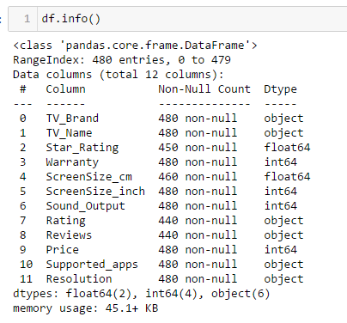
Data Extraction
We have extracted and imported around 12 columns and saved as .csv file

Slide 6
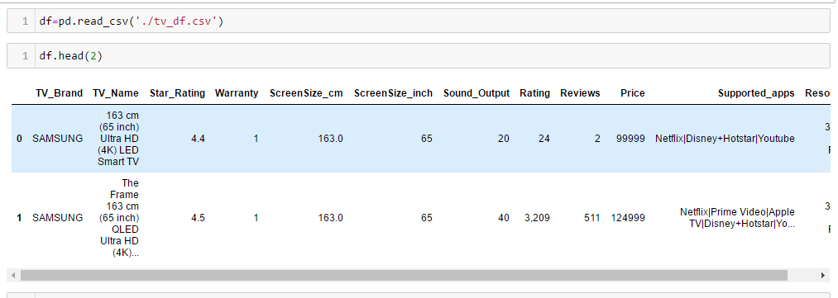
Data Cleaning
We are reading the saved .csv files and saving it in a df variable.

Slide 7
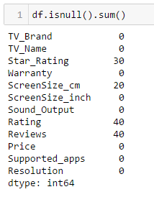
Data Cleaning
Checking all columns to see if there are any missing values present in the data.

Slide 8

Data Cleaning
Since rating and reviews containing null values we changing their data type into float

Slide 9
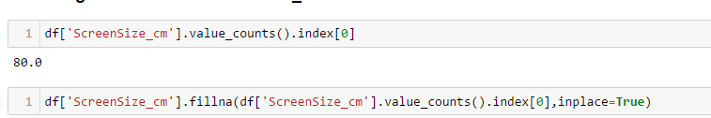
Data Cleaning
We are replacing missing values in the column ‘Screensize_cm’’ with the most frequently occurred value.

Slide 10

Data Cleaning
We have some tv which does not have Star_Ratings, we can say that they haven’t been star_rating yet..
We can assume zero to star_ratings column rather than deleting it..

Slide 11

Data Cleaning
We have some tv which does not have Ratings, we can say that they haven’t been rated yet..
We can assume zero to ratings column rather than deleting it.

Slide 12

Data Cleaning
We have some tv which does not have Reviews, so we can say that they haven’t been reviewed yet.
We can assume zero to reviews column rather than deleting it.

Slide 13
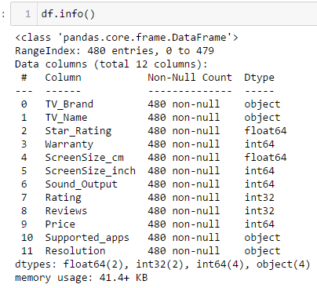
Data Cleaning
After cleaning the data, we save this in .csv file which will be used when we do data Analysis.

Slide 14

Data Analysis
We found these nine brands from the collected data.

Slide 15
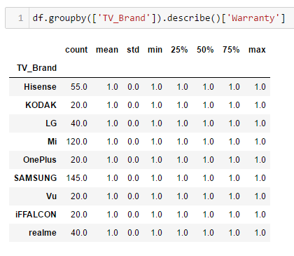
Data Analysis
Every tv_ brand is providing 1 year of warranty for their products.

Slide 16
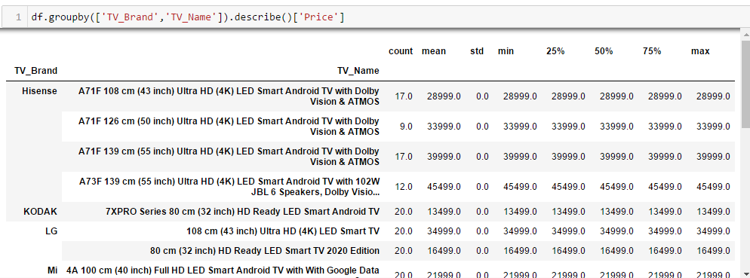
Data Analysis
- We observe that Samsung has highest price.
- Other Brands are offering below 50000 for their tv’s.

Slide 17
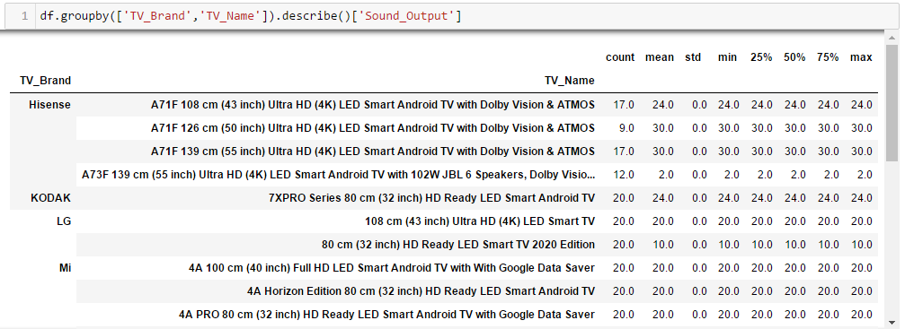
Data Analysis
It is observed that Samsung has given highest sound_output for one of its tv and one of LG and Hisense got less.
The rest of the brands have between 20W to 30W

Slide 18
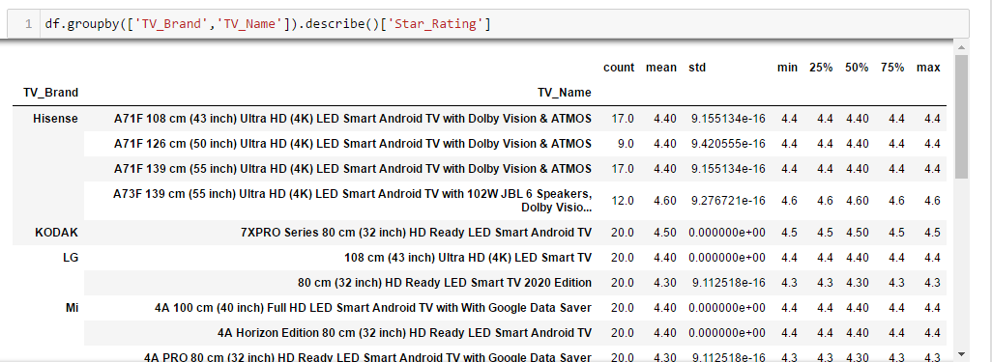
Data Analysis
Here, we can see that Kodak and Vu got high star_ratings while some of Samsung tv’s has not been rated yet.

Slide 19
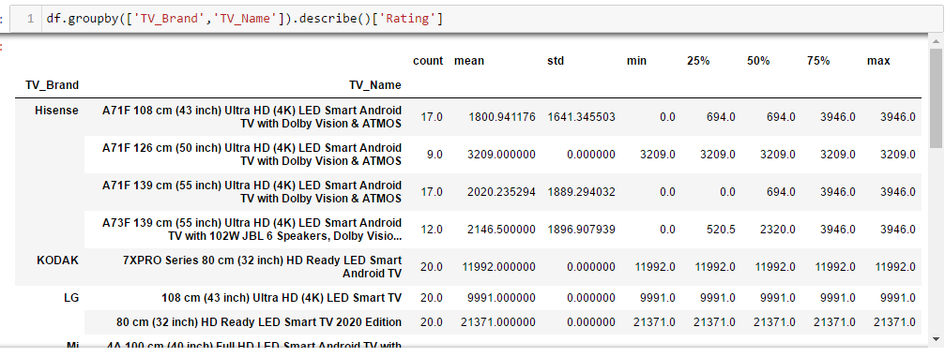
Data Analysis
Mi and Realme rated by many and some Samsung tv’s are not rated yet.
Other brand tv’s are rated by below 1 lakh .

Slide 20
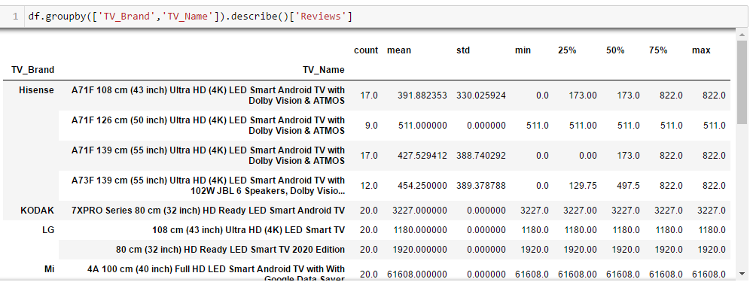
Data Analysis
It is observed that Mi and Realme has been reviewed highly for it’s tv’s.
The rest of the brands have been reviewed below 10000 people .

Slide 21
Conclusion
Overall Analysis:
We found out that the best specifications and better sound output is being offered by almost every brand.
But the cost of few of the Samsung tv’s are higher in price when compared to other brands, as we can get same features for less cost.
And all tv’s have similar features but some got less screen_size, some got less sound_output..
Samsung has given 40W sound_output for one of its tv.
Mi and Realme are rated and reviewed by lot of people, so we can say they were bought by many people.
Kodak and Vu are having highest star_ratings.
Hence we conclude the Brands MI AND REALME are offering better products for better value.

Slide 22
THANK YOU

