Slide 1
Predicting the “Fraud in auto insurance claims” & Pattern extraction
- A.Neelima, ID – 4888, Batch-122

Slide 2
Contents
Problem Statement & Description
Significance
Attribute Information
Approach followed to solve the problem
Advantages of Model
Conclusion

Slide 3
Problem Statement & Description:
Problem Statement: Develop a machine learning model to predict fraud in auto insurance claims and extract patterns that contribute to fraudulent behavior.
Description: Predicting fraud in auto insurance claims is about identifying fraudulent claims in the industry. This problem is critical for preventing financial losses for insurance companies. This is a pattern extraction and classification problem that involves identifying patterns in the data that indicate fraud and using them to classify claims. Relevant features such as type of accident, severity of damages, location, and demographics can be used to learn these patterns.

Slide 4
Significance:
Reducing Costs: Insurance companies lose millions of dollars each year due to fraudulent claims. By accurately identifying fraudulent claims, insurance companies can save money and pass on the savings to their customers.
Improving Efficiency: Identifying fraudulent claims can also help insurance companies streamline their claims processing and reduce the time and resources spent investigating false claims.
Protecting Policyholders: Fraudulent claims can also harm policyholders by leading to increased premiums and reduced coverage. By detecting and preventing fraud, insurance companies can help protect their policyholders from these negative effects.
Enhancing Data Analytics: By analyzing the data and identifying patterns and trends associated with fraudulent activity, insurance companies can develop new strategies and policies to prevent fraud in the future. This can also help insurance companies improve their overall data analytics capabilities and gain insights into customer behavior.

Slide 5
Attribute Information:
Demographic data - Contains information about customers, such as their age, zip code, gender, education level, occupation, hobbies, financial status, and country. By analyzing this data, we can gain insights into the characteristics and behaviors of the customers, which can be useful for various purposes such as marketing, risk assessment, and fraud detection.
Claim data - Contains details about auto insurance claims made by customers, including the date and type of incident, location, severity, and amount of the claim. By analyzing this data, we can gain insights into the types of incidents that are most common, the severity of incidents, and the amount of claims being made.
Policy data - Contains details about auto insurance policies held by customers, including the policy number, coverage details, premium amounts, and payment methods. By analyzing this data, we can gain insights into the policies that are most popular, the coverage and premium amounts offered, and the payment methods used by customers.
Vehicle data - The vehicle data provides information about the customer's vehicle attributes, specifically the service signed for and the value of the attribute. This data can help better understand the type of vehicles their customers are driving, which can impact their insurance rates.
Fraud data - The fraud data indicates whether a particular insurance claim has been reported as fraudulent or not. This data is important for insurers to identify potential fraud in their claims and take appropriate actions to investigate and prevent it.

Slide 6
Approach:
Import necessary libraries
Most basic required libraries like numpy, pandas, matplotlib, seaborn were imported.
Read the dataset
Read all the datasets provided using pandas
‘pd.read_csv’
Exploratory Data Analysis and Data Preprocessing
Performed basic EDA like df.head(), df.info(), df.describe(), df.shape and so on and then preprocessed the train and test datasets separately.
Then merged the preprocessed train datasets into one data and test datasets into one data on ‘CustomerID’ attribute, since it is the common one.

Slide 7
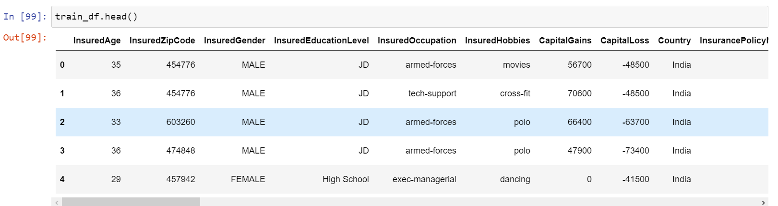
EDA and data preprocessing on merged train data
train_df.head(): From the picture below, we can observe the basic information where each row represents to a particular customer and their demographics characteristics like age, gender; their vehicle and the details of any insurance claims they have filled.
train_df.info(): From the output, we can get the information like total number of rows and columns in data and total non-null count of each column and data types of attribute.

Slide 8
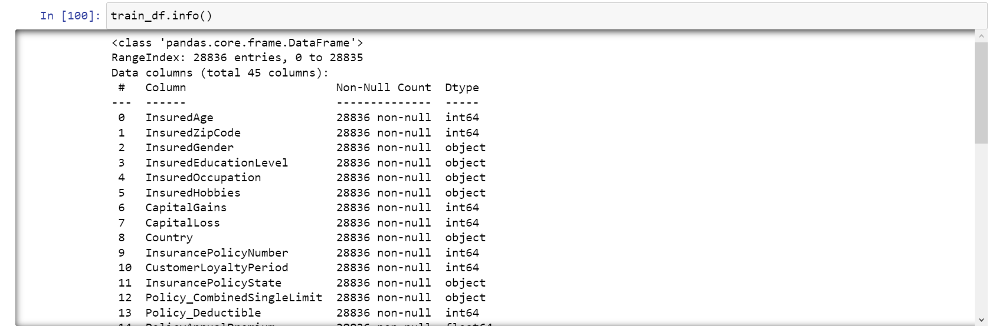
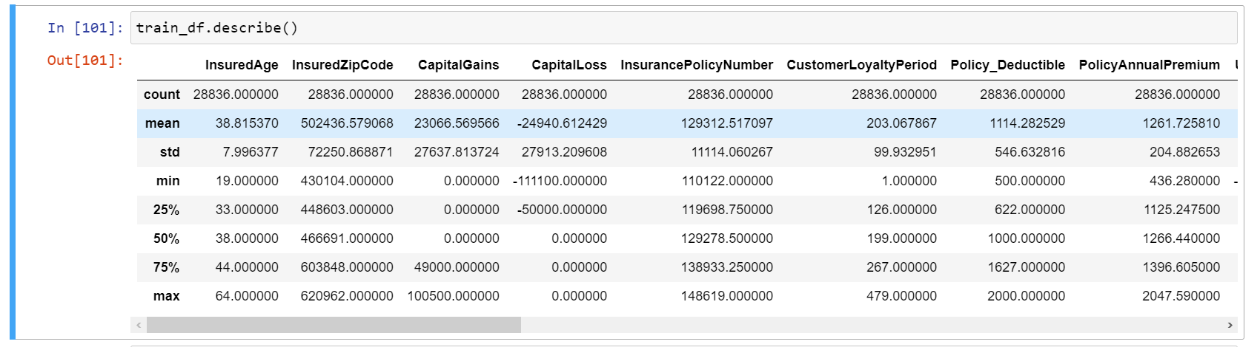
train_df.describe(): The information includes the count, mean, standard deviation, minimum and maximum values, as well as percentiles for the values.

Slide 9
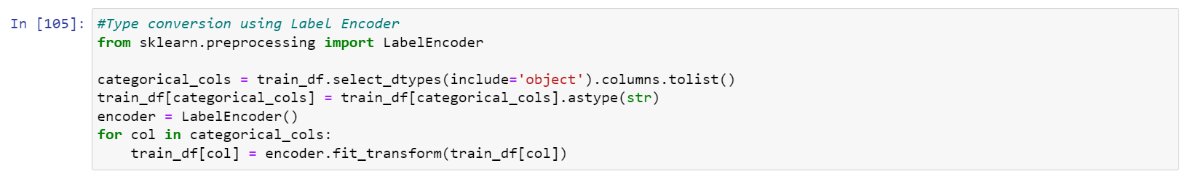
Missing values: “train_df.isnull().sum().sum()” – the output is ‘0’, since we have already treated the missing values and hence there are no missing values in the dataset.
Conversion of data types: Encoding the categorical columns in the dataset using LabelEncoder for further analysis.
Outlier Detection and treatment: Detected and treated the outliers in data using IQR method
Same steps are followed to preprocess the merged test data and finally obtained cleaned train(df_train) and test(df_test) data

Slide 10
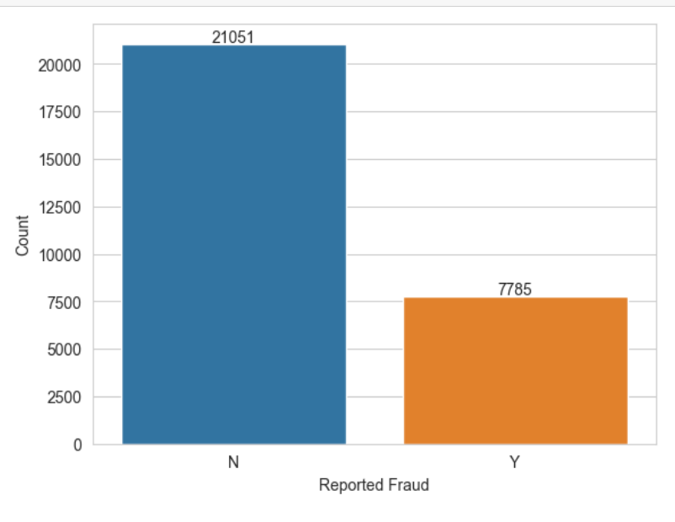
Visualizing count of total ‘No’ and ‘Yes’ from target attribute (‘ReportedFraud’)
Data Visualization
The total count of ‘No’(0) in target attribute is ‘21051’
And the count of ‘Yes’(1) in target attribute is ‘7785’
So, the total number of non-fraudulent are more than the fraudulent.

Slide 11
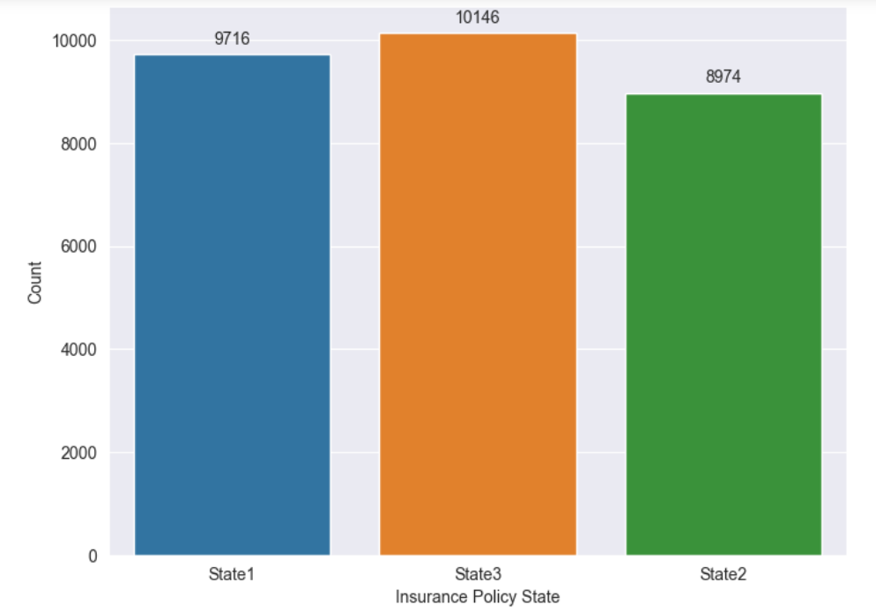
Visualizing bar chart of Insurance Policy State to show the number of claims by each state:
The total count of ‘State 1’ is ‘9716’
The count of ‘State 2’ is ‘8974’
And the count of ‘State 3’ is ‘10146’
So, majority of the policies are in ‘State 3’

Slide 12
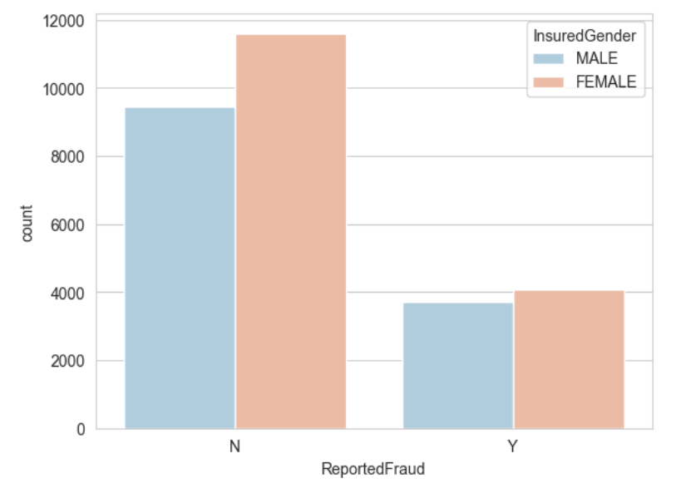
Visualizing bar chart of ‘Insured Gender’ and ‘Reported Fraud to show the distribution of fraudulent claims by gender:
The count of ‘Female’ are more than ‘Male’ who are claimed as fraud
So, there are more claims by ‘female’

Slide 13
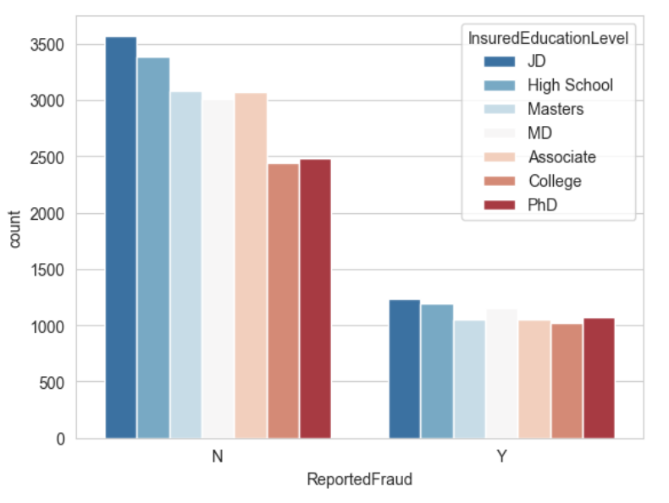
Visualizing plot of ‘Insured Education Level’ and ‘Reported Fraud to show the distribution of fraudulent claims:
The count of each Education level is plotted against Reported fraud.
So, ‘JD’ education level is more involved in fraud from the output.

Slide 14
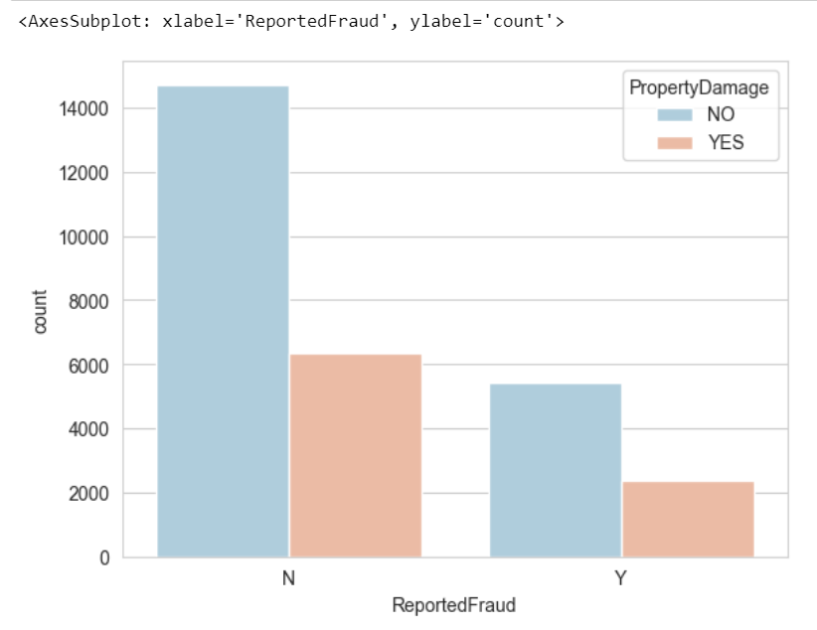
Visualizing plot of ‘PropertyDamage' and 'ReportedFraud‘:
From the picture, we can observe that the customers with ‘No’ property damage has more involvement in fraudulent claims.

Slide 15
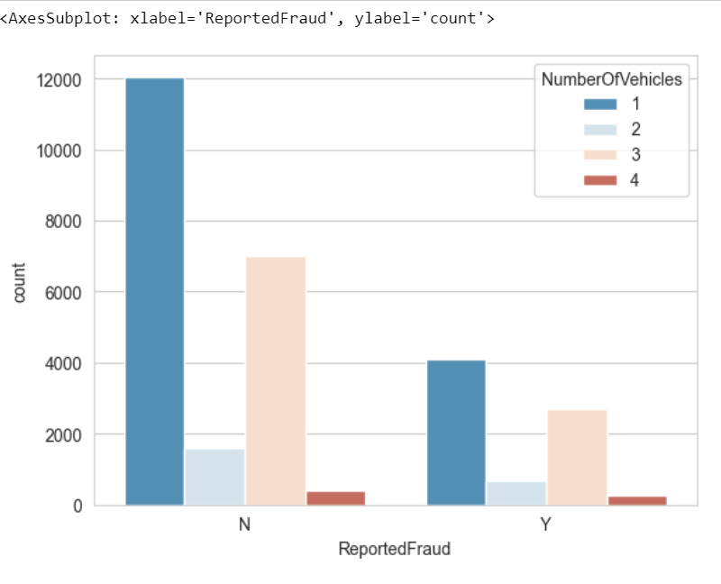
Visualizing plot of ‘NumberOfVehicles' and 'ReportedFraud‘:
From the picture, we can observe that the customers who has ‘1’ vehicle, has more involvement in fraudulent claims.

Slide 16
Model Building, Predictions
Input-Output Split: Firstly, splitted the data into input(contains all the columns except target column) and output(contains only target column)
Feature Scaling: Standardised the range of independent variables or features of data. This ensures that all features are on the same scale. This scaled data can then be used for machine learning models to improve their performance.
Train-Test Split: Considered scaled features ‘X_scaled_train’ as input, target variable as ‘y1’. The function then randomly splits the dataset into two sets: one for training and the other for testing.
Evaluation metric: Considered ‘F1 score’ as evaluation metric.

Slide 17
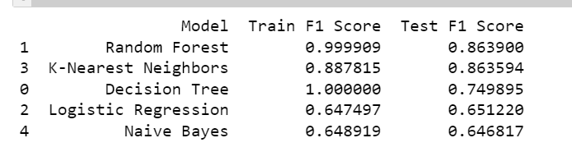
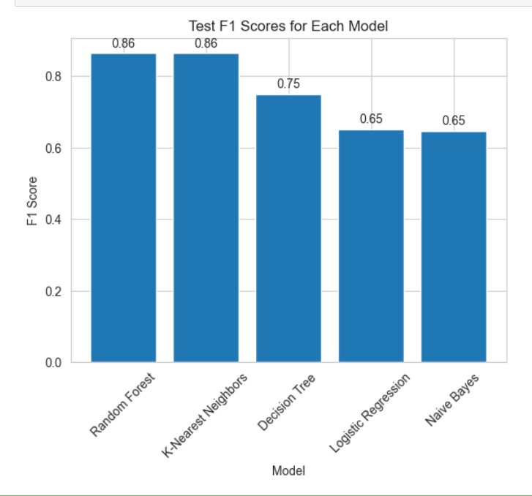
Built 5 machine learning models – Logisitic Regression, Decision Tree, Random Forest, K-Nearest Neighbors, Gaussian Naïve Bayes with the help of sklearn.
Evaluated the models with ‘F1 score’ for both train and test data.
And then compared the results obtained with the help of pandas.

Slide 18
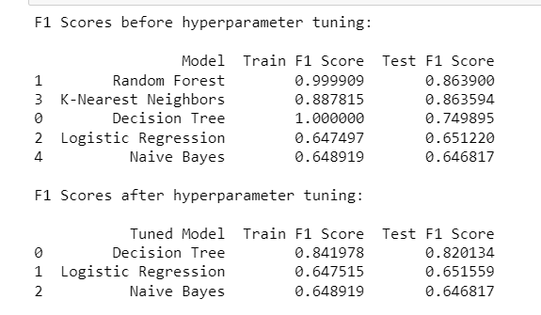
Hyper-parameter Tuning
Performed hyper-parameter tuning for 4 models – Decision tree, Logistic Regression, K-Nearest Neighbors and Gaussian Naïve Bayes.
Used GridSearchCV method for tuning the models. GridSearchCV help to avoid overfitting or underfitting the model to the data.
Obtained the best parameters for each model
Calculated the train and test F1 score of model to check if there is any improvement in the model performance after tuning.

Slide 19
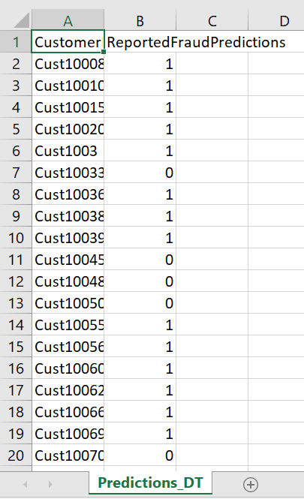
Submitting the predictions
Standardised the test data for better results.
Trained a KNN model on scaled data, saved the trained model as a pickle file, loaded the saved model to make predictions on test data, then stored the predictions in a pandas DataFrame, and finally saved the results as a CSV file.
In the predictions csv, there are 8912 rows and 2 columns – ‘CustomerID’, ‘ReportedFraudPredictions’.
the model has predicted the label "0" for some customers, which means that the transaction is not considered fraudulent, and "1" for others, which means that the transaction is considered fraudule.

Slide 20
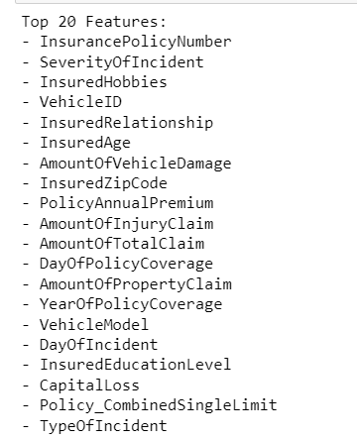
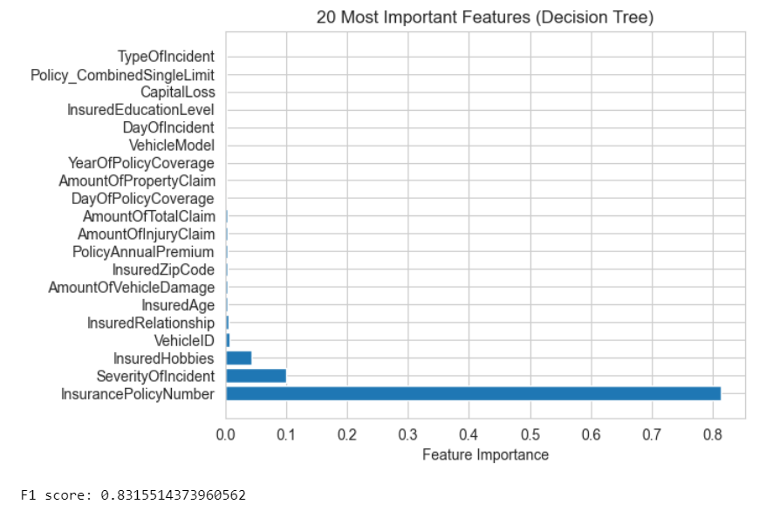
Feature Importance
Performed feature selection using a decision tree model and
Obtained the optimal hyperparameters for the model using grid search with cross-validation.
Also visualized the top 20 features and trained a new decision tree model using only those features.
Finally, evaluated the performance of the new model on the test data using the F1 score.
Obtained F1 score is ‘0.8315’

Slide 21
Advantages of Model
F1 Score: Evaluated the performance of models ‘F1 score’, which is a useful metric for imbalanced datasets like the one in auto insurance claims fraud detection.
Model Comparison: By building and evaluating multiple models, I have been able to compare their performances and choose the best model(s) for the task as ‘Random Forest Classifier’ with a high train F1 score of 0.99 and a relatively high test F1 score of 0.86.
Feature Extraction: The decision tree model was used to extract the 20 most important features, which can be used to inform future investigations and improve fraud prevention strategies.
Versatility: The models used in this, can be applied to other classification problems beyond auto insurance fraud detection.
Cost-Effective: By identifying fraudulent claims early, insurance companies can save money on payouts, making these models a cost-effective solution.

Slide 22
Conclusion
Firstly, the data preprocessing steps helped to clean and transform the data into a format that can be effectively used for modeling. Treated missing values and outliers to improve the quality of the data.
Then, the model building phase involved implementing machine learning algorithms. The evaluation metrics(F1 score) used during this phase helped to determine the model's ability to generalize to unseen data.
The predictions obtained from the model were evaluated using evaluation metrics F1 score. These metrics helped to quantify the performance of the model and identify areas of improvement.
Based on the results obtained, it can be concluded that the model was able to effectively predict the target variable(‘ReportedFraud’) using the selected features and achieved a certain level of F1 score.
Performed hyper-parameter tuning and observed the improvement of models.
Finally, Submitted the predictions from KNN model to CSV file.

