Slide 1

IMPACT OF SOCIAL MEDIA
B.NEELIMA 22A51A4407

Slide 2

INTRODUCTION
Social media plays vital role in our lifeWe use social media to communicate with others, to interact with people.
Through this we can connect globally .
Let us see whether this social media is connecting us or disconnecting us

Slide 3
ABOUT SOCIAL MEDIA
Social media refers to online platforms and tools that enable users to:
Connect and interact with others globally.
Share ideas, opinions, photos, videos, and information.
Create Communities based on common interests and activities.
Collaborate and participate in real-time conversations.
Examples of Popular Platforms:
Facebook, Instagram, Twitter, TikTok, LinkedIn, Snapchat.

Slide 4
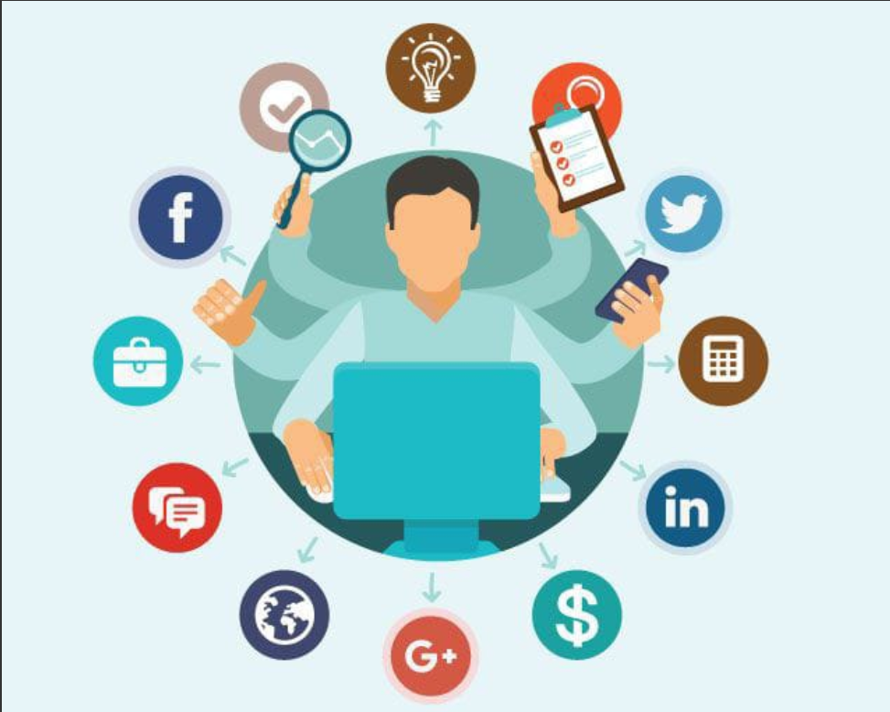
Advantages of social media:
1.Access to Information:
Provides instant updates on news, events, and trends.
Acts as a hub for educational resources, tutorials, and expert insights.
2.Educational Benefits:
Provides access to free learning resources and
online certifications.
Encourages peer collaboration and knowledge sharing.
3.Global Connectivity:
Social media connects people worldwide, overcoming geographical barriers.
Facilitates real-time communication, collaboration, and relationship building
4.Professional Networking
Helps build career connections through platforms like LinkedIn.
Provides job opportunities and exposure to global markets

Slide 5

DISADVANTAGES OF SOCIAL MEDIA
DISADVANTAGES OF SOCIAL MEDIA
Addiction:-Social media can be addictive, leading to excessive use and compulsive behavior. This can negatively impact productivity, relationships, and mental health.
Misinformation:-Social media can be used to spread fake news, propaganda, and unverified information. This can lead to confusion, rumors, and adverse effects on public opinion
Mental health:-Social media use has been associated with low self-esteem, anxiety, and depression, especially among teenagers.
Cyberbullying:-Facilitates bullying, harassment, and the spread of harmful behavior.
Social isolation:-
Excessive use of social media can lead to reduced in-person interactions, communication, and sociability

Slide 6
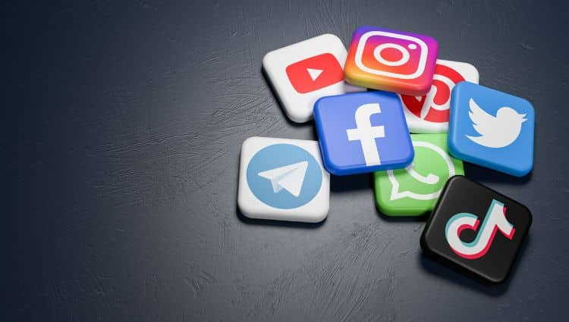
IMPORTANCE OF SOCIAL MEDIA
Nowadays, it isn’t easy to survive without social media. We need social media to connect with people.
Various social media give you modern and advanced methods of connecting with people from all over the world.
It is the easiest way of communication today. It takes a few seconds to reach out to a person who is living thousands of miles away
Online platforms that enable users to create and share content and participate in social networking
Businesses use social applications to market and promote their products and track customer concerns.

Slide 7

Impact of Social Media on Education
90% of college students use social networks. Instead of learning how to use these media for good, students should be taught how to use them more effectively.
It allows students to connect with peers, share updates, and exchange information quickly
making group projects and teamwork more efficient.
Platforms like Facebook and Instagram are often used to create study groups, share academic resources, and stay updated on class activities

Slide 8

OVERCOME FROM SOCIAL MEDIA
Set Clear Goals and Boundaries
Turn Off Notifications
Engage in Offline Activities
Time Limits
Don't mix work and entertainment

Slide 9


