Slide 1
ECS-444 ADVANCED DATA MINING
DISTRIBUTED DATA MINING
MODULE - IV

Slide 2
CONTENTS
Distributed data mining
Why distributed data mining?
Distributed data mining framework
Distributed data source
Distributed data mining techniques
Distributed classifier learning
Distributed clustering
Distributed association rule mining
Challenges of distributed data mining

Slide 3
DISTRUBUTED DATA MINING
Distributed Data Mining (DDM) is a field which deals with analyzing distributed data and proposes algorithmic solutions to perform different data analysis and mining operations in a distributed manner by considering the resource constraints.
Distributed Data Mining (DDM) is to extract useful information, knowledge and patterns from distributed heterogeneous data bases

Slide 4
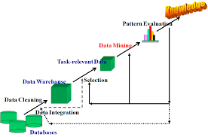
WHY DISRTIBUTED DATA MINING ?

Slide 5
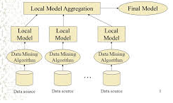
DISTRIBUTED DATA MINING FRAME WORK

Slide 6
DISTRIBUTED DATA SOURCE
In a distributed setting, the data are distribute across several data sources. Each data source contains only a fragment of data.
There are two types of data sources in distributed data mining:
Homogeneous data sources
Heterogeneous data sources

Slide 7
DISTRIBUTED DATA MINING TECHNIQUES
The data mining techniques which are used in the distributed environment are known as distributed data mining techniques.
The following are some of the distributed data mining techniques :
Distributed classifier learning
Distributed clustering
Distributed association rule mining

Slide 8
DISTRIBUTED CLASSIFIER LEARNING
Distributed classifier learning is the technique used to perform classification of data in the distributed environment.
Classification is the process of dividing the data into known groups.
The two approaches in distributed classifier learning are:
Meta - learning framework
Distributed learning with knowledge probing

Slide 9
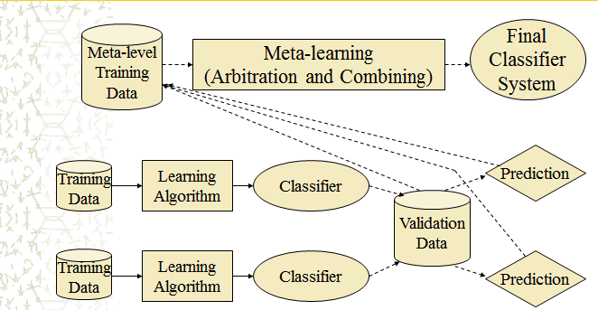
DISTRIBUTED CLASSIFIER LEARNING
Meta – learning framework

Slide 10
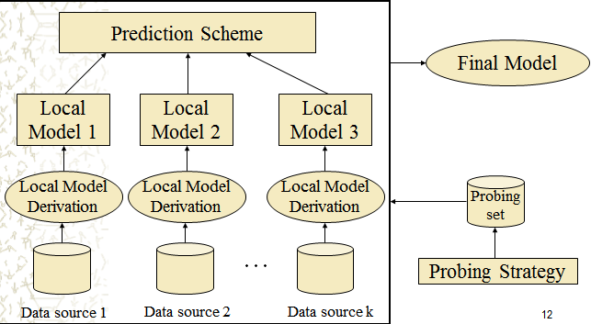
DISTRIBUTED CLASSIFIER LEARNING
Distributed learning with knowledge probing

Slide 11
DISTRIBUTED CLUSTERING
Clustering is an unsupervised learning method group objects into clusters such that objects within a cluster have high similarity in comparison to one another, but are very dissimilar to objects in other clusters.
Distributed clustering algorithms are to cluster the distributed datasets without necessarily downloading all the data to the single site.

Slide 12
DISTRIBUTED CLUSTERING
Distributed clustering is carried out at two different levels.
Local level: All sites carry out clustering process independently from each other and a local model is determined.
Global level: The local model is transferred to a central site, where the local models are merged in order to form a global model. The global model is again transmitted to local sites to update local models.
Eg : Distributed k-means algorithm

Slide 13
DISTRIBUTED ASSOCIATION RULE MINING
The distributed association rule mining is used to discover all rules with global support and global confidence greater than the user specified minimum support and confidence.
Support: Support is an indication of how frequently the item-set appears in the dataset.
Confidence: Confidence is an indication of how often the rule has been found to be true.

Slide 14
DISTRIBUTED ASSOCIATION RULE MINING
The following are some of the distributed association rule mining algorithms:
Count Distribution (CD) algorithm
Fast Distributed Mining(FDM) algorithm

Slide 15
DISTRIBUTED ASSOCIATION RULE MINING
Count Distribution (CD) Algorithm
Each processor generates candidate itemset Ck based on globally frequent large itemset Lk-1.
Each processor computes local support count for Ck by passing through the transactions in the database.
All processors exchange their Ck counts to develop global Ck using MPI technique.
Each processor computes Lk from Ck.
Each processor takes the decision either to continue or to stop. Decision will be the same since they have identical Lk.

Slide 16
DISTRIBUTED ASSOCIATION RULE MINING
Fast Distributed Mining (FDM) Algorithm
Computing candidate set: Each site generates candidate set based on globally large (k-1)-itemsets and locally large (k-1)-itemsets using Apriori algorithm.
Local pruning: For each item in the candidate set: if the support of the itemset is larger than minimum support, that particular item is added in the locally large k-itemsets.
Count exchange: Each site broadcasts locally frequent large itemsets to all other sites.
Globally frequent large itemset computation: Each site computes globally large k-itemsets which is utilized for the following iteration.

Slide 17
CHALLENGES OF DISTRIBUTED DATA MINING
Heterogeneous data mining
Data consistency
Communication cost
Knowledge integration
Data variance
Privacy preserving

Slide 18
THANK YOU

