Slide 1
Cyberspace Merchandise Fraudulence Detection Using ML Technique Protecting the Digital Marketplace
P Bhavya Sri (11733437)
T Veda Sri (11702156)
V Neelima (11723884)
D Sai Harshitha (11704257)

Slide 2
Introduction: The Evolving Landscape of Cybersecurity:
In the digital era, the internet has become a central part of daily life, facilitating numerous activities like shopping, banking, and social networking. This digitalization, however, has also led to an increase in online vulnerabilities.
The Rise of Online Fraud:
Growing Concern: With the expansion of e-commerce and digital transactions, online fraud has emerged as a significant threat. These frauds range from identity theft to financial scams, impacting both individuals and organizations.
Statistics & Impact: Cybersecurity threats are not just growing in number but also in sophistication, leading to substantial financial losses and erosion of consumer trust in digital platforms.
Need for Advanced Detection Techniques:
Limitations of Traditional Methods: Traditional cybersecurity methods often struggle to keep pace with the constantly evolving tactics of cybercriminals.
Role of Machine Learning: Machine Learning (ML) offers a dynamic and proactive approach to detect and prevent online fraud. ML algorithms can analyze vast amounts of data, recognize patterns, and learn from new fraud techniques, thereby enhancing the effectiveness of fraud detection systems.

Slide 3
Problem Statement/Hypothesis
Problem Statement:
Increasing incidents of merchandise fraud in online marketplaces are causing substantial financial losses and eroding consumer trust, necessitating more effective detection methods.
Hypothesis: Leveraging the Role of Machine Learning in Detecting and Preventing Online Merchandise Fraud
Solution Approach: Utilizing Machine Learning (ML) to detect and prevent online fraud.
Advantages:
Predictive Analysis: Identify potential fraud through pattern recognition in transaction data.
Adaptability: Continuously evolve with fraudsters' tactics.
Efficiency: Automate and streamline fraud detection processes.

Slide 4
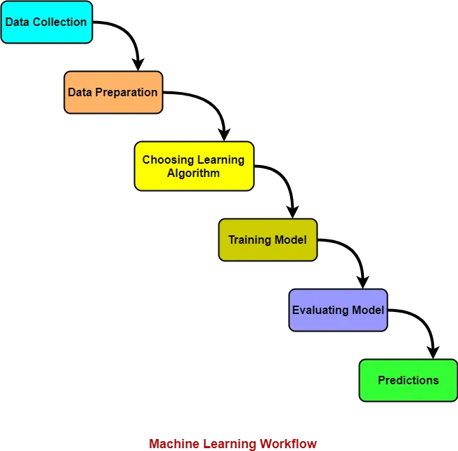
OUR ML Approach

Slide 5
Data Description
Column Name | Type | Description
user_id | Numeric | Unique identifier for each user
signup_time | Datetime | Time when the user signed up
purchase_time | Datetime | Time when the purchase was made
purchase_value | Numeric | Value of the purchase transaction
source | Categorical | Origin of the traffic (e.g., SEO, Ads)
browser | Categorical | Web browser used for the transaction
sex | Categorical | Gender of the user (M/F)
age | Numeric | Age of the user
ip_address | Numeric | IP address of the user
class | Binary | Indicates fraud (1) or not (0)
Key Characteristics:
Volume: 151112 rows and 10 columns
Features: Includes user details (age, sex), transaction details (purchase time, value), and technical data (IP address, browser used).
Target Variable: 'Class' indicating whether a transaction is fraudulent ('1') or not ('0').

Slide 6
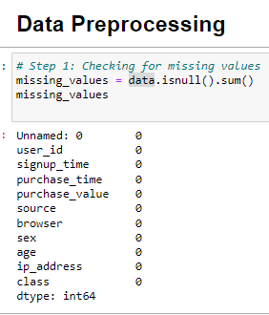
Data Preprocessing Checking Missing Values
We did not find any missing values which is a good sign to proceed with further analysis

Slide 7
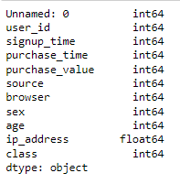
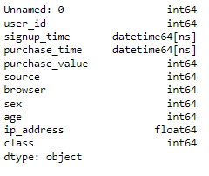
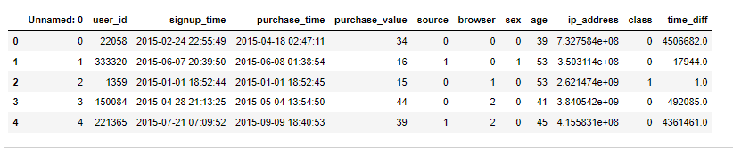
Data Preprocessing – Data Type Conversion
DATA TYPE OF SIGNUP TIME AND
PURCHAGE IS CONVERTED TO TIMESTAMP
Created a new feature time_diff which is the time difference between the signup time and purchase time in seconds.
This feature could be important in identifying fraudulent activity,
as unusually short or long time periods might be indicative of fraud

Slide 8
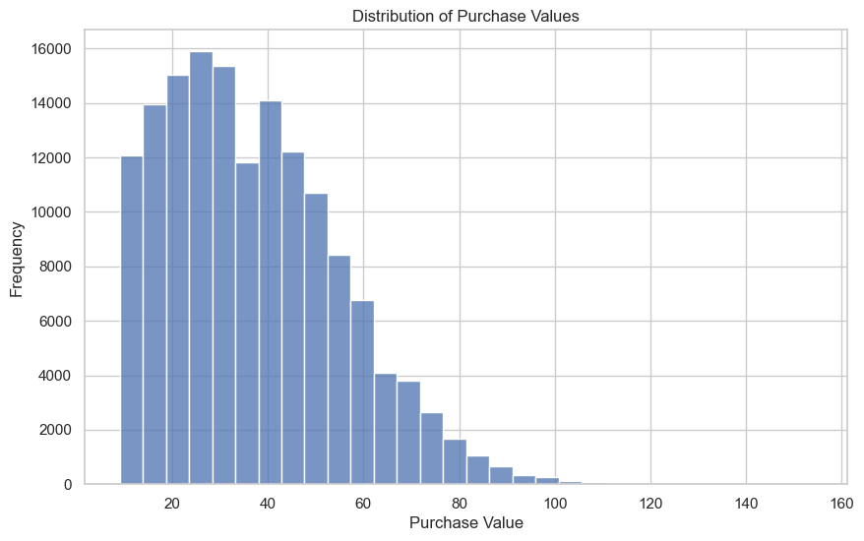
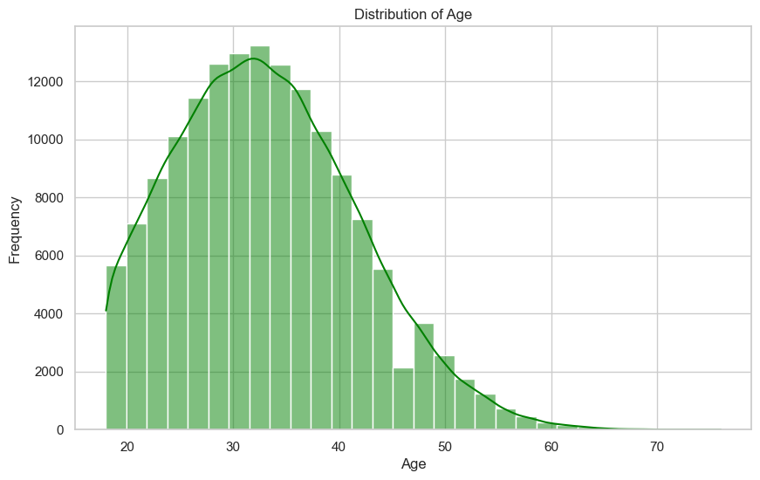
Exploratory Data Analysis (EDA)

Slide 9
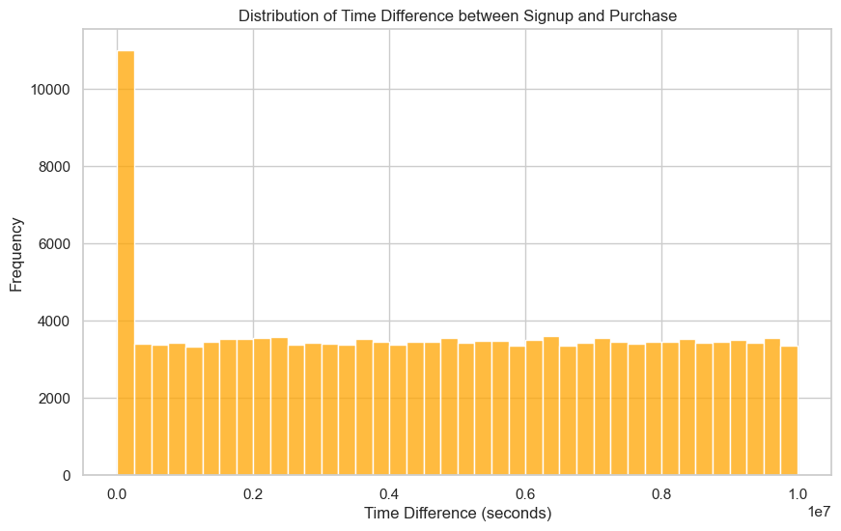
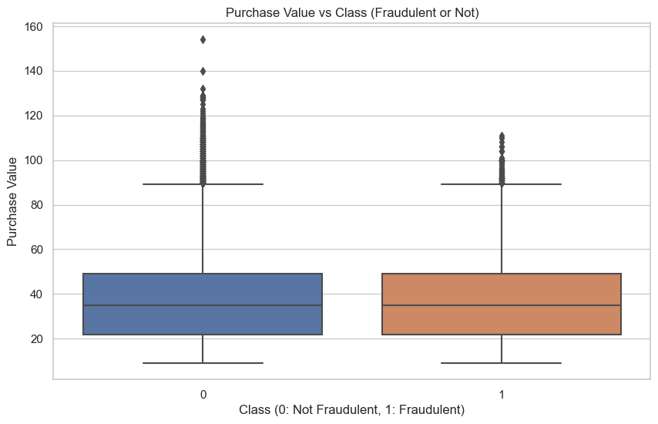
Exploratory Data Analysis (EDA)

Slide 10
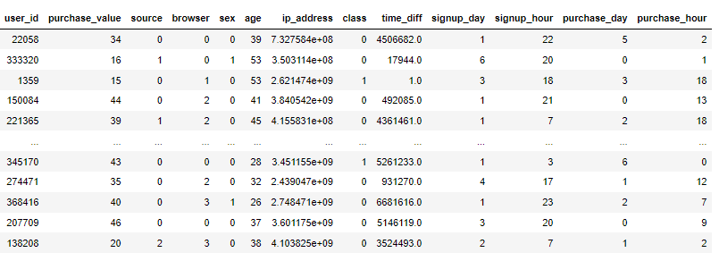
Feature Engineering
New features were created based on the signup and purchase times: signup_day, signup_hour, purchase_day, and purchase_hour.
The original datetime columns (signup_time and purchase_time) were removed as they were replaced by more model-friendly features.
The dataset was then standardized for optimal performance in the model.

Slide 11
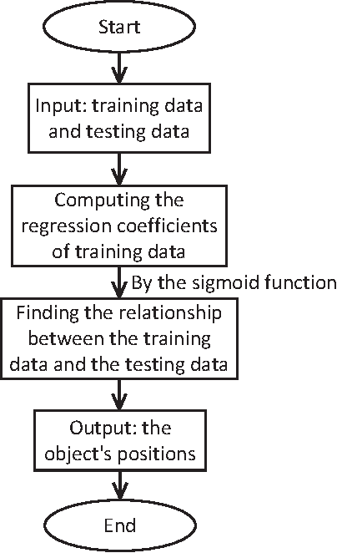
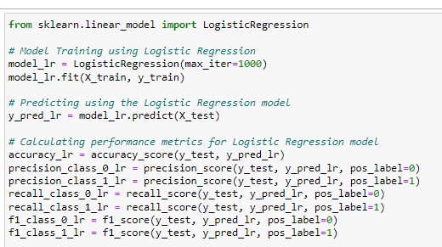
Model 1 : Logistic Regression

Slide 12
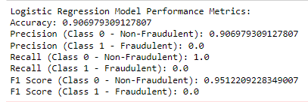
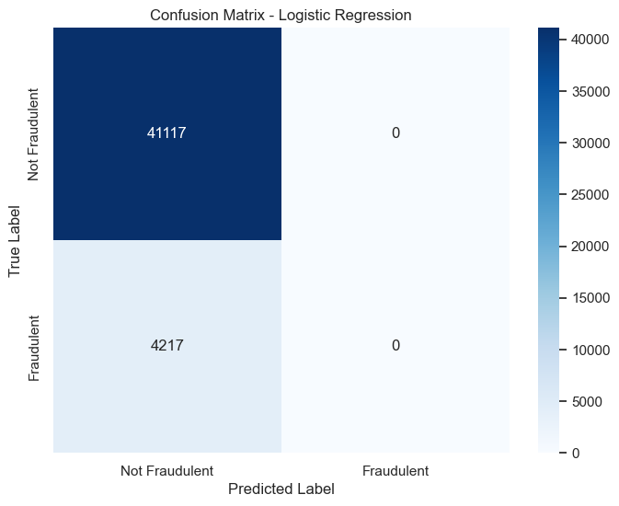
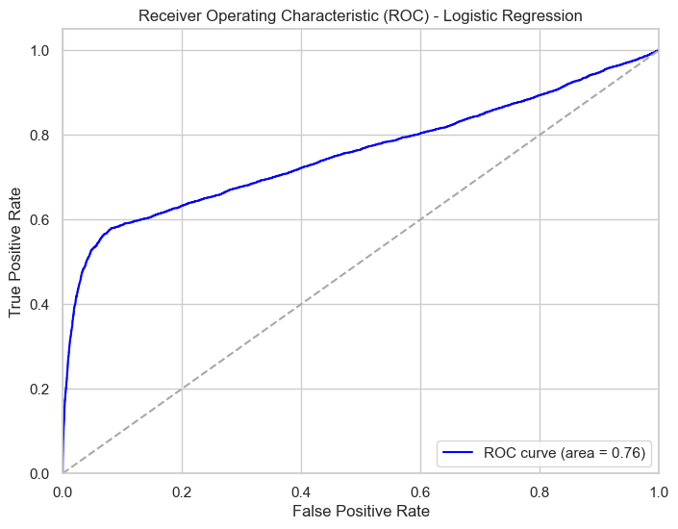
Model 1 : Logistic Regression Results

Slide 13
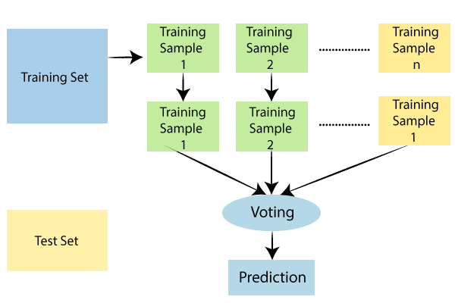
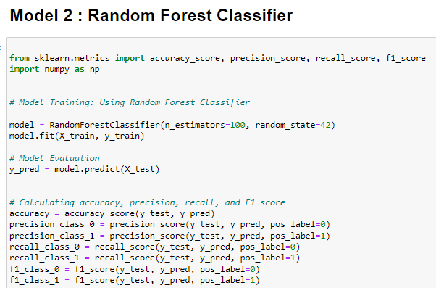
Model 2 : Random Forest

Slide 14
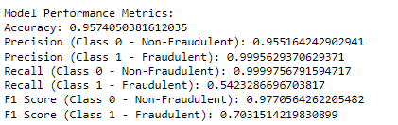
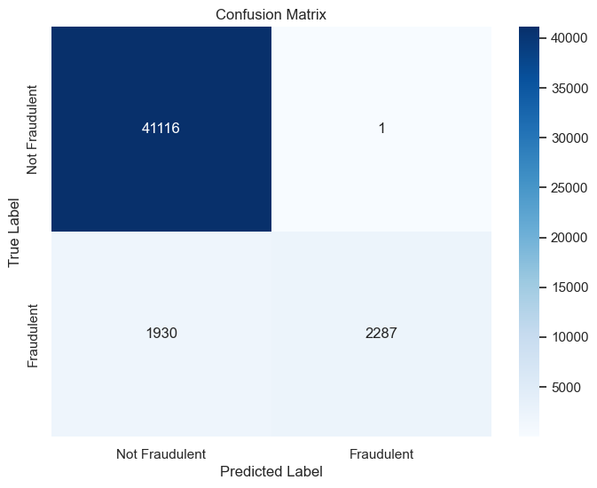
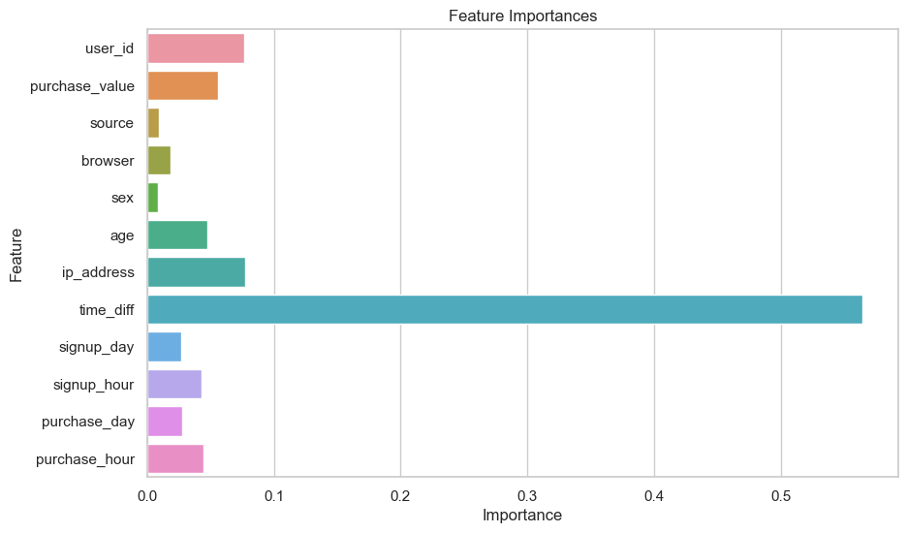
Model 2 : Random Forest Results

Slide 15
Model Comparative Analysis
Logistic Regression struggles with detecting fraudulent transactions, showing 0% precision and recall for Class 1.
Random Forest demonstrates superior performance, particularly in identifying fraudulent transactions with higher precision, recall, and F1 score for Class 1.
The comparison highlights the efficacy of Random Forest in balancing accuracy and class-specific performance in fraud detection.

Slide 16
CONCLUSION
Key Takeaways and Future Directions
Effective Fraud Detection: The project successfully demonstrated the application of Machine Learning techniques in detecting merchandise fraud in cyberspace. Random Forest, in particular, showed remarkable proficiency.
Model Comparison Insights: While Logistic Regression struggled with identifying fraudulent transactions, Random Forest excelled, offering high precision and recall for fraud detection.
Impact of the Project: This approach enhances the security of online marketplaces, safeguarding both businesses and consumers from the ramifications of fraudulent activities.
Future Directions
Model Refinement: Further tuning of the Random Forest model to improve recall for fraudulent transactions without compromising precision.
Data Enrichment: Incorporating more varied and extensive datasets to refine the model's predictive capabilities.
Real-Time Implementation: Deploying the model in a real-world scenario to monitor its performance in real-time and make necessary adjustments.

Slide 17
Implementation Status Report slide
Description | Responsibility (Task, Person) | Contributions (Members/Percentage) | Issues/Concerns
Data Preprocessing | P Bhavya Sri (11733437) | Bhavya Sri - 100% | None
Exploratory Data Analysis | T Veda Sri (11702156) | Veda Sri - 100% | None
Feature Engineering | V Neelima (11723884) | Neelima - 100% | None
Model Training (Random Forest) | D Sai Harshitha (11704257) | Sai Harshitha - 100% | None
Model Training (Logistic Regression) | P Bhavya Sri (11733437) D Sai Harshitha(11704257) | Bhavya Sri - 50% Sai Harshitha – 50% | None
Model Evaluation and Comparison | T Veda Sri (11702156) & V Neelima (11723884) | Veda Sri - 50%, Neelima - 50% | None
Presentation Preparation | All Members | Each - 25% | None

Slide 18
References
https://github.com/rzhou1/FraudDetection
https://www.sciencedirect.com/topics/computer-science/logistic-regression#:~:text=Logistic%20regression%20is%20a%20process,%2Fno%2C%20and%20so%20on.
https://www.analyticsvidhya.com/blog/2021/06/understanding-random-forest/

Slide 19
Project Presentation Link
https://myunt-my.sharepoint.com/personal/vedasritejatulabandula_my_unt_edu/_layouts/15/stream.aspx?id=%2Fpersonal%2Fvedasritejatulabandula%5Fmy%5Funt%5Fedu%2FDocuments%2FRecordings%2FCall%20with%20ML%2D21%2D20231130%5F234356%2DMeeting%20Recording%2Emp4&ga=1&referrer=StreamWebApp%2EWeb&referrerScenario=AddressBarCopied%2Eview

Slide 20
Thank You

