Slide 1
Results

Slide 2
Column Name | Type | Description
user_id | Numeric | Unique identifier for each user
signup_time | Datetime | Time when the user signed up
purchase_time | Datetime | Time when the purchase was made
purchase_value | Numeric | Value of the purchase transaction
source | Categorical | Origin of the traffic (e.g., SEO, Ads)
browser | Categorical | Web browser used for the transaction
sex | Categorical | Gender of the user (M/F)
age | Numeric | Age of the user
ip_address | Numeric | IP address of the user
class | Binary | Indicates fraud (1) or not (0)

Slide 3
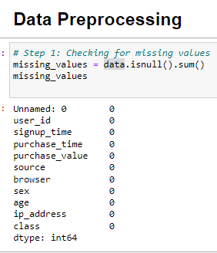
Data Preprocessing Checking Missing Values

Slide 4
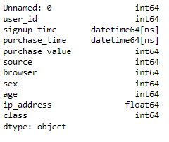
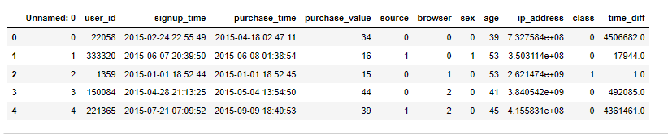
Data Preprocessing – Data Type Conversion

Slide 5
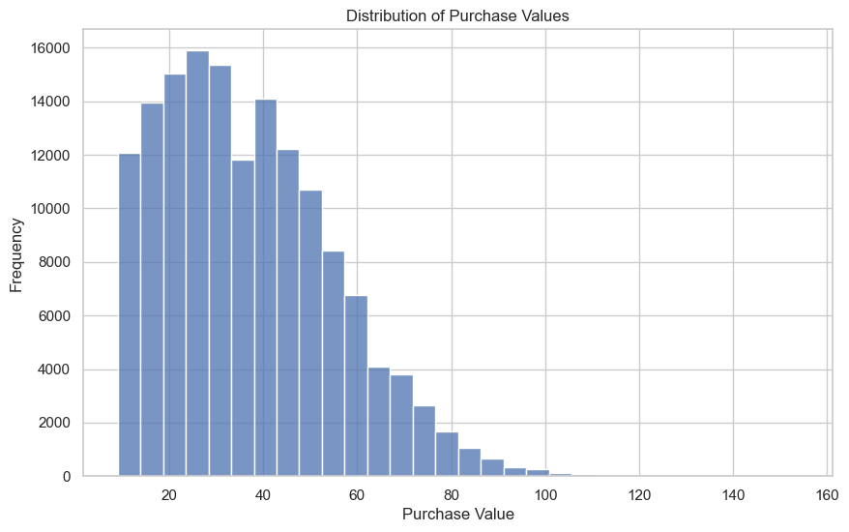
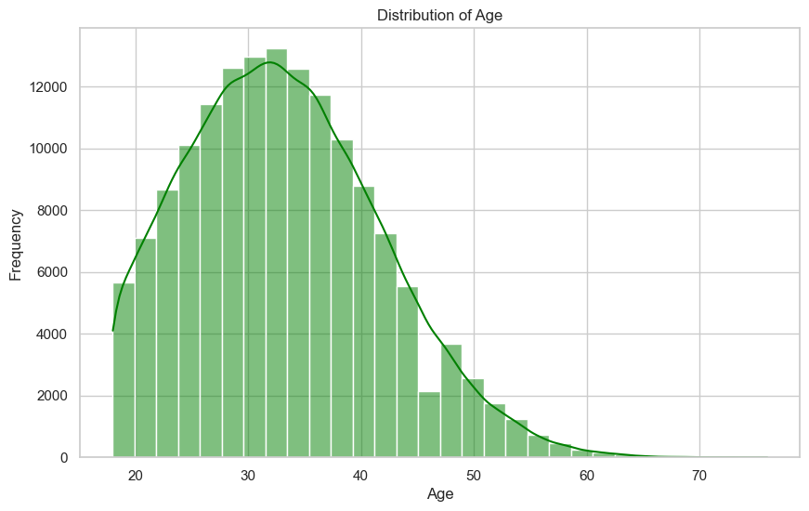
Exploratory Data Analysis (EDA)

Slide 6
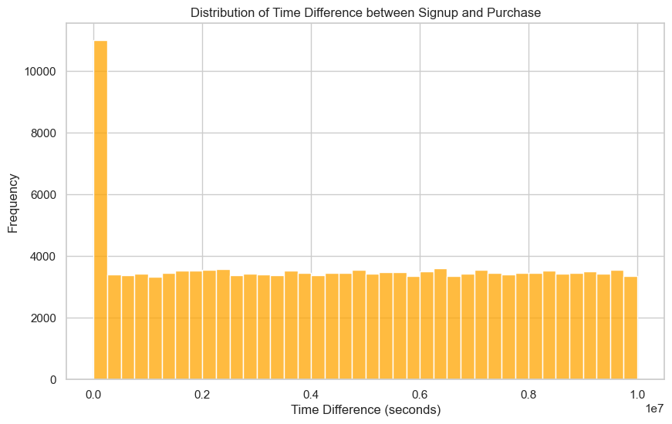
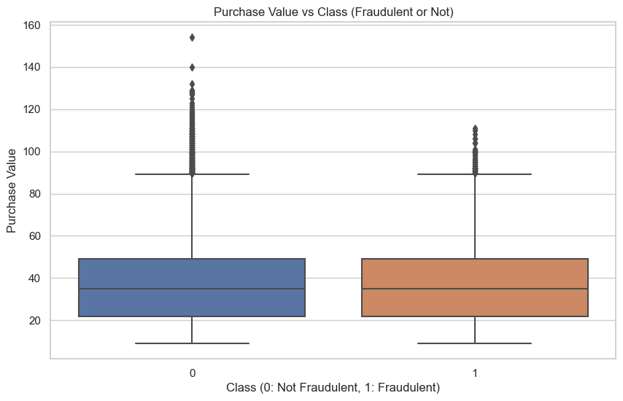

Slide 7
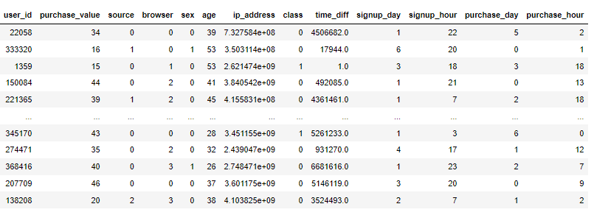
Feature Engineering

Slide 8
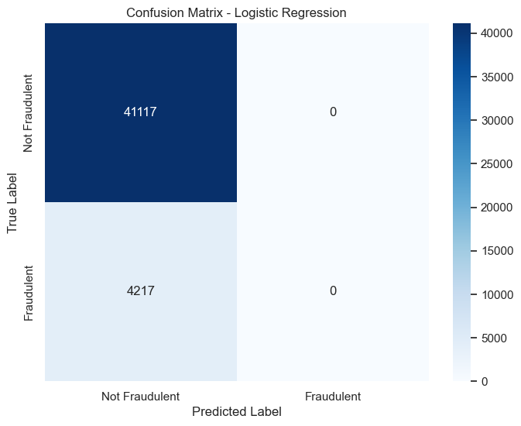
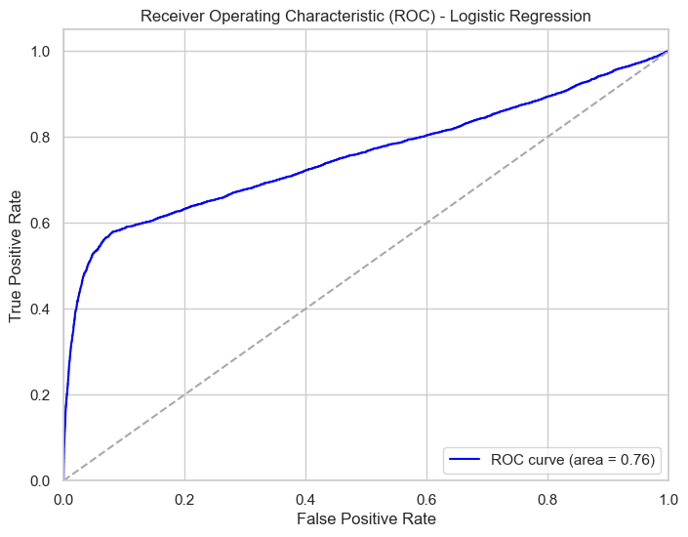
Logistic Regression Results

Slide 9
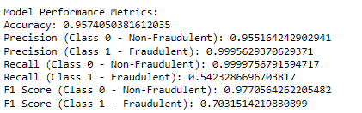
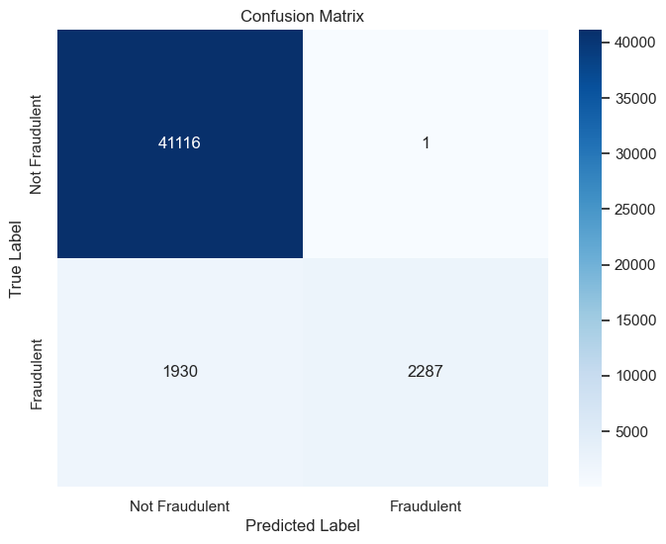
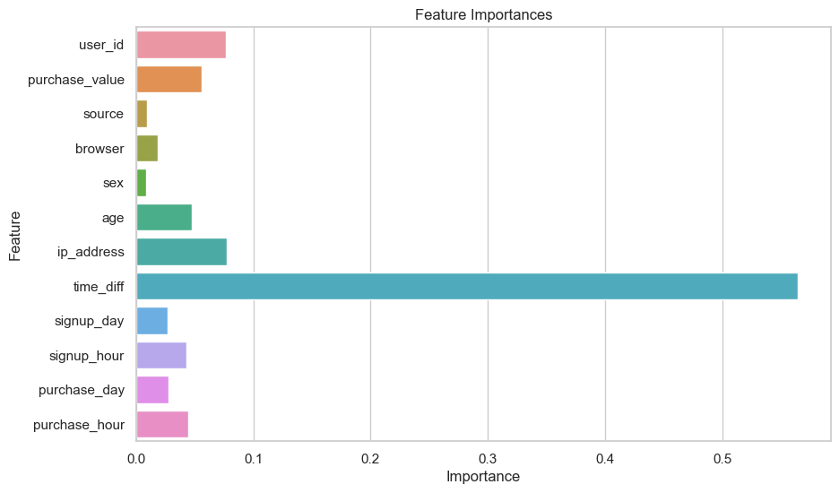
Random Forest Results

