Slide 2
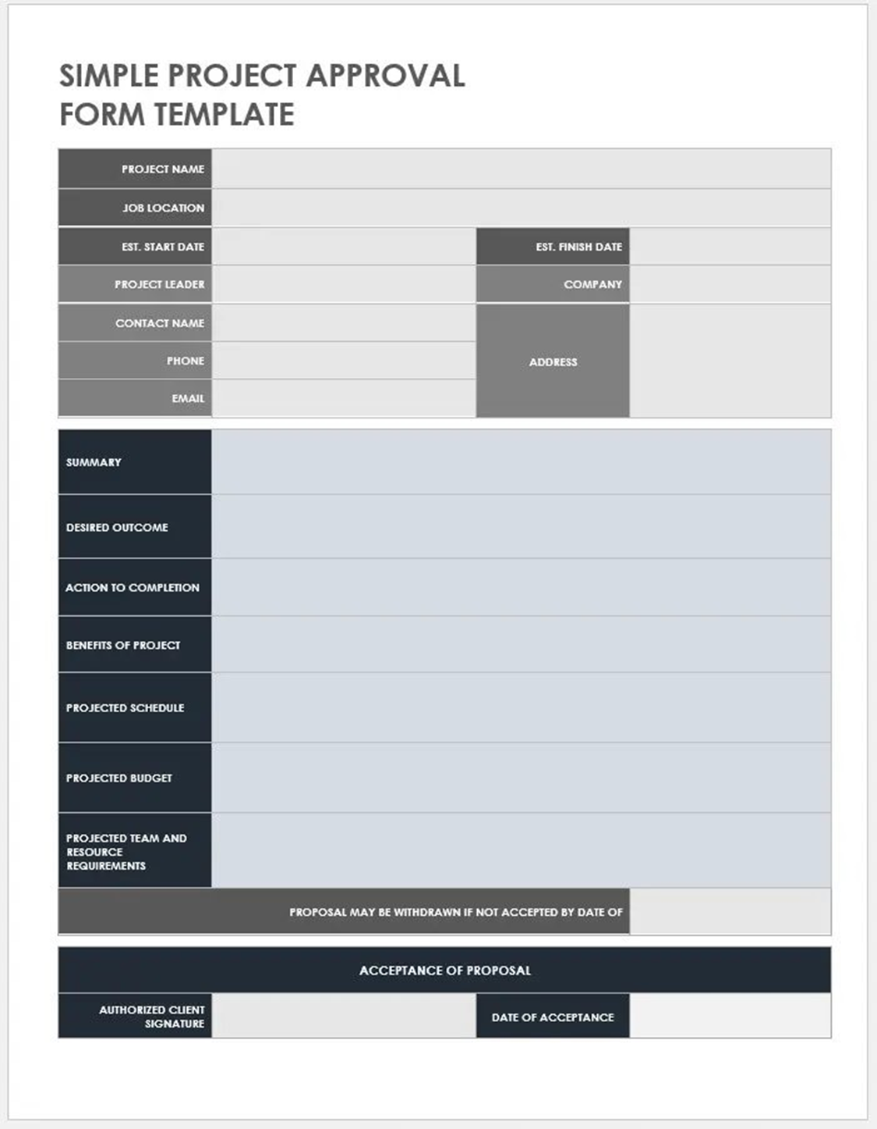

Hotel Website
Phagwara, Punjab
01/10/2023
25/10/2023
Neelotpal Chowdhury
The Imperial Poonam Hotel
Neelotpal Chowdhury
6Q8C+P62,NH1-Jairampur Rd, Guru Hargobind Nagar, Phagwara, Punjab 144401
8768321024
neelotpalchowdhury529@gmail.com
Front end part of a hotel website for The Imperial Poonam Hotel
A fully functioning front end part of a hotel website
Seamless working website
Industry experience and Completion of CA
01/10/2023---25/10/2023
No Budget(Its free of cost).
Single-person’s work(Neelotpal Chowdhury),No external resource is required.
05/11/2023
Pankaj Nayyar
01/11/2023

