Slide 1

Online Shopping Website TRENDIFY
HERITAGE INSTITUTE OF TECHNOLOGY
Bachelor of Technology (B.Tech)
Shayeri Nandy Richik Banerjee Sadhana Kumari Mondal
Anindya Sarmadhikari

Slide 2
01
Online Shopping Website- TRENDIFY
Trendify is an online clothing store that allows users to browse and purchase a variety of clothing items available in the online shop.The project features a catalog of clothing products displayed in various styles and designs, categorized for easy navigation. Users can explore these categories and add desired products to their shopping cart. To proceed to checkout, users must register on the site. Registered users can log in with their credentials for future purchases. Payment options include credit card, bank transfer or PayPal. The frontend of Trendify is made with HTML, CSS, and JavaScript. SQL serves as the backend to store the clothing inventory, product data and user data. This online clothing shopping project streamlines the shopping experience, making it convenient for both buyers and sellers to conduct clothing transactions.
A BRIEF INTRODUCTION OF OUR SOFTWARE

Slide 3
02
SCOPE
The various objectives of TRENDIFY can be laid down as follows:
1. Development of Business-Relationship:
The primary objective of the Trendify is to foster business development. By establishing direct contact between the company and consumers, the business relationship is enhanced. This direct interaction helps to expand the market reach and strengthen customer loyalty.
2. Better Customer Service:
Trendify offers round-the-clock customer service, providing assistance and information about the products at any time. By furnishing detailed product information, customers can easily choose the best product among various alternatives. Online support and service further enhance the customer experience.
3. Attracting More Customers:
In today's competitive market, it is crucial for companies to expand their customer base. Trendify aims to achieve this by offering value-added services and maintaining high product quality. This focus on customer satisfaction drives robust growth in sales and overall profitability.

Slide 4






03
STRUCTURE
Update/Delete
Product
View overall data
Login
Add Product
Admin
Cart
Product
View Product Order
Login
Buy Product
Customer

Slide 5
04
SYSTEM REQUIREMENT
HARDWARE REQUIREMENT:
• | PROCESSOR | Dual core and above
• | RAM / ROM | 20 Gb of free disk space & minimum 2Gb of RAM
• | MOTHERBOARD | INTEL
SOFTWARE REQUIREMENT:
•OPERATING SYSTEM | Windows 7 & above
•PROG.LANGUAGE | HTML, CSS, JS
•DATABASE | MYSQL
•IDE USED | VS Code

Slide 6
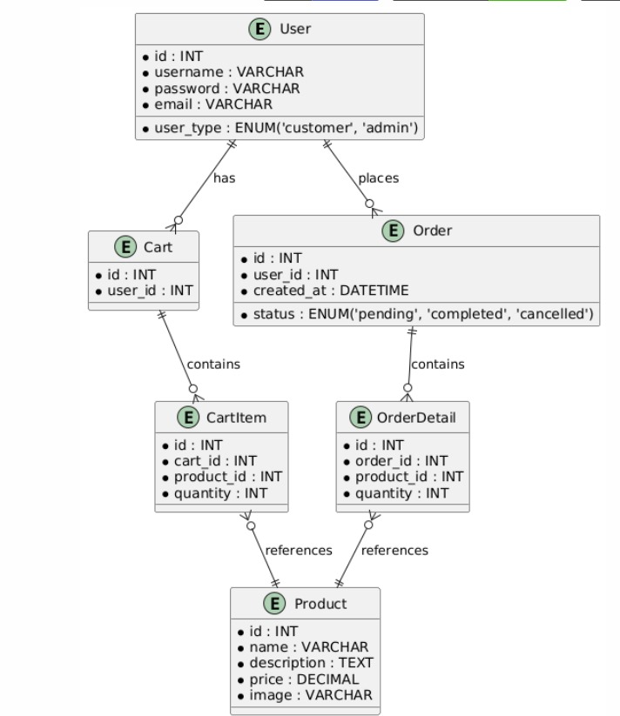
05
ENTITY RELATION DIAGRAM

Slide 7
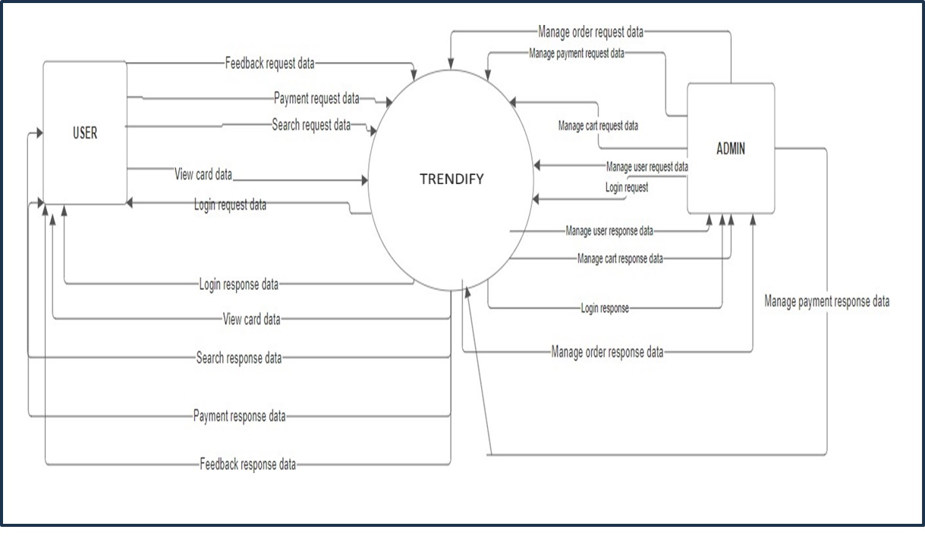
06
0 LEVEL DFD

Slide 8
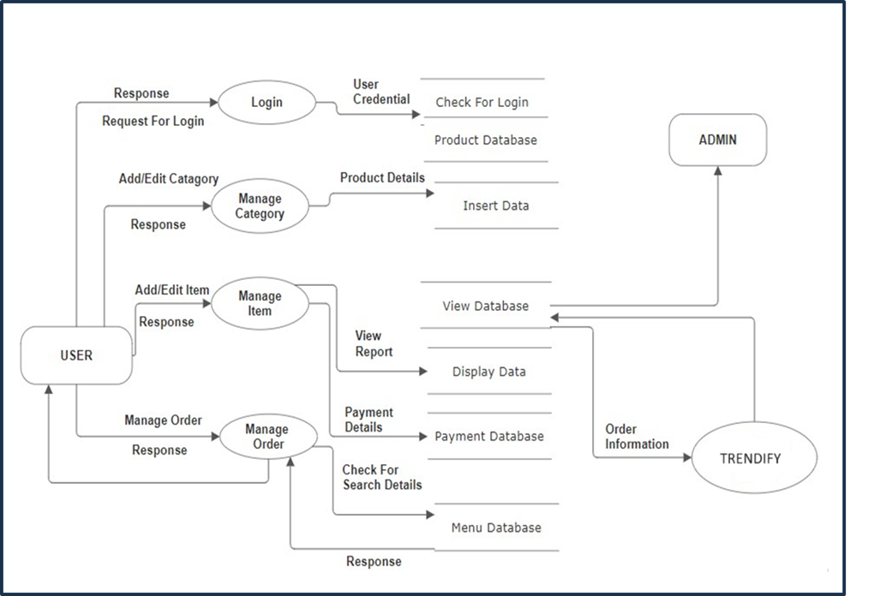
07
1 LEVEL DFD

Slide 9

PROJECT’S UI

Slide 10
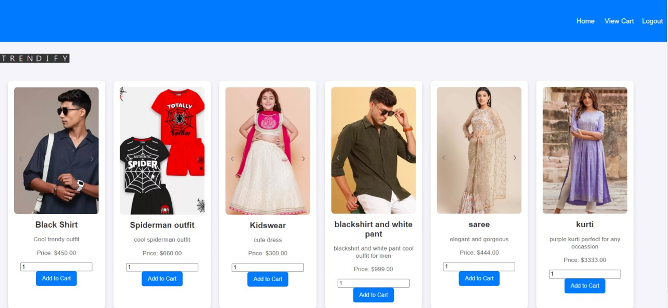
08
HOME PAGE

Slide 11
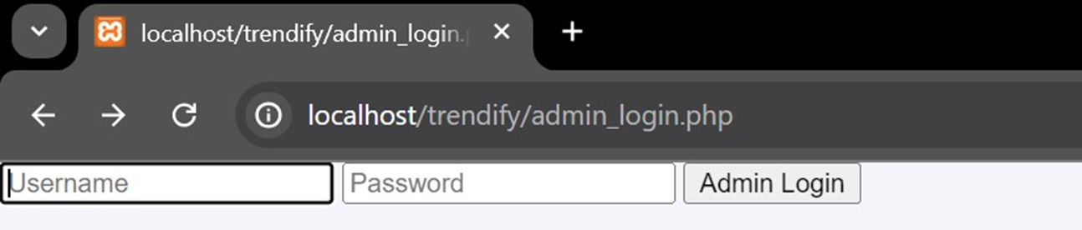
09
ADMIN LOGIN PAGE

Slide 12
10
USER SIGNUP PAGE

Slide 13
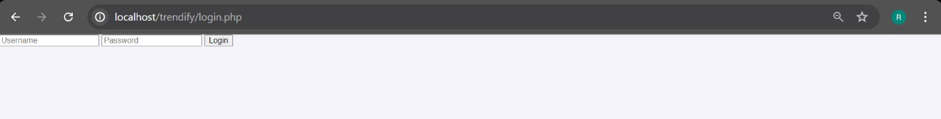
11
USER LOGIN PAGE

Slide 14
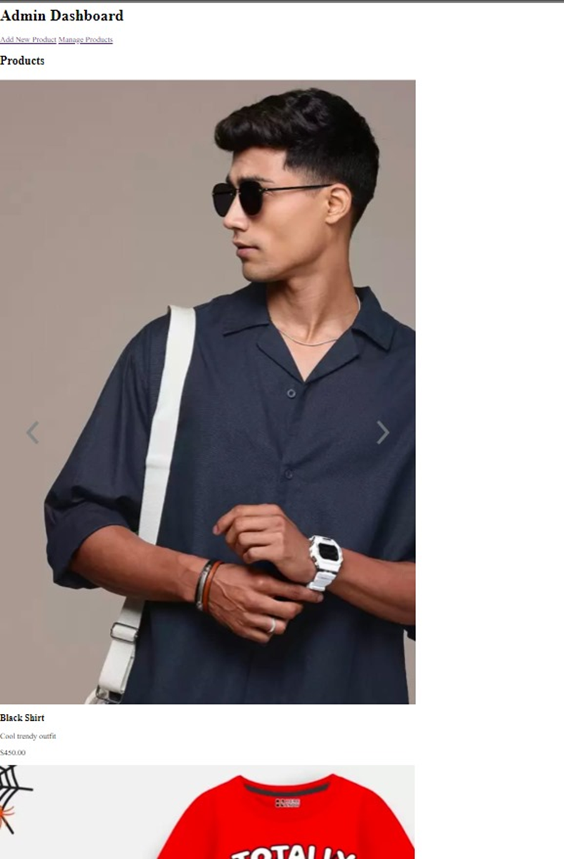
12
ADMIN DASHBOARD

Slide 15
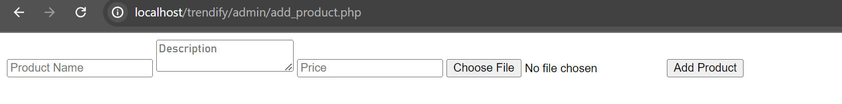
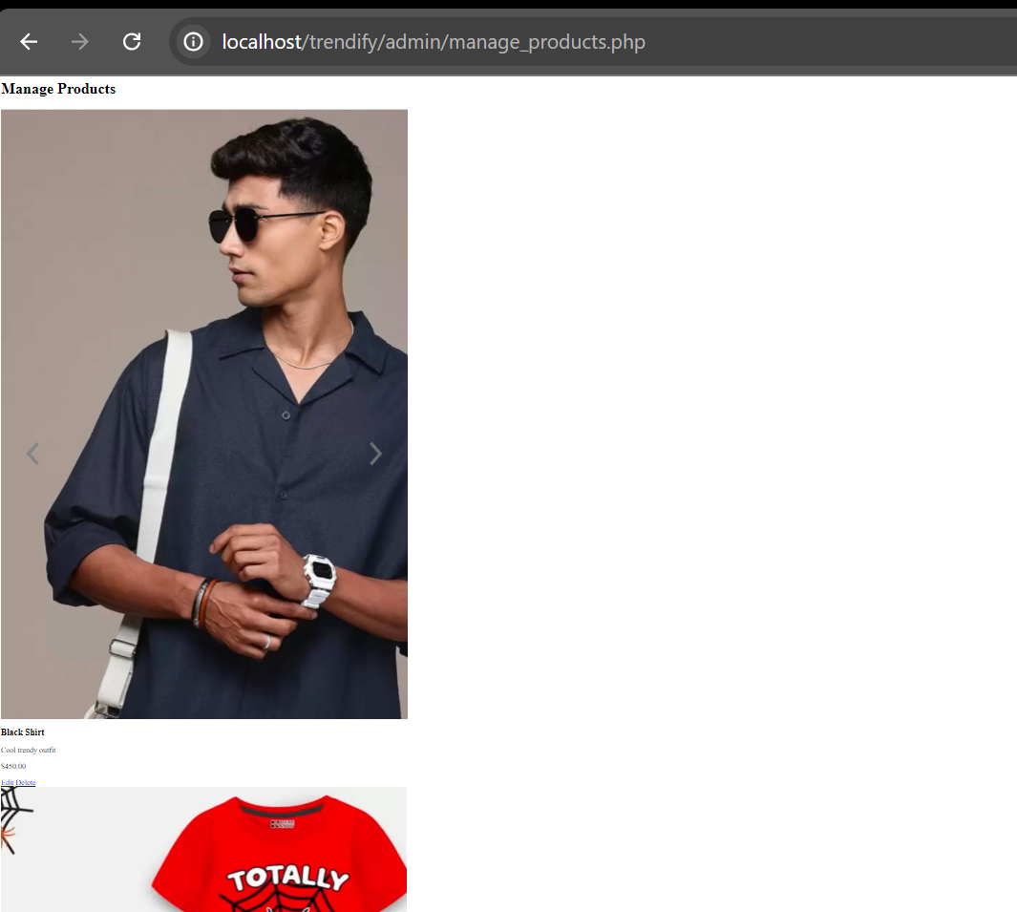
14
PRODUCT PROFILE

Slide 16
15
FUTURE SCOPE
In a nutshell, the future scope of the Trendify Clothing Shopping Website revolves around maintaining and enhancing various aspects of the online shopping experience. The potential advancements include:
Augmented Reality (AR) Integration: Implementing AR technology to allow customers to visualize how clothing items would look on them before making a purchase. This feature enhances the online shopping experience and reduces returns by providing a realistic preview of the product.
Virtual Reality (VR) Showrooms: Creating virtual showrooms where customers can virtually walk through and interact with clothing items. This provides a more immersive and engaging shopping experience, similar to in-store browsing.
Customization Options: Offering customization features that allow customers to personalize clothing items according to their preferences, such as choosing fabrics, colors, sizes, and additional accessories.
Machine Learning for Personalization: Utilizing machine learning algorithms to analyze customer behavior and preferences. This enables personalized product recommendations and targeted marketing campaigns to enhance customer satisfaction and loyalty.
Smart Clothing Integration: Exploring the integration of smart technology into clothing items, such as IoT sensors for monitoring usage, smart fabrics, and voice-controlled features, catering to the growing demand for smart wearable solutions.
Social Commerce Integration: Integrating social media platforms to enable social sharing, user-generated content, and social commerce features like shoppable posts and influencer collaborations. This approach reaches a wider audience and drives sales.
Subscription Services: Introducing subscription-based models where customers can subscribe to regular updates on new clothing collections, maintenance services, or curated fashion packages. This provides recurring revenue streams and fosters long-term customer relationships.
Sustainability Initiatives: Emphasizing sustainable practices by offering eco-friendly clothing options, implementing green supply chain strategies, and educating customers about the environmental impact of their purchases. This aligns with growing consumer preferences for eco-conscious brands.
Global Expansion: Scaling the online clothing shop system to international markets by adapting to local preferences, languages, and currencies. Leveraging cross-border e-commerce opportunities and establishing strategic partnerships for logistics and fulfillment are key strategies.
Blockchain for Transparency: Exploring blockchain technology to enhance transparency and traceability in the supply chain. This ensures product authenticity, ethical sourcing, and fair labor practices, thereby building trust and credibility with customers.
The above-mentioned points outline the enhancements that can increase the applicability and usage of the Trendify project. Additionally, we have kept options open for any other future requirements from users to enhance the system further. These enhancements ensure the system remains versatile and capable of meeting evolving user needs.

Slide 17
User Authentication: Secure registration and login functionalities for users to create accounts and access personalized services.
Product Catalog:
A diverse catalog showcasing furniture items with detailed descriptions, high-quality images, and pricing information.
Payment Gateway Integration: Seamless integration with secure payment gateways to facilitate smooth and secure transactions using various payment methods such as credit/debit cards, digital wallets, and bank transfers.
The Final Summary Of The Project
Order Management: Comprehensive order management tools enabling users to track order status, view past purchases, and manage returns or exchanges.
Admin Panel:
A robust admin panel equipped with functionalities to manage product listings, inventory levels, order processing, customer data, and website settings efficiently.
Shopping Cart:
Intuitive shopping cart system allowing users to add, remove, and modify selected items before proceeding to checkout.
Responsive Design:
Fully responsive design ensuring optimal viewing and functionality across a wide range of devices including desktops, laptops, tablets, and smartphones.
User Authentication: Secure registration and login functionalities for users to create accounts and access personalized services.

Slide 18
Thanking You

