Slide 1
DESIGN AND ANALYSIS OF ALGORITHMS | 5th Semester | Mini Project
Campus Navigation and Path-Finding System
Routes between campus locations with BFS, DFS, Dijkstra and A*
Group No: [____]
Members: [Name – Enrollment No.]
[Name – Enrollment No.]
[Name – Enrollment No.]
Faculty: [Faculty Name]
Notes:
Introduce the topic: finding routes on a campus map using four graph-search algorithms.

Slide 2
Problem Statement
Represent campus locations as a weighted graph and find routes between two locations with BFS, DFS, Dijkstra and A*, then compare the algorithms on route quality and performance.
INPUT
OUTPUT
Campus graph (locations with x, y in metres; walking paths with lengths), start and destination
Route, distance (m), hops, places explored, peak queue size and time for each algorithm
CONSTRAINTS
OBJECTIVE
Undirected graph; path lengths positive and never shorter than the straight line; destination may be unreachable
Find the shortest walking route and show how the four algorithms differ in quality and cost
Notes:
Inputs, outputs, constraints and objective.

Slide 3




Motivation and Real-World Application
Where it is used
Maps and navigation apps, delivery routing, game AI, robotics, indoor wayfinding in campuses, hospitals and malls.
Why it matters
New students and visitors lose time on large campuses; a good route saves walking distance.
Who benefits
Students, visitors, event organisers and campus administrators planning signage and shuttles.
Why it suits DAA
Same problem, four algorithms with different guarantees and costs: a clean case for complexity and experiments.
Notes:
Why path-finding matters.

Slide 4
Objectives
Model the campus as a weighted graph using an adjacency list
Implement BFS, DFS, Dijkstra and A* from scratch
1
2
Verify correctness with 17 automated tests, including all-pairs checks
Show routes and explored places in a web interface
3
4
Analyse best, average and worst-case time and space complexity
Compare theory with measurements for 25 to 2,500 locations
5
6
Notes:
Measurable objectives tied to the DAA flow.

Slide 5
Existing Approach and Background
Basic approach: BFS and DFS
Need for the proposed approach
BFS: fewest hops, but ignores distance in metres
DFS: finds some route, often long and winding
Neither guarantees the shortest walking distance
Both explore blindly, with no sense of direction
Dijkstra: always expands the nearest place, guaranteeing the shortest route
A*: adds a straight-line estimate to head toward the goal
Compare all four to see the trade-off between route quality and work done
Notes:
Basic searches and their limits.

Slide 6
Proposed Approach
1
2
3
4
Problem
›
Input
›
Select
›
Design
Campus routing
Sample and generated campuses
BFS, DFS, Dijkstra, A*
Pseudocode and complexity
5
6
7
8
Implement
›
Test
›
Compare
›
Results
Python and Flask
17 tests, 25–2,500 places
Quality, work, time, memory
Tables, charts, conclusion
Notes:
Flow from problem to results.

Slide 7
Algorithms Used
Algorithm | Basic idea | Why selected | Data structure
BFS | Explore level by level | Fewest hops; simplest search | Queue (deque), parent map
DFS | Go deep, then backtrack | Finds any route; shows no optimality | Stack (list), visited set
Dijkstra | Expand nearest place first | Guaranteed shortest distance | Min-heap (heapq), distance map
A* | Dijkstra + straight-line estimate | Same guarantee, fewer places explored | Min-heap on g + h
Notes:
Why each one was chosen.

Slide 8
Algorithm / Pseudocode
Dijkstra
BFS / DFS / A*
dist[start] <- 0; heap <- [(0, start)]
while heap not empty:
(d, u) <- pop smallest
if u done: continue
mark u done
if u = goal: stop
for (v, w) in neighbours(u):
if d + w < dist[v]:
dist[v] <- d + w
parent[v] <- u
push (d + w, v)
BFS : queue (FIFO), first seen = parent
DFS : stack (LIFO), go deepest first
A* : same as Dijkstra, heap key is
f(v) = g(v) + h(v)
h = straight-line distance
to the destination
Route: follow parent[] from goal
back to start
BFS, DFS: O(V+E) | Dijkstra, A*: O((V+E) log V) | Space: O(V)
Notes:
Walk through Dijkstra, then show how A* differs.

Slide 9
System Design / Architecture
User
Flask API
Algorithms
Output
Browser: pick map, start and destination
app.py
/api/network, /api/route
BFS, DFS, Dijkstra, A*
CampusGraph (adjacency list)
Routes on SVG map
Cards, table, benchmark page
›
›
›
Data: data/campus.json (24 places, 41 paths) and generated campuses of 25–400 places for the app, up to 2,500 for benchmarks.
Notes:
User, processing, algorithm and output.

Slide 10
Implementation
Language and tools
Important modules
Python 3. Standard library (deque, heapq, time, tracemalloc); Flask web app; pytest; matplotlib for charts.
graph/graph.py, graph/data.py, algorithms/ (one file per algorithm), app.py, benchmarking/benchmark.py, tests/.
Data structures
Safety check
Adjacency list (dict of lists), deque for BFS, list as stack for DFS, binary min-heap for Dijkstra and A*, dicts and sets for parent and visited.
add_path rejects a path shorter than the straight line, so the A* estimate never over-estimates and A* stays optimal.
Notes:
Simple code, standard library only.

Slide 11
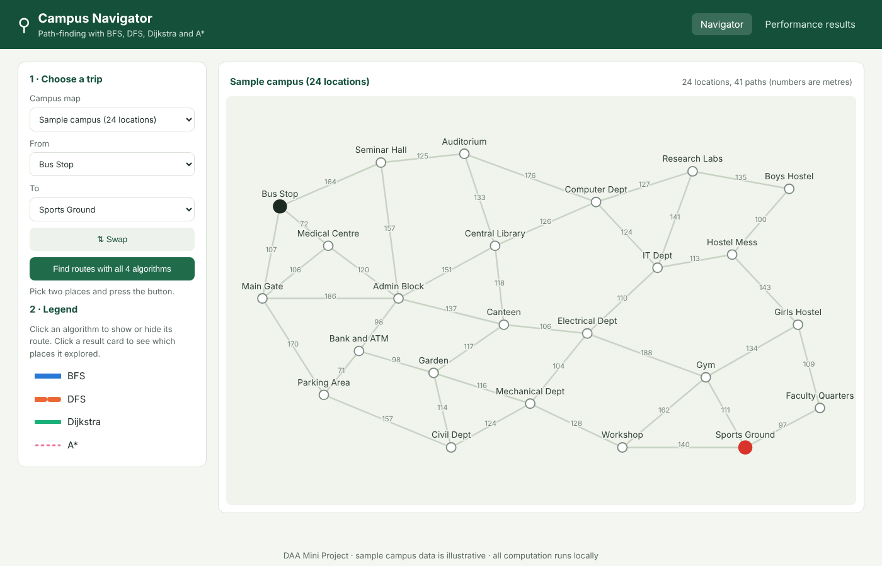
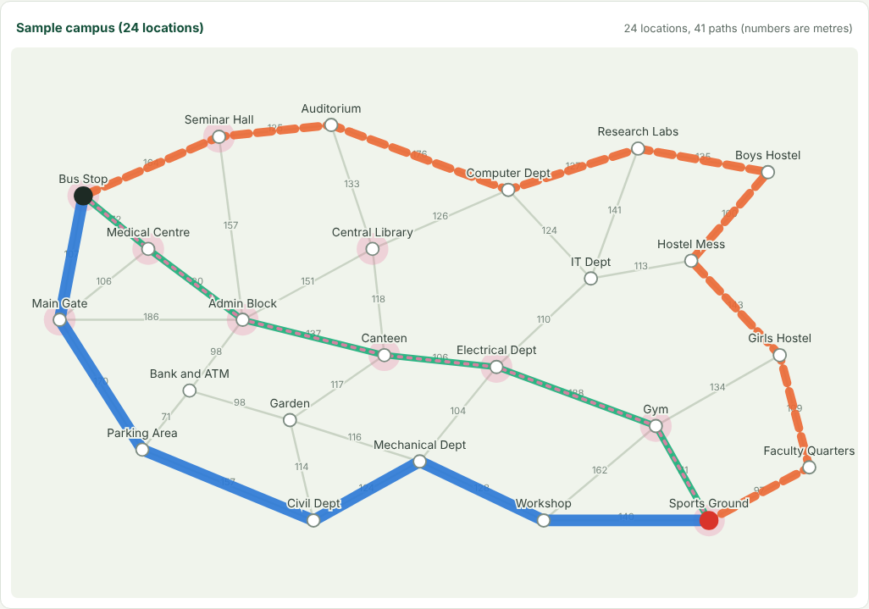
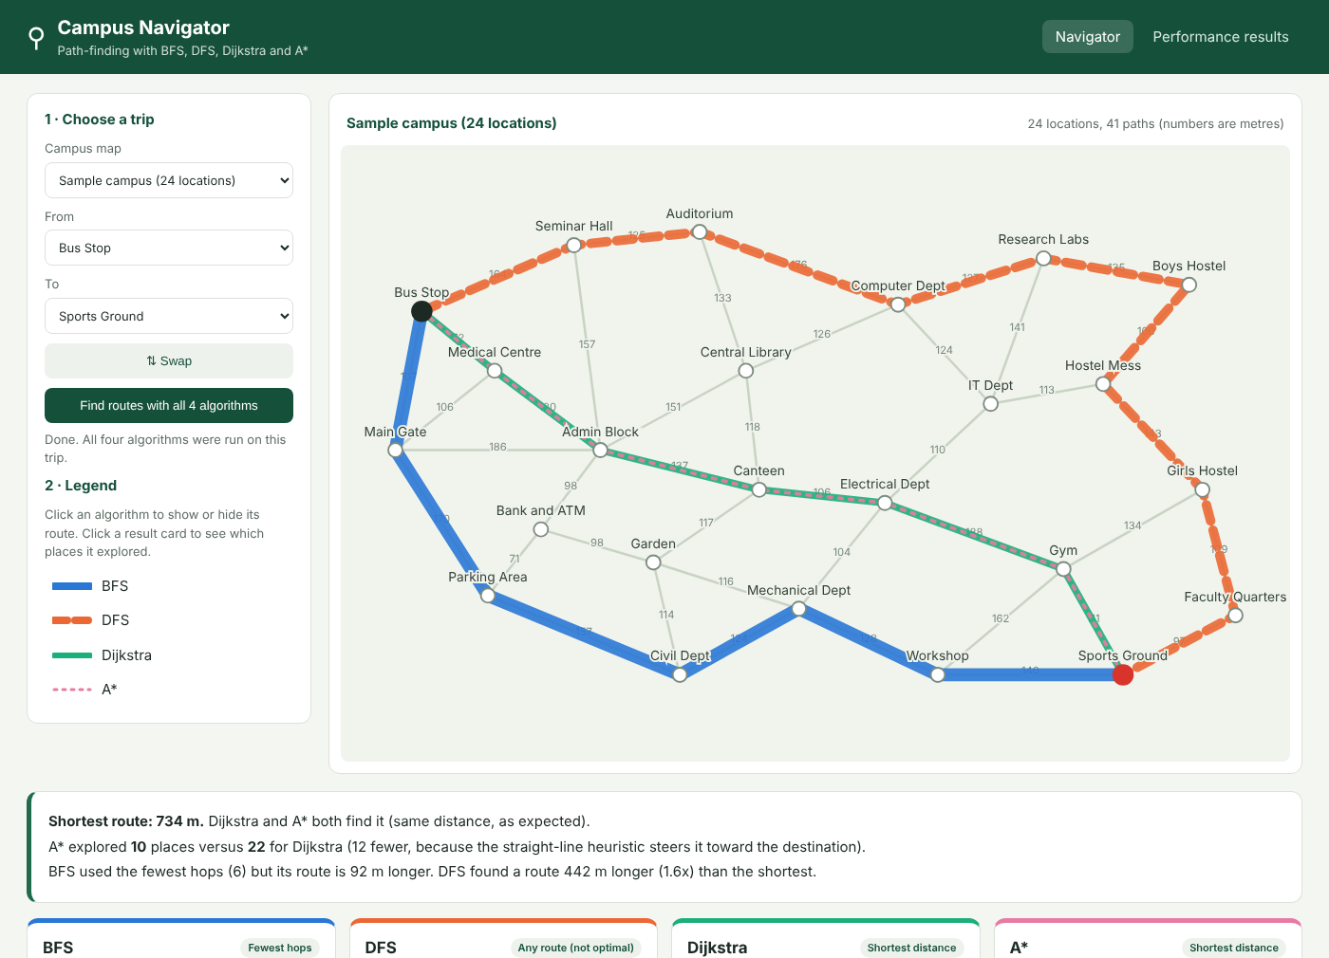
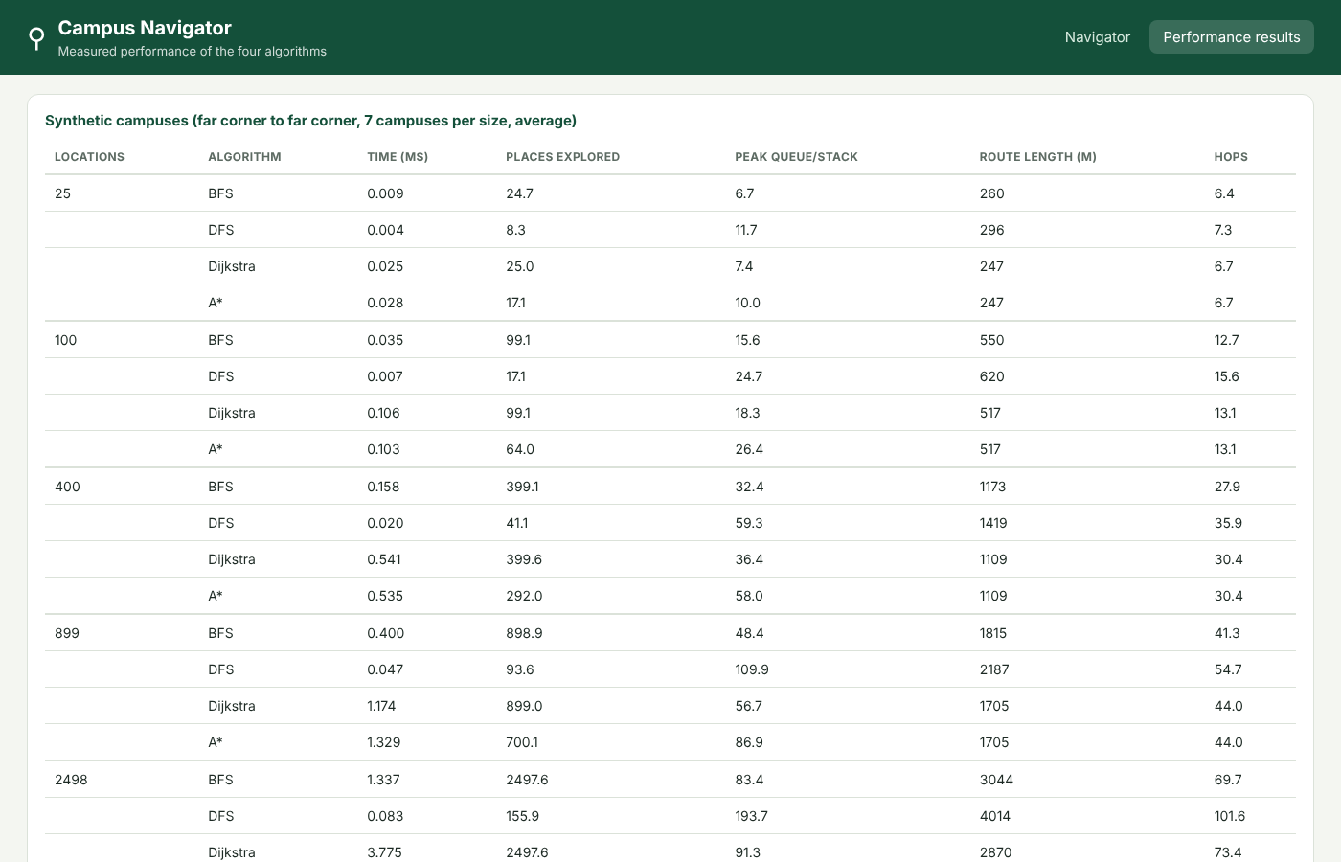
Project Screenshots
Input screen
Processing: places explored by A*
Output: all four routes and comparison
Performance results page
Notes:
Input, processing, output, performance.

Slide 12
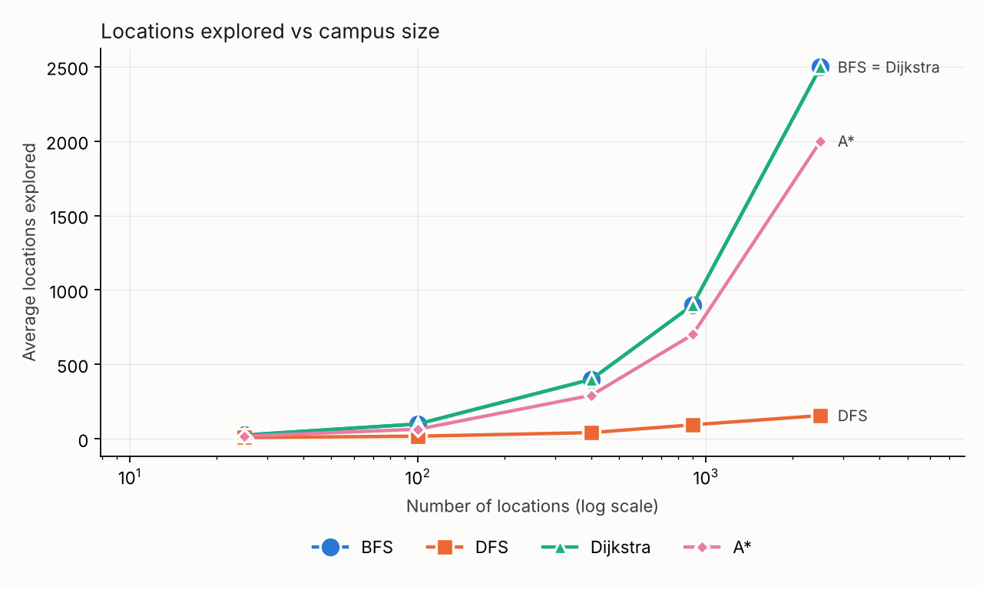
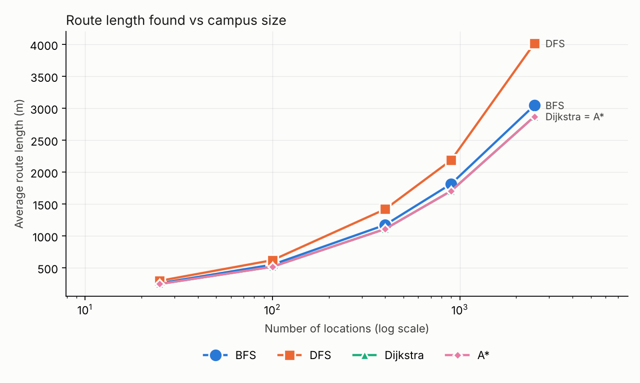
Results: Measured Comparison
Locations | Algorithm | Time (ms) | Explored | Route (m)
25 | BFS | 0.009 | 25 | 260
 | DFS | 0.004 | 8 | 296
 | Dijkstra | 0.025 | 25 | 247
 | A* | 0.028 | 17 | 247
400 | BFS | 0.158 | 399 | 1173
 | DFS | 0.020 | 41 | 1419
 | Dijkstra | 0.541 | 400 | 1109
 | A* | 0.535 | 292 | 1109
2,500 | BFS | 1.337 | 2498 | 3044
 | DFS | 0.083 | 156 | 4014
 | Dijkstra | 3.775 | 2498 | 2870
 | A* | 4.617 | 2000 | 2870
Sizes are requested locations (generated campuses keep the biggest connected part, so actual counts are 1–2 lower). Also tested: 100 and 900, and all 552 trips on the sample campus (see report).
Notes:
Averages over 7 random campuses per size; far-corner query; fastest of 3 runs.

Slide 13
Complexity Analysis
Algorithm | Best | Average | Worst | Space
BFS | O(1) | O(V+E) | O(V+E) | O(V)
DFS | O(1) | O(V+E) | O(V+E) | O(V)
Dijkstra | O(1) | O((V+E) log V) | O((V+E) log V) | O(V)
A* | O(1) | below Dijkstra in practice | O((V+E) log V) | O(V)
Theory vs practice
Time grows roughly in step with V+E for all four. A* explored 20% fewer places than Dijkstra at 2,500 locations and 27% fewer at 400, with identical routes.
In Python, though, A* was not faster at large sizes (4.62 vs 3.77 ms): the heuristic and a larger heap cost extra. DFS was fastest (0.08 ms) but its routes were 1.4x longer; BFS routes were 6% longer.
Notes:
V locations, E paths.

Slide 14



Advantages, Limitations and Future Scope
Advantages
Limitations
Future scope
Simple, readable code
Four algorithms, same inputs and metrics
Verified against Floyd–Warshall
Visual view of explored places
Fictional sample campus
Distance is the only cost
Python timings, not production speed
One start and one destination
Real campus map data
Accessibility and crowd-aware costs
Bidirectional search, landmarks
Multi-stop trips
Notes:
Be honest about limitations.

Slide 15
Conclusion and References
Campus modelled as a weighted graph; four algorithms implemented and tested.
Only Dijkstra and A* guarantee the shortest route; BFS minimises hops, DFS finds any route.
A* explored 20–27% fewer places on larger campuses with identical routes.
Measurements agree with O(V+E) and O((V+E) log V) theory.
References
Dijkstra (1959). A note on two problems in connexion with graphs. Numerische Mathematik 1.
Hart, Nilsson, Raphael (1968). A formal basis for the heuristic determination of minimum cost paths. IEEE SSC 4(2).
Cormen, Leiserson, Rivest, Stein. Introduction to Algorithms. MIT Press.
Python, Flask, pytest, matplotlib documentation. No external datasets.

