Slide 1
Phishing website detection using different ML algorithms:
NEEL RAYAL: 18162121028
NIDHAY VYAS: 18082261003

Slide 2
Contents
Abstract
Dataset to be used
Tools and Technologies
Project Stages

Slide 3
Abstract
Phishing is the most commonly used social engineering and cyber attack.
Through such attacks, the phisher targets naive online users by tricking them into revealing confidential information, with the purpose of using it fraudulently.
In order to avoid getting phished
users should have awareness of phishing websites.
have a blacklist of phishing websites which requires the knowledge of website being detected as phishing.
detect them in their early appearance, using machine learning models

Slide 4
Abstract
We will detect the phishing websties in the early appearance using ML algos.
Our objective is to classify phishing url from the from the legitimate URLs.
We will classify the websites using different ML algorithms and then prepare a report on which algo fits the best for our needs.

Slide 5
Dataset to be used
The dataset for phishing is obtained from:
https://www.phishtank.com/developer_info.php
The dataset for legitimate files is obtained from:
https://www.unb.ca/cic/datasets/url-2016.html
Both these datasets only contains the name of the websites so attributes have to extracted from the websites using web scraping and various python libraries.

Slide 6
Tools and Technologies
Web Scraping: beautiful soup and python libraries
IDE: jupyter notebook
Deployment: Heroku or amazon aws

Slide 7
Task1:
Extract all the Address based features
Extract all Domain based features using BeautifulSoup and urllib
Extract all the HTML and Javascript based features
After extracting all the features combined all the featues into one and made a data frame out of it for both legitimate URLs and phishing URLs.

Slide 8
Objective and tasks to be performed
Our objective is to collect data and extract features from URL’s.
For this project we need a bunch of URL’s of type legitimate(0) and phishing(1).
Phishing data was collected from a opensource website named as phishtank.
Legitimate data was collected from University of New Brunswick.
Tasks to be performed are as under:
Collecting the data.
Feature Extraction.
Computing URL’s features.
Create Final Dataset

Slide 9
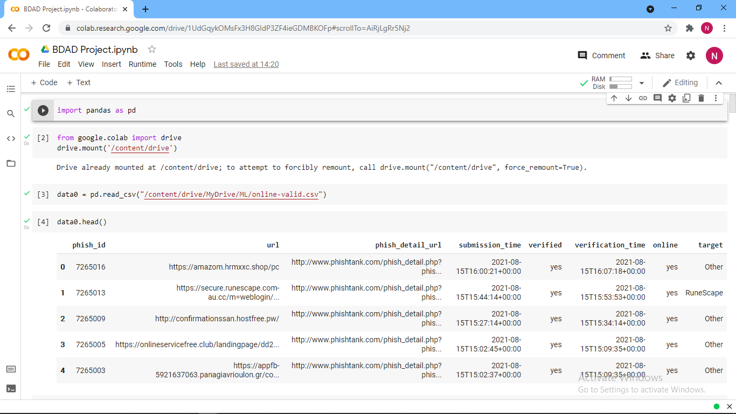
Phishing URL’s
Loading the phishing URL’s data into the dataFrame

Slide 10
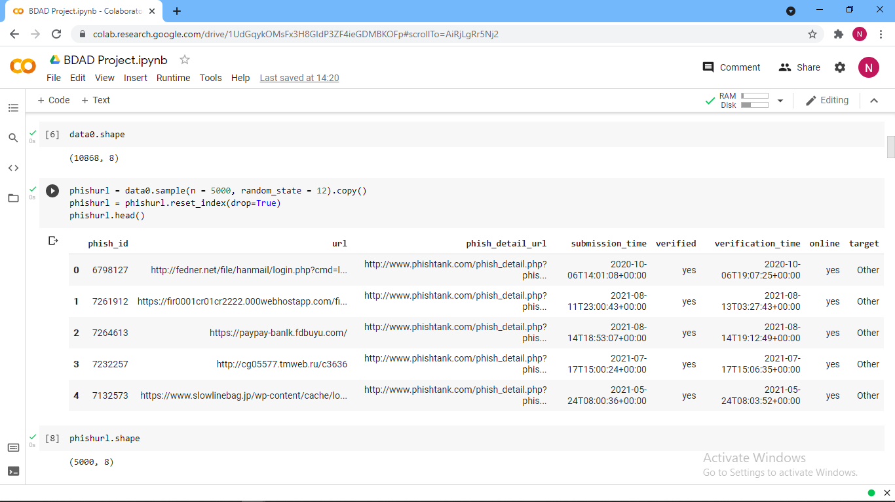
The dataset consists of thousands of phishing URL’s.
We randomly took five thousand samples from the above dataFrame.

Slide 11
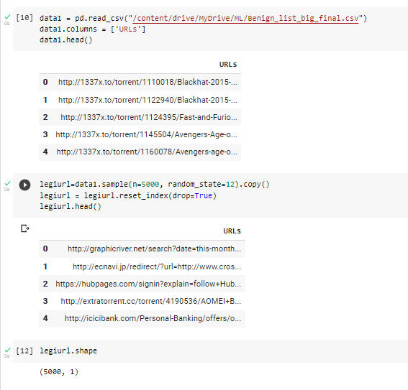
Legitimate URL’s
Legitimate URL’s are loaded into a dataFrame and five thousand URL’s are randomly collected from the above dataFrame.

Slide 12
Feature Extraction
Feature extraction is used to extract features from URL’s dataset.
It is used to improve the accuracy of ML algo’s in classifying phishing.
The URL’s features are analyzed to apply classification algos’s for identifying phishing websites.
There are three types of features extracted from the previously mentioned URL’s as follows:
Address Bar Based Features.
Domain Based Features.
HTML & JAVASCRIPT Based Features.

Slide 13
Address Bar Based Features
Various features are obtained and identified as address bar based features from which some of them are considered for this project as follows:
Domain of URL.
IP Address of URL.
“@”Symbol in URL.
Length of URL.
Depth of URL.
Redirection “//” in URL.
“HTTP/HTTPS” in Domain Name.
Using URL Shortening Services “TinyURL”.
Prefix or Suffix “-” in Domain.

Slide 14
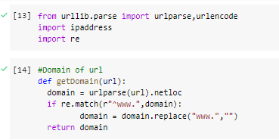
Domain of URL
The Domain present in the URL is been extracted.
A domain name might include ccTLD/country-code top-level domain, SLD/Second lvl domain, sub domain and etc.
Remove the Sub domain and ccTLD, count dots, if the dots are >1 it classified as SUSPICIOUS and if >2 it is classified as PHISING.

Slide 15
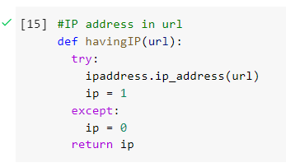
IP Address of URL
It examines the existence of IP Address in URL.
URLs might consist of IP address instead of domain name.
If an IP address is used as an alternative of the domain name in the URL, one can be sure that someone is trying to steal personal information with the URL hence the value assigned above in the code is for the same reason.
1(PHISHING), 0(Legitimate).

Slide 16
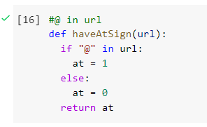
“@”Symbol in URL
The existence of the “@” in the URL is Examined.
This symbol if found in URL misguides browser ignoring everything foregoing the “@” symbol and the actual address frequently interprets the “@” symbol.
If the URL consists of “@”symbol, the value assigned to this feature is 1(Phishing) or else 0(Legitimate).

Slide 17
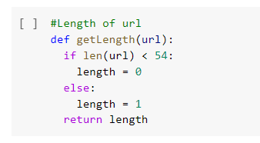
Length of URL
It evaluates the extent of the URL.
Phishers can manipulate lengthy URLs to disguise the skeptical fraction in the address bar.
If the extent of the URL is greater than or equal to 54 characters then the URL is assessed as phishing otherwise legitimate.
If the length of URL >= 54, the value assigned to this feature is 1 (phishing) or else 0 (legitimate).

Slide 18
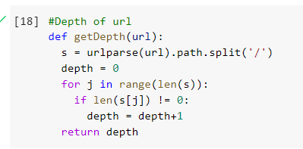
Depth of URL
Evaluates the depth of the URL.
This feature calculates the number of sub-pages in the provided URL based on the '/'.
The value of this attribute is numerical based on the URL.

Slide 19
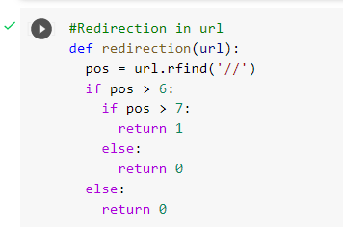
Redirection “//” in URL
It searches for the existence of “//” in the URL’s path.
If “//” exists in URL’s path user will be redirected to another website and the location of “//” in the URL will be enumerated.
If the URL begins with HTTP/HTTPS “//” will appear in sixth/seventh position.
If the “//” is present in the URL value assigned to this feature is 1(Phishing),0(Legitimate).

Slide 20
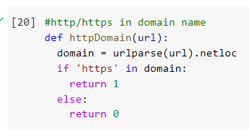
“HTTP/HTTPS” in Domain Name
The Phishers add “HTTP/HTTPS” in the domain part of URL to hoodwink users.
If the “HTTP/HTTPS” is found in the domain part, value assigned to this feature is 1(Phishing), 0(legitimate).

Slide 21
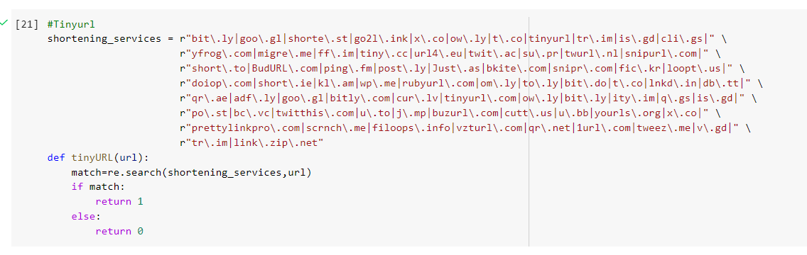
Using URL Shortening Services
Despite of small in length, URL still leads to the required webpage.
It is a method on the world wide web.
When an HTTP redirects on a smaller domain name, it links to the webpage which has long URL.
If the URL is Shortening Service, the value assigned to the feature is 1(Phishing), 0(legitimate).

Slide 22
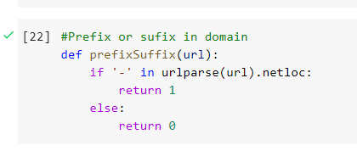
Prefix or Suffix “-” in Domain.
Prefix or Suffix are added, separated by (-) to domain name fooling user that they are surfing on a legitimate website.
It the URL has ‘-’ symbol in domain part, the value assigned to this feature is 1(Phishing) or 0(legitimate).

Slide 23
Domain Based Features
The large number of training features used and the lack of validating arguments for these feature choices.
The second concern is the type of datasets used are inadvertently biased with respect to the features based on the website URL or content.
To address these concerns, we put forward the intuition that the domain name of phishing websites is sign of phishing and holds the key to successful phishing detection.
Many features are extracted from the URL falls under Domain Based Features which are as follows:
DNS Record
Website Traffic
Age of Domain
End Period of Domain

Slide 24
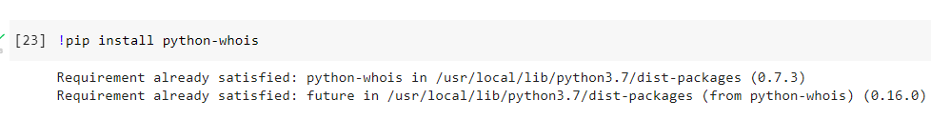
PYTHON WHOIS / DNS RECORD
WHOIS is a query & response protocol.
It is widely used for querying databases which store the registered users or assignees of internet resource, such as domain name, IP address block, or an autonomous system.
It is also used for wider range of other information.
The protocol stores and delivers database in human-readable format.
For Phishing websites hostname records and claimed identity are not recognized by WHOIS database.
If the DNS record is empty or not found, the value assigned to this feature is 1(Phishing), 0(Legitimate).

Slide 25
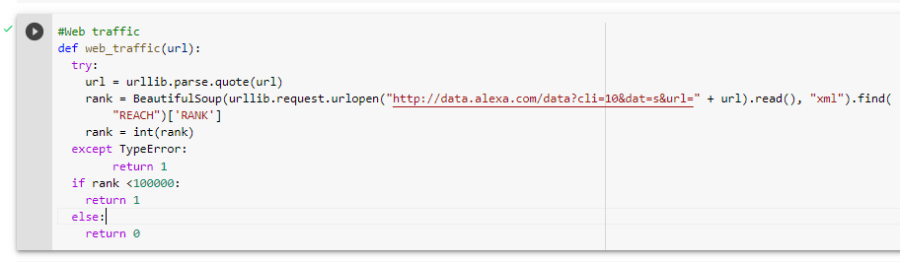
Website Traffic
This aspect assesses the popularity of the website by specifying the number of novices and the number of pages they visit.
However, since phishing websites live for a short period, they may not be recognized by the Alexa database.
Furthermore, if the domain has no traffic or is not recognized by the Alexa database, it is classified as “Phishing”.

Slide 26
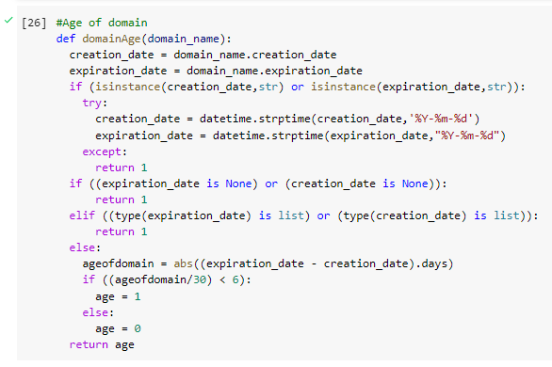
Age of Domain
This feature can also be extracted from the WHOIS database.
Most Phishing websites live for a short period of time.
We have considered 12 month as minimum age of domain therefore, if age of domain >12 months value assigned to this feature is 1(Phishing) else 0(Legitimate).

Slide 27
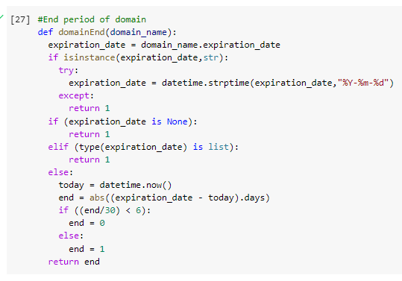
End period of Domain
This feature can also be extracted from WHOIS database.
End time of domain : Difference b/w termination time and current time
If end period of domain > 6 months the value of this feature is 1(Phishing) or 0(Legitimate).

Slide 28
HTML & JAVASCRIPT BASED FEATURES
It is an page source code based feature.
It includes URL’s embedded in the webpage and HTML and JAVASCRIPT.
It falls under the category of Content Based-Approach method for detection of phishing Under ad-hoc methods.
Features Extracted from the URL’s are as below:
IFrame Redirection
Status Bar Customization
Disabling Right Click
Website Forwarding

Slide 29
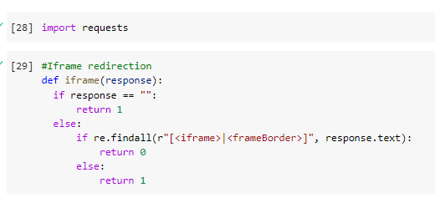
IFRAME Redirection
Webpage which is replica of the current webpage.
Phishers use frameBorder attribute to render visual portrayal.
If the Iframe is empty or the response is not found then, the value assigned to this feature is 1(Phishing) or else 0(Legitimate).

Slide 30
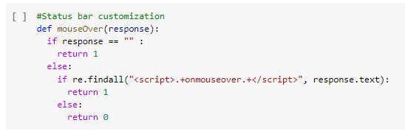
Status Bar Customization
This feature is extracted by exploring the webpage source code & finding the onMouseOver event.
After finding it monitor it on status bar say if it makes any changes or not.
If the onMouseOver is found then the value assigned will be 1(Phishing) or else 0(legitimate).

Slide 31
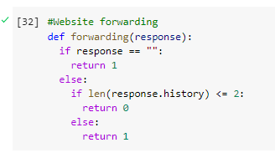
Website Forwarding
Through our dataset we came to knew that legitimate websites have been redirected one time max.
Phishing website compared to legitimate has been redirected 4 times.
If the redirect is greater then or equal to 2 value assigned to the feature is 1(Phishing) or else 0(Legitimate).

Slide 32
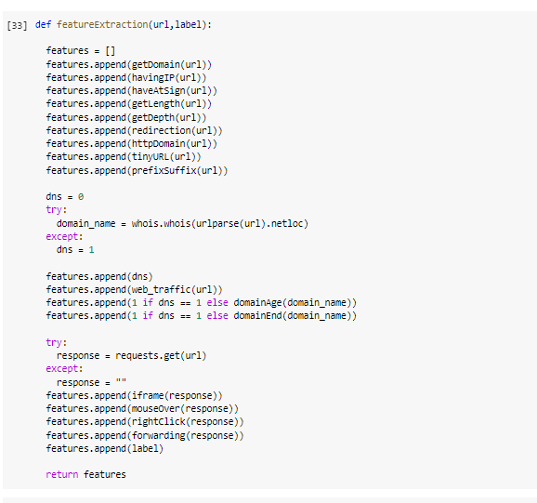
Computing URL Features
A list has been created with a function which calls the other functions and each and every feature of the URL in the list.
We are extracting the features of URL and to append the list.
Function are coded to extract the features.

Slide 33
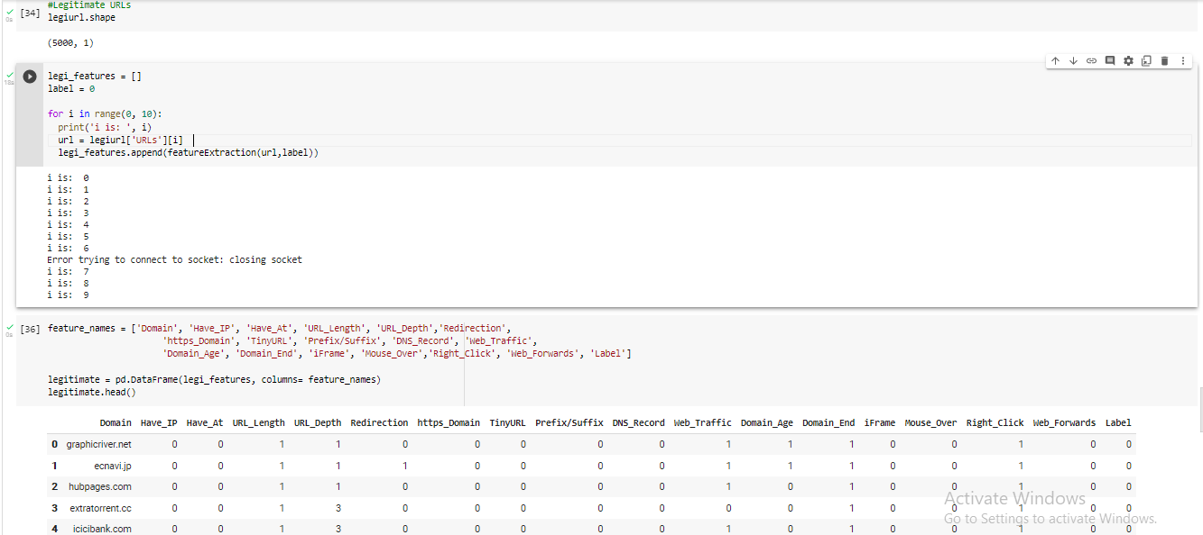
Legitimate URL’s

Slide 34
Feature extraction is performed on the legitimate websites.
Features are extracted and stored in the list.
List is being converted to dataframe.
The extracted legitimate features are stored into a csv file named as ‘Legitimate.csv’.

Slide 35
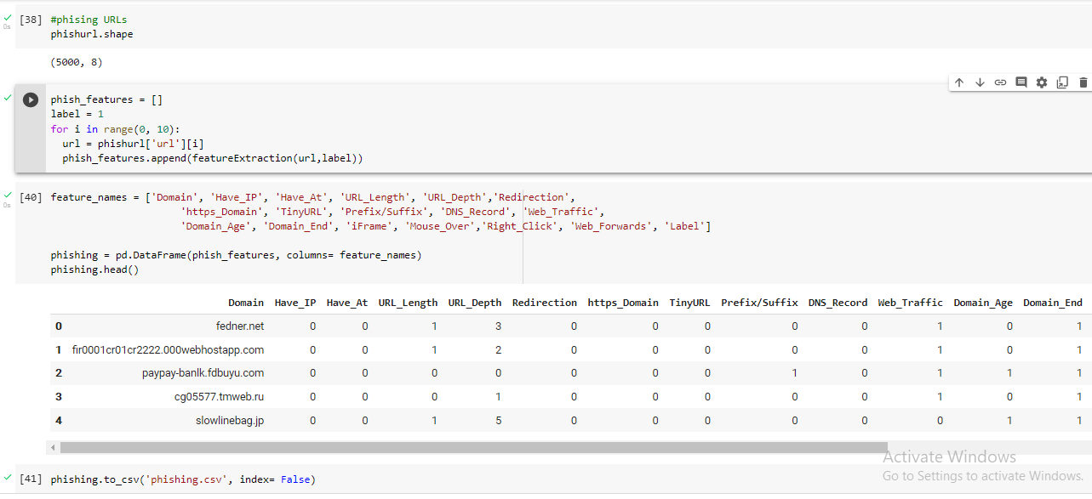
Phishing URL’s

Slide 36
Feature extraction is performed on phishing URL’s.
Features are extracted and stored in the list.
The list is converted to dataframe.
Features of extracted URL’s are stored into a CSV File named as ‘phishing.csv’.

Slide 37
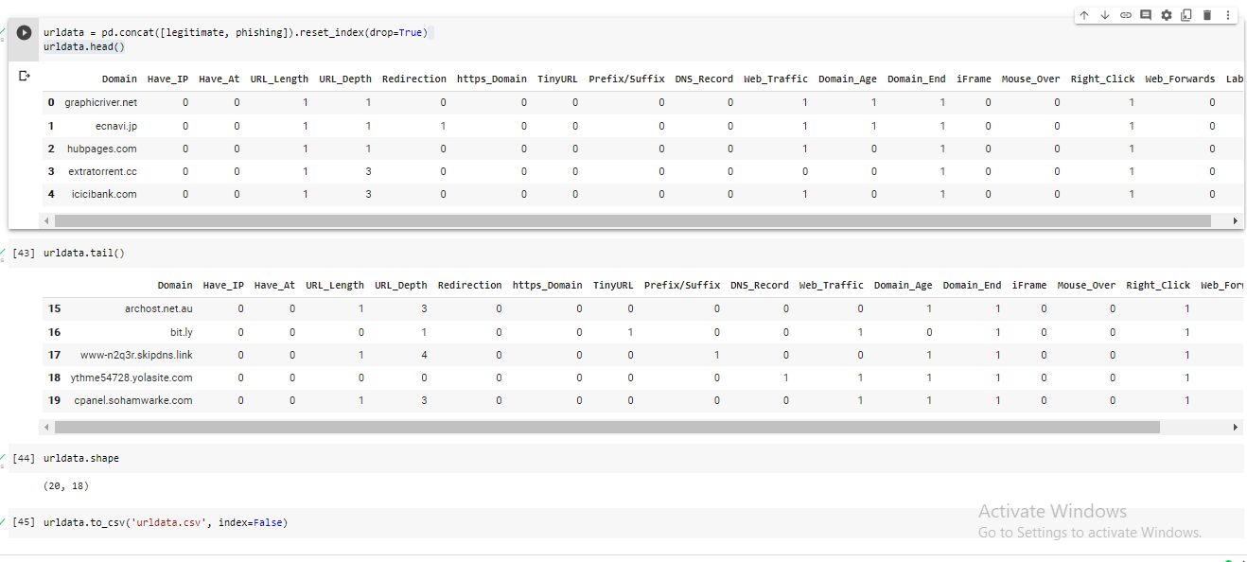
Final DataSet
We concatenated the dataframes into one.
Storing the data in a CSV file named ‘urldata.csv’

Slide 38
Task2 todo:
All the attributes have been extracted and now we will make a model for this. The data will be split into 80 - 20. This problem is a classification problem and different classfication models will be trained and we will select the model which classifies with best accuracy.
This data set comes under classification problem, as the input URL is classified as phishing (1) or legitimate (0). The supervised machine learning models (classification) considered to train the dataset in this project are:

Slide 39
Task2 cont
Logistic Regression.
Decision Tree
Random Forest
Support Vector Machines
XG Boost
SVM

Slide 40
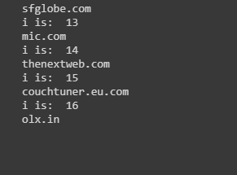
Error Correction
Our code was stuck on some of the iterations indefinitely for the reasons unknown.
We had to click here and there to resume the execution of our program

Slide 41
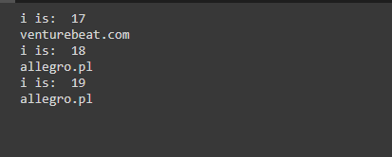
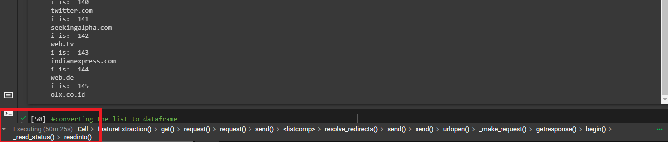
Even after resuming the execution, the program was taking too much time for mere 150 iterations.

Slide 42
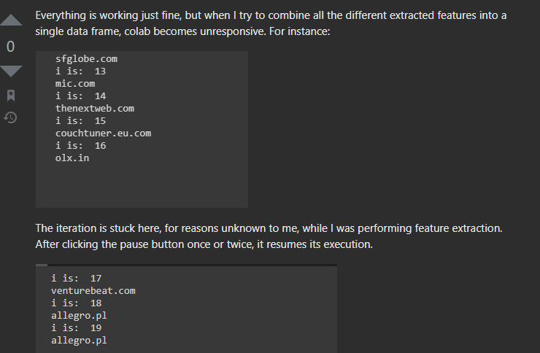
We tried to solve our problem by asking on stack overflow and reddit(implementation help)

Slide 43
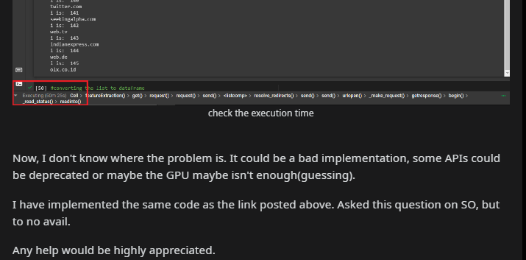
On reddit, for implementation help

Slide 44
After this we had to check for the error by hit and trial method.
We get to know that requests library was stuck when the server wasn’t responding.
Still the problem wasn’t solved.
The requests library was getting stuck when the website returns HTTPs code other than 200
So, we had to update the code accordingly.

Slide 45
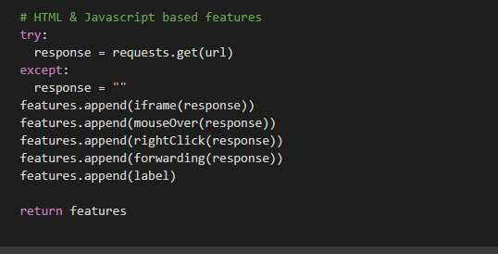
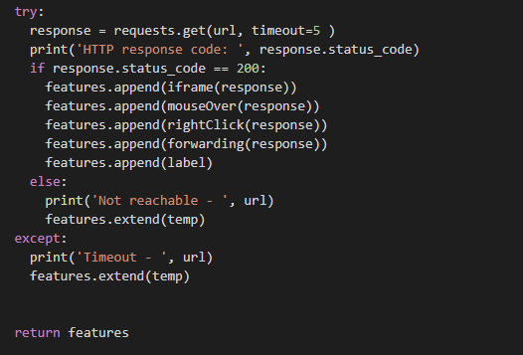
Old
Newly updated code:
HTTPs code
Timer
Not reachable vs timeout

Slide 46
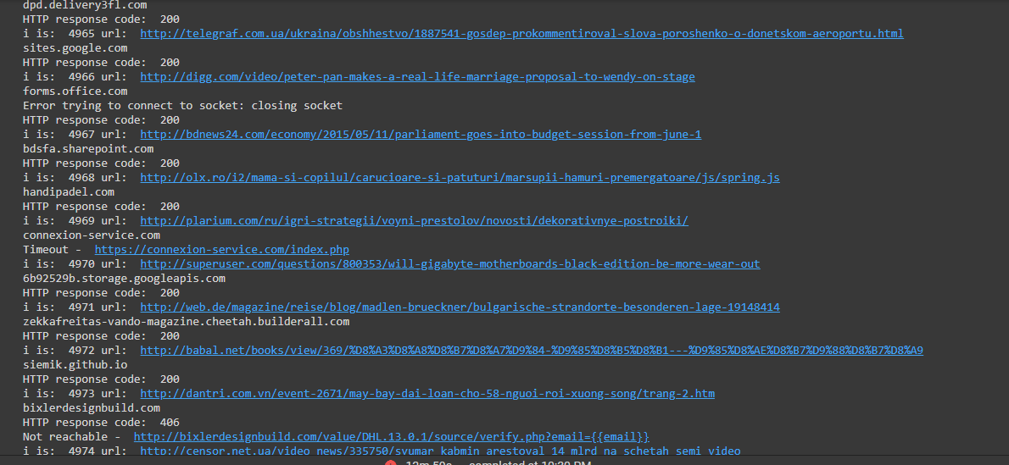
After this we ran this code on two different system
One for legitimate Urls.

Slide 47
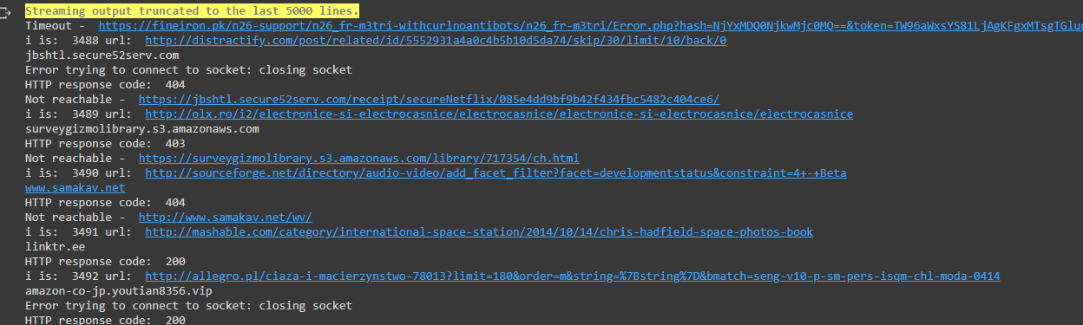
One for Phishing Urls.
This whole feature extraction took around 3-4 hours for each category.

Slide 48
Future Work
After implementing all these algorithms, select the one which has best accuracy.
Refactor the whole project into one neat file.
Choose a platform to deploy the model among GCP, Heroku, Azure, AWS lambda etc.
If the time permits, a small browser extension for the project.
The user just have to input the url and will get the results

Slide 49
Conclusion
Phishing is the most commonly used social engineering and cyber attack
Through such attacks, the phisher targets naïve online users by tricking them into revealing confidential information, with the purpose of using it fraudulently.
In order to avoid getting phished,
users should have awareness of phishing websites.
have a blacklist of phishing websites which requires the knowledge of website being detected as phishing.
detect them in their early appearance, using ML algorithms
We have proposed a model that automatically extracts important features for phishing website detection without requiring any human intervention
This project will help the naïve users to avoid getting tricked by phishing websites.

