Slide 1


Gujarat University School of Emerging Science and Technology CC-311 Operations Research Linear Programming Problem and Its Solution Techniques Topic: Optimizing Delivery Routes For Courier Company Sem 6: AIML and Data Science Yashvi Patel (DS 30) Enrollment No.: 202222600014 Neel Shah (AIML 31) Enrollment No.: 202222700024 Mentor: Prof. Ankush Suthar, Prof. Gautam Chauhan

Slide 2
Introduction
"Optimizing Delivery Routes for Courier Company Using LPP" focuses on improving the planning of deliveries for a courier company.
Courier companies like Maruti Courier or UPS have difficulties in the efficient delivery of packages.
To reduce costs and enhance customer satisfaction, optimizing delivery routes and schedules is essential.

Slide 3
Introduction
This optimization considers various factors such as the distance between locations, package demands and vehicle capacities.
Linear Programming can be a powerful tool to determine the best routes while following these constraints.

Slide 4
Objective
The goal of this project is to minimize delivery costs for a courier company by developing an optimized vehicle routing and scheduling system using Linear Programming. This provides the minimum cost by utilizing the most efficient routes for vehicles. The main goal of this problem is to create the most efficient delivery routes for a group of vehicles so they can deliver goods to multiple locations while traveling the shortest distance. This approach aims to improve overall efficiency, make deliveries faster and use resources effectively.

Slide 5
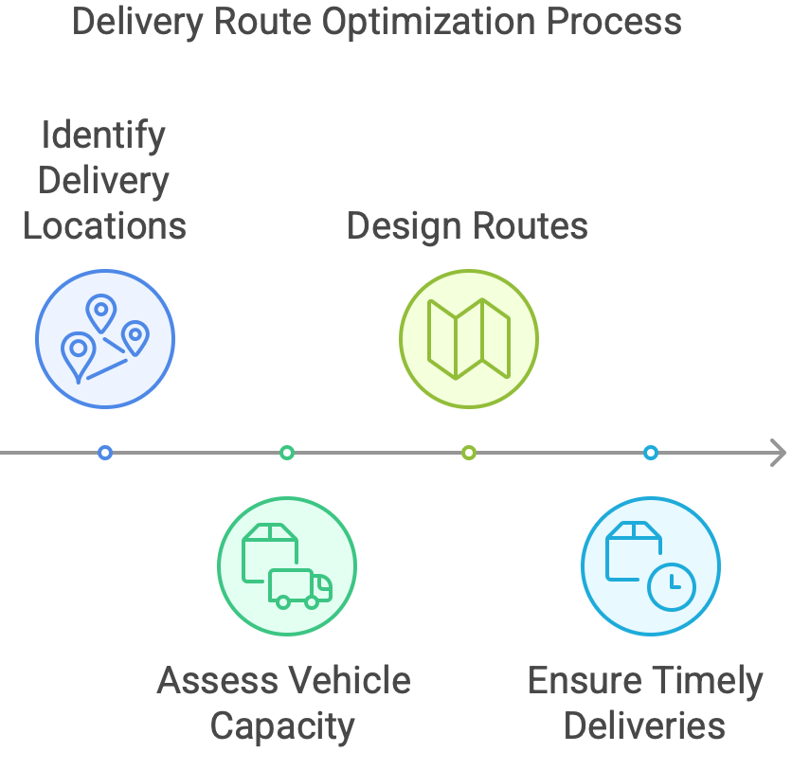
Objective
The optimization ensures that:
All delivery locations are visited.
Vehicle capacity and package demands are respected.
The routes are designed to minimize travel distance while ensuring timely deliveries.

Slide 6
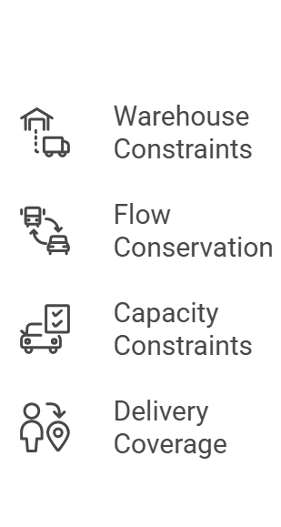
Constraints
1. Warehouse Constraints:
Each vehicle must starts its journey from the warehouse. After completing all deliveries, each vehicle must return to the warehouse.
2. Flow Conservation:
For every delivery location, the number of vehicles arriving and leaving must be same. This ensures smooth routes without any disconnected stops.

Slide 7
Constraints
3. Capacity Constraints:
A vehicle can only carry as many parcels as it has space for. This ensures no vehicle is overloaded.
4. Delivery Coverage:
Every delivery location must be visited once and only once by any vehicle. This ensures all deliveries are completed without missing or repeating any stops.

Slide 8
Literature Review
The problem of optimizing delivery routes has been a critical area of study in logistics and transportation.
Several studies and methodologies have been developed to tackle challenges in courier services, such as minimizing costs, meeting delivery deadlines and addressing real-world constraints like vehicle capacities and traffic conditions.
Here are some significant contributions from the literature:

Slide 9
Literature Review
1. Research by Chandra Sekhar Veluru (2023):
This study introduced a method to improve delivery routes using Generative AI and real-time data.
It applied Generative Adversarial Nets (GANs) to model dynamic delivery alterations and leveraged machine learning for traffic and environment analytics.
The research highlighted how AI can adapt to real-world challenges and make delivery systems smarter and more efficient.

Slide 10
Literature Review
2. Research by S.P. Anbuudayasankar (2019):
This study developed a Mixed-Integer Linear Programming model to address the Vehicle Routing Problem with Simultaneous Delivery and Pick-Up (VRPSDP) and a maximum route length constraint.
The study showed that the travel costs can be considerably reduced using the MILP model with simultaneous delivery and pick-up constraints.
The computational results showed better performance compared to existing methods.

Slide 11
Literature Review
3. Research by Apurv Choudhari (2022):
This study explored the Capacitated Vehicle Routing Problem (CVRP) using Integer Linear Programming (ILP).
• Two approaches were used: cluster-first, route-second and direct formulation with ILP.
• Results demonstrated that ILP provides more accurate and exact solutions compared to heuristic methods like clustering and approximation.

Slide 12
Literature Review
4. Research on Distribution Route Optimization (2022):
This research applied LP with branch and bound method to optimize distribution routes for a washing jeans company.
It minimized travel costs and distances while considering constraints like vehicle capacities and time limits.
Results demonstrated an 11.35% cost reduction, highlighting LP's practical applicability in medium-scale delivery systems.

Slide 13
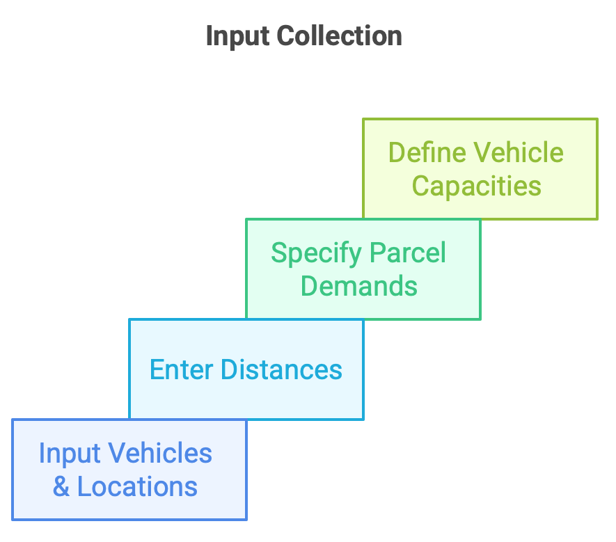
Methodology
Input Data Collection:
Number of Vehicles and Locations:
The user inputs the number of vehicles and delivery locations (excluding the warehouse).
Distances between Locations:
Distances between all pairs of locations (warehouse and delivery points) are entered.

Slide 14
Methodology
Input Data Collection:
Parcel Demands:
Each delivery point has a specific numbers of deliveries which is provided by the user.
Vehicle Capacities:
The capacity of each vehicle is specified by the user.

Slide 15
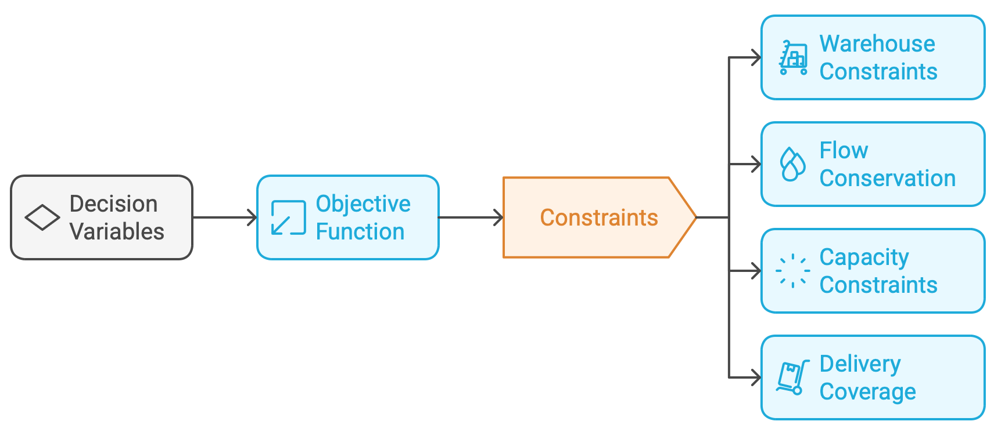
Methodology
Model Formulation:

Slide 16
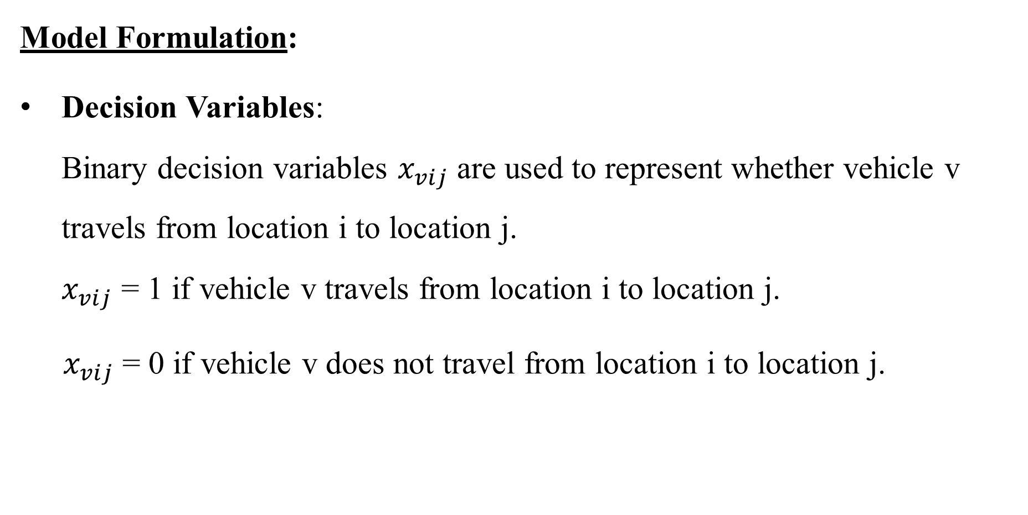
Methodology
Model Formulation:
Decision Variables: Binary decision variables $x_{vij}$ are used to represent whether vehicle v travels from location i to location j. $x_{vij}$ = 1 if vehicle v travels from location i to location j.
${ x}_{vij}$ = 0 if vehicle v does not travel from location i to location j.

Slide 17
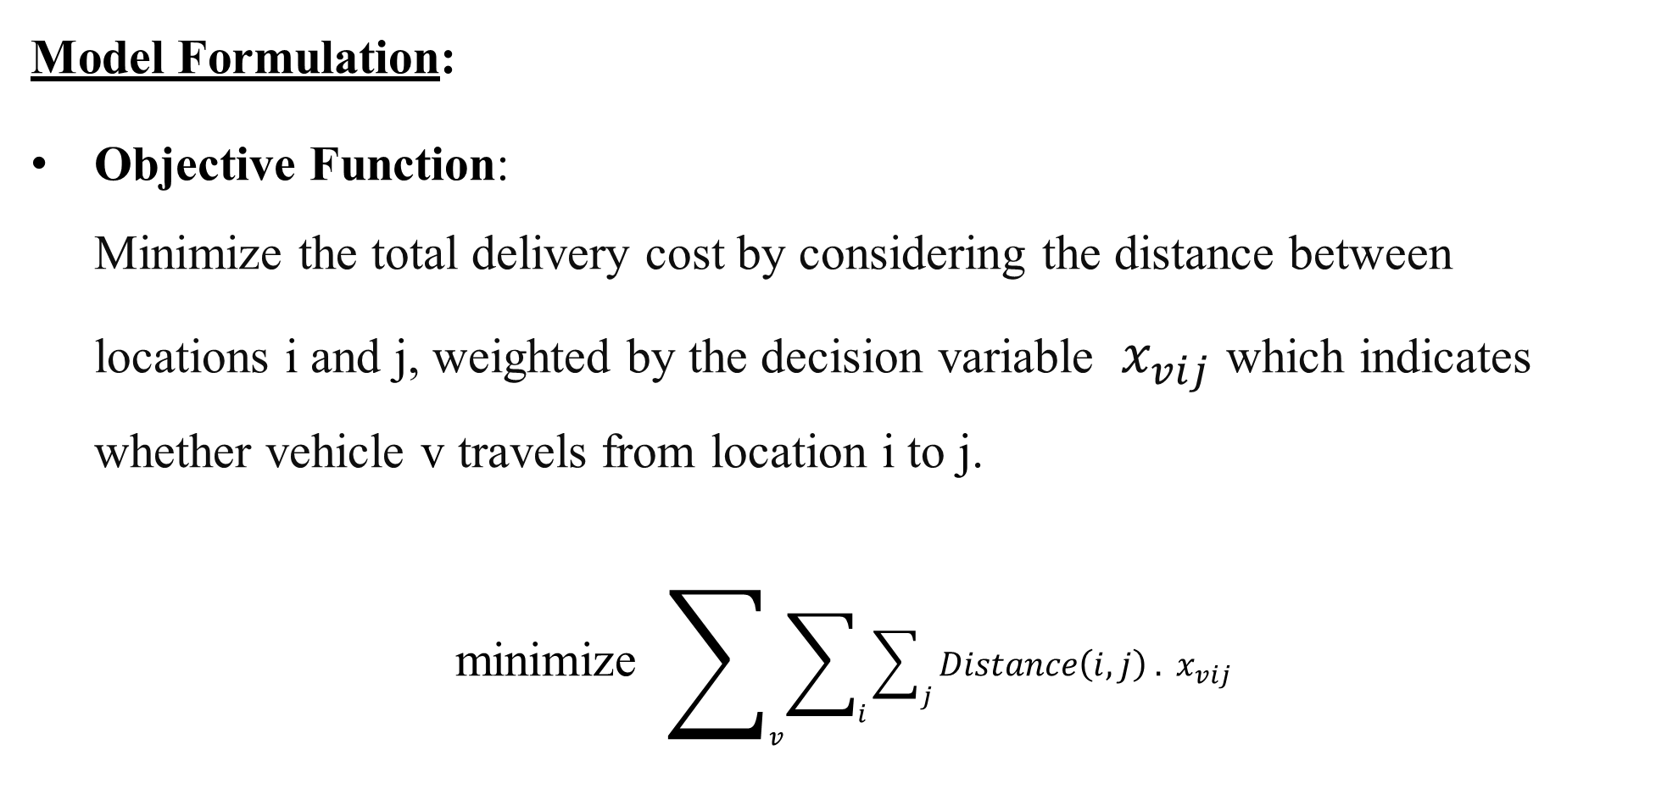
Methodology
Model Formulation:
Objective Function: Minimize the total delivery cost by considering the distance between locations i and j, weighted by the decision variable $x_{vij}$ which indicates whether vehicle v travels from location i to j.
minimize $\sum_{v}{\sum_{i}{\sum_{j}{Distance\left(i,j\right) . x_{vij}}}}$

Slide 18
Methodology
Model Formulation:
Constraints:
Warehouse Constraints: Each vehicle v must start and end its route at the warehouse.
Flow Conservation: The flow of vehicles is balanced, meaning that if a vehicle enters a location i, it must also leave i, ensuring the continuity of delivery routes.

Slide 19
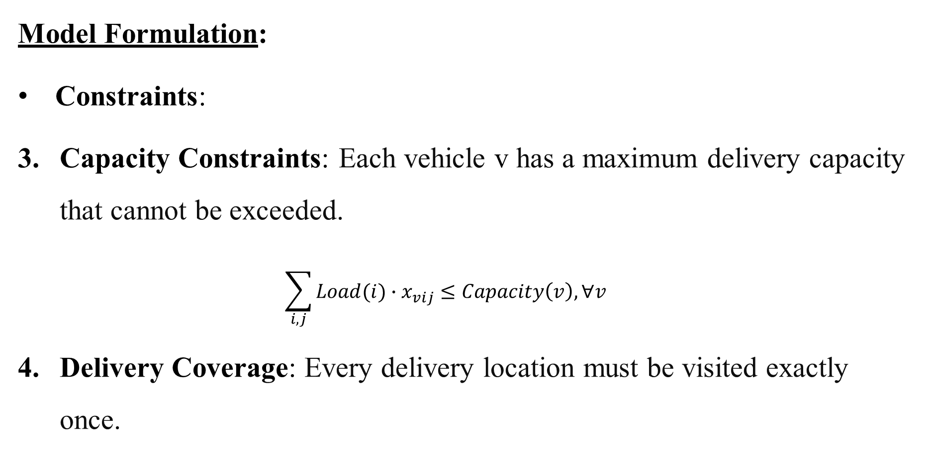
Methodology
Model Formulation:
Constraints:
Capacity Constraints: Each vehicle v has a maximum delivery capacity that cannot be exceeded. $\sum_{i,j}^{ }{Load(i)∙x_{vij}}≤Capacity\left(v\right), ∀v$
Delivery Coverage: Every delivery location must be visited exactly once.

Slide 20
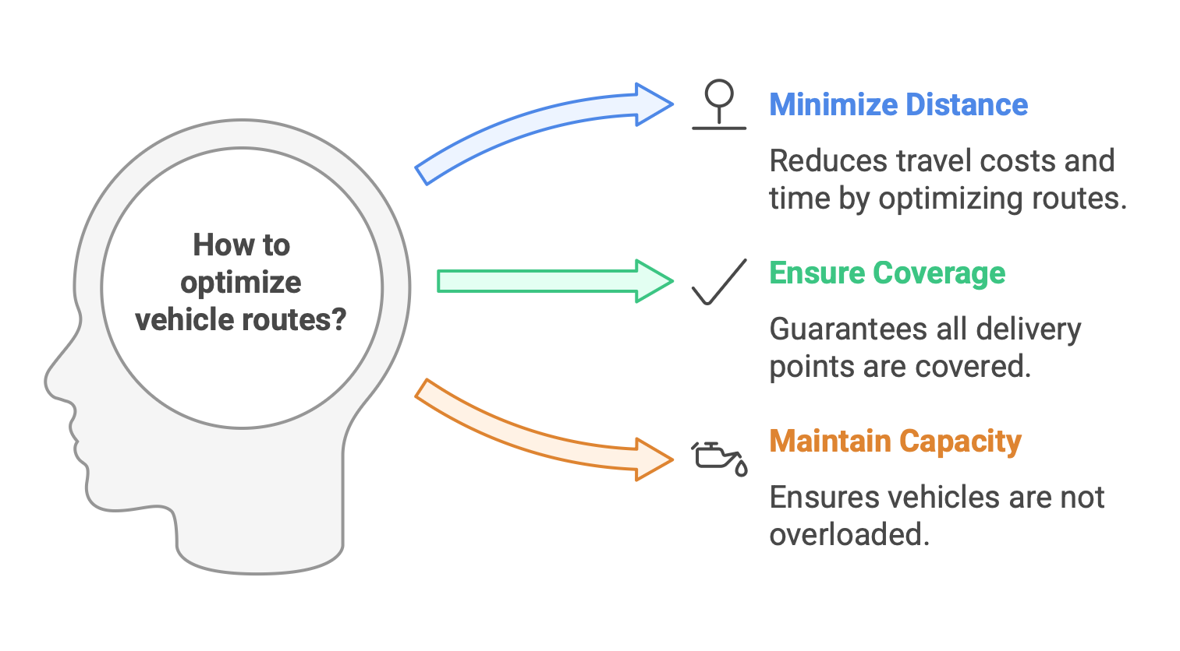
Methodology
Model Formulation:

Slide 21
Methodology
Optimization Process:
• Linear Programming: The problem is formulated as a Linear Programming (LP) model in which the main focus is on minimizing the objective function for all constraints to be satisfied.
• Solver: The PuLP library is used to define and solve the LP model, determining the optimal solution that minimizes total travel distance while satisfying all the constraints.

Slide 22
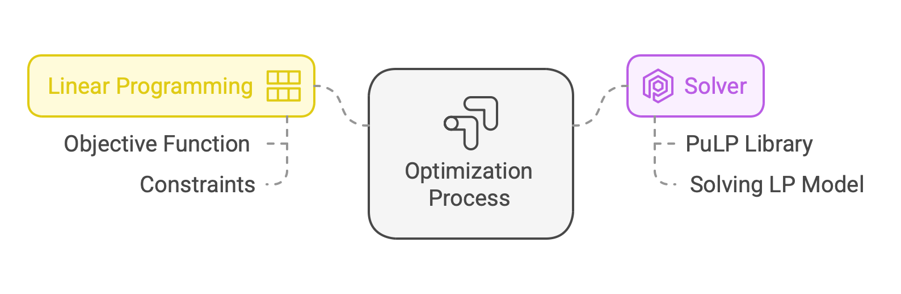
Methodology
Optimization Process:

Slide 23
Methodology
User Interface With Streamlit:
The optimization model is integrated into a simple web application using Streamlit.
User enter details like the number of vehicles, locations, distances and parcel demands.
The system calculates the best delivery routes when the user clicks a button.
The optimal routes and total distance are displayed with an interactive interface.

Slide 24
Methodology
Solution Interpretation:
Optimal Routes:
Once the problem is solved, the routes for each vehicle are extracted based on the values of the decision variables.
Total Cost Calculation:
The total minimum cost is computed from the objective function.

Slide 25
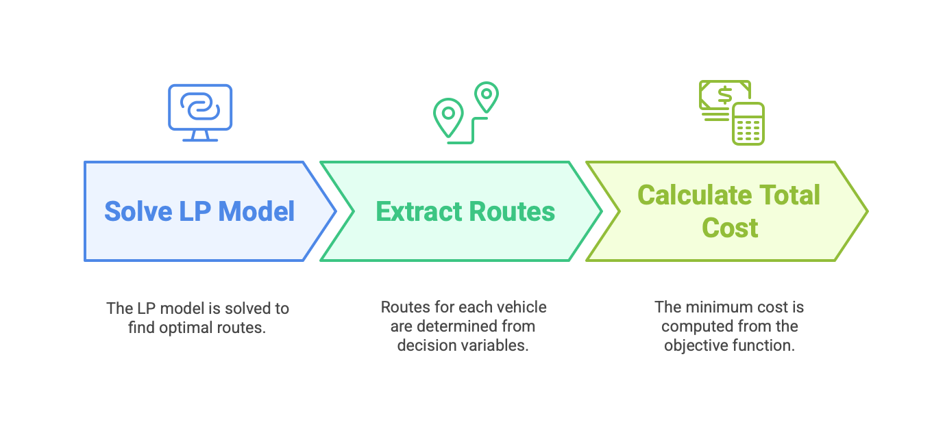
Methodology
Solution Interpretation:

Slide 26
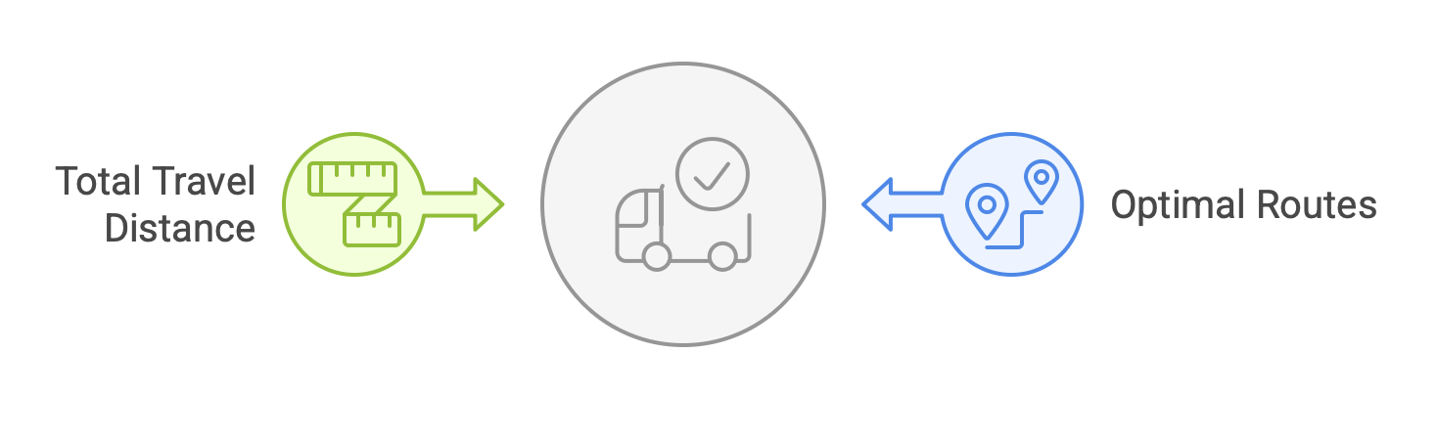
Methodology
Output:
The program displays the optimal routes for each vehicle and the total travel distance, providing a solution that can be directly applied for efficient courier delivery operations.

Slide 27
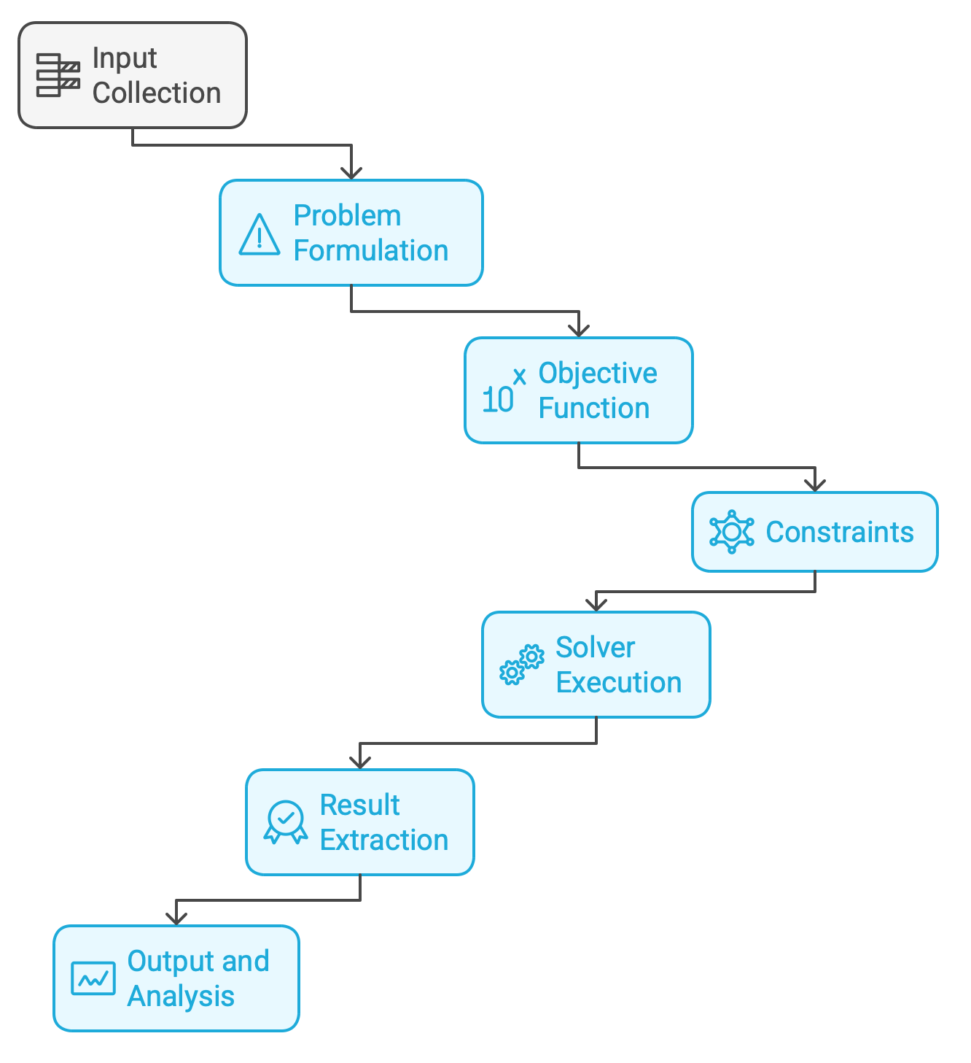
Methodology
Workflow:

Slide 28
Methodology
Code Link:
https://github.com/Neelshah1810/Optimizing-Delivery-Routes-for-Courier-Company-Using-LPP
Live Demo:
https://optimizing-delivery-routes-for-courier-company-using-lpp-cjtq8.streamlit.app

Slide 29
Observation
Effective Route Planning:
The model optimizes the total distance travelled by ensuring all delivery points are covered effectively.
Vehicle Capacity Limitations:
Every vehicle is used within its capacity avoiding overloading and making the best use of vehicles.
Binary Decision Variables:
The model uses binary variables to avoid unnecessary stops.

Slide 30
Observation
Optimal Route Display:
The final output is easily readable and indicates the optimal delivery routes, total travel distance and vehicle assignments.
Scalability & Practical Use:
The model can be adapted for different logistics scenarios, such as courier deliveries, e-commerce shipping and supply chain management.

Slide 31
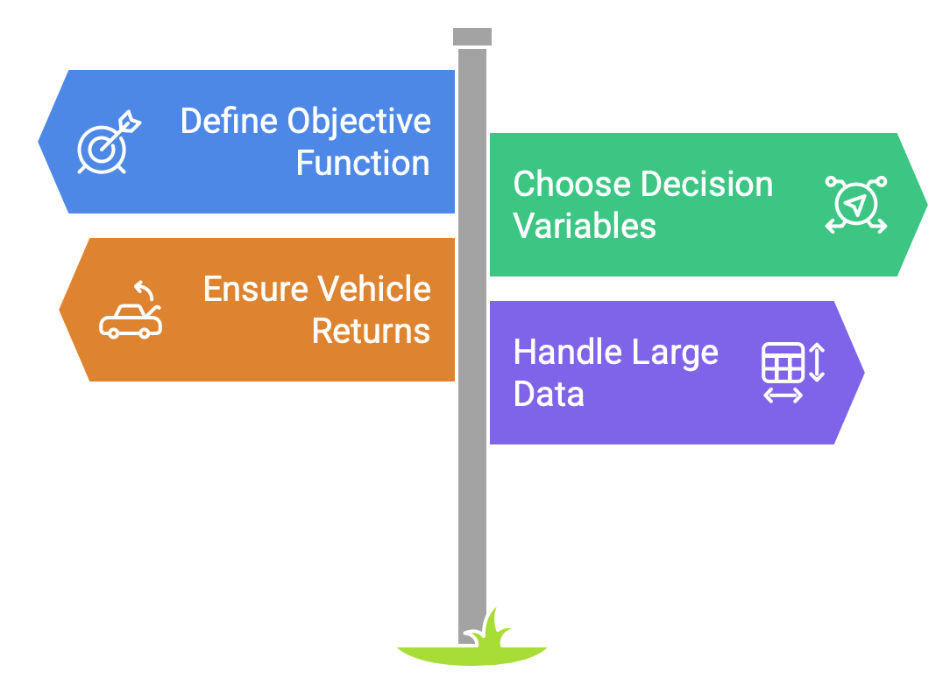
Challenges
Defining Objective Function & Constraints: The solution depends on correctly setting the objective function and constraints; mistakes can lead to incorrect results.
Choosing Decision Variables:
Defining binary decision variables correctly is crucial to getting the optimal route and minimum distance.

Slide 32
Challenges
Ensuring Vehicles Return to Warehouse:
Vehicles must start and end at the warehouse, requiring proper constraints to calculate the total minimum distance.
Handling Large-Scale Data:
As locations and vehicles increase, processing becomes complex, requiring efficient computation to avoid slowdowns.

Slide 33
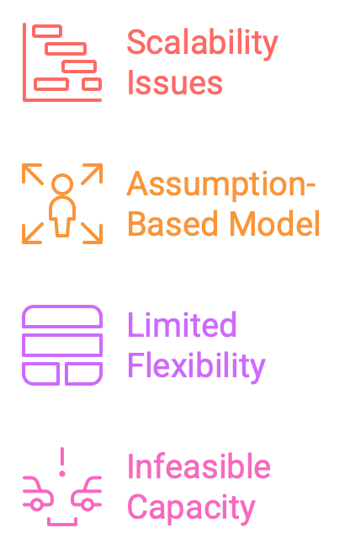
Limitations
Scalability Issues:
As the number of locations and vehicles increases, the computational complexity grows, making it difficult to solve in real-time.
Assumption-Based Model:
The model assumes fixed distances and demands but real-world factors like traffic, weather and delivery delays are not considered.

Slide 34
Limitations
Limited Flexibility:
Any changes in routes, demands or vehicle capacities require re-running the optimization which can be time-consuming.
Infeasible Solution Due to Capacity:
If a vehicle’s capacity is less than the required demand, the model will return an infeasible solution, requiring capacity adjustments.

Slide 35
Conclusion
This project successfully optimizes courier delivery routes using Linear Programming, minimizing total delivery costs while ensuring efficient vehicle utilization. By defining the correct objective function, constraints and decision variables, we achieve the shortest possible route for each vehicle. Although challenges like handling dynamic inputs and managing increasing complexity exist, the model provides a structured approach to improving delivery efficiency. With further enhancements, such as real-time traffic updates and dynamic scheduling, this system can be even more effective in real-world applications.

Slide 36
References
Veluru, C. S. (2023). A Comprehensive Study on Optimizing Delivery Routes Through Generative AI Using Real-Time Traffic and Environmental Data. Journal of Scientific and Engineering Research, 10(10), 168-175.
Anbuudayasankar, S.P., Ganesh, K. & Mohandas, K.(2019). Mixed-Integer Linear Programming for Vehicle Routing Problem with Simultaneous Delivery and Pick-Up with Maximum Route Length. International Journal of Applied Management and Technology, 6(1), 31-52.

Slide 37
References
Choudhari, A., Ekbote, A., & Chaudhuri, P. (2022). Capacitated Vehicle Routing Problem Using Conventional and Approximation Method. Vishwakarma Institute of Technology, 7(10), 850-853.
Rainisa, M. H., Yenny, S., & Santoso. (2019). Determination of Distribution Route Using Linear Programming Model. Proceedings of the International Conference on Industrial Engineering and Operations Management, Volume 173, 253-259.

Slide 38
Thank you

