Slide 1
LPG GAS MANAGEMENT
SYSTEM
Developed Using Visual Basic 6.0 & Microsoft Access
Submitted By Neelkamal Jangde PGDCA - ISBM University
Year 2025 - 2026 PGDCA Final Year

Slide 2
INTRODUCTION
What is this?
A desktop-based application to manage LPG gas distribution operations efficiently.
Technology Used
Front-end: Visual Basic 6.0 | Back-end: Microsoft Access 2019
Purpose
To replace manual paper-based records with a fast, accurate computerized system.
Developer
Neelkamal Jangde | PGDCA Final Year | ISBM University | 2025-26

Slide 3
OBJECTIVES OF THE PROJECT
1
User-friendly desktop application for LPG management
5
Efficient stock management for cylinder types
2
Centralized database of all customer registrations
6
Secure login system for access control
3
Automated gas booking with real-time status tracking
7
Quick Search, Update and Delete of records
4
Accurate bill generation with payment tracking
8
Professional Dashboard for easy navigation

Slide 4
SYSTEM REQUIREMENTS
HARDWARE REQUIREMENTS
SOFTWARE REQUIREMENTS
Processor
Intel Pentium 4 or higher
Language
Visual Basic 6.0
RAM
Minimum 512 MB
Database
Microsoft Access
Hard Disk
500 MB free space
Connectivity
ADO + OLEDB
Monitor
800x600 resolution
Provider
ACE OLEDB 12.0
OS
Windows XP/7/10/11
OS Support
Windows Platform

Slide 5
DATABASE DESIGN
tblCustomer
tblBooking
CustomerID (PK)
BookingID (PK)
CustomerName
CustomerID (FK)
Address
BookingDate
PhoneNumber
CylinderType
ConnectionType
Quantity
ConnectionDate
Status
tblBill
tblStock
BillID (PK)
StockID (PK)
CustomerID (FK)
CylinderType
BookingID (FK)
TotalStock
BillDate
AvailableStock
Amount
LastUpdated
PaymentStatus

Slide 6
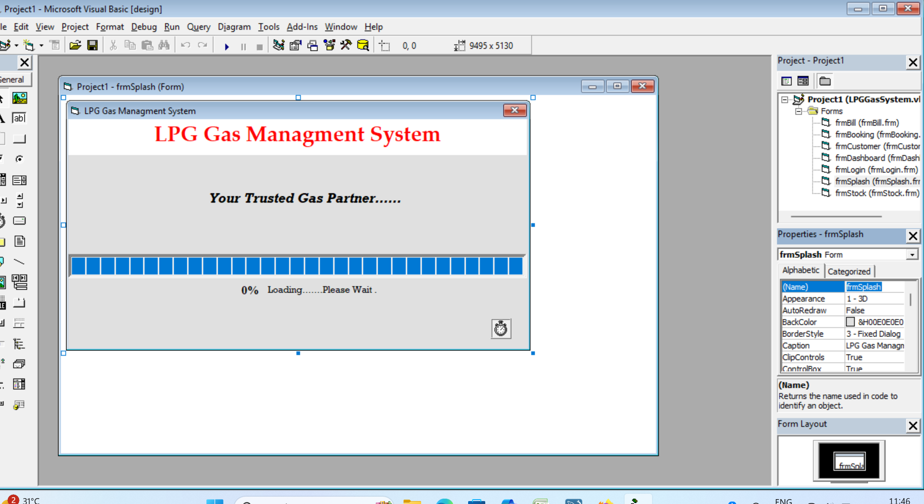
SPLASH SCREEN
KEY FEATURES
✔ Animated Progress Bar
✔ Loading Percentage Display
✔ Auto-transition to Login Form
✔ Professional Title Display

Slide 7
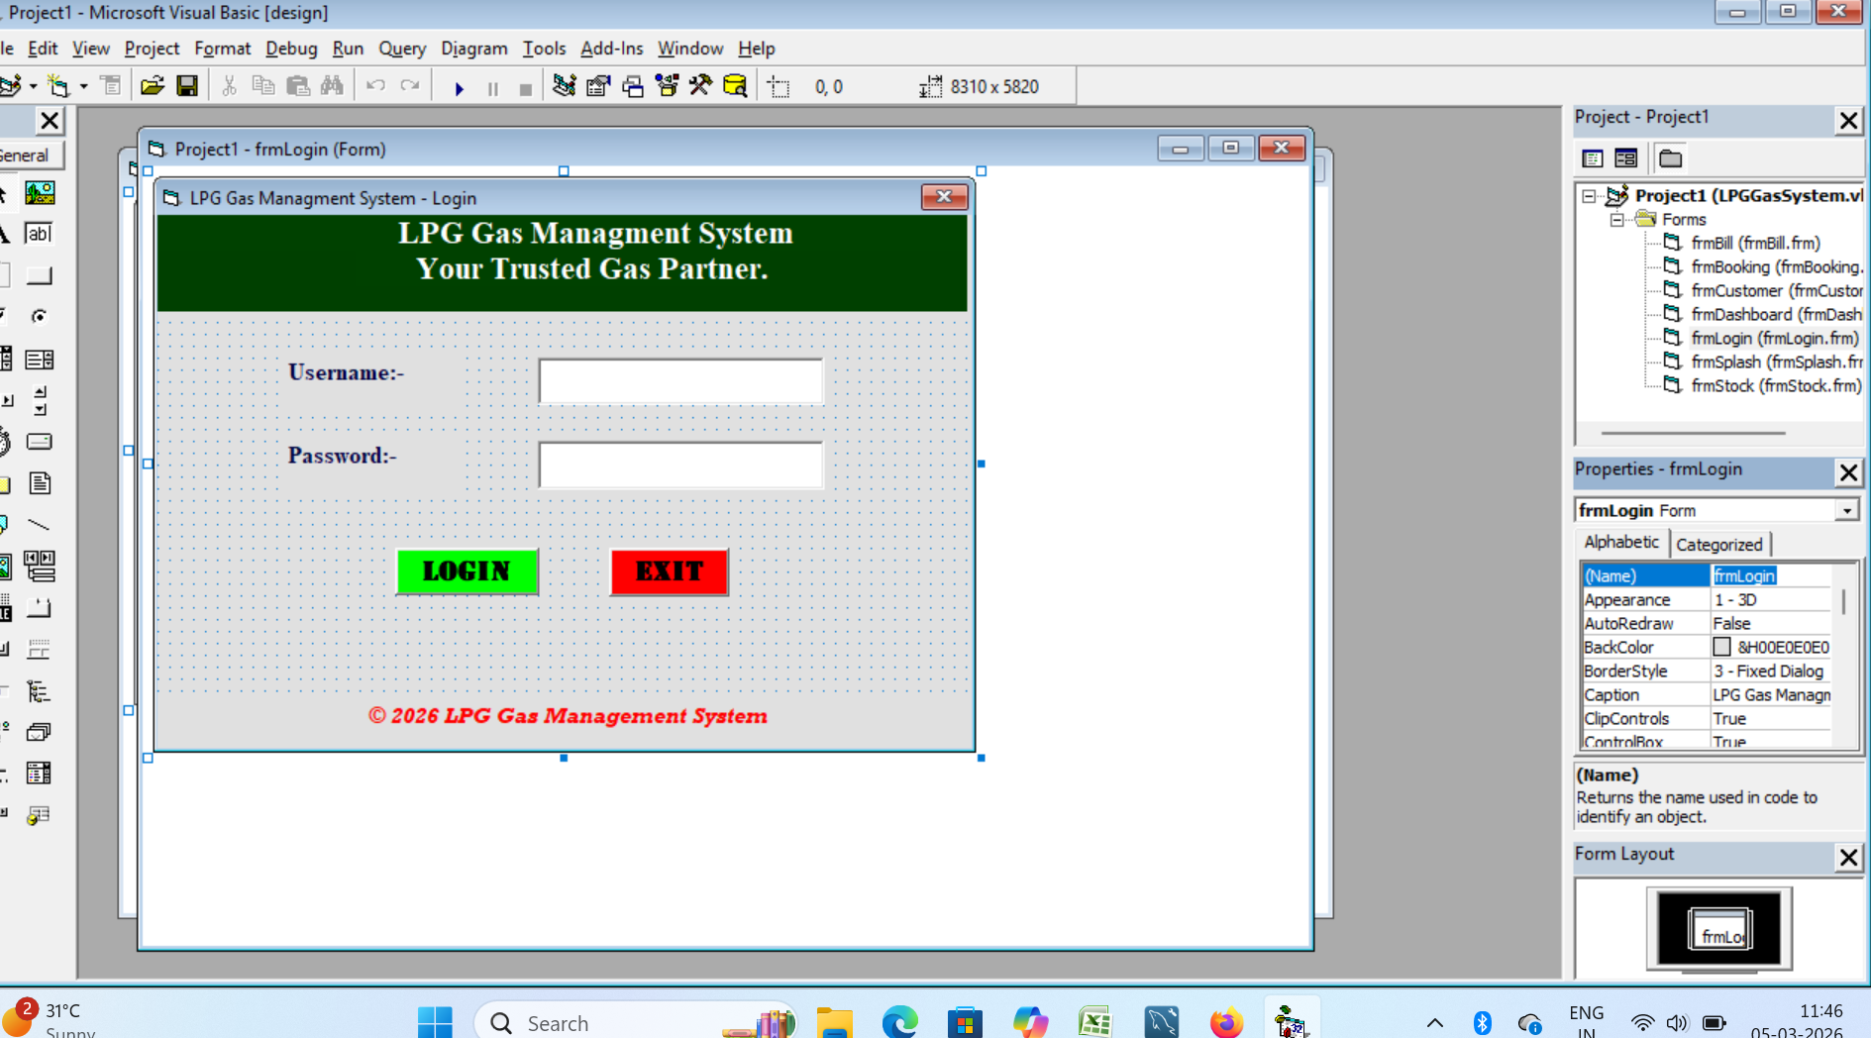
LOGIN FORM
KEY FEATURES
✔ Secure Username & Password
✔ Green LOGIN Button
✔ Red EXIT Button
✔ Error on Wrong Credentials

Slide 8
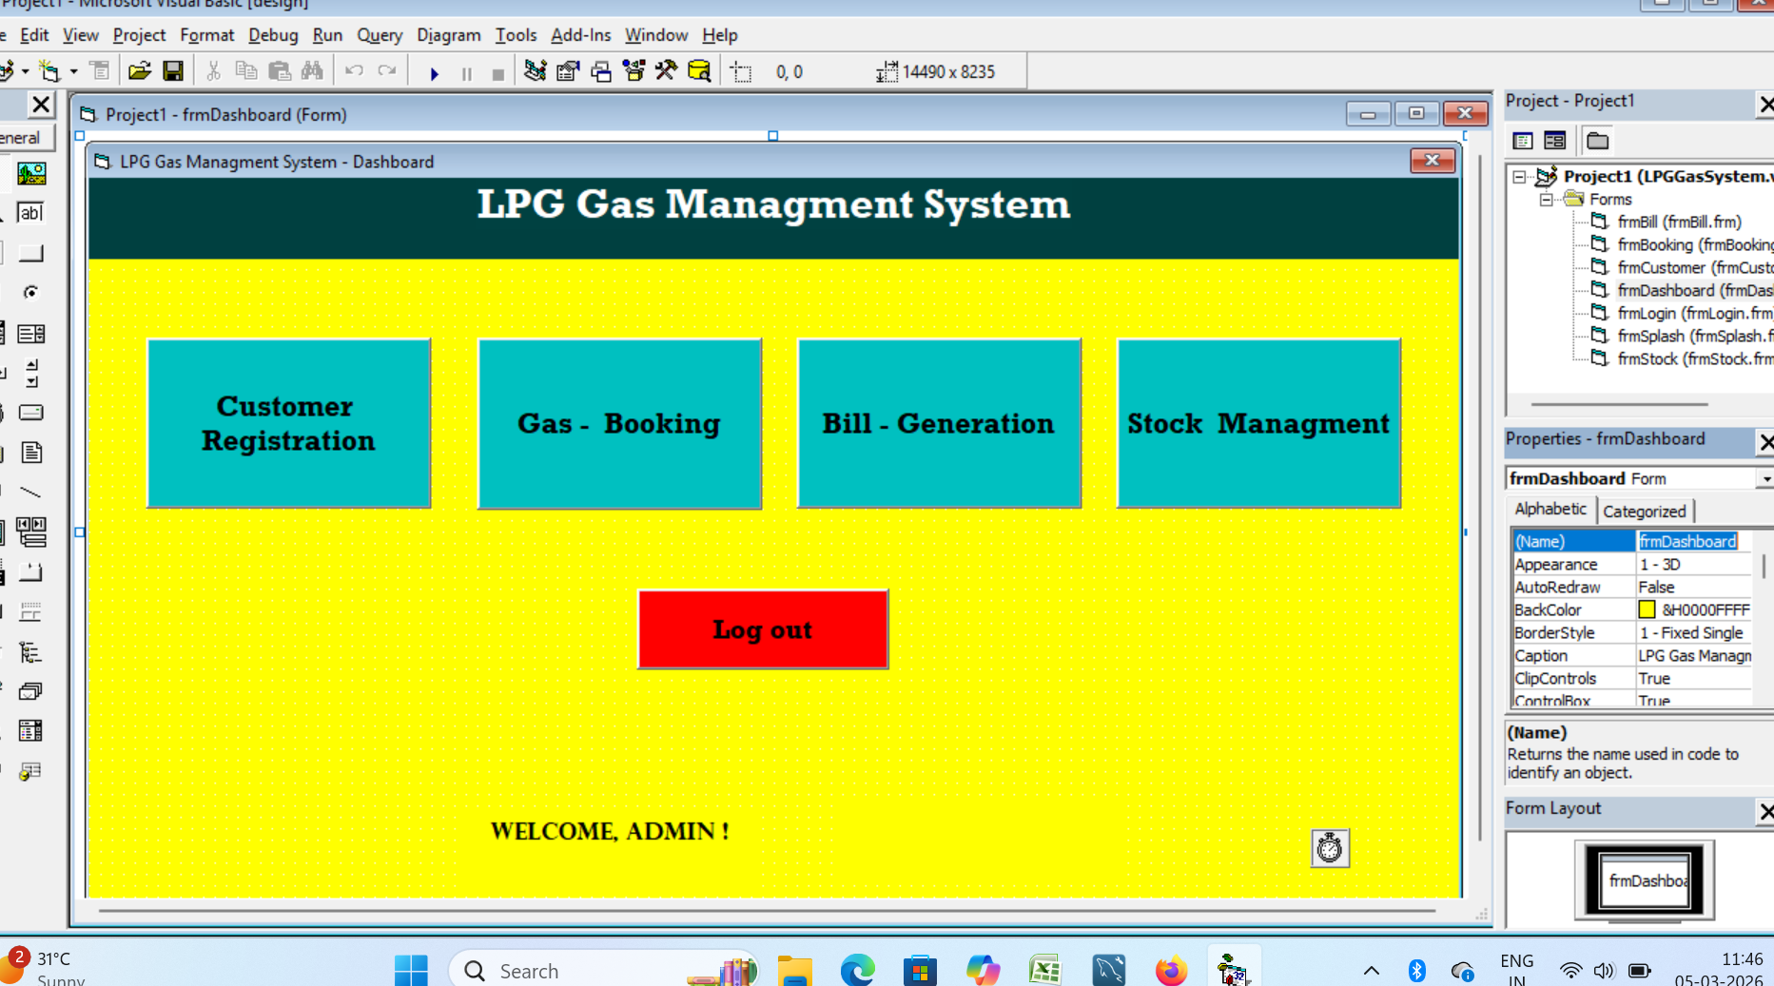
DASHBOARD
KEY FEATURES
✔ 4 Module Navigation Buttons
✔ Real-time Clock & Date
✔ Welcome Admin Message
✔ Logout Button

Slide 9
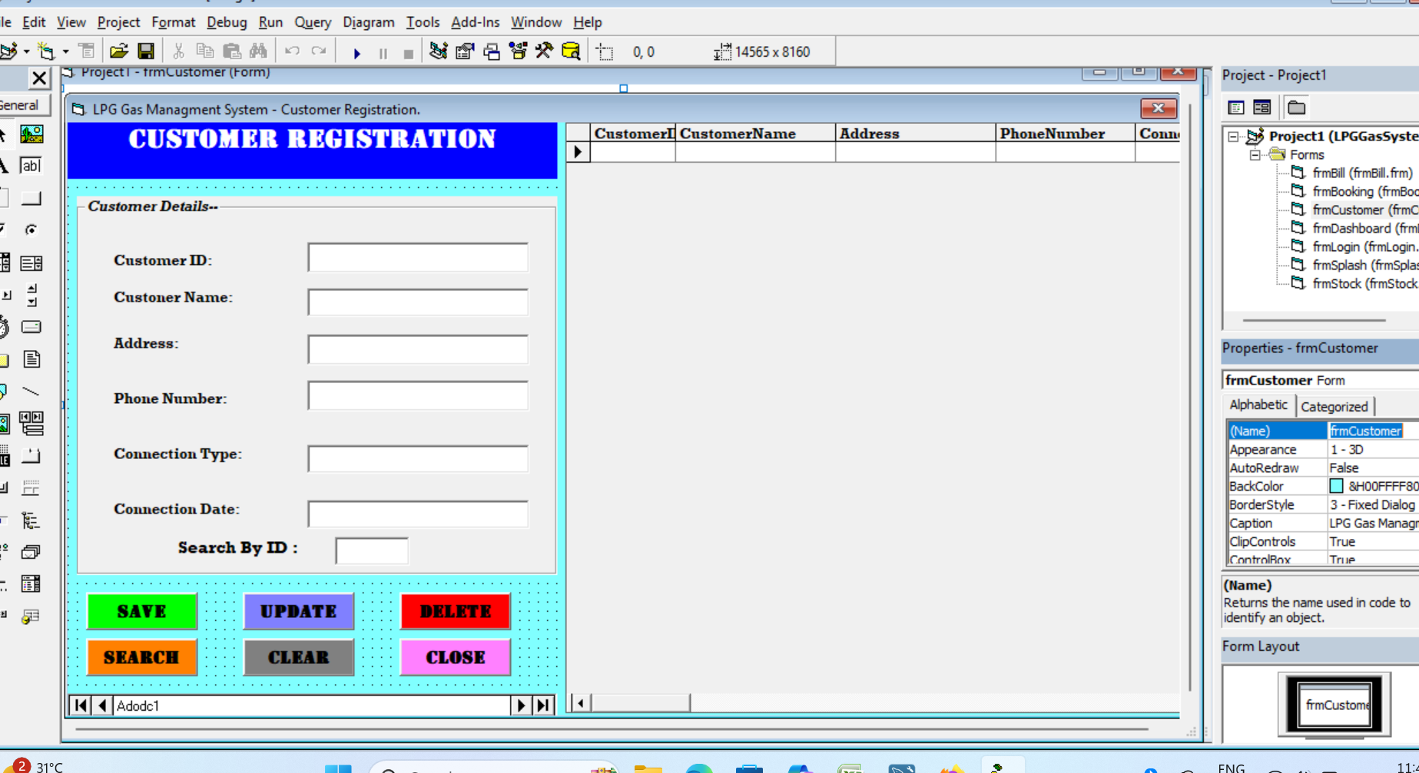
CUSTOMER REGISTRATION
KEY FEATURES
✔ Full CRUD Operations
✔ DataGrid Live Display
✔ Search By ID Feature
✔ 6 Action Buttons

Slide 10
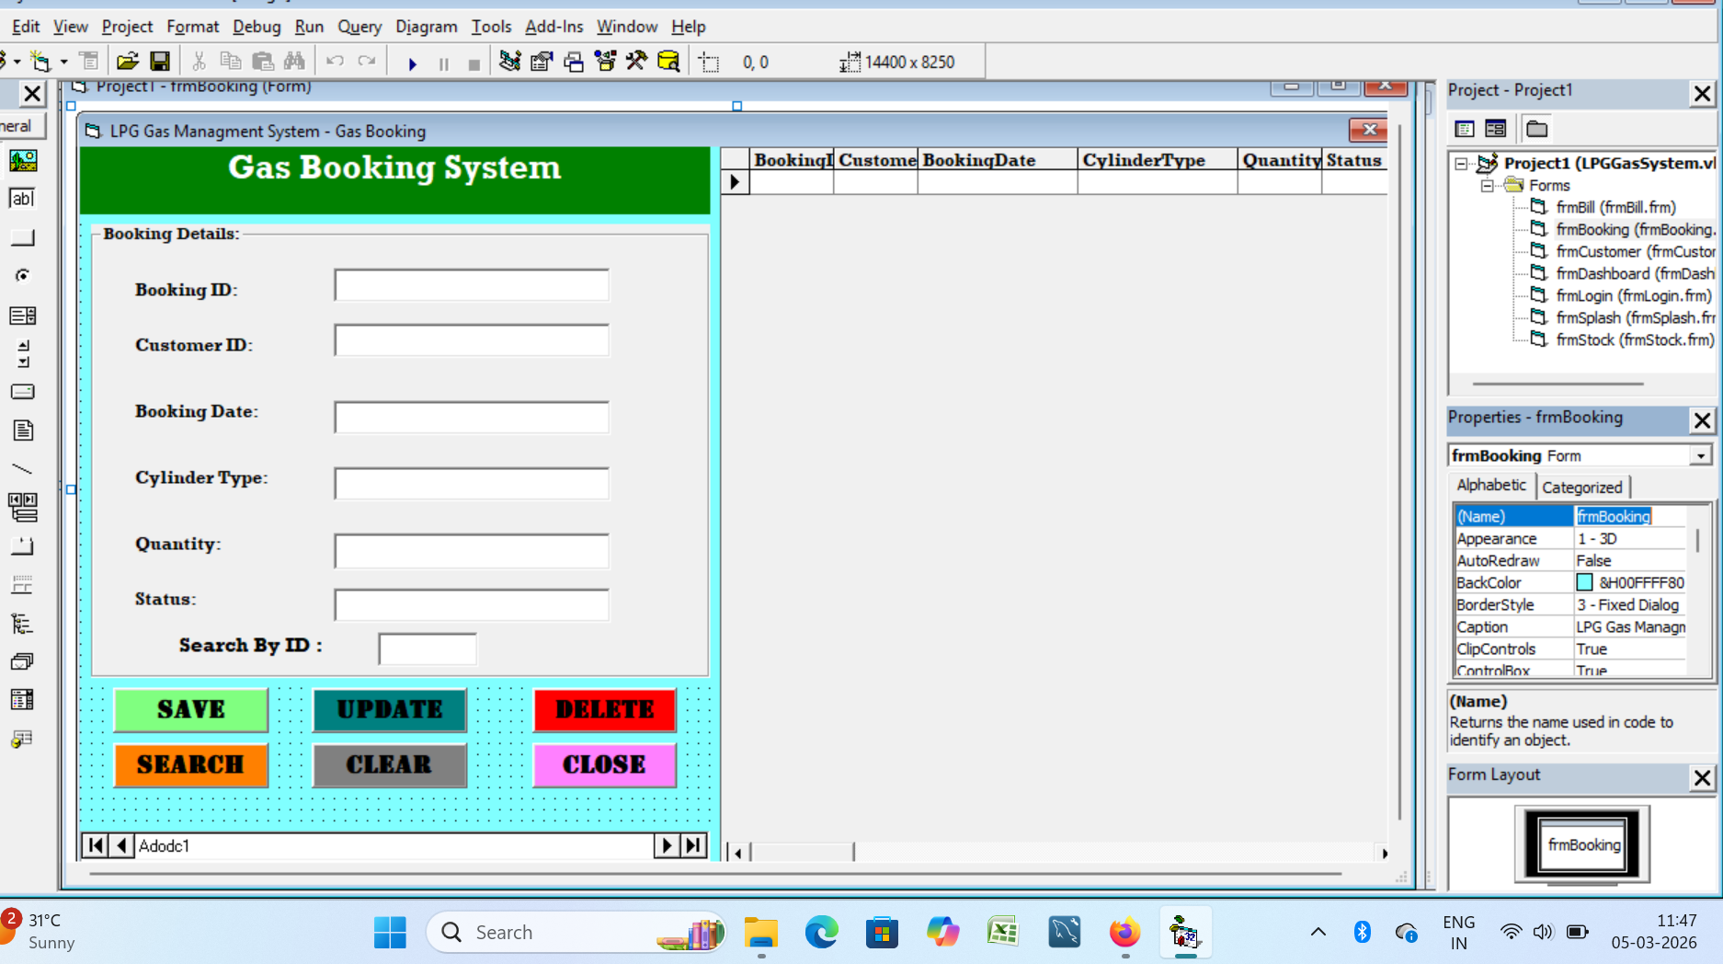
GAS BOOKING SYSTEM
KEY FEATURES
✔ Auto Booking Date
✔ Cylinder Type Selection
✔ Status Tracking
✔ Customer ID Validation

Slide 11
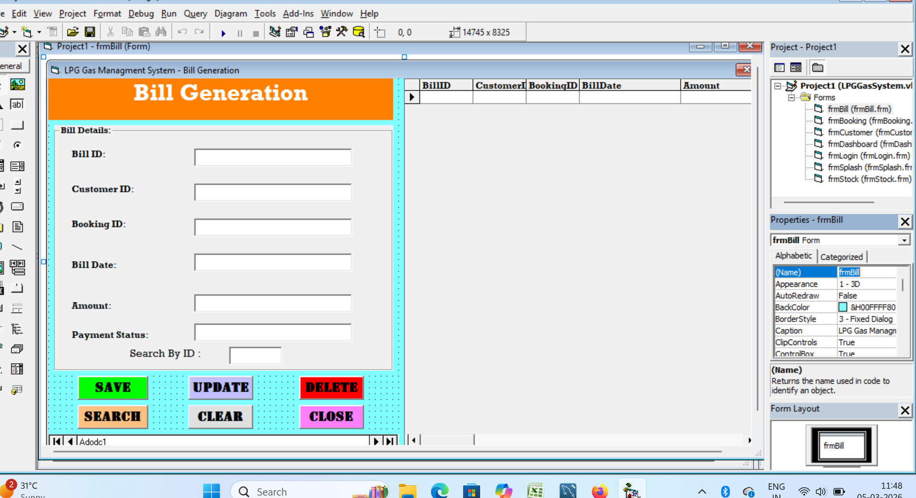
BILL GENERATION
KEY FEATURES
✔ Auto Bill Date
✔ Amount Entry
✔ Payment Status Tracking
✔ Links to Booking Records

Slide 12
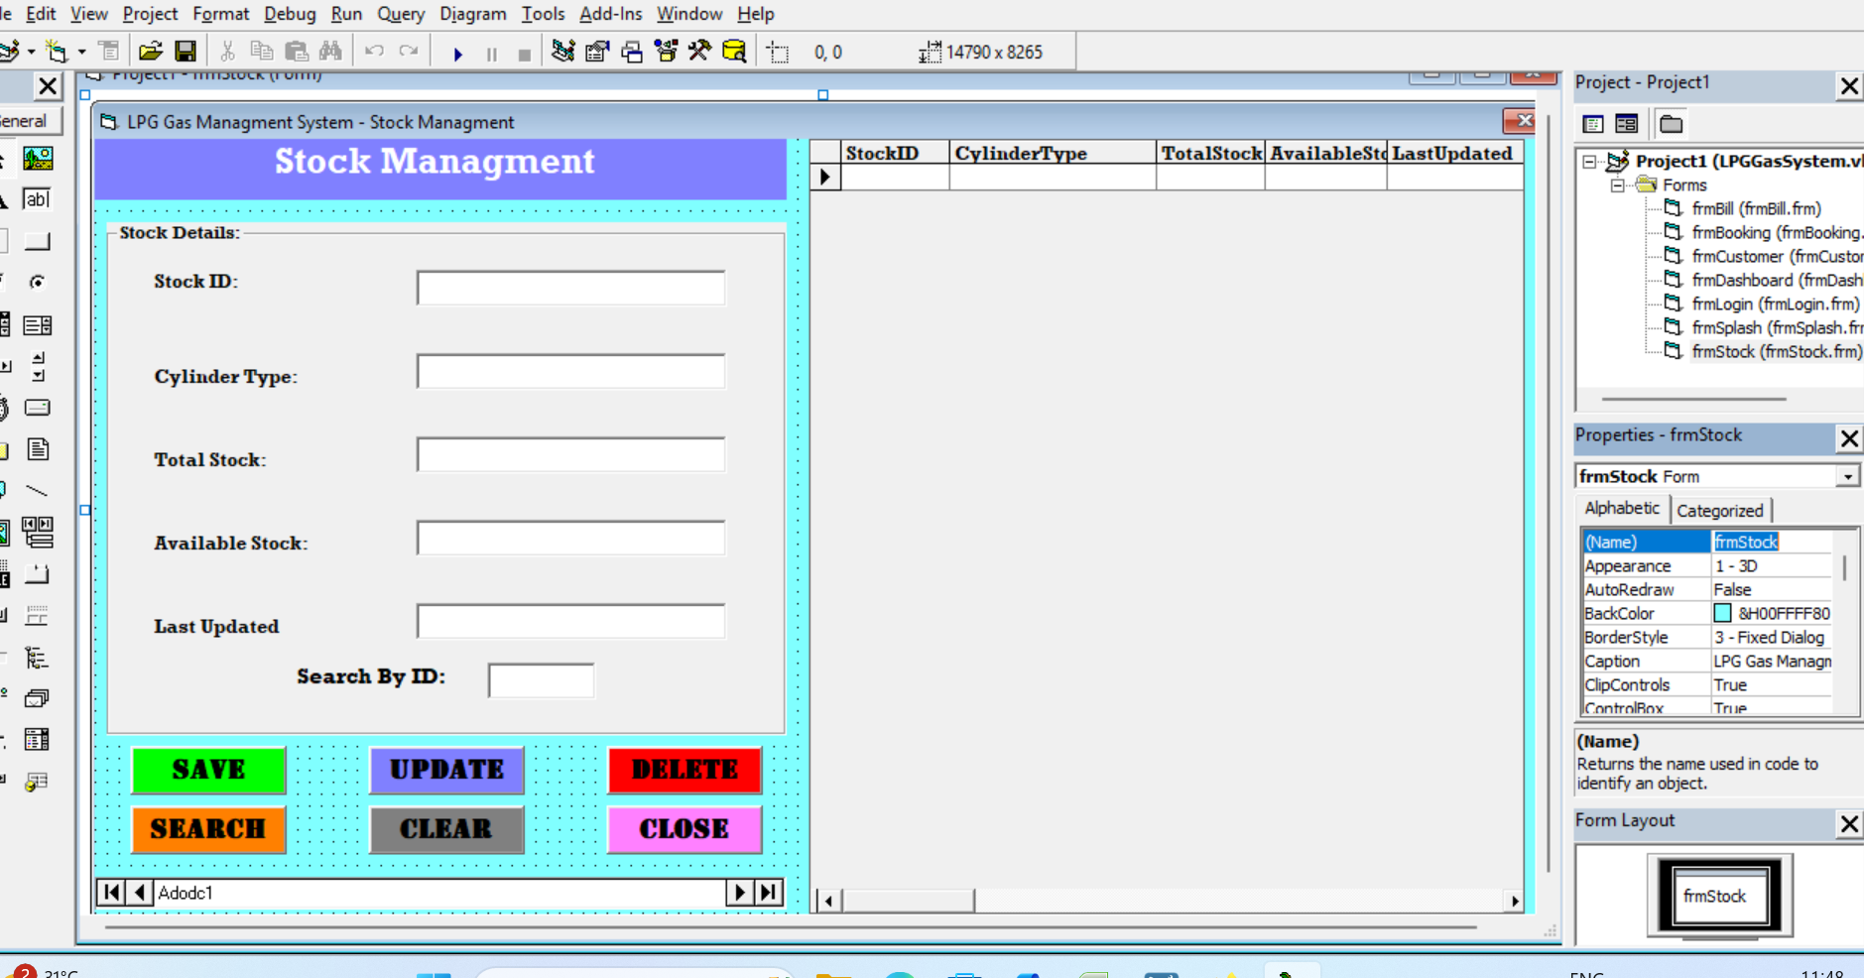
STOCK MANAGEMENT
KEY FEATURES
✔ Multiple Cylinder Types
✔ Total & Available Stock
✔ Auto Date Update
✔ Real-time DataGrid

Slide 13
CRUD OPERATIONS
CREATE (Save)
READ (Search)
C
• Fill all required fields
R
• Enter ID in Search By ID
• Click SAVE button
• Click SEARCH button
• Record saved to database
• Record loads in all fields
• DataGrid auto refreshes
• Not Found if invalid ID
UPDATE
DELETE
U
• First Search the record
D
• First Search the record
• Modify required fields
• Click DELETE button
• Click UPDATE button
• Confirmation dialog shown
• Changes saved to database
• Record deleted on Yes

Slide 14
CONCLUSION
✅ All 4 modules working perfectly with full CRUD operations
✅ Secure login system implemented successfully
✅ Real-time DataGrid showing live database records
✅ 100% test cases passed in all modules
✅ Project ready for real-world LPG agency deployment
Thank You! 🙏

