Slide 1



Sales_Data
View in Power BI
Last data refresh:
5/15/2023 10:32:09 AM UTC
Downloaded at:
5/15/2023 11:27:30 AM UTC

Slide 2
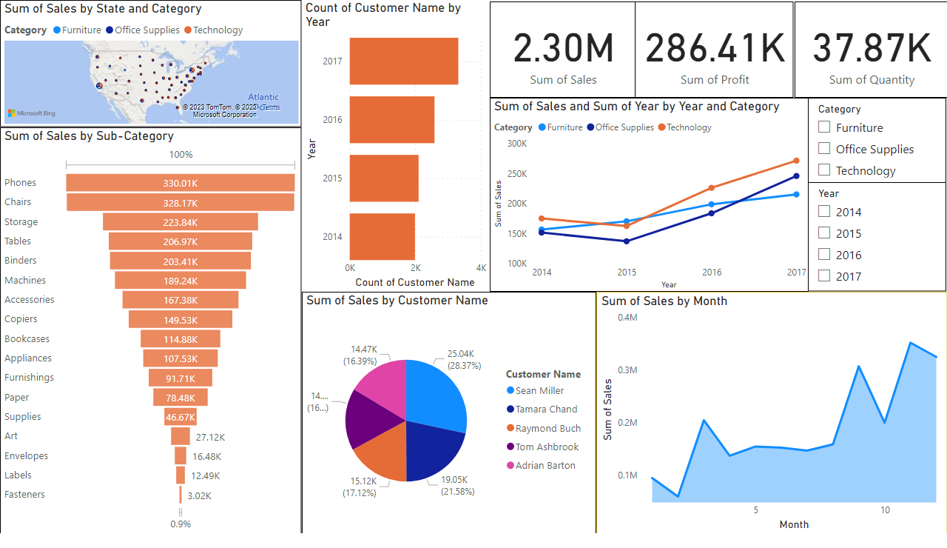
Sales_Dashboard
Notes:
funnel
No alt text provided
pieChart
No alt text provided
areaChart
No alt text provided
lineChart
No alt text provided
slicer
No alt text provided
slicer
No alt text provided
card
No alt text provided
card
No alt text provided
card
No alt text provided
map
No alt text provided
barChart
No alt text provided

