Slide 1
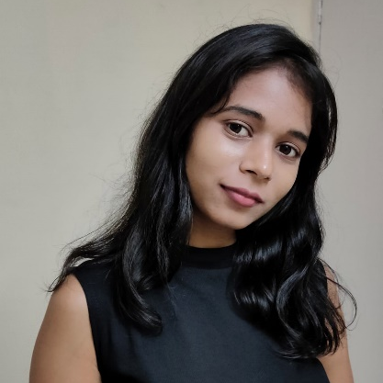


NEELIMA KHERDE
Analyst/Software Engineer
Bachelor of Engineering, Computer Science and Engineering : 2015-2019
Skills
C# | Basics, OOPS, Exception Handling ,Arrays ,Collection and Generics, Delegates and Events, File Io and Serialization.
.NET Framework | Architecture which includes CTS,CLS,FCL,BCL and CLR.
Ado.net | Basics Architecture
Angular | Components, Routing, Services, Forms
Database | Basic SQL
Tools | GIT
UI Technology | HTML and CSS
Mumbai
neelima.a.neelima@capgemini.com
+918965025188
A4
Full Stack Developer
Understanding of RDMS concepts using SQL Server
Practical understanding of C# and SQL concepts using Visual Studio and SQL Server
Hands on experience in developing applications using .NET Framework, ADO.NET and SQL Server.
Understanding of HTML and CSS
Angular
Currently completing the course on Azure AZ-900 fundamentals
Created a flight Booking System with MySQL Backend and Web API as middleware and Angular as frontend used HTML, CSS, Bootstrap and Typescript for designing.
My GitHub
My project - Flight Booking System

