Slide 1

Rockey housekeeping
Clear ownership for cleaning work
Housekeepers execute their assigned tasks
Managers and admins supervise readiness
ROCKEY / 1 minute / 1 of 7
Notes:
Explain the problem: assigning work is different from proving a room ready. Scope is User, Room, Task and Inspection. No bookings, payments or Analytics. Source: docs/CAPSTONE_SUBMISSION.md.
Timing: 1 minute.
Baseline main aa8d2b9c7e2ee43b20b88fc895a613f12d18c8e7 with uncommitted required-completion changes. No publication or submission readiness claim.

Slide 2
The local application
React and Vite provide six routes
Spring Security authenticates and checks roles
Services coordinate JPA and MySQL transactions
ROCKEY / 45 seconds / 2 of 7
Notes:
Explain Browser -> React API client -> Spring Security -> Controller -> Service -> Repository -> MySQL. Local source is implemented. Proposed HTTPS same-origin hosting is prepared, not deployed. Source: docs/REQUIRED_COMPLETION.md and docs/BACKEND_GUIDE.md.
Timing: 45 seconds.
Baseline main aa8d2b9c7e2ee43b20b88fc895a613f12d18c8e7 with uncommitted required-completion changes. No publication or submission readiness claim.

Slide 3
Four entities and retained history
User owns assigned cleaning tasks
Task links a worker and a room
Inspection records task, room and supervisor
Cancellation and deactivation retain rows
ROCKEY / 45 seconds / 3 of 7
Notes:
Refer to the four-table ERD and five required foreign keys. PASS makes READY; FAIL makes DIRTY. A new task preserves earlier cycles. Source: database/schema.sql and docs/CAPSTONE_SUBMISSION.md.
Timing: 45 seconds.
Baseline main aa8d2b9c7e2ee43b20b88fc895a613f12d18c8e7 with uncommitted required-completion changes. No publication or submission readiness claim.

Slide 4
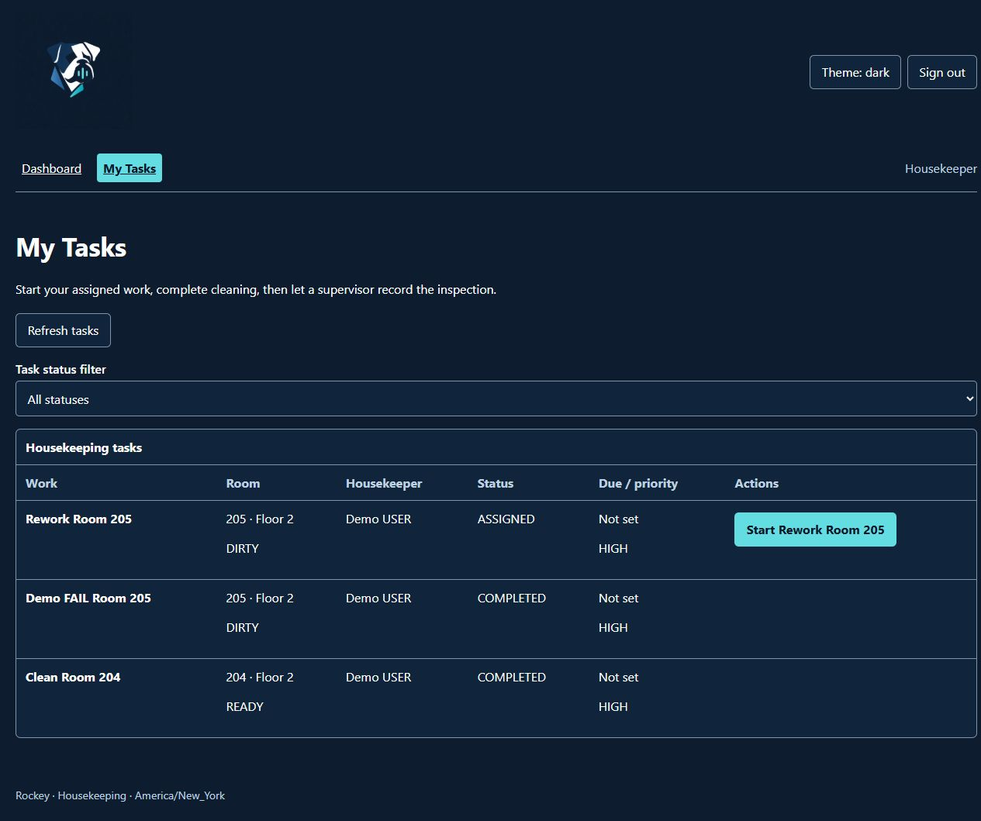
Prepared cleaning and inspection demo
Room 204 shows completed work and READY
Room 205 retains FAIL and assigned rework
Use existing authorized views
Execute rework only with fixture approval
Screenshot captured October 11, before pagination. Current lists add Previous/Next page controls and a record count.
ROCKEY / 3 minutes / 4 of 7
Notes:
Screenshot is historical October 11 evidence, inspected October 12. Do not call it a fresh recording. Current read-only walkthrough: sign in privately as housekeeper, show completed/assigned tasks; switch privately to manager for history if available. Do not display credentials, hashes, tokens, .env or network responses. Mutations need separate fixture approval. Source: docs/LOCAL_DEMO_WALKTHROUGH.md; image target/frontend-demo-completed.png.
Timing: 3 minutes.
Baseline main aa8d2b9c7e2ee43b20b88fc895a613f12d18c8e7 with uncommitted required-completion changes. No publication or submission readiness claim.

Slide 5
History and one rejected action
Show the retained inspection record
Explain why a supervisor inspects
Housekeeper access to Rooms is denied
ROCKEY / 1 minute / 5 of 7
Notes:
Use manager history read-only if private access is available. Otherwise use documented verified example and disclose the fallback. Demonstrate a USER navigating to /rooms: Access denied; this was observed in the prior closeout. No destructive action needed. Source: docs/LOCAL_DEMO_WALKTHROUGH.md and docs/SECURITY_AND_QUALITY.md.
Timing: 1 minute.
Baseline main aa8d2b9c7e2ee43b20b88fc895a613f12d18c8e7 with uncommitted required-completion changes. No publication or submission readiness claim.

Slide 6
Transactions, ownership and pagination
Service transactions keep workflow changes together
Ordered locks protect competing writes
Page rows and totals share authorization
Dashboard reads all scoped pages for counts
ROCKEY / 1.5 minutes / 6 of 7
Notes:
Explain User -> Room -> Task lock ordering and separate login/logout account locking. Page defaults: 0 and 20, max size 100, fixed ordering with id tie-breaks. Dashboard never estimates from one page; it rejects changing totals/duplicates. Multi-request reads are not an atomic database snapshot. Offline verification is distinct from the 21 skipped live entries. Source: service classes, dto/PageResponse.java, frontend/src/services/housekeepingService.js.
Timing: 1.5 minutes.
Baseline main aa8d2b9c7e2ee43b20b88fc895a613f12d18c8e7 with uncommitted required-completion changes. No publication or submission readiness claim.

Slide 7
Lessons and required completion
Keep scope small and evidence precise
AWS is the only waiver
Sonar and Jenkins require authorized services
Deployment, protection and external artifacts remain
ROCKEY / 1 minute / 7 of 7
Notes:
Close honestly: locally implemented pagination, guarded seed and pipeline/deployment configuration do not prove executed MySQL seed, Sonar quality gate, Jenkins success or deployed end-to-end behavior. No current hosting URLs exist. Genuine peer reviews, Jira, self-assessment, Canvas and private access remain user-owned. Source: docs/REQUIRED_COMPLETION.md.
Timing: 1 minute.
Baseline main aa8d2b9c7e2ee43b20b88fc895a613f12d18c8e7 with uncommitted required-completion changes. No publication or submission readiness claim.

