Slide 1
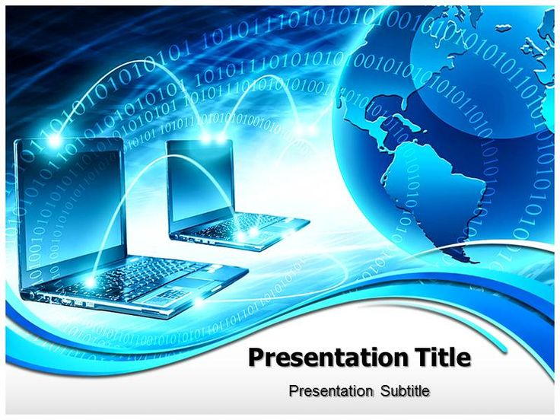
computer

Slide 2
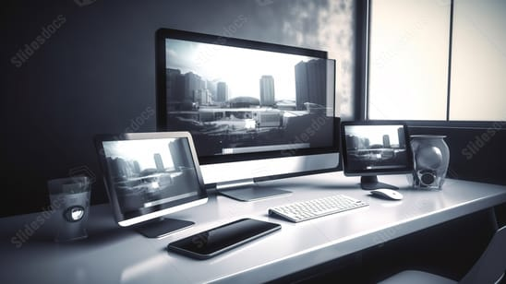
What is a computer
A computer is a programmable device that stores, retrieves, and processes data. The term "computer" was originally given to humans (human computers) who performed numerical calculations using mechanical calculators, such as the abacus and slide rule. The term was later given to mechanical devices as they began replacing human computers. Today's computers are electronic devices that accept data (input), process that data, produce output, and store (storage) the results (IPOS).

Slide 3
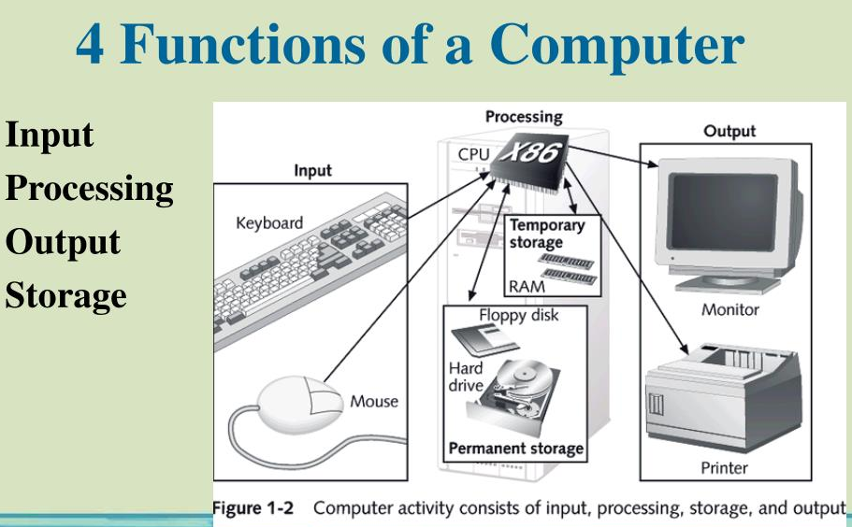
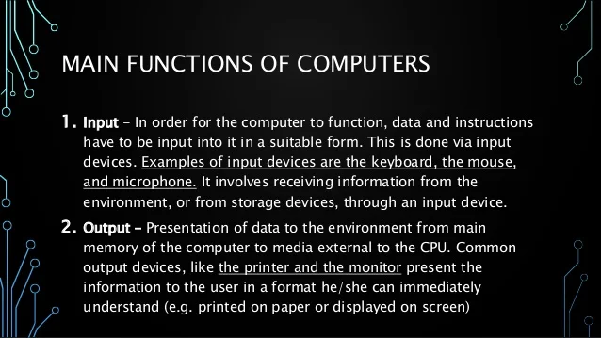

Functionalities of a computer

Slide 4
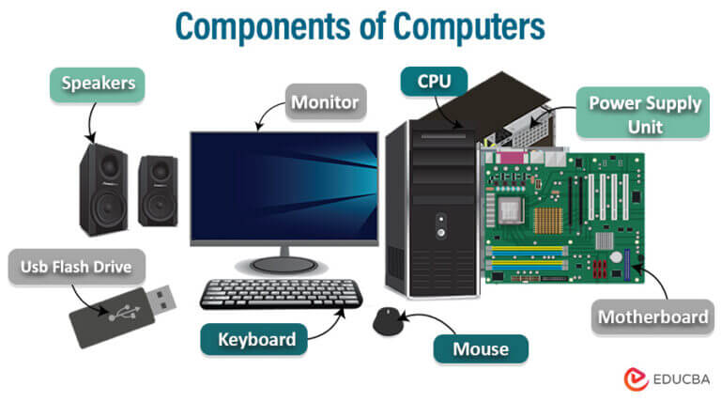
Computer Of Components
A computer is an electronic device that accepts data, performs operations, displays results, and stores the data or results as needed. It is a combination of hardware and software resources that integrate together and provides various functionalities to the user. Hardware is the physical components of a computer like a processor, memory devices, monitor, keyboard, etc., while software is a set of programs or instructions that are required by the hardware resources to function properly.

Slide 5
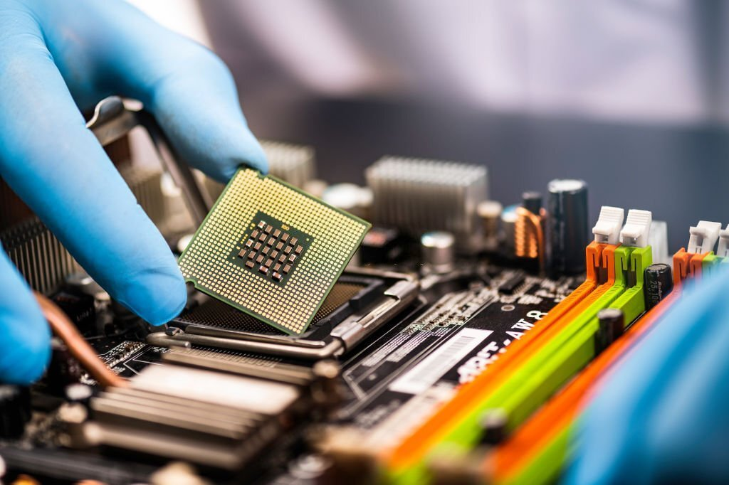
WHAT IS Hardware computer
hardware is the collection of physical elements ”Tangible objects ” that constitutes a computer system . The actual machinery, wires, transistors, and circuits … etc.
A computer's hardware consists of its physical parts, including its internal pieces and connected external devices. Hardware components perform a computer's tasks like calculating data, storing information, processing input, and providing output. Any part of a computer that you can physically touch is hardware.

Slide 6
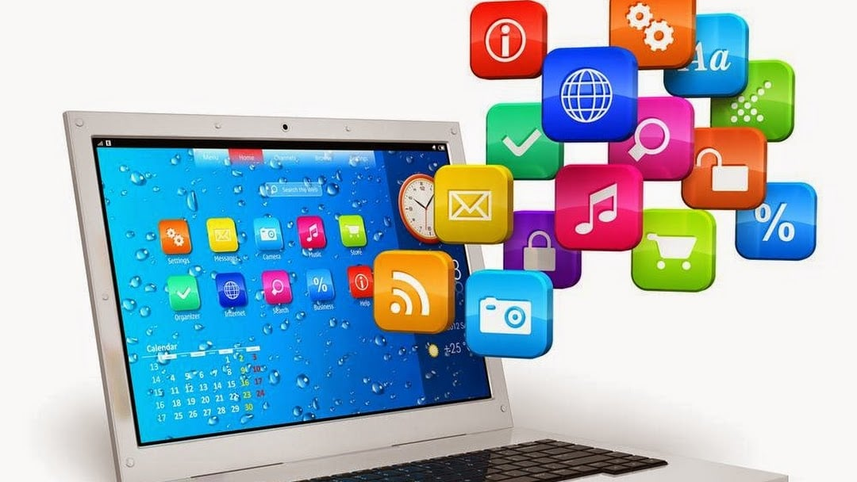
What is Software computer
. Software, instructions that tell a computer what to do. Software comprises the entire set of programs, procedures, and routines associated with the operation of a computer system. The term was coined to differentiate these instructions from hardware—i.e., the physical components of a computer system.
In a computer system, the software is basically a set of instructions or commands that tell a computer what to do. In other words, the software is a computer program that provides a set of instructions to execute a user’s commands and tell the computer what to do. For example like MS-Word, MS-Excel, PowerPoint, etc

Slide 7
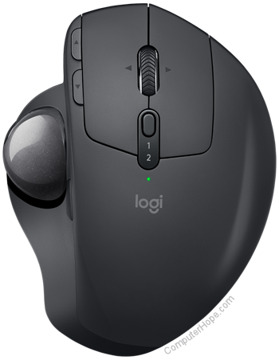
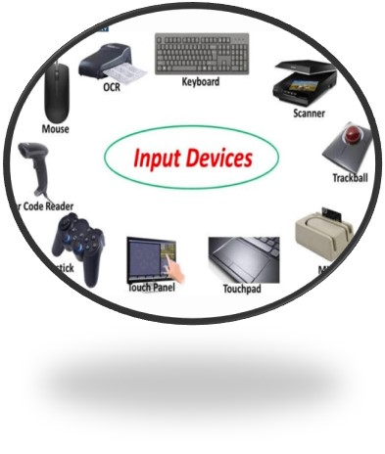
Software, instruction
In computing, an input device is a piece of equipment used to provide data and control signals to an information processing system, such as a computer or information appliance. Examples of input devices include keyboards, computer mice, scanners, cameras, joysticks, and microphones.
An input device is any hardware device that sends data to a computer, allowing you to interact with and control it. The picture shows a Logitech trackball mouse, an example of an input device.
The keyboard and mouse are a computer's most commonly used or primary input devices. However, other devices also input data into a computer.

Slide 8
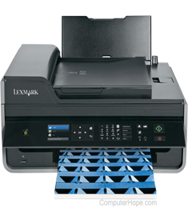
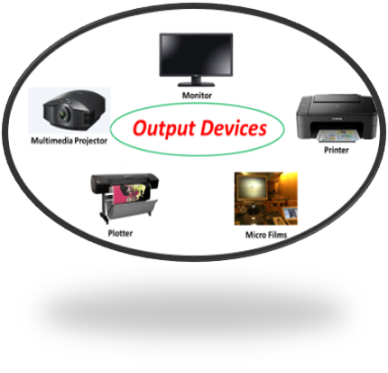
Output device
An output device is any piece of computer hardware that converts information or data into a human-perceptible form or, historically, into a physical machine-readable form for use with other non-computerized equipment. It can be text, graphics, tactile, audio, or video. Examples include monitors, printers, speakers, headphones, projectors, GPS devices, optical mark readers, and braille readers.
An output device is any peripheral that receives data from a computer, usually for display, projection, or physical reproduction. For example, the image shows an inkjet printer, an output device that make a hard copy of anything shown on the monitor. Monitors and printers are two of the most commonly used output devices used with a computer

Slide 9
Types of Computers
Super Computer
*Mainframe computer
*Mini Computer
*Workstation Computer
*Personal Computer (PC)
*Server Computer
*Analog Computer
*Digital Computer
*Hybrid Computer
*Tablets and Smartphone

Slide 10
Usage of computer
Computer is the best companion of our daily life
* Network attached strong
*Media server
*graphics designs
*online banking
*gaming
*social networking
*knowledge sharing

Slide 11


