Slide 1
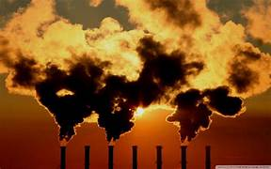
pollution
Pollution occurs when an amount of any substance or any form of energy is put into the environment at a rate faster than it can be dispersed or safely stored. The term pollution can refer to both artificial and natural materials that are created, consumed, and discarded in an unsustainable manner
Air pollution, water pollution, and land pollution are three major forms of environmental pollution. Pollution can also refer to excessive human activity, such as light and noise pollution, or to specific pollutants such as plastic or radioactive material. Learn more in this infographic.

Slide 2
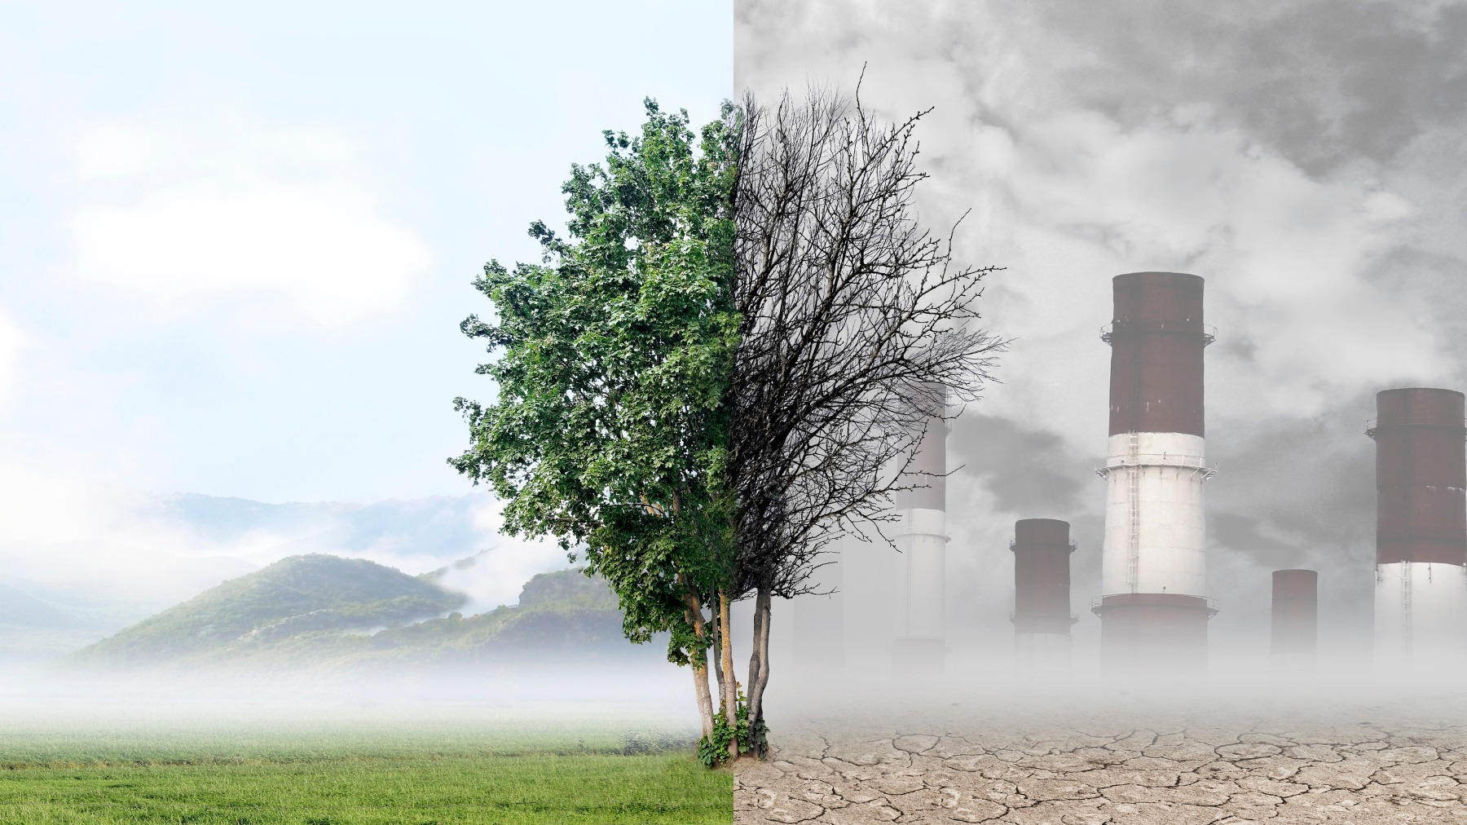
Air pollution
Air pollution is contamination of the indoor or outdoor environment by any chemical, physical or biological agent modifies the natural characteristics of the atmosphere. Household combustion devices motor vehicles, industrial facilities and forest fires are common sources of air pollution.
Household combustion devices, motor vehicles, industrial facilities and forest fires are common sources of air pollution.

Slide 3
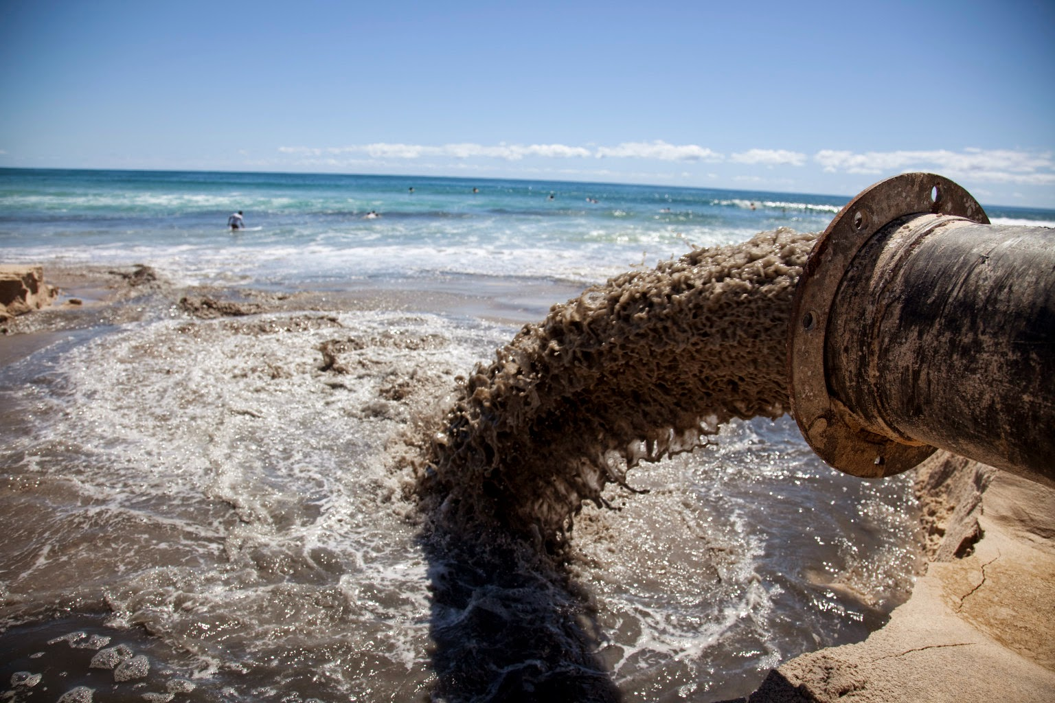
Water pollution
Water pollutants come from either point sources or dispersed sources. A point source is a pipe or channel, such as those used for discharge from an industrial facility or a city sewerage system. A dispersed (or nonpoint) source is a very broad unconfined area from which a variety of pollutants enter the water body, such as the runoff from an agricultural area. Point sources of water pollution are easier to control than dispersed sources, because the contaminated water has been collected and conveyed to one single point where it can be treated. Pollution from dispersed sources is difficult to control, and, despite much progress in the building of modern sewage-treatment plants, dispersed sources continue to cause a large fraction of water pollution problems.

Slide 4
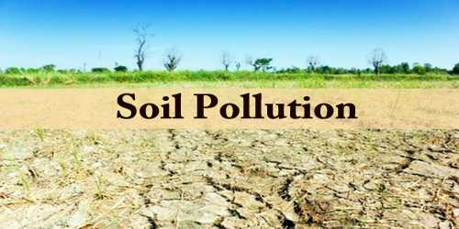
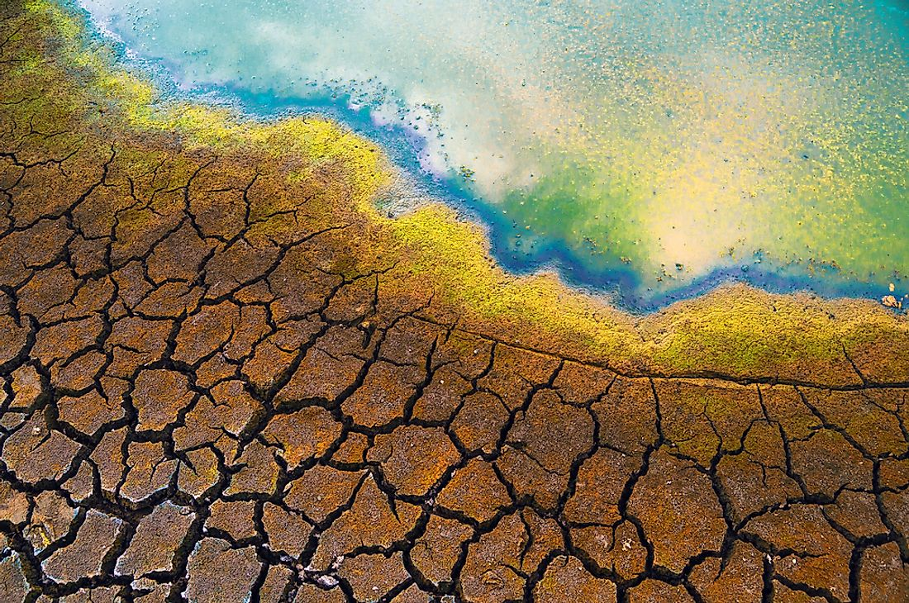
Soil pollution
Soil pollution refers to the dangerously high concentrations of contaminants in soil. While contaminants such as metals, inorganic ions, salts, and organic compounds naturally occur in soils, these can exceed natural levels and qualify as pollution.
Soil pollution can have far-reaching consequences; it is often detrimental to plant growth, disrupting food chains and entire ecosystems. In turn, it has a direct impact on food security. Here, we'll review the causes of soil pollution, its widespread environmental impacts, and how to improve soil conditions.

Slide 5


Noise pollution
The Clean Air Act Amendment added Title IV to the document, which relates to noise pollution. This amendment established the EPA Office of Noise Abatement and Control to study the effect of noise on public health and the effect on wildlife, the psychological and physiological effects it may have on people, and the effect of sporadic extreme noise. The sources of noise that are regulated by the EPA include construction equipment, trucks, transport equipment, low-noise emission products, and rail and motor carriers. It also regulates. During the time this amendment was written, the EPA identified the average exposure to environmental noise to be 70 dB over 24 hours and average levels of 55 dB outdoors. However, the Office of Noise Abatement and Control was closed as the administration thought it was best if issues regarding noise were handled at the local and State level.

Slide 6
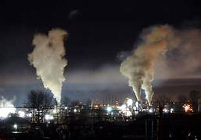

Light pollution
Light pollution is a global issue. This became glaringly obvious when the World Atlas of Night Sky Brightness, a computer-generated map based on thousands of satellite photos, was published in 2016. Available online for viewing, the atlas shows how and where our globe is lit up at night. Vast areas of North America, Europe, the Middle East, and Asia are glowing with light, while only the most remote regions on Earth (Siberia, the Sahara, and the Amazon) are in total darkness. Some of the most light-polluted countries in the world are Singapore, Qatar, and Kuwait.

Slide 7
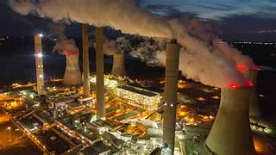
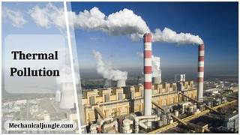
Thermal pollution
Thermal pollution, sometimes called "thermal enrichment", is the degradation of water quality by any process that changes ambient water temperature. Thermal pollution is the rise or drop in the temperature of a natural body of water caused by human influence. Thermal pollution, unlike chemical pollution, results in a change in the physical properties of water. A common cause of thermal pollution is the use of water as a coolant by power plants and industrial manufacturers.^{[1]} Urban runoff—stormwater discharged to surface waters from rooftops, roads, and parking lots—and reservoirs can also be a source of thermal pollution.^{[4]} Thermal pollution can also be caused by the release of very cold water from the base of reservoirs into warmer rivers.

Slide 8
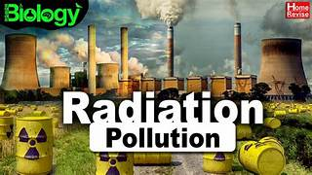
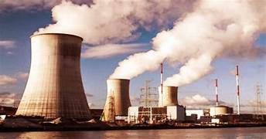
Radioactive pollution
Radioactive contamination, also called radiological pollution, is the deposition of, or presence of radioactive substances on surfaces or within solids, liquids, or gases (including the human body), where their presence is unintended or undesirable (from the International Atomic Energy Agency definition). Such contamination presents a hazard because the radioactive decay of the contaminants produc..

Slide 9


