Slide 1








SQL HACKATHON 2023
TEAM 17 – GLUCOSQUAD5
Aakruthi Ghattu
Auxilia Rani Arockiasamy
Select * from
GLUCOSQUAD5
Merin Mary Shaji
Neenu Nair
Maya Ravichandran
Successfully run. Total query runtime: 1 ms. 5 rows affected.

Slide 2


















The SQL Hackathon Experience
80
Queries
50
Extra Queries
All queries
Optimized
80 SQL Functions
Well Documented Steps
DAY 1
DAY 2 | 3
DAY 4 | 5
DAY 6 | 7
Data – Exploratory Analysis
Solve Queries
Query Walkthrough
Explored new functions
As a team framed 50 meaningful queries
Solved queries using complex functions
Optimized the query
Brainstorming
Documented Queries
Prepared Presentation
Tableau Visuals
Task Assignment – Each 16 queries
Standup | Peer Review

Slide 3


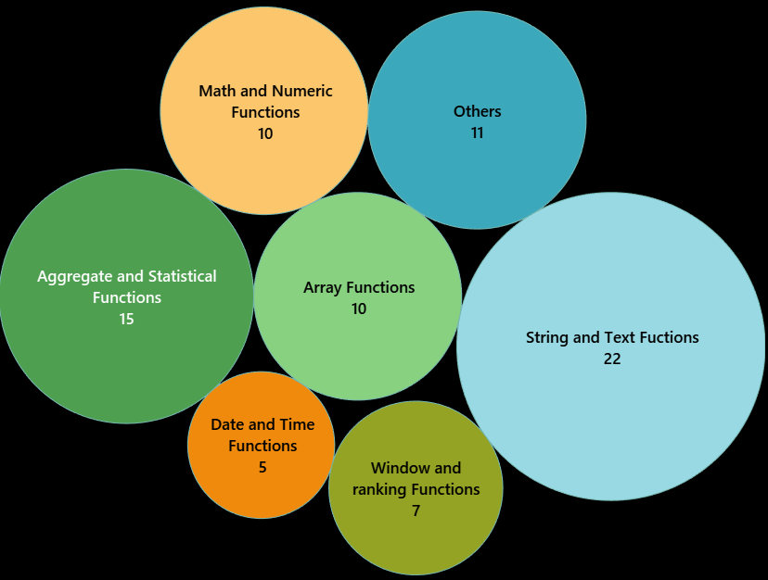





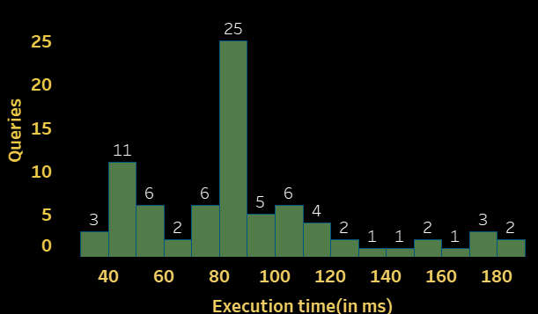
Diving into dataset
PostgreSQL Functions Used
16 PATIENTS
Query Execution Times
Our List of Functions Used Document
Reference : PostgreSQL: Documentation: 16: Chapter 9. Functions and Operators

Slide 4
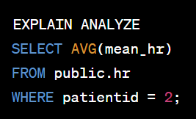
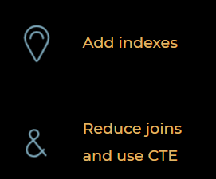
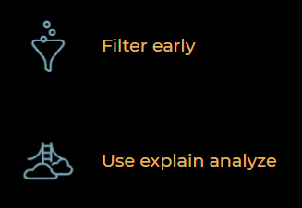
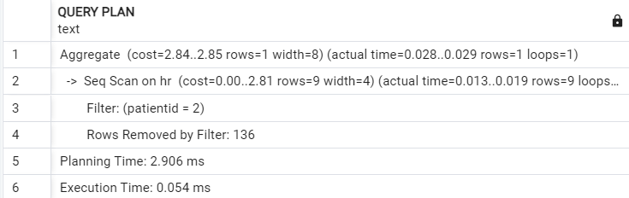

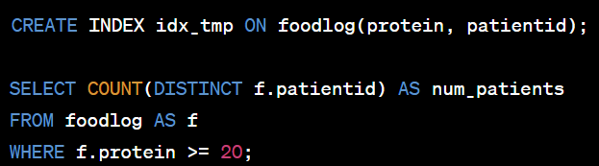
QUERY OPTIMIZATION APPROACH
Optimization Techniques
Find out how many patients consumed meals with at least 20 grams of protein
Less optimized Query
Optimized Query
AVOID MANY
JOINS

Slide 5
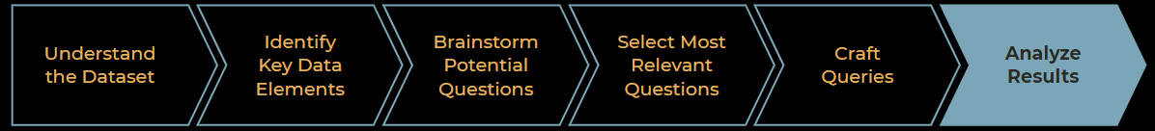
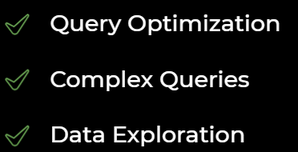
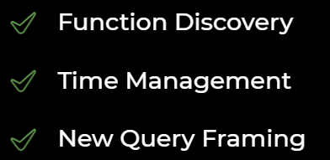

New Query Framing
Challenges during the Hackathon
Learnings From Hackathon

Slide 6
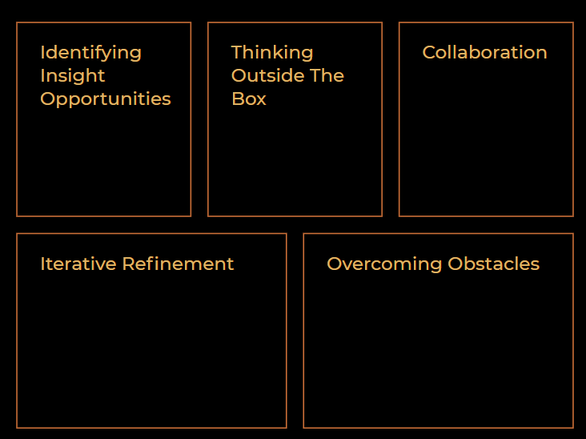
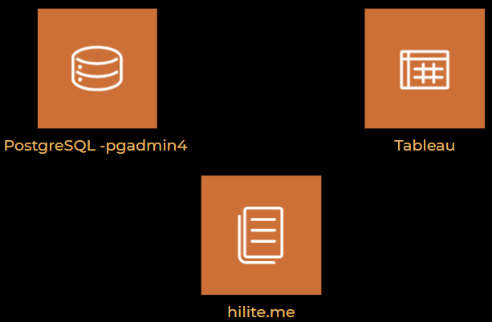
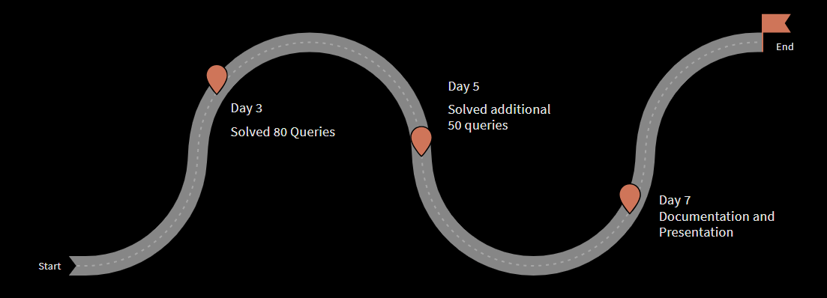
Hackathon – Fostering Creativity
Frameworks and Tools
Thank You!

