Slide 1

DIGITAL HEALTH GROUP CONTRACT PROPOSAL
MXB201 Group Project — Group 15
Presented by:
Jean Warren Bulacan
Anish Kamalakkannan
Charlie McBride
Amber Xie

Slide 2
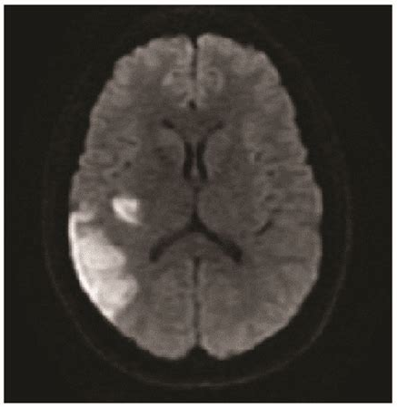
Exploring Non-Invasive Insights into Brain Health
Utilizing diffusion-weighted MRI to assess brain tissue integrity.
Project divided into two parts:
Part I: Brain MRI Analysis
Part II: Image-Based Feature Extraction
Source: Chin, R.-I., et al. (2017)

Slide 3
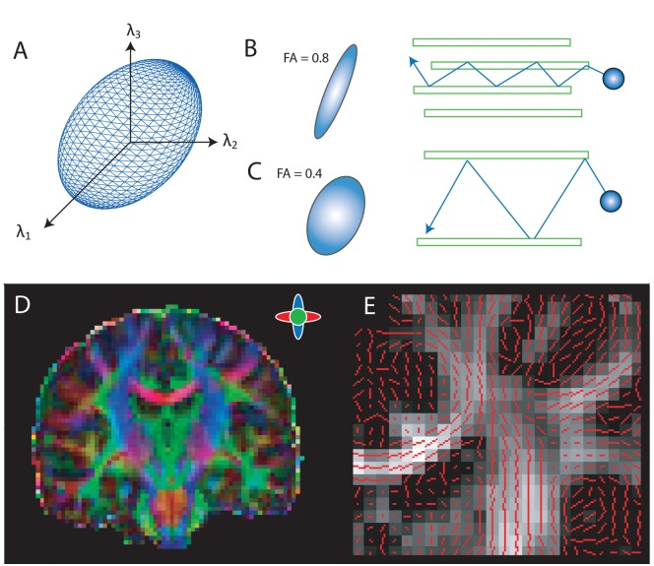
PART I: Modeling Water Molecule Movement in the Brain
Estimation of the diffusion tensor to capture water diffusion patterns.
Baseline scan → applies six or more magnetic shoves
Reveals microstructural changes
Source: Anderson, E. J., et al. (2011).
Notes:
Panel A: Illustrates the diffusion tensor ellipsoid, representing the probability distribution of water molecule diffusion within a voxel.
Panel B: Shows areas of high anisotropy with elongated ellipsoids, indicating a higher likelihood of diffusion in one direction.
Panel C: Depicts areas of lower anisotropy with more spherical distributions, reflecting uniform diffusion in all directions.
Panel D: Presents a color-coded fractional anisotropy (FA) map, highlighting principal diffusion directions within white matter pathways.
Panel E: Overlays principal diffusion directions (red lines) on an FA map, demonstrating alignment with white matter tracts.

Slide 4
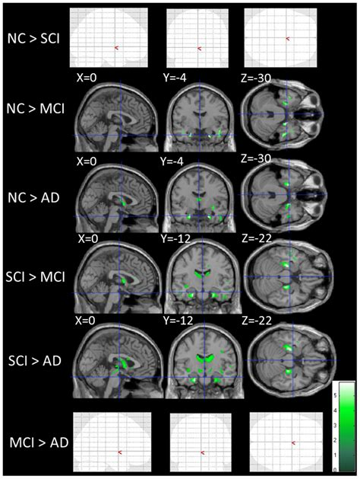
Why it’s Powerful ↴
Detecting Neurological Conditions Early
Stroke
Tumours
Neurodegenerative diseases
Transforming Complex Imaging Data into Actionable Insights
Facilitating early and confident clinical decisions.
Source: Kiuchi, K., et al. (2014)

Slide 5
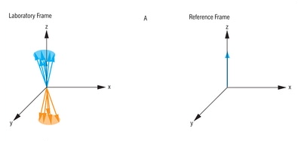
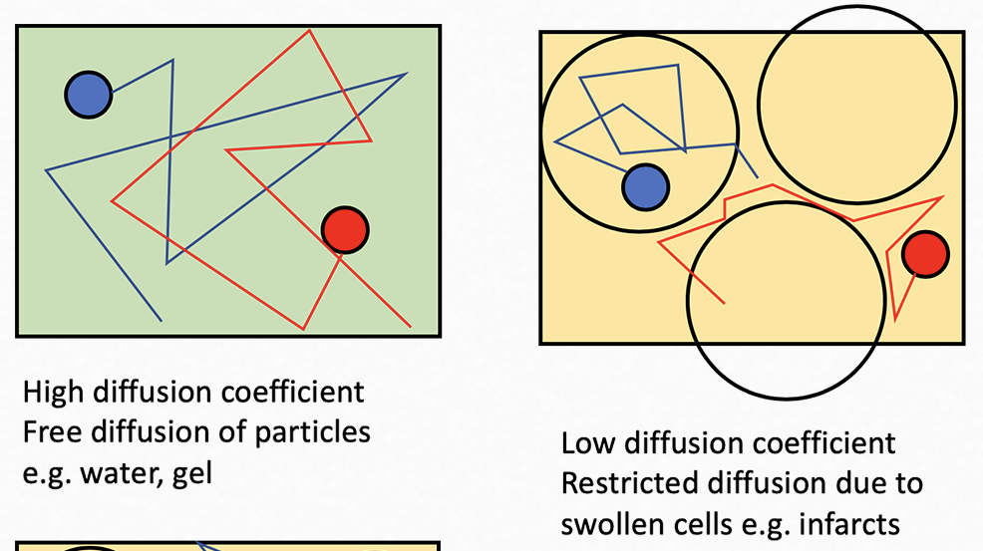
Deriving Meaning from Weighted Signals
Compare all 6 directional ‘shoves’ to baseline.
If water moves, the material is known to allow high diffusion.
If water can’t move, the material is known cause low diffusion.
Based on how water diffuses in an area, physicians can quickly identify what tissue types are present.
A
B
A. Comparison of weighted-signal (left) and baseline (right) measurements (McMahon et al., 2011)
B. Diagram of low-diffusivity and high-diffusivity materials (Abdulla, 2019).

Slide 6
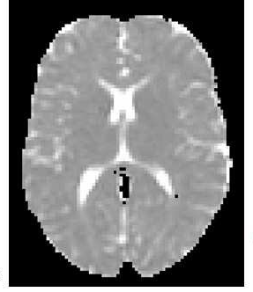
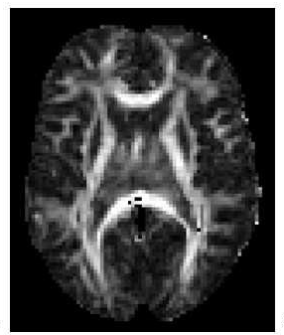
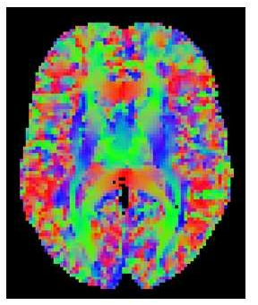
Different Visualisations
A
B
C
A. Mean diffusion map retrieved by visualising average diffusion (Schwartzman, 2019).
B. Fractional anisotropy retrieved by visualizing primary diffusion direction (Schwartzman, 2019).
C. Principal diffusion direction retrieved by assigning colours (red, green, blue) to direction of diffusion (Schwartzman, 2019).

Slide 7
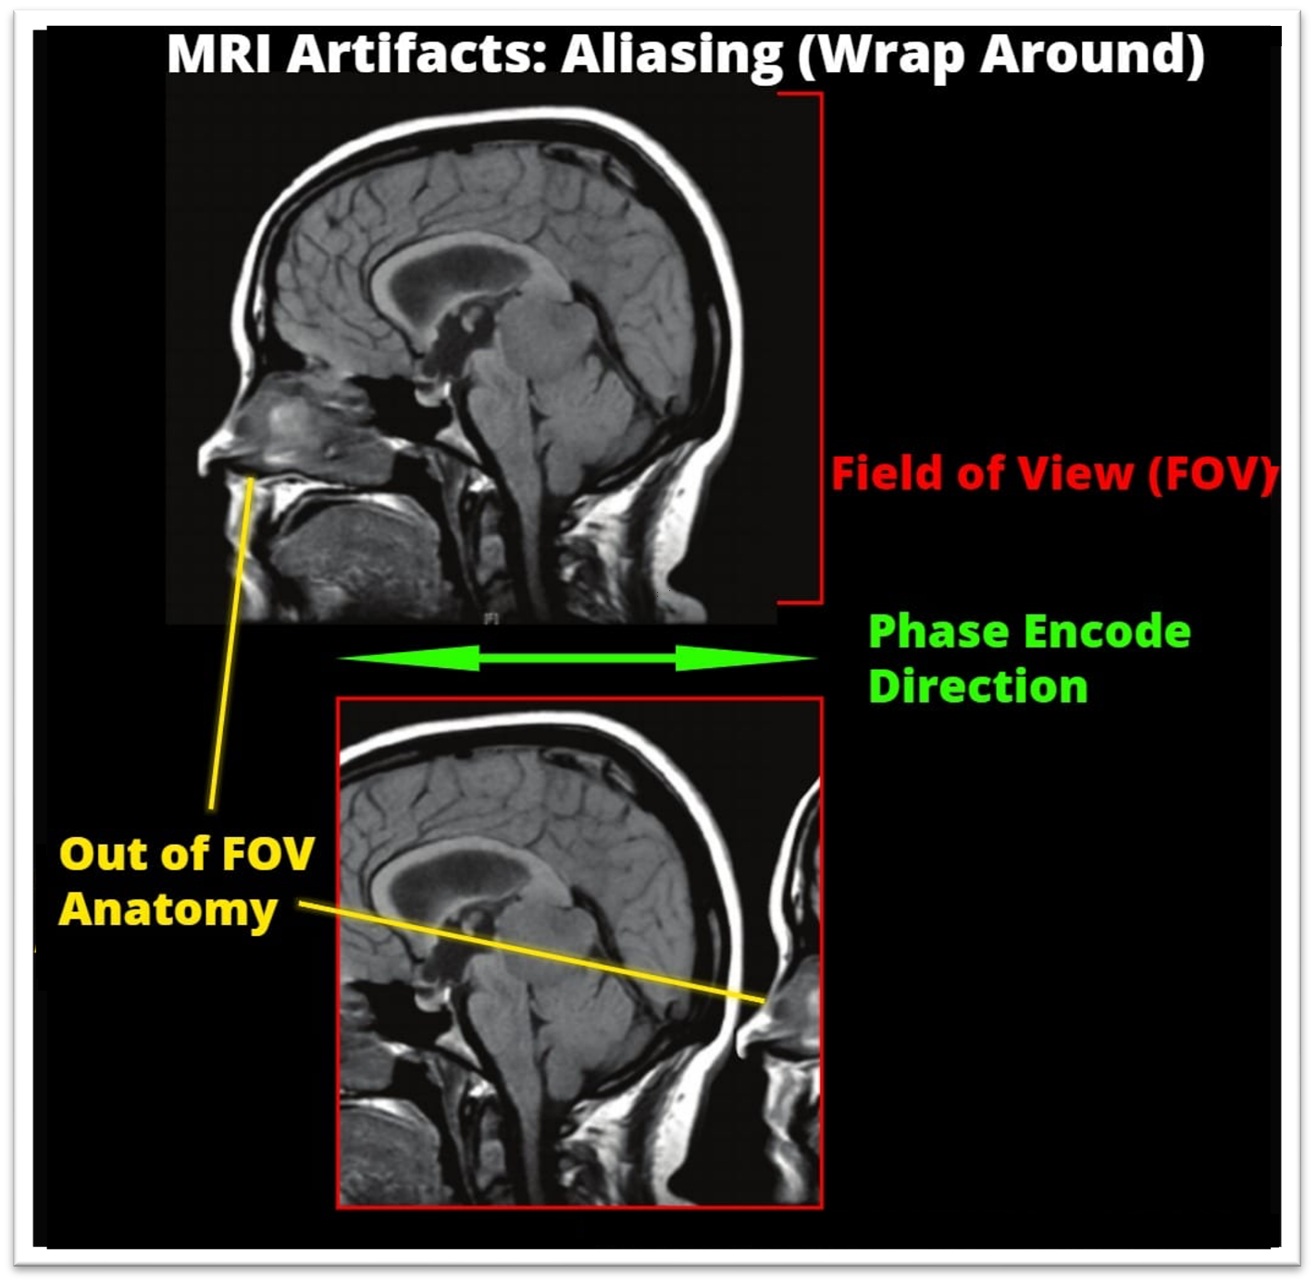
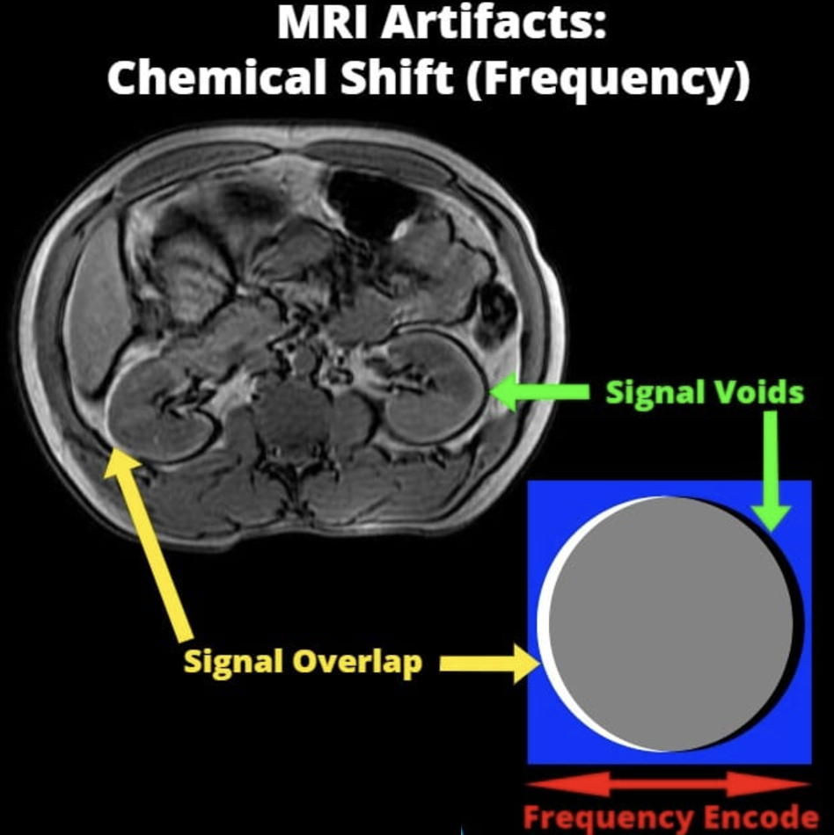
Error Correction
Diffusion can also inform us of noise in the dataset.
Water diffusion occurring outside the scan area from noise or artifacting.
Negative diffusion of water is impossible.
Using this knowledge, we can safely discard incorrect data before generating the image.
Constructive interference of MRI signals causing improper diffusivity measurements, which may result in negative values (Oncology Medical Physics, n.d.).

Slide 8

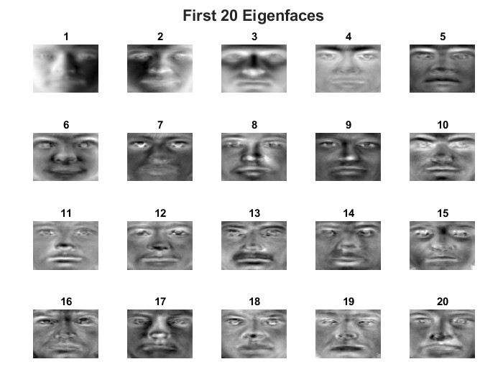
PART II: Interpreting MRI Demonstrated Through Facial Analysis
MRI can be used to search for diseases within the brain.
Manual MRI analysis is often impractical.
Mathematical techniques can be used to extract key features from large datasets.
Our group created a moustache detector as a 2D proxy for an MRI disease flagger.
The extension to three dimensions is mathematically straight forward.
Notes:
A significant use case for MRI is the identification of neurodegenerative diseases and/or tumours within the brain. MRI scans produce enormous amounts of data which can be extremely difficult to analyse manually. As such, a combination of mathematical and machine learning techniques are often employed in conjunction with one another to aid such analysis. As a group we used a mathematical technique common in this field to create a model that can detect moustaches within images of faces. This was done as a demonstrative proxy for the use of this technique in the identification of tumours and/or biomarkers of disease within MRI brain scans. It should be noted that although our chosen proxy is two dimensional while MRI data is three dimensional, extending the maths to three dimensions is extremely simple.

