Slide 1
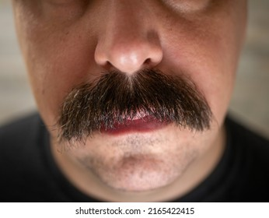
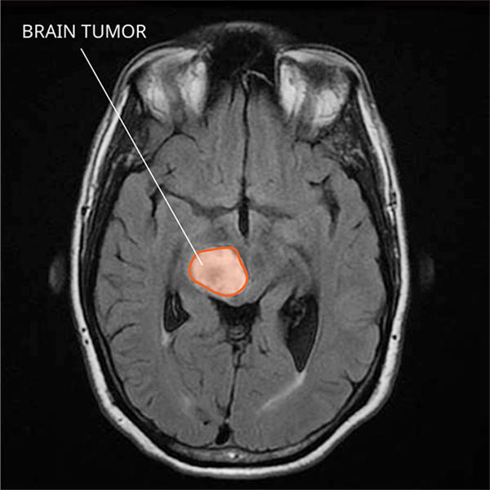
=
A Visual Analogy: Moustaches as Medical Markers
(Shutterstock, 2015)
(National Cancer Institute, 2024)
Notes:
Thank you Charlie,
*Click*
Picture a moustache as a visual marker for a specific brain disease in an MRI scan; one that is too intricate to discern if such abnormality was in-fact a potential indicator of disease.

Slide 2
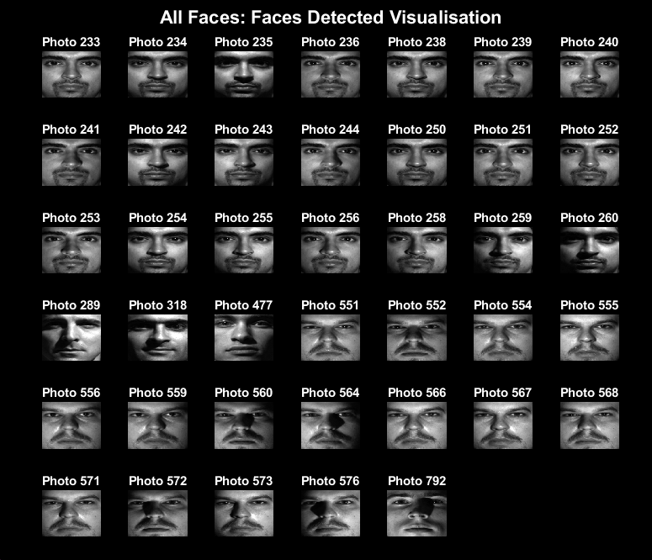
First Sample: All Faces
1000 face photos
Accuracy: 97.4%
Notes:
We tested our moustache detector on an entire face database, showing a *click* 97.4% accuracy *click* with minimal errors,

