Slide 1

DIGITAL HEALTH GROUP CONTRACT PROPOSAL
MXB201 Group Project — Group 15
Presented by:
Jean Warren Bulacan
Anish Kamalakkannan
Charlie McBride
Amber Xie

Slide 2
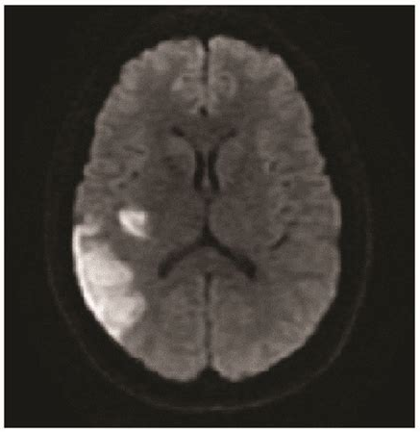
Exploring Non-Invasive Insights into Brain Health
Utilizing diffusion-weighted MRI to assess brain tissue integrity.
Project divided into two parts:
Part I: Brain MRI Analysis
Part II: Image-Based Feature Extraction
Source: Chin, R.-I., et al. (2017)

Slide 3
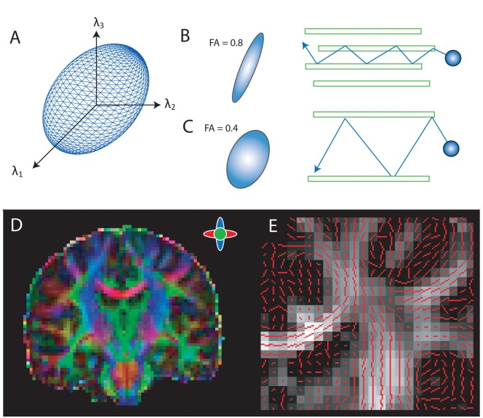
PART I: Modeling Water Molecule Movement in the Brain
Estimation of the diffusion tensor to capture water diffusion patterns.
Reveals microstructural changes in neural tissue.
Source: Anderson, E. J., et al. (2011).
Notes:
Panel A: Illustrates the diffusion tensor ellipsoid, representing the probability distribution of water molecule diffusion within a voxel.
Panel B: Shows areas of high anisotropy with elongated ellipsoids, indicating a higher likelihood of diffusion in one direction.
Panel C: Depicts areas of lower anisotropy with more spherical distributions, reflecting uniform diffusion in all directions.
Panel D: Presents a color-coded fractional anisotropy (FA) map, highlighting principal diffusion directions within white matter pathways.
Panel E: Overlays principal diffusion directions (red lines) on an FA map, demonstrating alignment with white matter tracts.

Slide 4
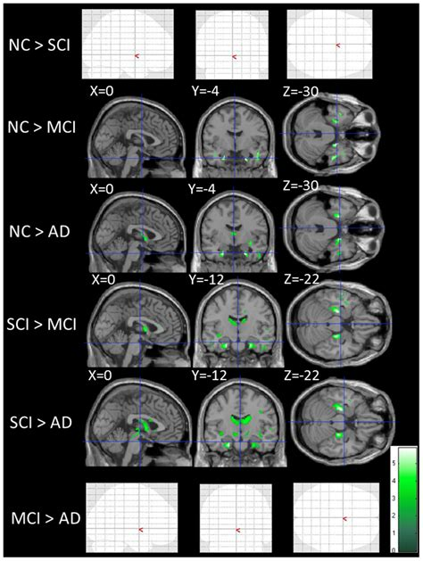
Why it’s Powerful ↴
Detecting Neurological Conditions Early
Stroke
Tumors
Neurodegenerative diseases
Transforming Complex Imaging Data into Actionable Insights
Facilitating early and confident clinical decisions.
Source: Kiuchi, K., et al. (2014)

Slide 5
PART I: The Solution

Slide 6
PART II: The Problem

Slide 7
PART II: The Solution

