Slide 1
Facial Expression Recognition: Accuracy, Attention and Bias
Team P31: Neeraj Parmar, Rakshita K Biradar, Pawan Kushwah
Deep learning project, November 2026
Notes:
Introduce the project: we classify faces into 7 emotions, but the goal is to also ask whether the models generalise, whether they are fair, and where they look.

Slide 2
Accuracy alone is not enough
Task: classify a face photo into one of 7 emotions: angry, disgust, fear, happy, sad, surprise, neutral.
1
2
3
Does it generalise?
Is it fair?
Where does it look?
Train on FER-2013, test on RAF-DB: a different dataset the model has never seen.
Accuracy broken down by gender, race and age group, with confidence intervals.
Grad-CAM heatmaps show which face regions drive each prediction.
Notes:
Task: 7 emotions (angry, disgust, fear, happy, sad, surprise, neutral). We train on FER-2013 only, then ask three questions. Generalise: test on RAF-DB, a different dataset. Fair: break RAF-DB results down by gender, race and age. Attention: Grad-CAM heatmaps.

Slide 3
Two datasets, two jobs
35,887
FER-2013 images (48×48 grayscale, 7 emotions): training
3,068
RAF-DB test images, in the wild, with gender, race and age labels
16.6×
class imbalance in FER-2013: happy vs disgust
7.4%
of FER-2013 test images also appear in training
Notes:
FER-2013: 35,887 images, 48x48 grayscale, used for training, validation (10% of train) and in-domain test. RAF-DB: used only for testing; it has gender, race and age labels, which is what makes the bias audit possible. EDA (PR #21): happy has 16.6x more training images than disgust; 531 FER-2013 test images (7.4%) also appear in train/val.

Slide 4
Three models, one pipeline
CNN from scratch
ResNet-18 / 50
Vision Transformer
About 5M parameters
4 conv blocks, 48×48 grayscale
No pretraining
ImageNet-pretrained, new 7-class head
112 px, 3-channel input
Fully fine-tuned
ImageNet-pretrained (timm)
224 px input
Fine-tuned; results pending
Notes:
CNN: about 5M parameters, trained from scratch (Neeraj). ResNet-18/50: ImageNet-pretrained, new 7-class head, 112 px (Rakshita). ViT: ImageNet-pretrained transformer, 224 px (Pawan; results pending). All three use the same training and evaluation scripts, selected by a YAML config.

Slide 5
The same recipe for every model
1
Optimiser: AdamW, short warmup, cosine decay
2
Loss: Cross-entropy, label smoothing 0.1, class weights
3
Augmentation: Flip, small affine, colour jitter, random erasing
4
Model selection: Best validation macro-F1, with early stopping
5
Comparison: Same pipeline, split and metric for all models
Notes:
One training script, one split (10% of FER-2013 train held out as validation, same seed), one selection metric (validation macro-F1). Differences between models therefore come from the model, not from the pipeline.

Slide 6
Fine-tuning matters most; ResNet-50 is best
Frozen backbone: 34.5% vs 69.1% fine-tuned (this head, trained this way).
224 px adds 1.2 points on FER-2013: no clear benefit.
ResNet-50 is the best ResNet on RAF-DB (64.2%), chosen on validation macro-F1.
Notes:
ResNet tuning (results/resnet_tuning.md). FER-2013 test accuracy / RAF-DB accuracy: ResNet-18 69.1 / 60.4; frozen backbone 34.5 / 36.5; 224 px 70.3 / 61.3; ResNet-50 70.1 / 64.2. ResNet-50 was selected on validation macro-F1 (0.681), not on RAF-DB. One seed per run, so differences under about a point are noise.

Slide 7
ResNet-50 loses least of the tuned models
Among models picked on FER-2013 validation, ResNet-50 loses least.
The untuned CNN transferred as well: 65.1% / 0.480 on RAF-DB.
RAF-DB is 39% happy, so accuracy flatters; macro-F1 is the better guide.
ViT: pending.
Notes:
FER-2013 to RAF-DB, accuracy drop / macro-F1 drop: untuned CNN baseline 67.6 to 65.1 (2.5) / 0.648 to 0.480 (0.168); tuned CNN 70.2 to 61.2 (9.0) / 0.684 to 0.443 (0.241); ResNet-18 69.1 to 60.4 (8.7) / 0.664 to 0.449 (0.215); ResNet-18 at 224 px 70.3 to 61.3 (9.0) / 0.675 to 0.465 (0.210); ResNet-50 70.1 to 64.2 (5.9) / 0.687 to 0.493 (0.194). Among models selected on FER-2013 validation, ResNet-50 loses least, but the untuned CNN baseline loses even less and scores 65.1% / 0.480 on RAF-DB, so ResNet-50's advantage over a simple CNN is small (macro-F1 +0.013, one seed). RAF-DB is 39% happy, which flatters accuracy, so the macro-F1 drop is the better guide. ViT row pending Pawan's runs.

Slide 8
Every model is worse on men
8–10 points
gap between women and men, clear in every model
In ResNet-50, emotion mix explains only about a quarter of it: the model is less accurate on men even within the same emotions.
Notes:
RAF-DB accuracy by gender (female / male): CNN 65.5 / 55.1, ResNet-18 63.8 / 54.8, ResNet-18 224 px 65.0 / 56.8, ResNet-50 67.5 / 59.4. The gap is clear in all four (p < 0.001, intervals separated). We checked ResNet-50 only (python -m src.class_mix_check): men and women have different emotion mixes, but re-weighting men to the women's mix lifts their accuracy only from 59.4 to 61.5, so the mix explains about a quarter of the gap.

Slide 9
Age gaps shrink; the gender gap stays
Model | Age gap | Gender gap | Race gap
CNN (best) | 15.2 * | 10.4 * | 5.3
ResNet-18 | 18.2 * | 9.0 * | 3.1
ResNet-18, 224 px | 9.2 | 8.2 * | 7.1
ResNet-50 | 11.7 | 8.1 * | 4.7
ViT | pending | pending | pending
Age: 18.2 → 11.7 → 9.2 with better models.
Race: no gap reaches p < 0.05, but groups are small.
70+ has only 89 images, so it is the least certain.
* intervals of best and worst group do not overlap (conservative). Unmarked is not zero: ResNet-50 age gap p = 0.03. Points.
Notes:
Gaps are best group minus worst group in accuracy points; gender is female minus male. An asterisk = the two groups' 95% bootstrap intervals do not overlap (a conservative test); p-values are two-proportion z-tests between best and worst group, uncorrected. Age gap falls 18.2 to 11.7 (ResNet-50, p = 0.03, borderline) and 9.2 (224 px, p = 0.09). No race gap reaches p < 0.05, but african-american has n=234 so its intervals are wide. The 70+ group has only 89 images. ViT row pending.

Slide 10
Balanced sampling added little
Fine-tuning on RAF-DB alone halves the gap (8.1 → 4.1).
Gender balancing: 3.6 vs 4.1, within noise.
It also widened the age gap (13.3 vs 10.9).
Cost: FER-2013 accuracy falls from 70.1% to about 63%.
Notes:
Mitigation (results/resnet_mitigation.md): fine-tune ResNet-50 on RAF-DB train for 10 epochs, lr 1e-5. Gender gap (F-M): before 8.1; control (no balancing) 4.1; gender-balanced 3.6; age-balanced 4.5. The control alone halves the gap, so fine-tuning on target data did most of the work; balancing added about 0.5 points, within noise. Gender balancing widened the age gap to 13.3 (control 10.9). Cost: FER-2013 accuracy falls from 70.1 to about 63. Loss reweighting and adversarial debiasing were not tried.

Slide 11
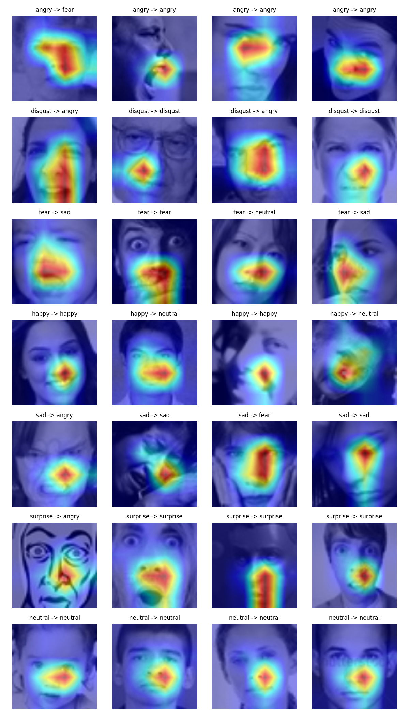
Where does ResNet-50 look?
ResNet-50 on FER-2013 test images (28 examples shown).
Heat sits mostly on the mouth and nose. The eyes are rarely highlighted, even for fear and surprise.
Wrong predictions (for example fear → sad) look much like correct ones.
ViT attention and per-group heatmaps: pending.
Notes:
Grad-CAM grid for ResNet-50 on FER-2013 test images (results/resnet50/explain_fer2013/gradcam_grid.png): rows are true classes, titles read true -> predicted. In these 28 examples the heat sits mostly on the mouth and nose; the eyes are rarely highlighted even for fear and surprise, and wrong predictions look much like right ones. This is a small qualitative sample. From the CNN run (PR #22), Grad-CAM also focused on mouth and eyes, with several fear errors attending to hands or background. ViT attention maps and per-subgroup mean heatmaps are Pawan's (#11) and pending.

Slide 12
What we learned
Transfer
Bias persists
Mitigation
Among tuned models ResNet-50 transfers best (64.2% on RAF-DB), though the untuned CNN reached 65.1%.
Women beat men by 8–10 points in every model; age gaps shrink with better models.
Balanced sampling added about 0.5 points over training on target data.
Limits: one seed per run, small subgroups (70+ has 89 images), audit on RAF-DB only. ViT comparison pending.
Notes:
Three messages. Transfer: among models selected on FER-2013 validation ResNet-50 transfers best (64.2% on RAF-DB), but the untuned CNN reached 65.1%, so the margin is small. Bias: women are recognised 8-10 points better than men in every model, and age gaps shrink with better models. Mitigation: balanced sampling added about 0.5 points over simply training on target data, so we cannot claim it reduced bias. Limits: one seed per run, small subgroups, audit on RAF-DB only, and the ViT comparison is still pending.

