Slide 1
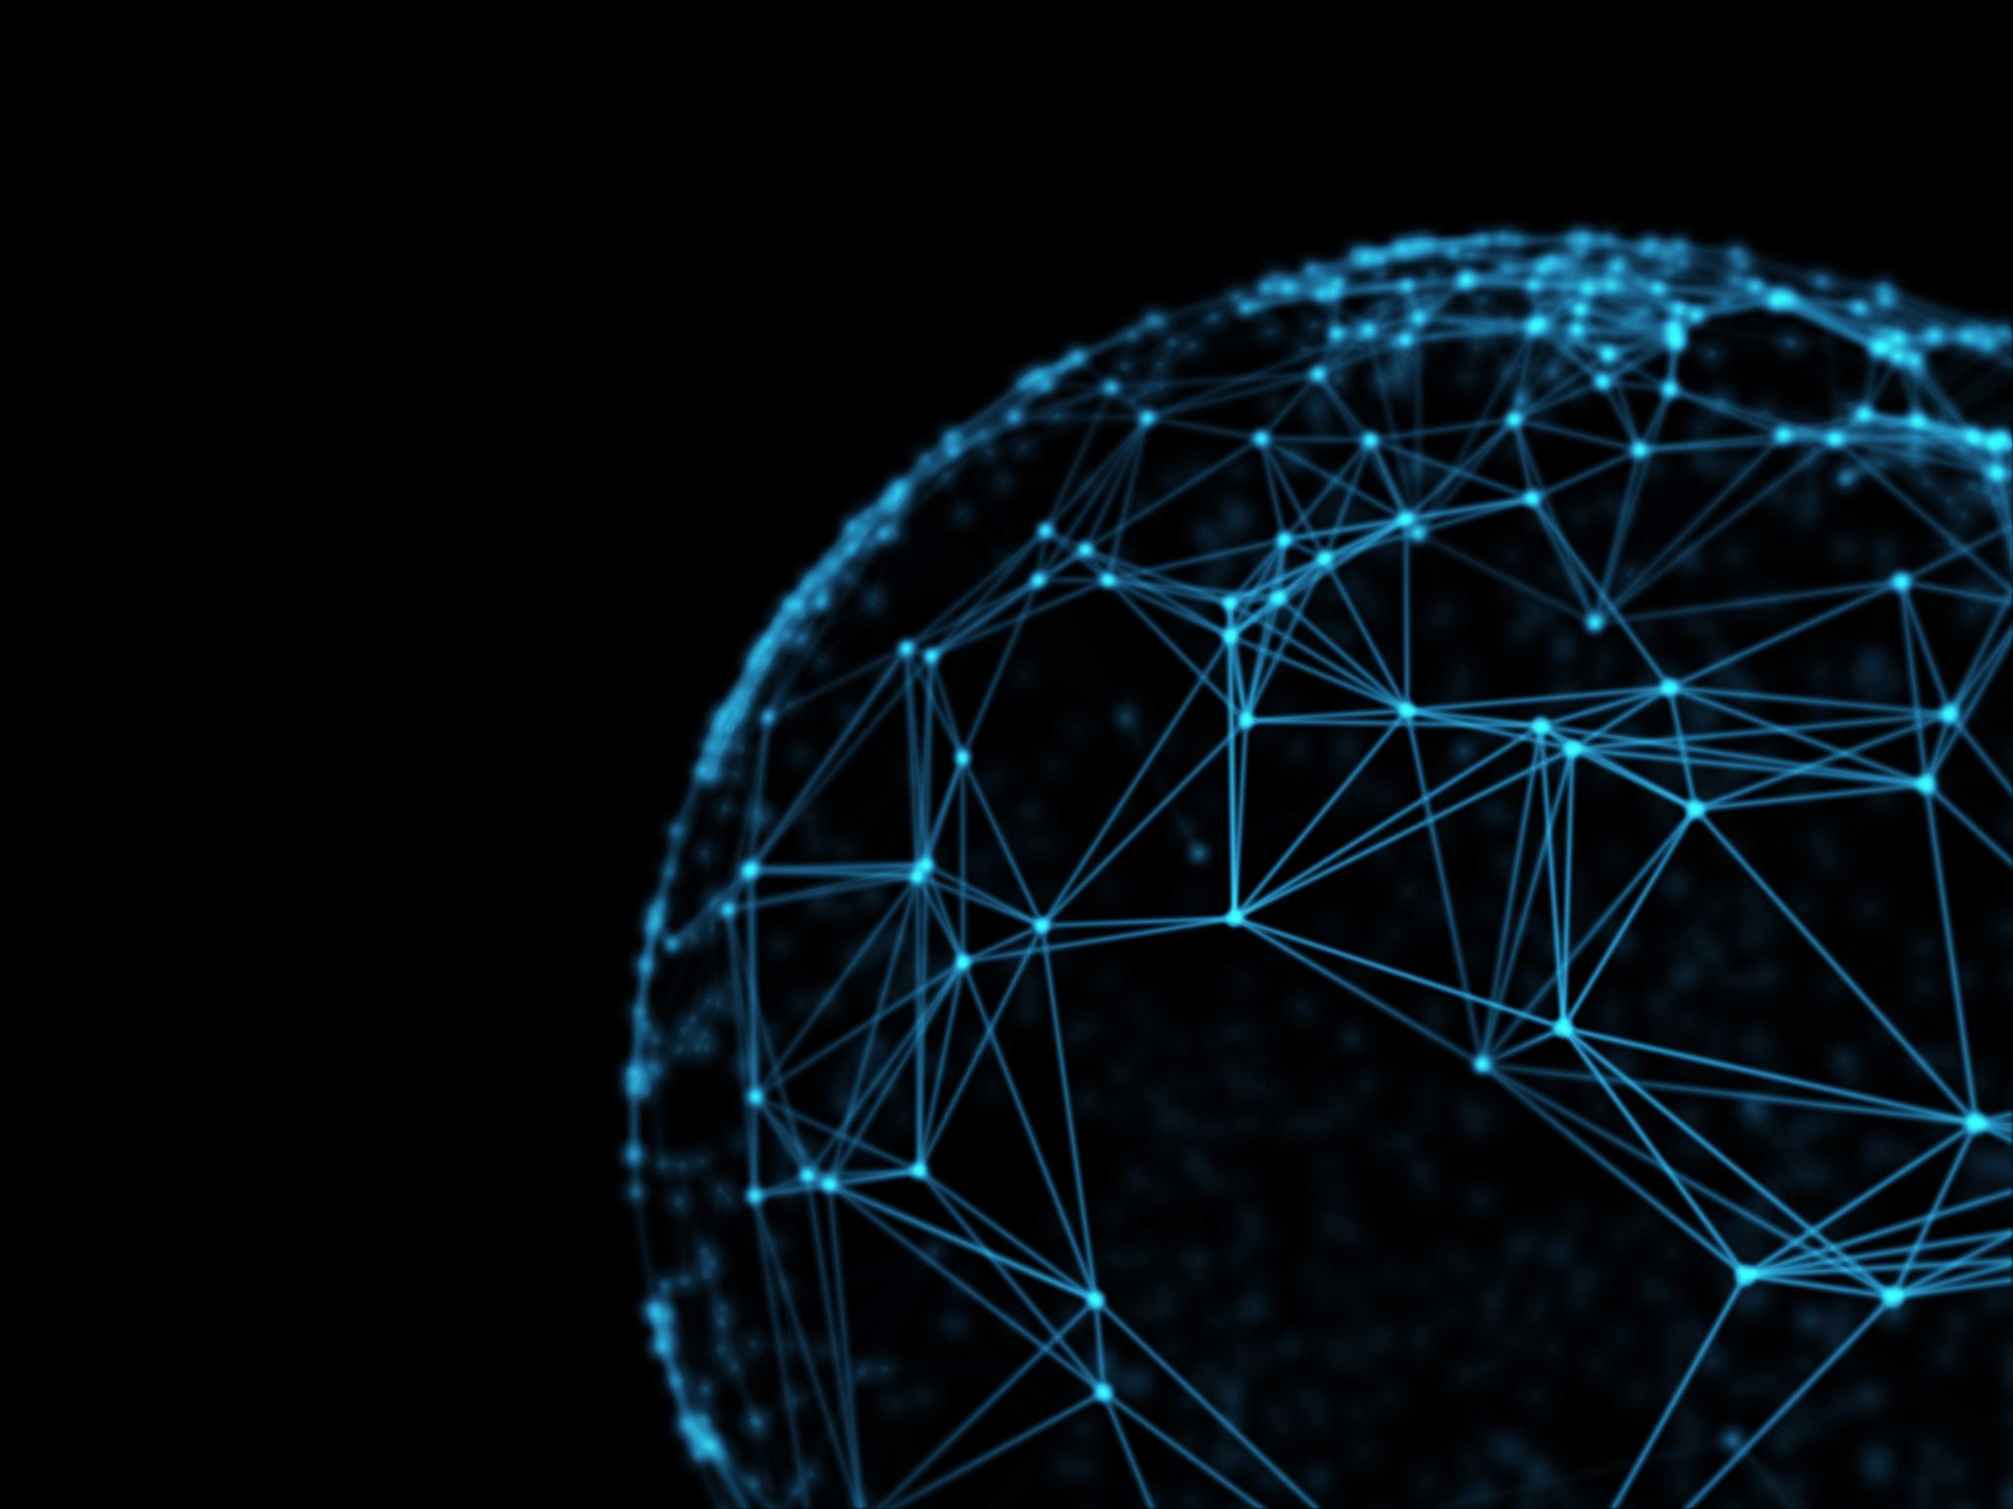
Healthcare Management system using Ethereum Blockchain
Presented By:
Akshitha Babburi
Deepika Rajashree Penuballi
Naveen Kumar Udumula
Rakshya Aryal
Roopa Tumu

Slide 2
Abstract This project aims to maintain patient medical records on a blockchain. The DApp architecture offers a patient-centric system where the patient has control over his or her data, i.e., the patient decides who is allowed to view their profiles or data. Three categories are used by the system to group users: Admins, Doctors, and Patients. Any doctor can request or receive permission from the patient to see their data. Patients may also upload files to their profiles or data, such as reports, X-rays, or other items, to be preserved via IPFS. The clinicians (who have access) can review these files to better evaluate and treat patients. Patients can also view the records of previous consultations. Doctors can view the patient records to which they have been given access. Doctors can check patient records and previous appointments to properly consult or treat their patients.

Slide 3
What is Blockchain? "Blockchain is a chain of blocks that are connected together and are continuously growing by storing transactions on the blocks"
It uses a decentralized approach that allows the information to be distributed and that each piece of distributed information or commonly known as data have shared ownership. What is Electronic Health Records (EHR) An Electronic Health Record (EHR) is longitudinal electronic record of patient health information. It consists of a patient personal information, which can be uploaded , edited and accessed by Doctors.

Slide 4
Problem Over the years, medical facilities have rapidly grown with the increase in population. Yet, one needs to carry their files of previous visit such as any test reports, medical prescriptions and bills. Hospital needs to maintain records of doctors and patients should call up the Hospital administration to make appointments. To maintain all these files and to avoid this tedious task, we can make use of blockchain. It also helps us overcome the following: -Data Breach -Lack of Interoperability -Information asymmetry

Slide 5
Proposed Solution Creating a digital web portal, where a doctor can register themselves, patients can book an appointment and access their records makes it easy to not have a hold on physical documents brings a major improvement. This can be done using blockchain and the information can be maintained at high confidence, cryptographically stored and immutable. It exhibits the following characteristics: -Decentralization -Data Transparency -Security

Slide 6
Features Proposed 1. Admin: Helps in registering or deleting doctors or patients on the Blockchain network 2. Doctor: Has access to the prescriptions/test reports which are available and stored on ledgers on the blockchain network. Other tasks involve: •Add Patient Record
•View Patient Record
•Update Patient Record
•Delete Patient Record
•Edit Doctors Info
3. Patient: Every patient has a unique id – can view their records, book appointment and edit info

Slide 7
Technologies used & Steps to Perform:
Front End : ReactJS, HTML, CSS, JS
Back End : NodeJS, Ganache(BlockChain), Truffle Framework, Metamask Browser extension (Connect Browser to Blockchain),
Some NodeJS Libraries.
IDE : VSCode
1. Install nodeJs
2. Install Ganache
3. Add Metamask Extension in Browser
4. Open cmd in project directory: npm install –force
5. Open cmd/terminal as Administrator and type: npm install -g truffle
6. Open Ganache
New Workspace
AddProject
Select truffle-config.js in Project Directory
Save Workspace
7. Compile and migrate Contracts - truffle migrate

Slide 8
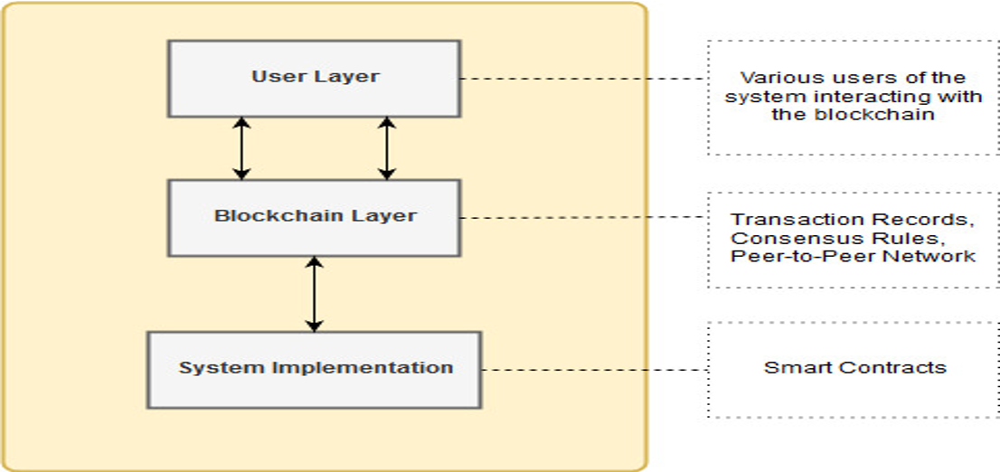
System Architecture

Slide 9
User: This is a role-based system, where a user can be either patient, Doctor or an admin who can interact with the system to perform respective tasks. The main tasks are to book an appointment, update medical record, registering doctor or patient etc. User uses the GUI in the proposed system to interact with the blockchain layer.

Slide 10
Blockchain: This layer contains the mechanism for the interaction of the user with DApp. 1) Assets: External user can update state/information of the record known as transaction. The Ethereum blockchain treats these transactions as assets since they contain information that users can send to other users or just store for later use. 2) Governance Rules: Uses POW algorithm(Proof of work). Maintained through consent from trusted nodes attached to the network. 3) Network: All nodes are connected as peers implementing P2P network. It is a decentarlized network promoting a distributed platform. Blockchain: Implemented using Ethereum and its dependencies.

Slide 11
Transactions: It can perform the following functions: 1) Add records: Creates patient medical records along with relevant fields and IPFS hash which contains medical records of the patient. 2) Update records: Can be used to change the basic information of the patient with no change in the IPFS hash for security purpose. 3) View records: Used by both doctors and patients. To ensure that the relevant medical records are shown to the patient, the system uses public account address. 4) Delete records: The doctors have the right to delete patient records. 5) Grant Access: Only doctors have access to add/update patient's medical records.

Slide 12
Smart Contract: These contracts are used to grant users' access to the DApp and carry out CRUD operations on patient records. The contracts used in this framework are Patient Records and Roles. The sole purpose of the Patient Records smart contract is to carry out the functionality of the suggested architecture.
The Open Zeppelin smart contract library provides a predefined smart contract called Roles. This library includes a number of smart contracts that execute different functionalities and can be used to build our own functions. The role-based access ensures that no third party has access to these functions except for the authenticated users of the system.

Slide 13
Functionality: Admin possesses all the functionalities of a Doctor and a patient. Whenever a function is performed, the transaction will cost some ethers to verify it. Whenever an account has access to the user's functions, their details are converted to a JSON object and are uploaded to the IPFS, and the IPFS hash is stored in Blockchain which is used to retrieve the record.

Slide 14
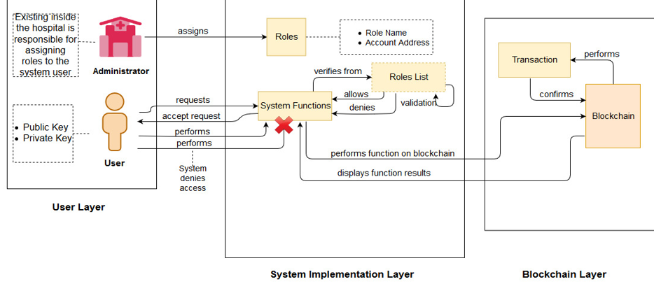
User Interaction with DApp

Slide 15
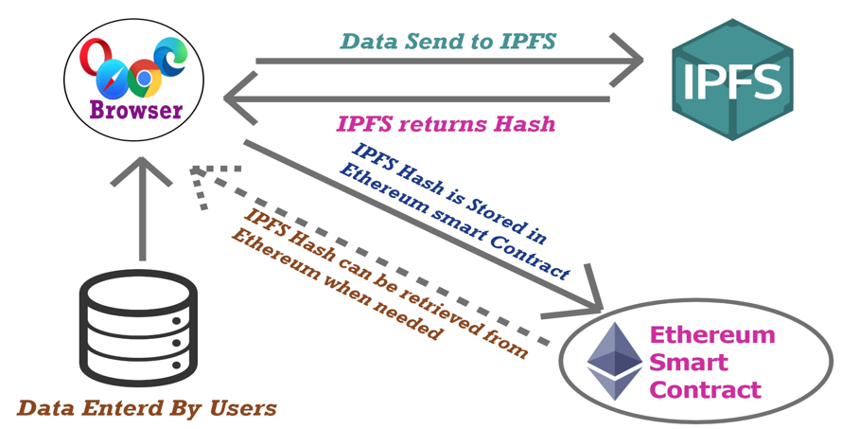
Workflow of DApp

Slide 16
Advantages Secure/confidentiality – Records can be accessed and managed securely. Authentication – Only admins can create records of Doctors/Patients Access – Patients can access only their records. Blockchain helps in simplifying the process of booking an appointment eliminating in the need of manual work. Patients can upload their documents easily.

Slide 17
Conclusion: Our suggested framework combines granular access controls for those records with secure record storage. It develops a system that is simpler for users to use and comprehend. The framework also suggests steps to ensure that the system addresses the issue of data storage given that it makes use of IPFS's off-chain storage feature. Additionally, the system benefits from role-based access because only related and trustworthy individuals have access to medical records. This also fixes the EHR system's information asymmetry issue.

Slide 18
Future Work: Payment module can be implemented in the existing framework. In order to determine how much a patient will pay for a doctor appointment on this decentralized system operating on the blockchain, we must take certain factors into account. Medical Insurance and appointment module can also be implemented.

Slide 19
Thank you

