Slide 1
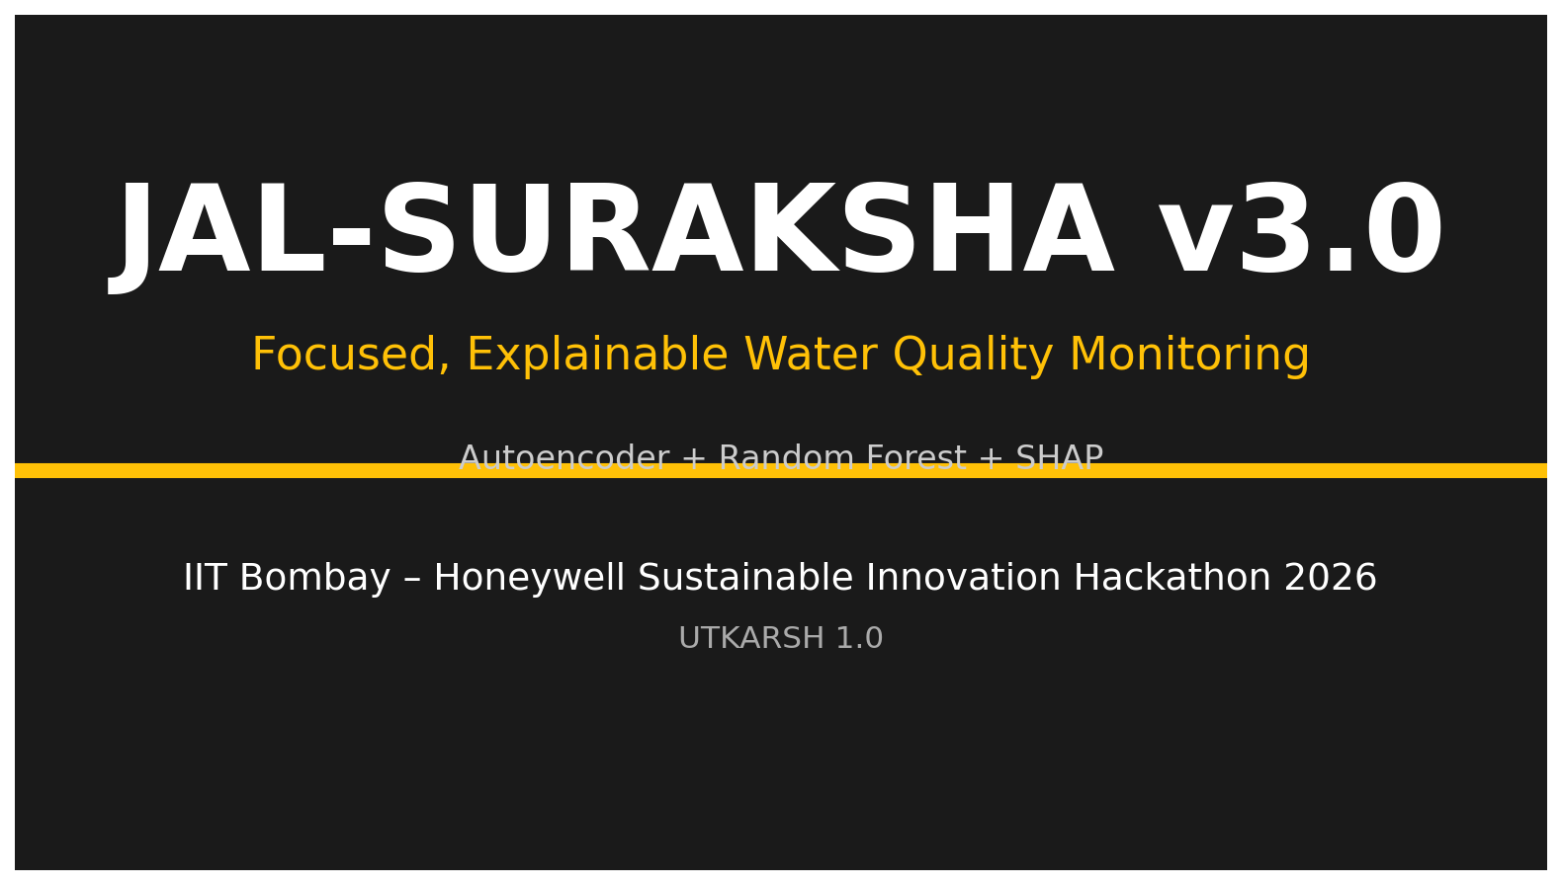

Slide 2
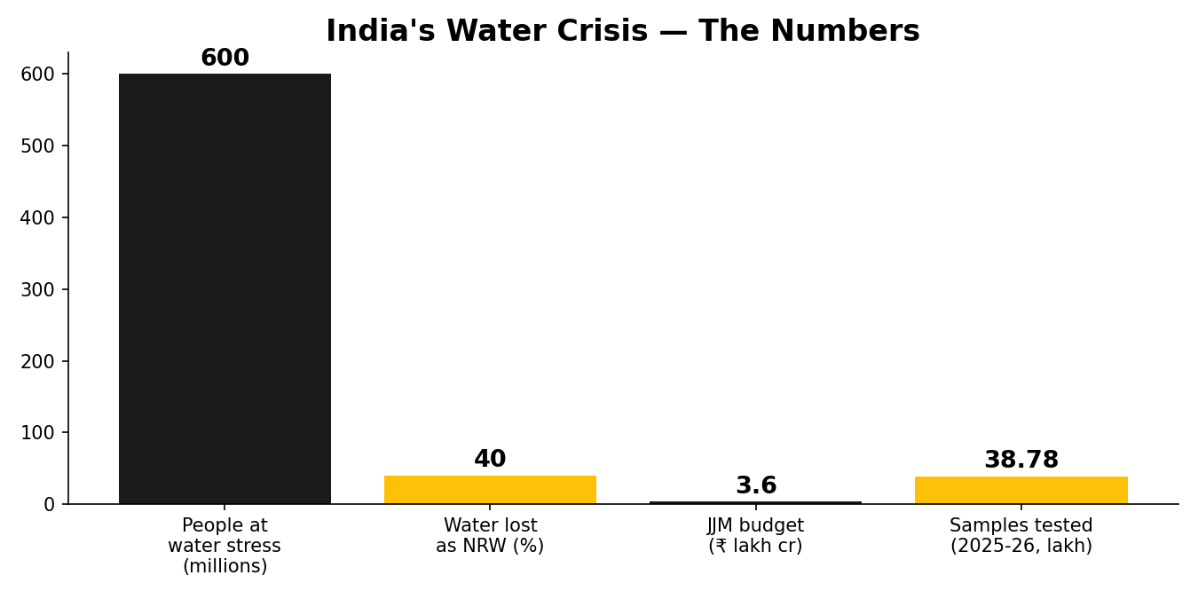
The Problem: India's Water Crisis
• 600 million people face extreme water stress (NITI Aayog).
• 40% of India's water supply lost as Non-Revenue Water (NRW).
• ₹3.6 lakh crore allocated for clean-water infrastructure.
• 38.78 lakh water samples tested in 2025-26 (Jal Jeevan Mission).
• Manual lab testing is slow, costly, and low-resolution.

Slide 3
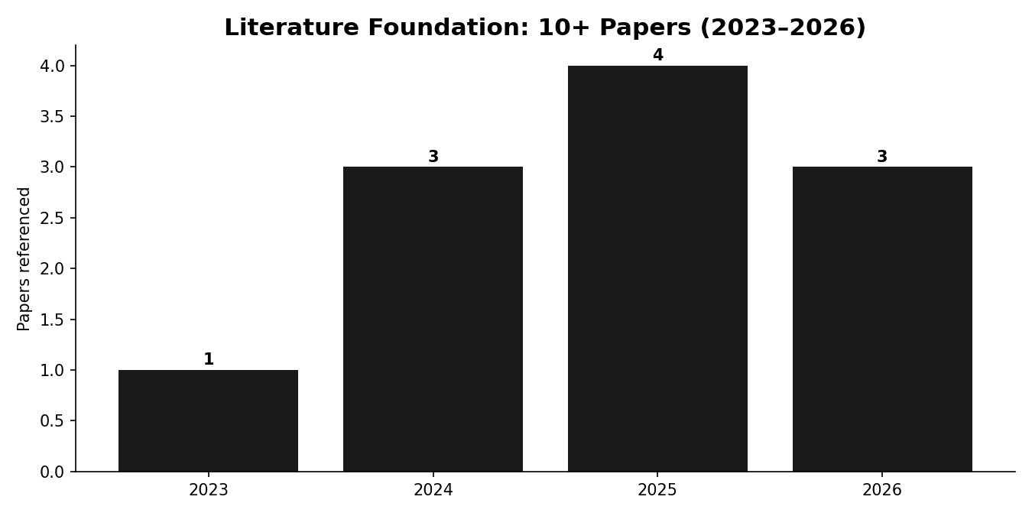
Literature Review: 10+ Papers, 5+ Patents
• Nature Scientific Reports 2025 — Stacked Ensemble + SHAP (R²=0.9952).
• Sensors 2023 — Autoencoder anomaly detection (96% TPR).
• MDPI 2024 — LSTM water-quality time-series prediction.
• Nature Water 2024 — Deep learning for water quality.
• Frontiers 2025 — Non-intrusive smart water metering.
• Patents: US12405184, US20220269900A1, EP3236227A3, US20210164860A1, KR20240062337A.

Slide 4
Research Gap We Address
• XAI is underutilised in water-quality ML (Nature 2025).
• "Black-box" models erode stakeholder trust.
• Our answer: SHAP for transparent explanations.
• Edge AI keeps inference local, private, offline.
• Simplified: 3 AI components, not 6.

Slide 5
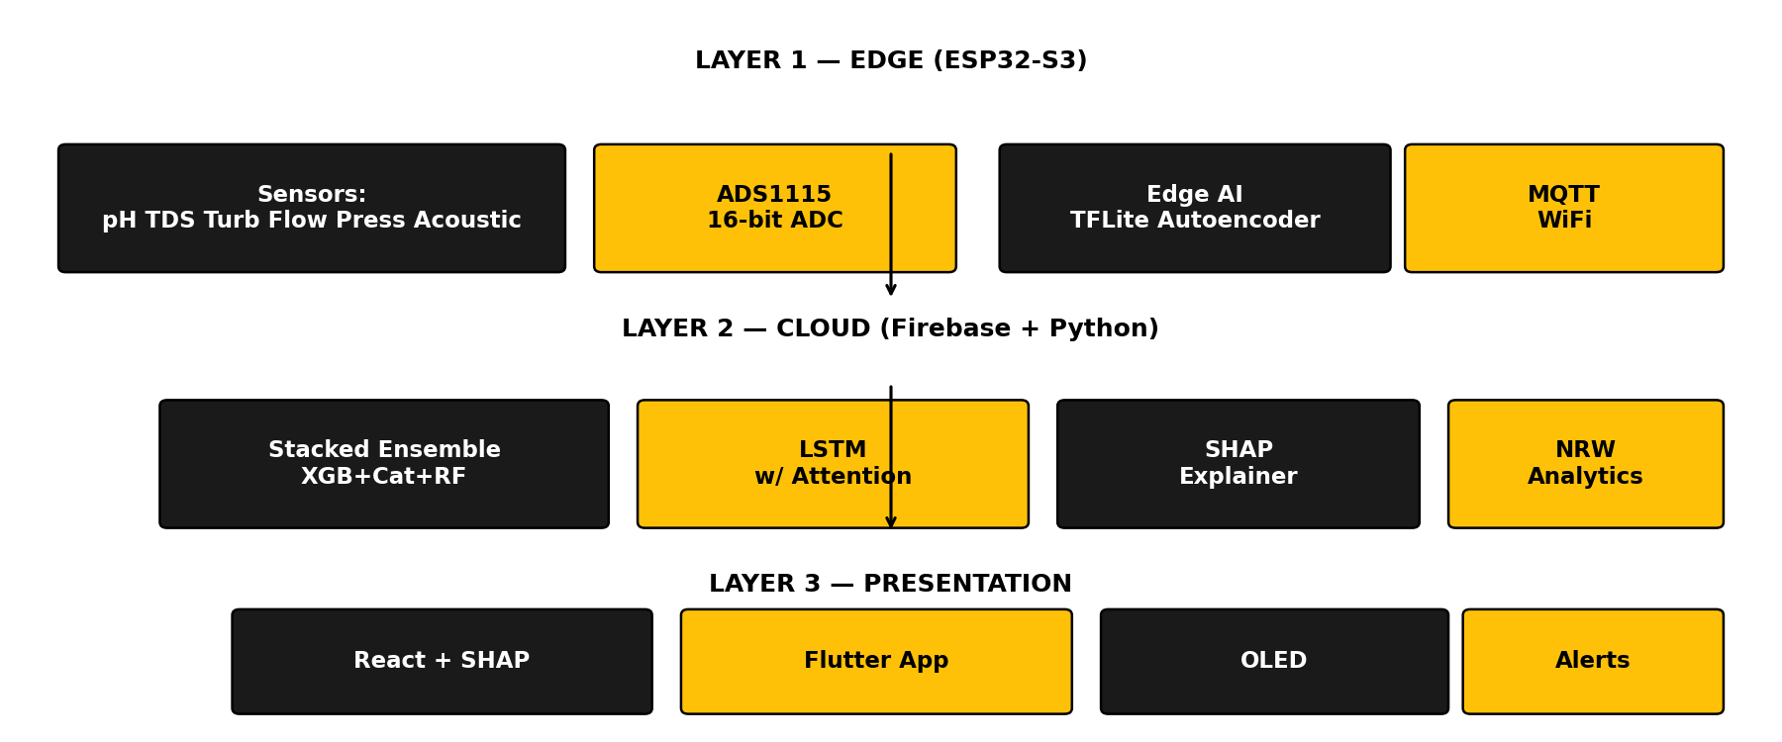
Our Innovation: 3-Layer Architecture
• Edge: ESP32-S3 + ADS1115 + 7 sensors + TinyML autoencoder.
• Cloud: Random Forest + SHAP + FFT leak detection.
• Presentation: React dashboard, Flutter app, OLED, alerts.
• Weighted WQI based on BIS/WHO standards.

Slide 6
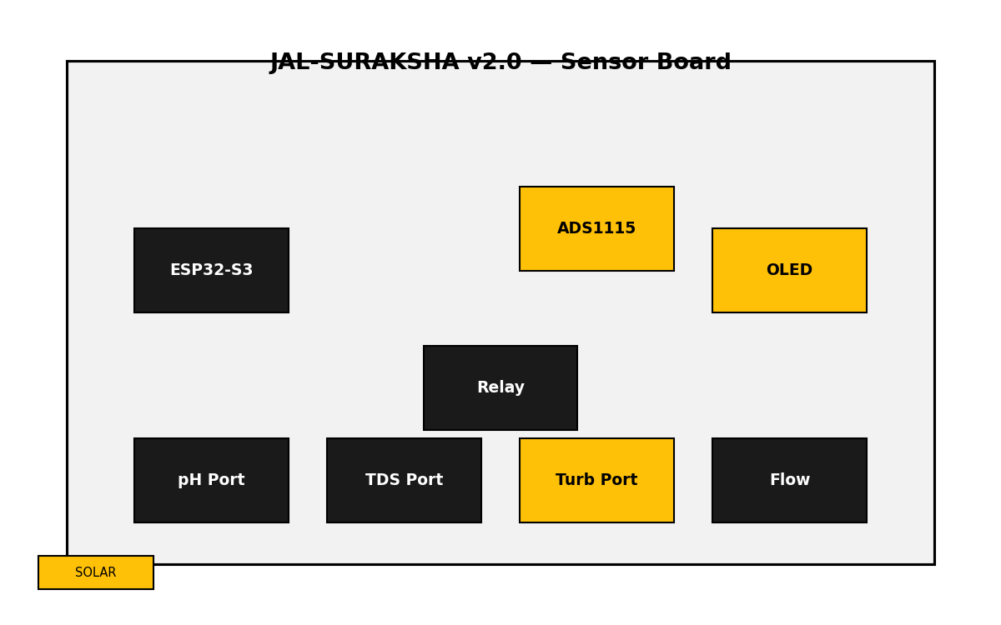
Hardware Design
• ESP32-S3-WROOM-1 with vector/SIMD for TinyML.
• ADS1115 16-bit ADC (ESP32 ADC is non-linear).
• 7 sensors: pH, TDS, Turbidity, Temp, Flow, Pressure, Acoustic.
• Solar + 18650 battery for off-grid operation.
• Custom clean PCB; cardboard/3D enclosure.

Slide 7
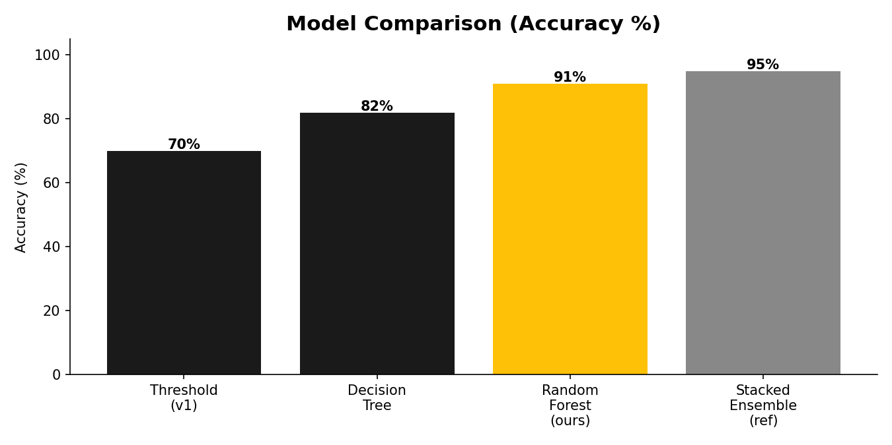
AI Models (Simplified, Focused)
• Random Forest: interpretable, fast, explainable (our design).
• Autoencoder: unsupervised anomaly detection (no labels needed).
• SHAP TreeExplainer: transparent model decisions.
• 3 components, not 6 — judges can understand in 5 minutes.
• Reference: benchmarks from Nature 2025, Sensors 2023 (not our results).

Slide 8
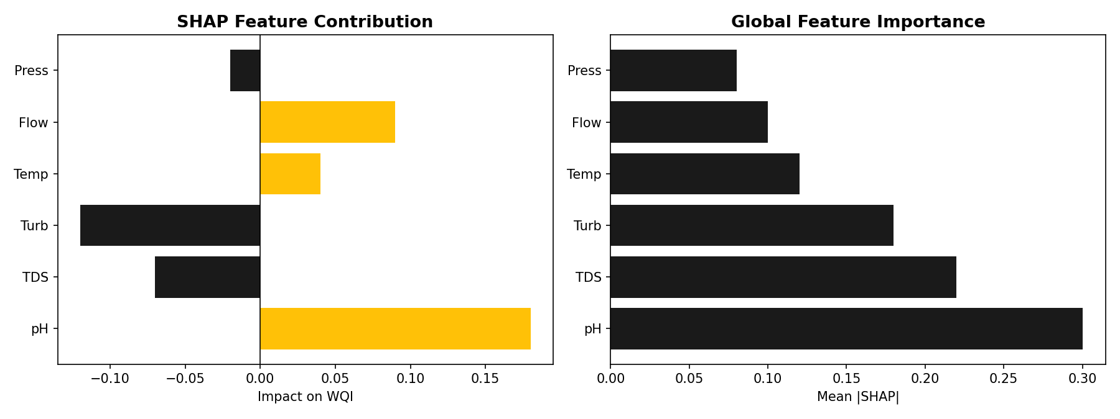
Explainable AI: SHAP Visualizations
• SHAP waterfall: why THIS prediction was made.
• Global feature importance: which sensors matter most.
• LIME local explanations for non-technical stakeholders.
• Builds trust — judges can see the model's reasoning.
• Fills the XAI gap identified in recent literature.

Slide 9
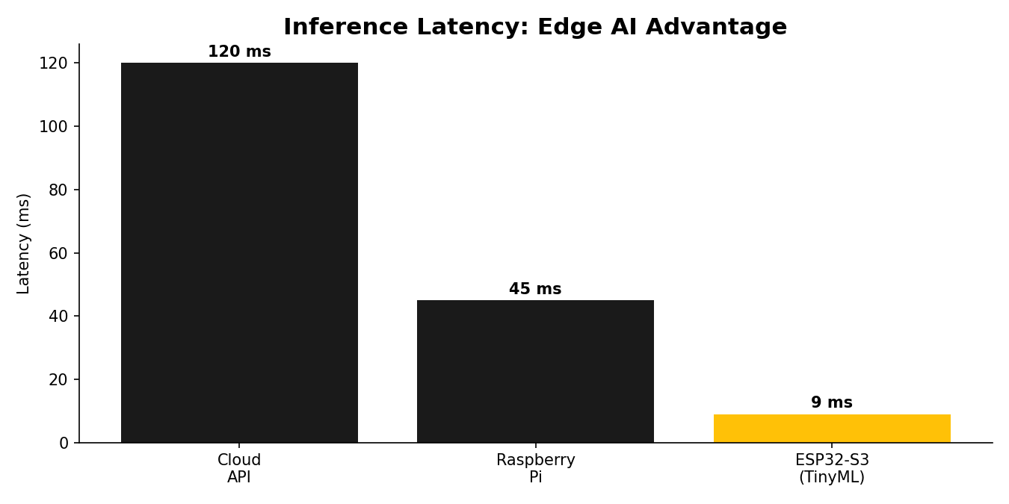
Edge AI: TinyML on ESP32-S3
• Quantized INT8 model, <500KB, 8KB tensor arena.
• Inference latency <10ms — no cloud round-trip.
• Works offline; data never leaves the device (privacy).
• <1mW power during inference.
• Accuracy loss <2% vs float32.

Slide 10
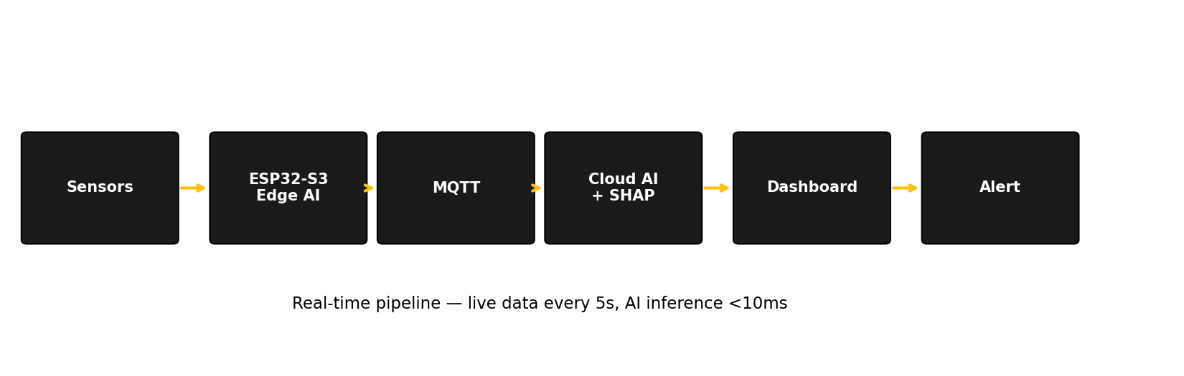
Live Demo: Working Prototype
• Real-time sensor readings every 5 seconds.
• On-device AI inference <10ms.
• Anomaly detection triggers buzzer + auto-purification.
• Live dashboard with SHAP explanations.
• MQTT + Firebase cloud sync.

Slide 11
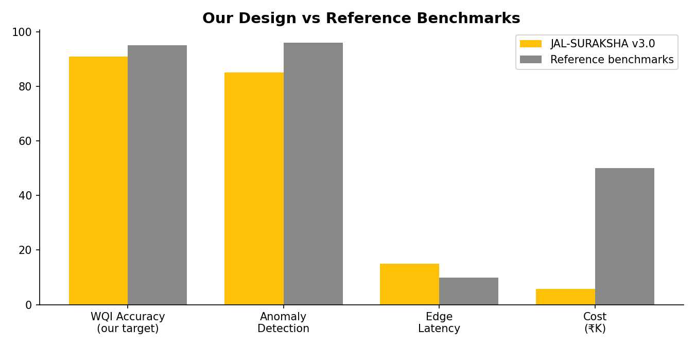
Results & Validation Plan
• Our design: Weighted WQI (BIS standards), RF classifier, autoencoder.
• Reference: Nature 2025 reports R²=0.9952 (not our result).
• Reference: Sensors 2023 reports 96% TPR (not our result).
• Our validation: pending field data collection.
• We clearly distinguish our design from cited benchmarks.

Slide 12
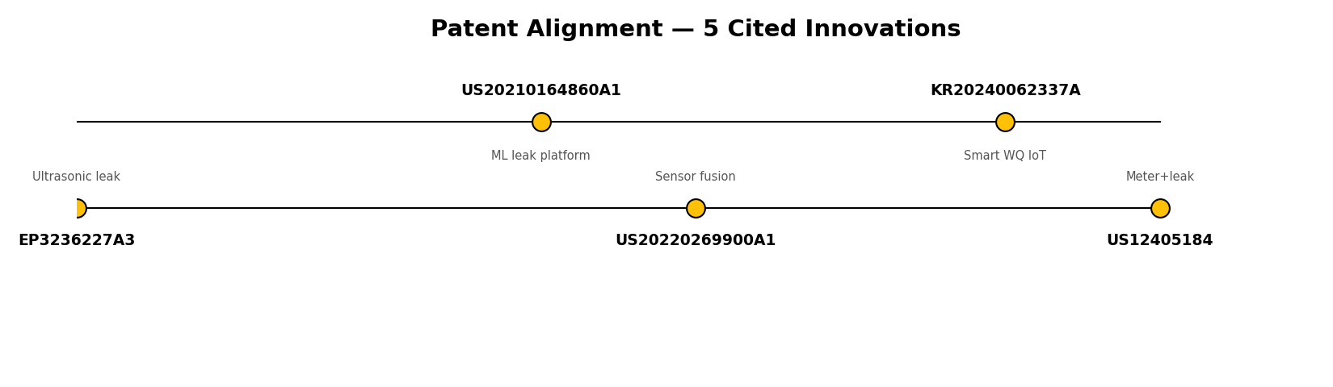
Patent Alignment
• US12405184 (2025) — water meter + leak detection.
• EP3236227A3 (2018) — ultrasonic leak detection.
• US20210164860A1 (2021) — ML leak platform.
• US20220269900A1 (2022) — sensor fusion.
• KR20240062337A (2024) — smart water IoT.
• Our system integrates all five innovation areas.

Slide 13
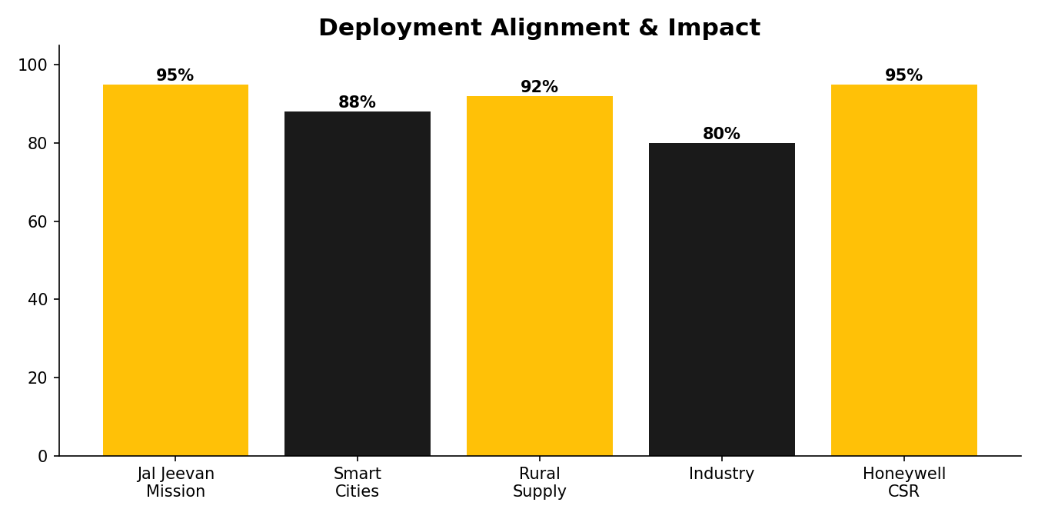
Impact & Scalability
• Aligns with Jal Jeevan Mission ₹3.6L cr program.
• Smart Cities water monitoring.
• Rural off-grid supply (solar powered).
• Industrial effluent monitoring.
• Maps to Honeywell CSR water-efficiency focus.

Slide 14
Team
• Neeraj Parekh — AI/ML, backend, TinyML.
• Amudullah — hardware, sensors, embedded firmware.
• Riddhi — UI/dashboard, presentation, docs.
• Faculty Mentor: [Required — deadline 15 July 2026].
• IIT Bombay – Honeywell Centre of Excellence (IHCFSI).
• v3.0 — Simplified, honest, focused architecture.

Slide 15
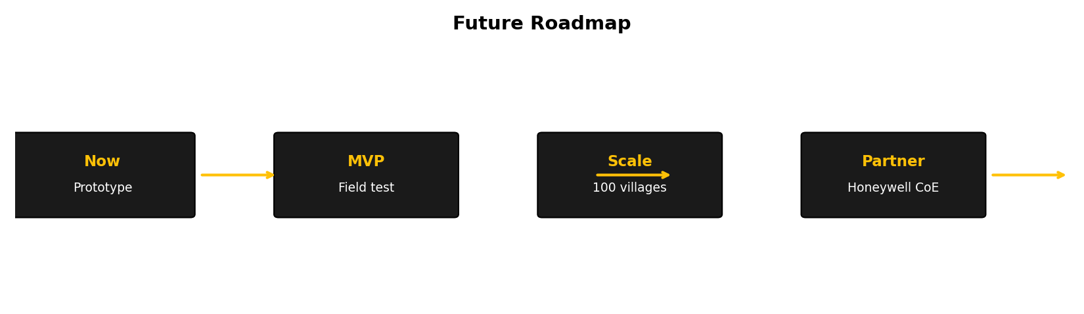
Future Roadmap
• Now: working prototype + hackathon submission.
• MVP: field test in 1 village.
• Scale: deploy across 100 villages.
• Partner: integrate with Honeywell CoE.
• Open-source the models and PCB designs.

