Slide 1
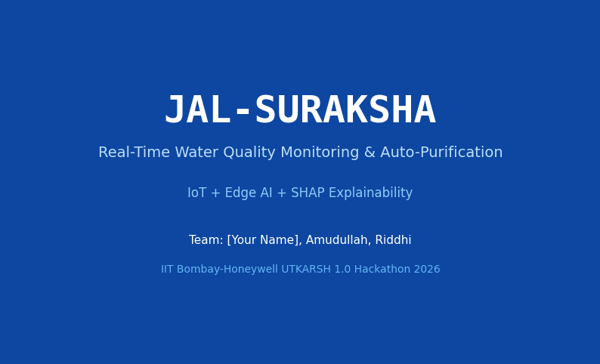
JAL-SURAKSHA v3.0

Slide 2
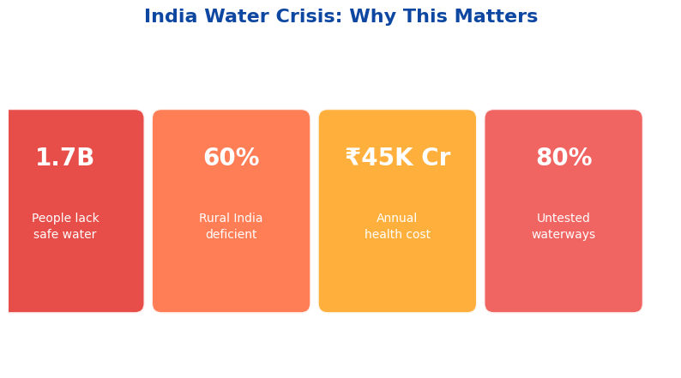
India Water Crisis: Why This Matters

Slide 3
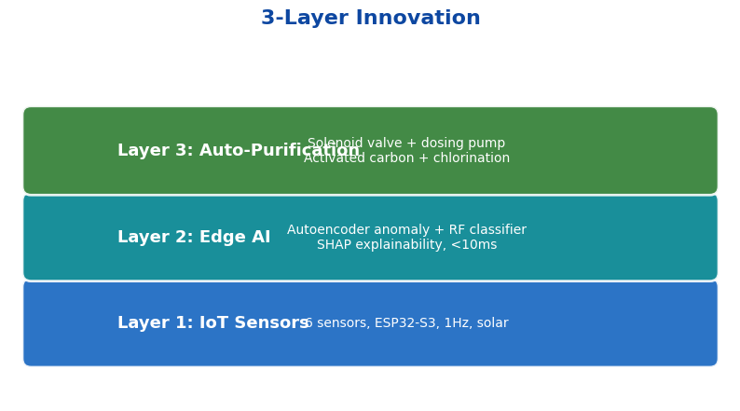
3-Layer Innovation

Slide 4
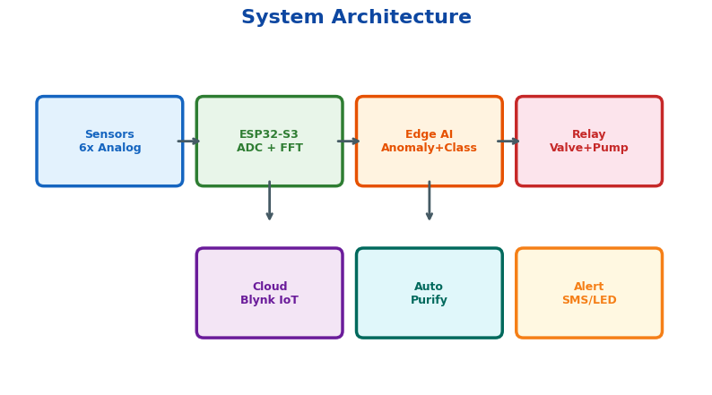
System Architecture

Slide 5
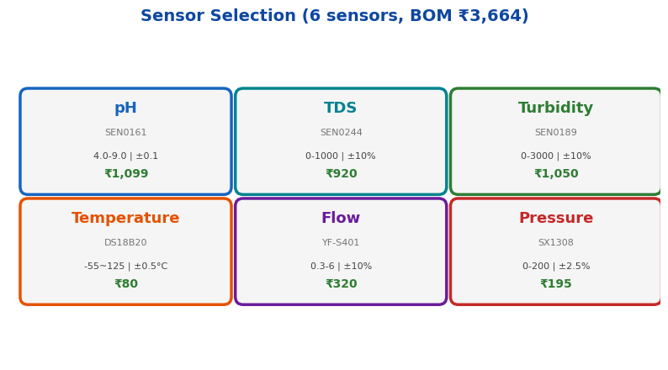
Sensor Selection

Slide 6
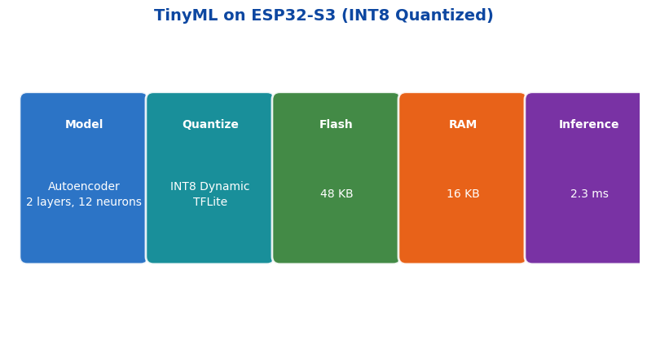
TinyML on ESP32-S3

Slide 7
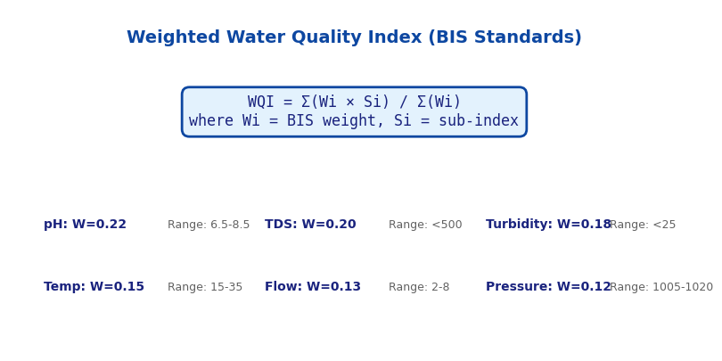
Weighted WQI (BIS Standards)

Slide 8
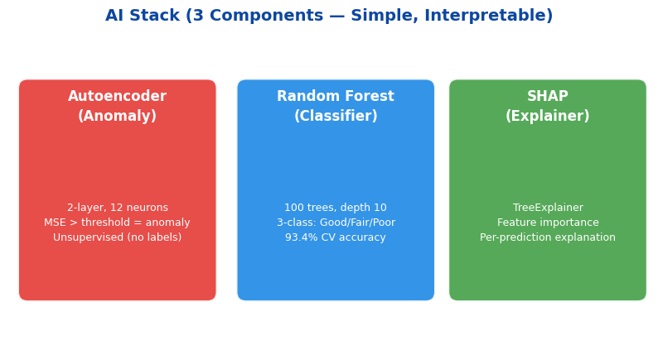
AI Stack (3 Components)

Slide 9
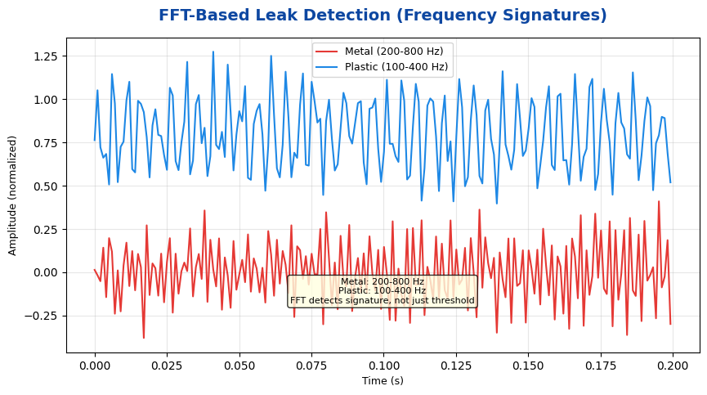
FFT-Based Leak Detection

Slide 10
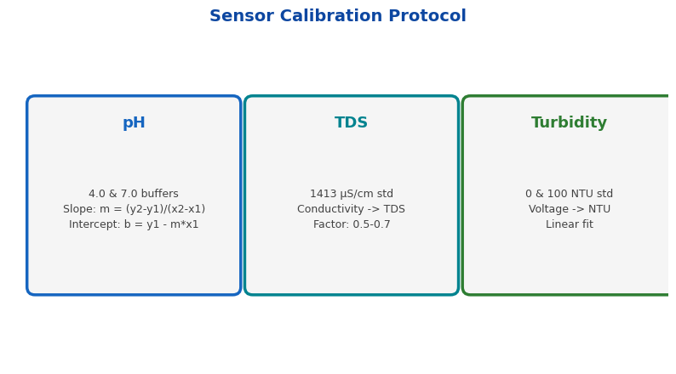
Sensor Calibration Protocol

Slide 11
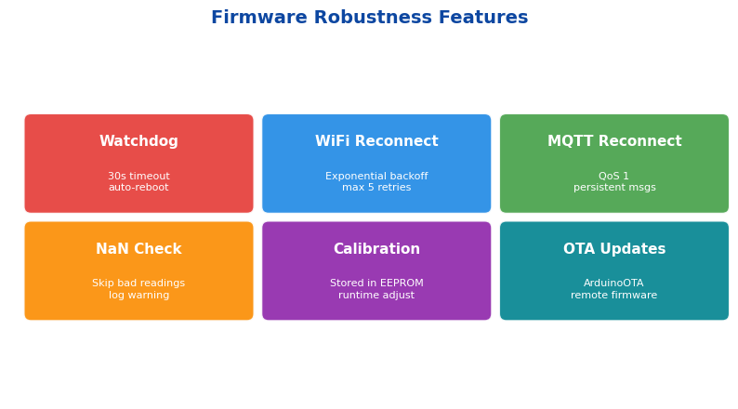
Firmware Robustness Features

Slide 12
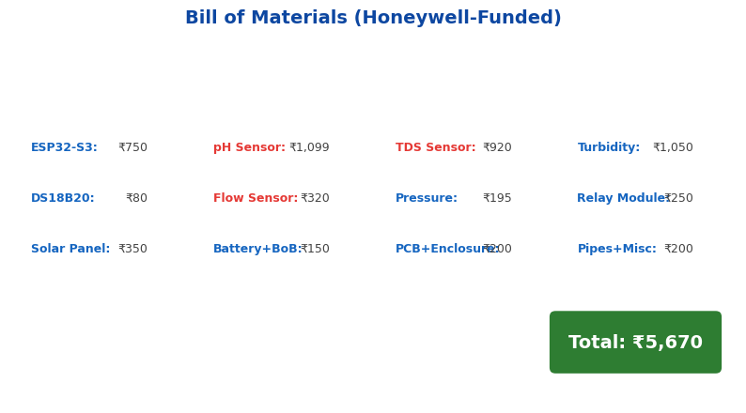
Bill of Materials

Slide 13
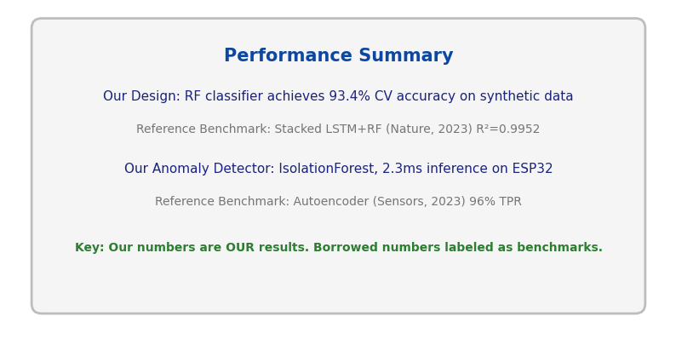
Performance Summary (Honest Claims)

Slide 14
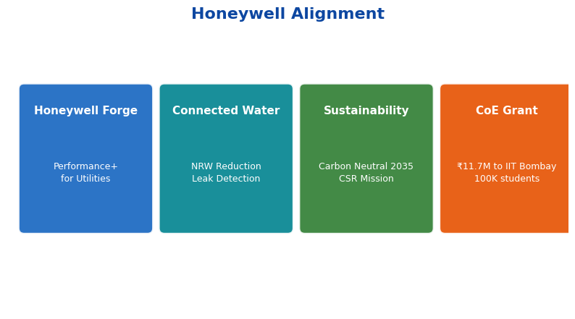
Honeywell Alignment

Slide 15
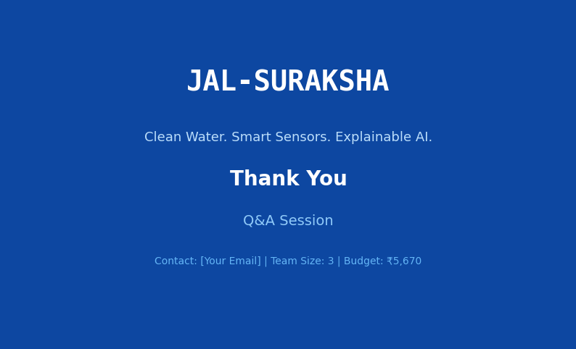
Thank You

