Slide 1

UTKARSH 1.0 · IIT BOMBAY × HONEYWELL · 2026
✦
LORA · EDGE AI · CREDIT
A PADDY-FIELD INTELLIGENCE SYSTEM
865 MHZ · 1–5 KM
AGRI-GRID
◐
◐
NODE A
NODE B
◌
✦
GATEWAY
◐
LoRa Sensor Grid for Paddy Water & Methane Intelligence
◐
01
NODE C
✦
LoRa Grid
◯
Edge AI
✿
Credit Engine
TEAM [TBD] · PROBLEM STATEMENT ID [TBD] · MENTOR [TBD]
✿
SUSTAINABILITY · ESG · MRV
Notes:
Speaker notes:
- Open with the project name and a one-line value prop: "AGRI-GRID turns a few cheap LoRa sensors into paddy water + methane intelligence that farmers and credit markets can trust."
- Name the team: Neeraj (AI/ML), Amudullah (Hardware), Riddhi (Frontend). Mentor and PSID to be confirmed.
- Signal the three pillars up front — LoRa Grid, Edge AI, Credit Engine — so the audience has the spine before we dive in.
- Transition: "Before the solution, the problem — and why it has stayed unsolved."

Slide 2
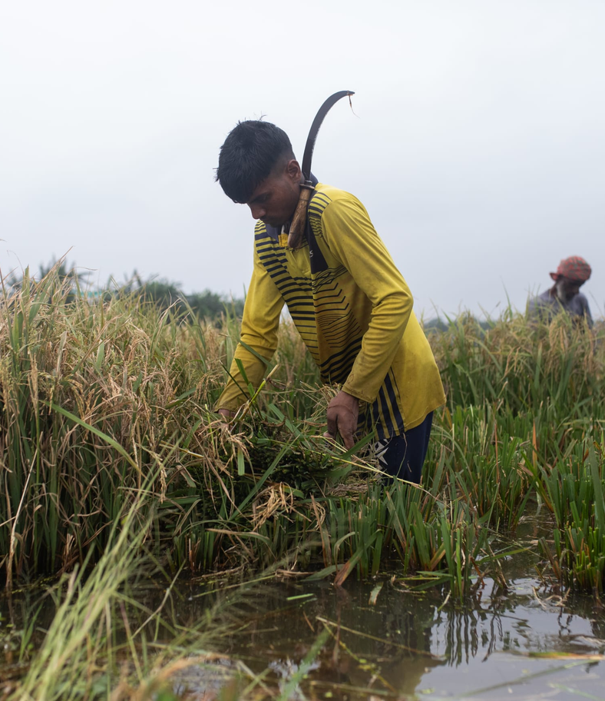
THE PROBLEM
Paddy farming is drowning
in water — and methane
30–50%
Avoidable irrigation water wasted in continuously flooded paddy
◐
~10–12%
Of agricultural greenhouse-gas emissions come from paddy methane
☁
Flooded paddy, monsoon India
Income loss
Over-irrigation raises input cost and cuts farmer margin per hectare
↘
flooded fields · 30–50% avoidable water · methane hotspot
Notes:
Speaker notes:
- Open with the felt problem: paddy is flooded by default, not by design.
- Land the two numbers hard — 30–50% of irrigation water is avoidable, and ~10–12% of agricultural GHG comes from paddy methane.
- Connect the third card to farmer income: over-irrigation is not just waste, it's lost margin.
- Transition: "So why haven't existing tools solved this? They fail in three specific ways."

Slide 3
WHY CURRENT TOOLS FAIL
Single sensors. No AWD. No proof.
✕
THREE FAILURE MODES
✕
01 / IOT KIT
✕
02 / MANUAL
✕
03 / APP-ONLY
Generic IoT kit
Manual observation
App-only dashboards
Single WiFi node, 10–50m range, one point measurement. No spatial view of the field.
Farmer walks paddy zones daily to eyeball water level. Misses anomalies overnight, no audit record.
Pretty UI on top of sparse or simulated data. No AWD cycle, no methane math, no credit eligibility.
MISSING: SPATIAL GRID · LONG RANGE
MISSING: AWD · CREDIT ENGINE
MISSING: CONTINUOUS DATA · PROOF
point-only · no spatial · no credit
AGRI-GRID · 03
Notes:
Speaker notes:
- Name the three failure modes: generic IoT kit, manual observation, app-only dashboards.
- Emphasize that all three miss one thing — credit-grade proof. That's the gap we close.
- "No AWD" is the technical term that anchors the rest of the deck.
- Transition: "Here's the coordinated grid that fixes all three at once."

Slide 4
OUR SOLUTION
A coordinated sensor grid that turns water data into credit
▦
3 PILLARS · 1 BUILD
✦
PILLAR 01
◯
PILLAR 02
✿
PILLAR 03
LoRa Grid
Edge AI
Credit Engine
Spatial sensing across paddy zones
On-device anomaly detection
AWD → methane → water/carbon credit
✓ IsolationForest (sklearn)
✓ AWD cycle detection
✓ Explainable scores 0–1
✓ 865MHz IN865 · 1–5 km range
✓ 3+ nodes per field
✓ Star topology → 1 gateway
✓ Days-in-AWD compliance
✓ Methane −30–50%
✓ MRV-ready eligibility flag
IDENTIFY
SENSE
DECIDE
grid · edge-AI · AWD→credit
AGRI-GRID · 04
Notes:
Speaker notes:
- Pillar 1 — LoRa Grid: spatial sensing, not point sensing, with 1–5 km range at 865MHz.
- Pillar 2 — Edge AI: anomalies flagged on-device with IsolationForest, AWD cycles auto-detected.
- Pillar 3 — Credit Engine: turns AWD days into methane reduction and a credit-eligibility flag.
- Punchline: grid + AI + credit in one ~₹15K build — that combo is what's new.
- Transition: "Here's how those three pillars fit together in one architecture."

Slide 5
SYSTEM ARCHITECTURE
Star grid → cloud → Agri Stack → dashboard
✦
4 LAYERS
LAYER 04
Web heatmap dashboard · AWD→methane→credit engine · Alert panel · Agri Stack adapter
▦
DATA FLOW ↑
DASHBOARD + CREDIT
Sensor data
↑
HTTPS · REST
Aggregated + identified
Credit-decisioned
LAYER 03
FastAPI / ThingsBoard · PostgreSQL + PostGIS · IsolationForest anomaly model · UFSI schema adapter (mock)
☁
CLOUD
⚡
OFFLINE-FIRST
↑
WIFI/HTTP ↑
Gateway buffers LoRa frames if WiFi drops; replays on reconnect.
LAYER 02
Heltec WiFi LoRa 32 V3 · ESP32 + SX1262 · WiFi uplink · OLED debug display
◌
GATEWAY
↑
LORA 865MHZ IN865 ↑
TOPOLOGY
✦
Star · 3 nodes → 1 gateway
LAYER 01
Node A (NW edge) · Node B (NE edge) · Node C (S center) — each: water level + temp + soil moisture + battery
✦
FIELD NODES ×3
865MHz IN865 · star topology · offline-first
AGRI-GRID · 05
Notes:
Speaker notes:
- Walk the stack bottom-up: 3 field nodes → Heltec gateway → FastAPI/ThingsBoard cloud → dashboard + credit engine.
- Emphasize offline-first: gateway buffers LoRa frames if WiFi drops, replays on reconnect.
- Note UFSI adapter is mocked for the prototype — Agri Stack integration is real but stubbed.
- Transition: "Let's open up one node and see exactly what's inside."

Slide 6


HARDWARE / NODE
One node: ₹~2,200 · months of solar life
▦
5 SENSORS · 1 BRAIN
Component | Spec
Heltec WiFi LoRa 32 V3 | ESP32 + SX1262 + OLED, 865MHz IN865
JSN-SR04T | Waterproof ultrasonic, IP67, ±3mm
DS18B20 | Waterproof temp probe, -55 to +125°C
Capacitive soil v1.2 | No corrosion, air=0% / sat=100%
18650 + 1W solar | 3400mAh, 6–10 months deep-sleep
IP65 box | Weatherproof field enclosure
◐
JSN-SR04T
✦
DS18B20
Ultrasonic · IP67
Temp probe · ±0.5°C
₹315
₹120
▦
BRAIN
Heltec WiFi LoRa 32 V3
✿
Capacitive soil v1.2
No corrosion
ESP32 + SX1262 · 865MHz
₹80
ONLINE
◆
HONEST NOTE
6–10 months battery-only with true deep sleep. Heltec V3 quiescent (~100µA+) cuts this to 1–3 months — cut board power with a MOSFET between reads to hit the full claim.
⛨
IP65 box
▮
18650 + 1W solar
Weatherproof
3400mAh Li-ion
₹200
₹350
IP67 sensor · IN865 · 6–10 mo battery
AGRI-GRID · 06
NODE CALLOUT · ₹~2,200 BOM
Notes:
Speaker notes:
- Walk the 5 callouts: ultrasonic (water level), DS18B20 (temp), capacitive soil v1.2, 18650+solar, IP65 box.
- Brain board is Heltec WiFi LoRa 32 V3 — ESP32 + SX1262 on 865MHz IN865.
- Land the BOM number: ~₹2,200 per node, replicable from off-the-shelf parts.
- Read the honest battery note aloud — Heltec V3 quiescent current limits the claim unless we add a MOSFET cut.
- Transition: "Now let's see how a single reading becomes a credit decision."

Slide 7
HOW IT WORKS
From field to farmer credit in 4 hops
01
✦
02
◯
03
☁
04
✓
SENSE
EDGE-AI
CLOUD
CREDIT
3 nodes measure water level, temp, soil moisture every 5 min. Deep-sleep between reads.
→
On-device IsolationForest flags anomalies + AWD cycle detection. Score 0–1 per reading.
→
Gateway forwards to FastAPI. Zone data linked to FPO farmer ID via UFSI schema (mock).
→
Dashboard computes methane reduction (kg CO₂e/ha) + water/carbon credit eligibility flag.
04
5-MIN CADENCE
UFSI-LINKED
MONETIZABLE
NO CLOUD ROUND-TRIP
sense → infer → link → credit
Notes:
- Narrate the 4 hops in 20 seconds: Sense → Edge-AI → Cloud → Credit.
- Step 4 (CREDIT) is the monetizable differentiator — methane reduction translated to a credit eligibility flag.
- Deep-sleep + 5-min cadence keeps the nodes battery-frugal.
- Edge-AI runs on-device (IsolationForest) so we don't need cloud round-trips for alerts.
- Transition: "next slide shows the AWD cycle and how it cuts methane 30–50%".

Slide 8
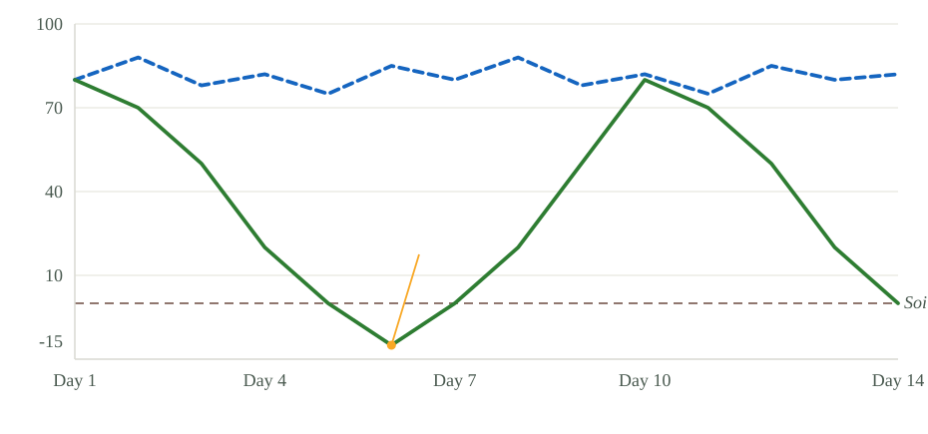
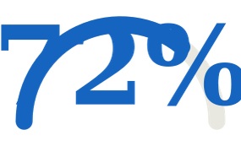
THE DIFFERENTIATOR
Alternate Wetting & Drying cuts methane 30–50%
Water depth (mm) — 14-day cycle
Flooded (baseline) AWD
30–50%
CH₄ REDUCED
methane cut vs continuous flooding
Range per published AWD field studies
AWD dry-down to −15cm triggers methanogenesis stop → methane cut 30–50%
CREDIT ELIGIBILITY
driven by AWD adherence + water saved
illustrative · formula: AWD adherence × water saved
AWD · −30–50% CH₄ · credit-ready
Notes:
- Walk the chart: AWD = drain to −15 cm then refill; flooded baseline stays ~80 mm.
- The −15 cm dry-down halts methanogenesis → 30–50% methane cut (IRRI range).
- Donut = methane cut %; gauge = credit eligibility score a farmer takes to an MRV/buyer.
- 72% is illustrative; derived from AWD adherence + water saved per zone.
- Transition: "next slide shows how we link each zone to a farmer via Agri Stack".

Slide 9
AGRI STACK INTEGRATION
Agri-Stack-ready: farmer identity, sandbox today
✦
✦
⛨
SENSOR ZONE
→
FPO FARMER ID (UFSI MOCK)
→
SCHEME ELIGIBILITY
Each paddy zone maps to a geo-referenced plot boundary from Agri Stack village maps.
PM-KUSUM / PMFBY eligibility flag computed from AWD compliance + plot data.
Zone linked to farmer identity via UFSI schema — simulated Farmer Registry + Crop Sown payloads.
GEO-REFERENCED PLOT
AUTO-FLAGGED PER CYCLE
OPENAPI 3.0 SCHEMA
⚠
⚠ HONEST SCOPE
Live UFSI / Agri Stack API is not openly callable by students — it requires developer-portal registration, MoAFW use-case review, sandbox credentials, and CERT-In empaneled security audit for production. We build against the published OpenAPI 3.0 UFSI schema with simulated payloads and ship a clean adapter module — when sandbox credentials arrive, live calls drop in with zero code change. We claim "Agri-Stack-ready (sandbox-integrated)", not "live in prod".
UFSI schema · mock · FPO identity
Notes:
- Walk the 3-step flow: zone → farmer identity → scheme eligibility.
- READ the honest scope note aloud — credibility signal to a technical jury.
- Emphasize "zero code change when the live API arrives" — adapter pattern.
- We claim "Agri-Stack-ready (sandbox-integrated)", not "live in prod".
- Transition: "next slide shows the live dashboard a farmer/FPO sees".

Slide 10
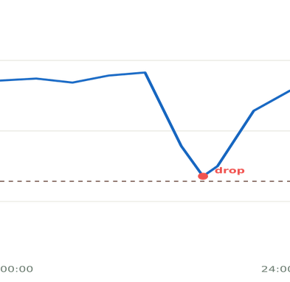
DASHBOARD & ALERTS
One field. Live spatial view.
LIVE KPI STRIP
Water saved (m³)
1,240
AGRI-GRID Dashboard · FPO Cluster Maharashtra
PADDY ZONES · LIVE MOISTURE
ZONE B2 · 24H WATER DEPTH
Methane cut
(kg CO₂e/ha)
180
A1
A2
A3
B1
B2
B3
Credit eligibility
72%
C1
C2
C3
Live KPIs update every 5 min from grid
⚠
Zone B2: water level dropped 4 cm in 30 min — anomaly flagged by IsolationForest (score: 0.87)
mm
heatmap · alert · live
Notes:
- Walk the dashboard: 3×3 heatmap → alert toast → live KPI strip on the left.
- Zone B2 (red) is the anomaly IsolationForest flagged; score 0.87 above 0.7 threshold.
- Right-side mini chart shows the 24h water-depth trend for B2 with the visible drop.
- "This is what the live demo will show" — set expectation for jury demo.
- Transition: "next slide goes under the hood of the edge-AI model".

Slide 11
AI / ML COMPONENT
Edge anomaly detection, not just dashboards
PIPELINE · ON-DEVICE
Anomalies caught vs baseline (30-day window)
1
✦
INPUT: 4-NODE TIME SERIES
Count of confirmed anomaly events
water level · temp · soil · battery (5-min cadence)
Sudden water drop
(leak / breach)
7
↓
Sensor drift
(calibration loss)
4
2
▦
MODEL: ISOLATIONFOREST (SKLEARN)
on-device, no cloud round-trip
Battery drain pattern
3
↓
Moisture anomaly
(pest indicator)
2
3
▦
SCORE: 0–1 PER READING
threshold > 0.7 = anomaly
↓
Baseline (simple threshold) — same 30 days
Sudden water drop caught
2 / 7
4
◔
OUTPUT: ALERT + AWD CYCLE TAG
Baseline = simple threshold alerts: catches only 2 of 7 leak events.
explains which feature drove the score
on-device · IsolationForest · explainable
Notes:
- Emphasize "on-device" — IsolationForest runs locally, no cloud round-trip = offline-first.
- Explainability: each alert says which feature drove the score (water / temp / soil / battery).
- Land the bar chart: 7/7 leak events caught vs 2/7 with simple thresholds.
- Anomaly types beyond leaks: sensor drift, battery drain, moisture anomaly (pest proxy).
- Transition: "next slide compares us against paddyAkvo and generic IoT kits".

Slide 12
COMPETITIVE LANDSCAPE
vs paddyAkvo & generic IoT
Feature | paddyAkvo (Enthu Tech) | Generic IoT kit | AGRI-GRID
Grid spatial view | single node | single node | 3+ node grid✓
Edge AI anomaly detection | no | threshold only | IsolationForest on-device✓
Agri Stack identity (UFSI) | no | no | schema-ready, sandbox mock✓
AWD → methane → credit engine | partial (methane claim only) | no | full (AWD + methane + credit)✓
Cost (3-zone build) | proprietary / SaaS | ₹5K–10K | ₹14,995✓
paddyAkvo is the closest rival — we add multi-node grid + edge AI + Agri Stack FPO identity in one ₹15K build.
grid · edge-AI · credit · ₹15K
Notes:
- Walk the table row-by-row: grid, edge-AI, Agri Stack, AWD→credit, cost.
- Name paddyAkvo as the closest rival — single-node, no edge AI, no Agri Stack.
- Generic IoT kits are cheap (₹5K–10K) but lack the credit engine and grid spatial view.
- Land the "unique combo" line: grid + edge AI + Agri Stack identity in one ₹15K build.
- Transition: "next slide shows the impact & SDG alignment".

Slide 13
IMPACT & SDG ALIGNMENT
Measurable ESG impact
2
6
9
12
13
Zero Hunger
Clean Water
Industry & Innovation
Responsible Consumption
Climate Action
AWD sustains paddy yield with less water/input
Cuts irrigation water 15–30% per cycle
Resilient rural LoRa IoT infrastructure
AWD cuts paddy methane 30–50%
Water/carbon-credit eligibility drives efficiency
15–30%
30–50%
1 FPO
irrigation water saved per paddy cycle (vs continuous flooding)
methane (CH₄) reduction via AWD compliance
pilot cluster (10–50 farmers scalable to district)
SDG 2/6/9/12/13 · ESG · scalable
Notes:
- Name the 5 SDGs: 2 (Zero Hunger), 6 (Clean Water), 9 (Industry & Innovation), 12 (Responsible Consumption), 13 (Climate Action).
- Land the 3 impact numbers: 15–30% water saved, 30–50% methane cut, 1 FPO pilot cluster.
- Tie explicitly to Honeywell ESG thesis: measurable, scalable, SDG-aligned.
- Transition to feasibility (cost + risks).

Slide 14
FEASIBILITY & COST
₹15K. 4 days. Honest risks.
Cost breakdown — total ₹14,995
Lead-time (LoRa boards)
MED
Robocraze same-day shipping in Bangalore; order Day 1 morning.
Heltec WiFi LoRa 32 V3 ×4
₹8,800
18650 battery ×6
₹1,200
18650 shield ×4
₹1,000
LoRa range in paddy
MED
JSN-SR04T ultrasonic ×3
₹945
Star topology fallback if mesh fails; 1–5 km realistic at 865MHz IN865, +30 dBm EIRP.
IP65 box ×4
₹800
1W solar ×3
₹750
Mentor sign-off
MED
Antenna 865MHz ×4
₹600
Cables/misc
₹300
Email Day 1; IIT-B / IHCFSI faculty targets identified.
DS18B20 ×3
₹360
Capacitive soil ×3
₹240
Agri Stack API gating
MED
Schema-driven mock with simulated payloads; adapter ready for live calls when sandbox arrives.
TOTAL: ₹14,995 · within ₹15K budget
₹14,995 · 4-day · risk-aware
Notes:
- Land the ₹14,995 total — under the ₹15K cap by ₹5.
- Walk top 3 cost lines: Heltec boards ₹8,800 (the dominant line), 18650 battery ₹1,200, shield ₹1,000.
- Walk the 4 risks WITH mitigations — honesty is credibility: lead-time, range, mentor sign-off, Agri Stack API.
- Transition to roadmap (Day 1–4 build).

Slide 15
BUILD ROADMAP
Built in 4 days, July 12–15
JUL 12
JUL 13
JUL 14
JUL 15
DAY 1
DAY 2
DAY 3
DAY 4
JUL 12
JUL 13
JUL 14
JUL 15
Hardware + Firmware
Backend + Integration
Dashboard + Demo Prep
SUBMIT
✓
Final hardware test
Order components (Robocraze same-day)
Set up FastAPI/ThingsBoard + PostgreSQL
Heatmap + alerts dashboard
Deploy dashboard to cloud
Submit on events-ihcfsi.org
Flash Heltec boards, wire sensors
Data ingestion + anomaly model
Agri Stack adapter (mock)
End-to-end dry run + demo rehearsal
Test LoRa link between 2 nodes
Connect gateway → backend
Post-submission: pilot deployment at 1 FPO cluster (Maharashtra / Tamil Nadu) + credit onboarding with MRV partner.
Day1–4 · submit Jul 15
Notes:
- Walk left-to-right through Day 1 → 2 → 3 → 4.
- Day 1: hardware + firmware. Day 2: backend + integration. Day 3: dashboard + demo prep. Day 4: SUBMIT.
- Emphasize Day 4 = submission on events-ihcfsi.org.
- Mention post-submission pilot plan: 1 FPO cluster + MRV credit onboarding.
- Transition to live demo plan.

Slide 16
DEMO PLAN
3-minute live demo
Story arc: problem → proof → impact
01
0:00–0:30
02
0:30–1:30
03
1:30–3:00
LIVE GRID READING
DASHBOARD HEATMAP + ALERT
AWD → CREDIT NUMBER
Open dashboard. Show 3 nodes streaming real water level + temperature + soil moisture from the on-stage paddy setup. LoRa packets arriving every 5 seconds.
Pour water onto Zone B2 sensor live. Heatmap cell turns amber then red. Alert toast fires with IsolationForest anomaly score 0.87.
Switch dashboard to AWD compliance view. Show methane reduction (kg CO₂e/ha) and credit eligibility % computed live from accumulated grid data.
PROOF:
PROOF:
real sensor data on screen, not mocked
spatial view + edge AI working in real time
PROOF:
the credit engine — our differentiator — runs end-to-end
live · spatial · credit
Notes:
- Open with "this is what the judges will see live" — set expectation.
- Walk the 3 beats: 0:00–0:30 grid reading, 0:30–1:30 heatmap + alert, 1:30–3:00 AWD → credit number.
- Emphasize Beat 3 (credit) as the climax — that's our differentiator.
- Transition to team.

Slide 17
TEAM
Who builds it
☻
☻
☻
Neeraj
Amudullah
Riddhi
AI / ML · BACKEND
HARDWARE · FIRMWARE
FRONTEND · DEMO
Backend API (FastAPI)
Anomaly detection (sklearn IsolationForest)
Flash firmware to all 4 Heltec boards
Dashboard (ThingsBoard / React)
Wire sensors + stilling tubes
Spatial heatmap viz
Agri Stack UFSI adapter
LoRa 865MHz link test
Alert UI + KPI strip
PostgreSQL + PostGIS schema
Solar + battery power budget
Demo slides + dry run
▿
MENTOR (TBD)
PENDING
IIT-B / IHCFSI faculty — email Day 1
3 members · mentor TBD
Notes:
- Name each member + their lane: Neeraj (AI/ML · backend), Amudullah (hardware · firmware), Riddhi (frontend · demo).
- Acknowledge mentor as TBD — outreach plan is Day-1 email to IIT-B / IHCFSI faculty.
- 3-person team covers all lanes; mentor fills the sign-off + advisor gap.
- Transition to closing.

Slide 18
THE ASK
Grid the paddy.
Bank the carbon.
A ₹15K LoRa grid that turns paddy water data into measurable methane reduction, water savings, and farmer-credit eligibility — Agri-Stack-ready, edge-AI-checked, SDG-aligned.
✓ Mentor sign-off
✓ Live demo Day 4
✓ Submit Jul 15 on events-ihcfsi.org
TEAM [TBD] · CONTACT [TBD] · UTKARSH 1.0 · IIT BOMBAY × HONEYWELL · 2026
Notes:
- Land the tagline: "Grid the paddy. Bank the carbon."
- State the ask: mentor sign-off + live demo Day 4 + submission Jul 15 on events-ihcfsi.org.
- Thank the judges for their time and attention.
- Open the floor for Q&A.

