Slide 1

Infosys Stroke Patient Healthcare Using Deep Learning
This presentation will provide an overview of the Infosys internship program focused on using deep learning to improve stroke patient healthcare. We'll explore the key program details, the agile methodology, and the technical topics covered throughout the 8-week internship.
by Neeraj Parihar

Slide 2
Programme Overview
Start Date
End Date
Timings
Topics Covered
07 October 2024
02 December 2024
5:00 PM to 6:00 PM
Introduction to Agile Methodology
Version Control with GitHub
Importing Libraries and Loading the Dataset
Data Exploration and Pre-processing

Slide 3
Agile Methodology
1
Team Collaboration
2
Iterative Development
The internship will utilize an agile framework to encourage frequent collaboration and feedback between team members.
Projects will be broken down into smaller, incremental steps that can be rapidly prototyped and improved upon.
3
Continuous Improvement
4
Flexible Adaptation
The agile approach provides the flexibility to respond to changing requirements and new insights as the project progresses.
Regular retrospectives will allow the team to identify areas for improvement and implement changes throughout the program.

Slide 4
Version Control with GitHub
Collaborative Coding
Commit History
GitHub will be used to manage the codebase, enabling multiple team members to contribute simultaneously.
The commit history will track changes over time, allowing the team to review progress and revert if necessary.
Issue Tracking
Remote Access
GitHub's issue tracking system will help the team organize tasks, report bugs, and manage the project workflow.
The centralized GitHub repository will provide remote access to the codebase, facilitating collaboration across locations.

Slide 5




Importing Libraries and Loading the Dataset
Python
Pandas
The core programming language for the project, used to write the deep learning algorithms.
A powerful data manipulation and analysis library, used to import and preprocess the dataset.
NumPy
TensorFlow
A fundamental library for scientific computing, providing support for large, multi-dimensional arrays and matrices.
An open-source library for machine learning and deep learning, used to build and train the neural network models.

Slide 6
Contents
Objective
A summary of the project goals and aim
Project Overview
Define the outline of the project
Milestone 1
Details the initial steps, such as data collection, cleaning, and preprocessing.
Milestone 2
Covers data visualization used to understand patterns and trends.
Milestone 3
Covers encoding techniques
Milestone 4
Focuses on tuning, optimizing, and finalizing model performance metrics.
Dataset Conclusion
Summarizes insights drawn from the dataset analysis
Model Final Evaluation
Highlights the final model's performance and weakness based on key metrics
Final Insights
Presents the overarching conclusions,

Slide 7

Objective of the project:
The central aim of this project is to conduct a comprehensive analysis of healthcare data to uncover significant patterns and develop a high-accuracy predictive model to assess the likelihood of health conditions, such as stroke. By leveraging robust data exploration, insightful visualizations, and machine learning techniques, this project aims to derive actionable insights and reliable predictions.

Slide 8
Our aim
The goal
To analyze the dataset and build a machine learning model that predicts stroke occurrence based on patient health data.
To derive meaningful insights from the data through preprocessing and visualization, and to evaluate the performance of various models to identify the most effective one for accurate predictions.

Slide 9
Project Overview
The project focuses on analyzing healthcare data to uncover patterns and build a high-accuracy predictive model for assessing stroke risk. It encompasses four milestones that systematically progress from data exploration to model development.
1
2
3
4
01
02
03
04
Data Preparation
Data Visualization
Data Encoding
Machine Learning Models

Slide 10
01
Data
Preparation

Slide 11
Data Exploration and Pre-processing
Understand Data
Feature Engineering
Analyze the dataset to gain insights into the structure, distribution, and relationships between the features.
Create new features by combining or transforming existing variables to improve the model's predictive power.
1
2
3
Clean and Transform
Handle missing values, encode categorical variables, and scale numerical features to prepare the data for modeling.

Slide 12
Dataset Characteristics
The dataset consists of 5110 entries across 12 attributes, incorporating both numerical and categorical features.
Key columns include age, gender, hypertension, heart_disease, work_type, avg_glucose_level, bmi, and the target variable stroke.
Exploratory Analysis:
Analysis
Definition
Observation
df.shape()
Returns a tuple representing the number of rows and columns in the dataset.
The dataset contains 5110 rows and 12 columns, indicating sufficient data for analysis and modeling.
df.info()
Displays a concise summary of the DataFrame, including non-null counts and data types.
Identified bmi as the only column with missing values. Other columns are complete, with data types categorized as int, float, or object.

Slide 13
Key numerical features like age, avg_glucose_level, and bmi were analyzed. The values show a wide range, with notable outliers in glucose levels and BMI.
df.describe()
Provides statistical summary (mean, std, min, max, etc.) for numerical columns.
The dataset has higher representation of females (2,994 occurrences) and married individuals (3,353 occurrences). Private employment is the most common work type, urban areas are slightly more prevalent (2,596 occurrences), and the majority of participants have never smoked (1,892 occurrences).
df.describe(include=object)
Provides statistical summary for categorical columns (e.g., count, unique values, top category, frequency).
The unique values are: ['formerly smoked', 'never smoked', 'smokes', 'Unknown']. These categories will need encoding for model compatibility.
df.smoking_status.unique()
Displays unique values in the smoking_status column.
Only bmi has 201 missing values. These were handled by imputing the median, ensuring no missing data remained.
df.isnull().sum()
Counts the number of missing values for each column.

Slide 14
02
Data Visualization

Slide 15
Data Visualization Techniques
1
Scatter Plots
2
Bar Charts
3
Histograms
4
Heatmaps
Visualizing the data through various techniques, such as scatter plots, bar charts, histograms, and heatmaps, will help the team identify patterns, outliers, and relationships within the dataset. These insights will guide the feature selection and model development processes.

Slide 16
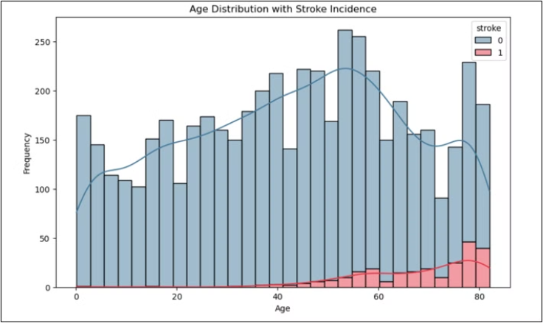
This part focuses on exploring the dataset visually to uncover meaningful patterns and relationships between variables. Through graphs and plots, we analyze trends and distributions, helping identify key insights related to stroke prediction. Additionally, data encoding ensures that categorical variables are transformed into a format suitable for machine learning models.
Age Distribution with Stroke Incidence
Visualization: A histogram with KDE overlay showing the distribution of age with stroke incidence.
Observation:
Stroke incidence increases significantly in older age groups.
Younger individuals have a relatively low frequency of strokes.

Slide 17
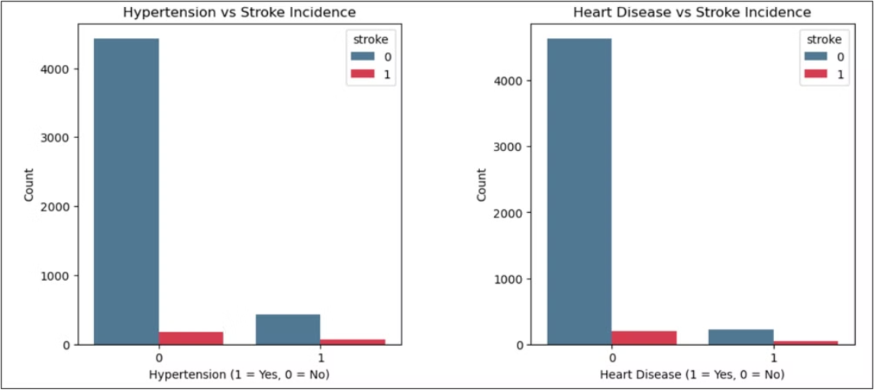
Hypertension and Heart Disease vs Stroke Incidence
Visualization: Two side-by-side bar plots depicting the correlation of hypertension and heart disease with stroke incidence.
Observation:
Hypertension and heart disease are strong predictors of stroke.
Individuals with either condition have a higher likelihood of experiencing a stroke.

Slide 18
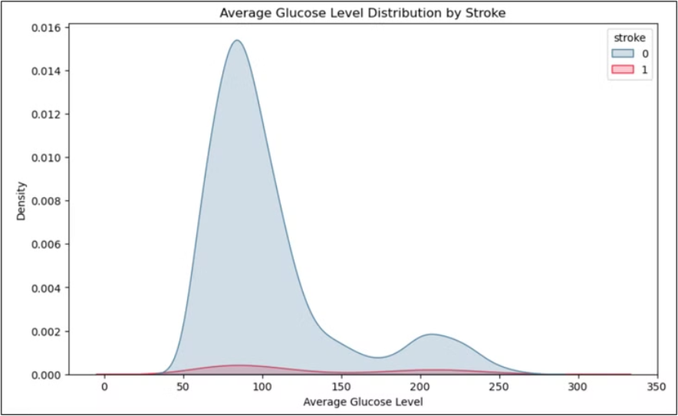
Average Glucose Level Distribution by Stroke
Visualization: A KDE plot illustrating the distribution of average glucose levels for stroke and non-stroke cases.
Observation:
Higher average glucose levels are associated with increased stroke incidence
A clear separation in glucose levels exists between stroke and non-stroke groups.

Slide 19
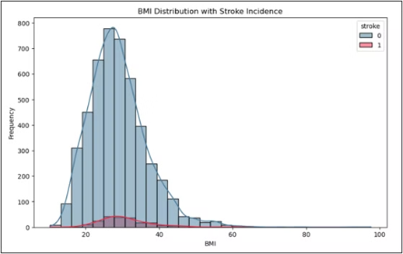
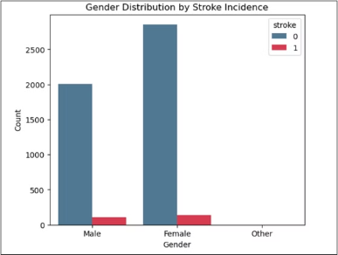
BMI Distribution with Stroke Incidence
Visualization: A histogram with KDE overlay depicting BMI distribution for stroke and non-stroke cases.
Stroke cases are slightly more frequent among individuals with higher BMI.
BMI alone does not show a strong correlation with stroke.
Gender Distribution by Stroke Incidence
Visualization: A count plot showing the distribution of stroke cases by gender.
Both genders show comparable stroke incidence rates, though slight variations exist.

Slide 20
Age Distribution by Smoking Status and Stroke Incidence
Visualization: A boxplot showing age distribution across different smoking statuses with stroke incidence.
Stroke is more prevalent among older individuals, regardless of smoking status.
Smoking does not directly correlate to stroke in younger age groups but shows an impact in older populations.
Scatter Plot of Age vs BMI by Stroke Incidence
Visualization: A scatter plot showing the relationship between age, BMI, and stroke incidence.
Most stroke cases cluster in older individuals with a range of BMI values.
No distinct pattern emerges in BMI but age is a significant factor.

Slide 21
Key Takeaways
Agile Methodology
GitHub for Version Control
The internship will follow an agile framework, emphasizing collaboration, iterative development, and continuous improvement.
GitHub will be used to manage the codebase, enabling remote collaboration and efficient project management.
Data Exploration and Preparation
Visualization for Insights
The team will dive deep into understanding the dataset, cleaning and transforming the data, and engineering new features to enhance the model's performance.
Data visualization techniques will be employed to uncover patterns, identify outliers, and gain a deeper understanding of the dataset.

Slide 22

Data Encoding
03

Slide 23


Data Encoding
Data encoding is the process of converting categorical data into numerical formats so that machine learning algorithms can interpret it.
Residence_type
Work_Type
Smoking_status
0-Rural
1-Urban
work_type_Never_worked
work_type_Private
work_type_Self-employed
smoking_status_never smoked
smoking_status_formerly smoked
smoking_status_smokes

Slide 24

04
Machine Learning Models

Slide 25
Key Objectives
1
Develop High-Precision Model
Improve Healthcare Outcomes
2
Leverage the model to enable early intervention and better treatment planning for stroke patients.
Create a machine learning model with enhanced accuracy for predicting the likelihood of stroke in patients.
3
Enhance Data-Driven Insights
Uncover valuable data-driven insights that can inform future advancements in stroke prevention and management.

Slide 26
Machine Learning (ML) models are algorithms that enable computers to learn patterns from data and make predictions or decisions without being explicitly programmed. Common models are:
Linear Regression
Ridge Regression
Logistic Regression
Logistic Regression

Slide 27
Preprocessing and Data Preparation for Regression Models
1
2
3
Handling Missing Values
Encoding Categorical Variables
Feature Selection
1
Standardization
2
Train-Test Split

Slide 28
Maths Behind Ridge Regression Model
In a Ridge Regression model, the relationship between the dependent variable y and the independent variables x1, x2, x3,...xp is also assumed to be linear, similar to linear regression. However, Ridge Regression introduces a regularization term to prevent overfitting by penalizing large coefficients, which helps improve the model's generalization.
The model can be expressed mathematically as:
minβ { Σni=1(yi - ŷi)2 + λ Σpj=1 βj2 }
yi: Actual value of the target variable for the ith observation
ŷi: Predicted value for the ith observation
n: Number of observations
p: Number of features
βj: Coefficient for each feature
Σ(yi - ŷi)2: Residual sum of squares
Σ βj2: Penalty term

Slide 29
Maths Behind Ridge Regression
Root Mean Squared Error (RMSE): RMSE is a commonly used metric to evaluate the accuracy of a regression model. It measures the average magnitude of the error between predicted values and actual values.
RMSE = √(1/n Σ(yi - ŷi)^2)
n: is the number of data points
yi: is the actual value for the i-th data point
ŷi: is the predicted value for the i-th data point.

Slide 30
Model Performance Summary: RMSE and Accuracy
Model
Accuracy
RSME
Ridge Regression
92.5
18.128
Logistic Regression
96.13
19.67
Linear Regression
96.23
18.12
Lasso Regression
96.23
18.95

Slide 31
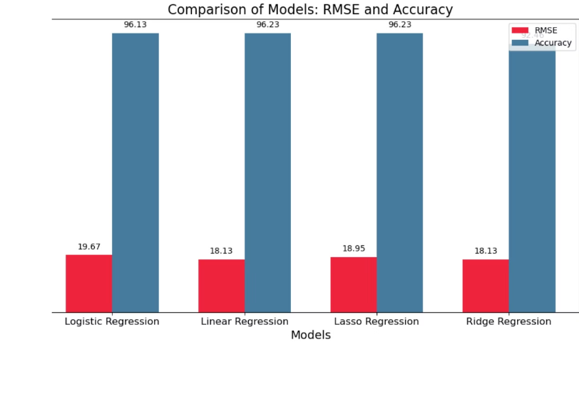
Visualizing Different Models
Key observations
RMSE Insights: Linear and Ridge models have the lowest RMSE, indicating the most accurate predictions, while Lasso has slightly higher errors, and Logistic Regression performs the worst with the highest RMSE.
Accuracy Insights: All models show high accuracy (above 92%), with Linear and Lasso achieving 96.23%, Ridge at 92.46%, and Logistic Regression slightly behind at 96.13%.

Slide 32
Precision, Recall, F1 Score, and Accuracy Across Models

Slide 33
Precision, Recall, F1 Score, and Accuracy
Precision (P): Measures how many predicted "Stroke" cases are correct. P = TP/[TP + FP]
Confusion Matrix
No Stroke
Stroke
Recall (R): Measures how many actual "Stroke" cases are correctly identified. R = TP/[TP + FN]
No Stroke
True Negatives (TN) 876
False Positives (FP) 69
F1 Score: Harmonic mean of Precision and Recall, providing a balance between both. F1 Score = 2*(P x R)/P + R
Stroke
False Negatives (FN) 20
True Positives (TP) 17
Accuracy: Overall correctness of the predictions. Accuracy = (TP + TN)/(TP + TN + FP + FN)

Slide 34
Observations
Model
Precision
Recall
F1 Score
Accuracy
Ridge Regression
0.253
0.513
0.339
0.92
Linear Regression
0.333
0.054
0.093
0.96
Lasso Regression
0.197
0.459
0.276
0.90
Logistic Regression
0.333
0.0270
0.05
0.96
Ridge Regression: Best recall with balanced performance overall.
Linear Regression: High accuracy but poor recall, struggles with the minority class.
Lasso & Logistic Regression: High accuracy but very low recall and F1 scores, indicating poor minority class detection.

Slide 35
Is accuracy a factor for model performance?
Accuracy alone is not a reliable metric for evaluating model performance, especially in cases of class imbalance. While high accuracy values (e.g., Logistic Regression: 96.13%, Linear Regression: 96.02%) might seem impressive, they can be misleading when the minority class is poorly identified.
For instance:
Ridge Regression, despite having lower accuracy (92.46%), achieves the highest recall (51.35%), making it more effective at detecting the minority class.
Logistic Regression has the highest accuracy (96.13%) but extremely low recall (2.7%), failing to identify most minority cases.

Slide 36

Is the dataset biased?
Class 0 (No Stroke): 95.74%
Class 1 (Stroke): 4.26% This severe imbalance skews the model toward predicting the majority class, leading to poor detection of the minority class.
Steps to mitigate bias:
- Changing random state
- Threshold tuning
- Adjusting class weights
- Resampling

Slide 37
Ridge Regression Model Evaluation
Strengths:
High Recall (51.35%): Ridge effectively identifies positive cases (true positives).
Good Accuracy (92.46%): Performs well overall in correct predictions.
Weaknesses:
Low Precision (25.33%): Many false positives, reducing precision.
Moderate F1 Score (33.93%): Indicates an imbalance between precision and recall.
Conclusion:
Ridge Regression excels in recall but requires improvement in precision to balance performance.

Slide 38
Final Insights
Class Imbalance: Dataset is heavily skewed (95% "No Stroke", 5% "Stroke"), causing bias towards the majority class.
Impact on Performance: High accuracy but poor detection of strokes due to the imbalance.
Evaluation Metrics: Metrics like recall and F1-score are more reliable than accuracy for evaluating minority class detection.
Analysis Conducted: Data preprocessing, visualizations, and modeling plays significant role in this project.

Slide 39
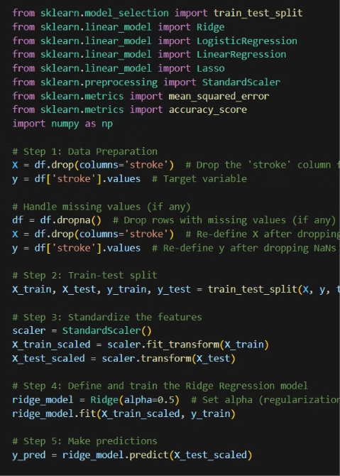
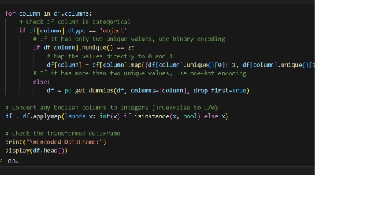
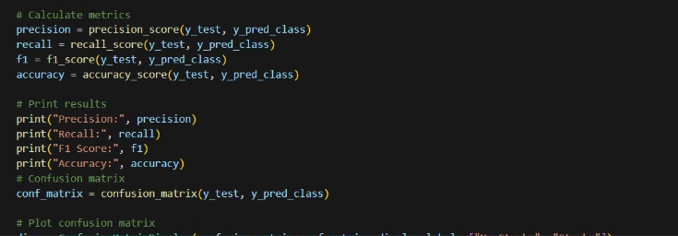

Slide 40
Conclusion and Next Steps
Continuous Improvement
Expansion to Other Domains
Collaboration with Clinicians
The team will continuously refine and optimize the machine learning models to enhance their precision and reliability.
The learnings and techniques developed in this project can be applied to other healthcare domains, driving further advancements.
Ongoing collaboration with medical professionals will ensure the models address real-world clinical needs and challenges.

Slide 41
Special Thanks to Our Mentor
We extend our heartfelt gratitude to Aswin Vellaichamy for being more than just an instructor throughout our project journey. Your guidance, support, and encouragement were instrumental in helping us achieve key milestones.
Thank you for being a mentor who inspired us, a friend who supported us, and a great motivator who made learning enjoyable with your humor and positivity in class. Your efforts have made a lasting impact on our growth and success.

Slide 42
Thank YOU 🙂

