Slide 1
PROJECT DEFENCE · 2026
AeroReserve
HYD
VGA
DEL
Flight Booking and
Seat Allocation Platform
Fictional sample schedule · IST
Dated routes · 45-minute connections · one PNR per itinerary
Student: ____________________ Roll No.: ____________________
Department / Institution: __________________________________________
Computational Thinking and Programming
13 OCT 2026

Slide 2
01 · PROBLEM
Flight booking needs flight-specific rules
Not just a renamed rail UI
Core constraints
A flight itinerary has dated instances, separate cabin inventory on each leg, airport transfers and flight schedules. One PNR must represent the complete trip.
Origin and destination · travel date · cabin
Direct or up to 2 connections (3 legs)
At least 45 minutes at every transfer
One PNR and leg-specific seats
01 · Search
02 · Connect
03 · Reserve
Fictional daily schedule
7 airports · 27 flight templates
Same transfer airport
≥45-minute minimum layover
Cabin seats per flight leg
One PNR for the itinerary
Scope boundary: no live airline feed · no payment processing · no passenger login
AeroReserve · Project Defence · Fictional sample platform
02 / 11

Slide 3
02 · REQUIREMENTS
A complete passenger journey
1
2
3
4
Search
Compare
Book
Manage
Choose airports, travel date, cabin and party size.
Review direct and connecting options, times, seats and fare.
Allocate cabin seats separately on each leg under one PNR.
Retrieve or cancel; live seat maps refresh on updates.
Cabin inventory per sample flight
Economy
Premium Economy
Business
First
36 seats
12 seats
8 seats
4 seats
Passengers: 1–6 · dates: today through the next 180 days (IST) · schedules/fare constants are fictional.
AeroReserve · Project Defence · Fictional sample platform
03 / 11

Slide 4
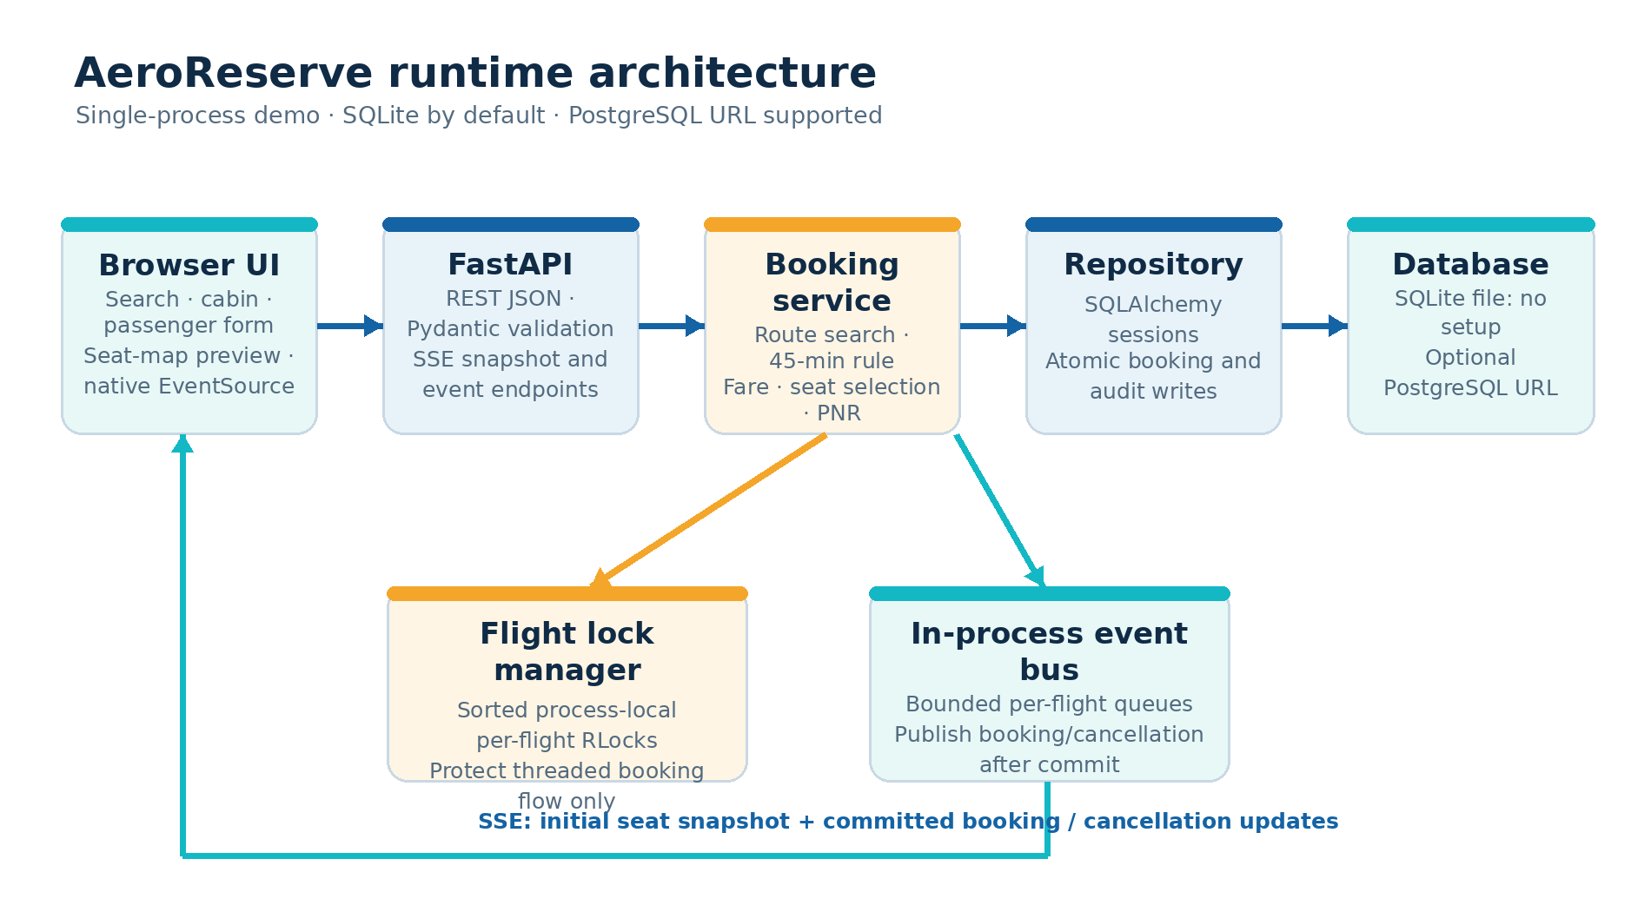
03 · DESIGN
Layered design with explicit boundaries
Locks and event queues are process-local. PostgreSQL URL support is provided, but multi-process consistency is not claimed.
AeroReserve · Project Defence · Fictional sample platform
04 / 11

Slide 5
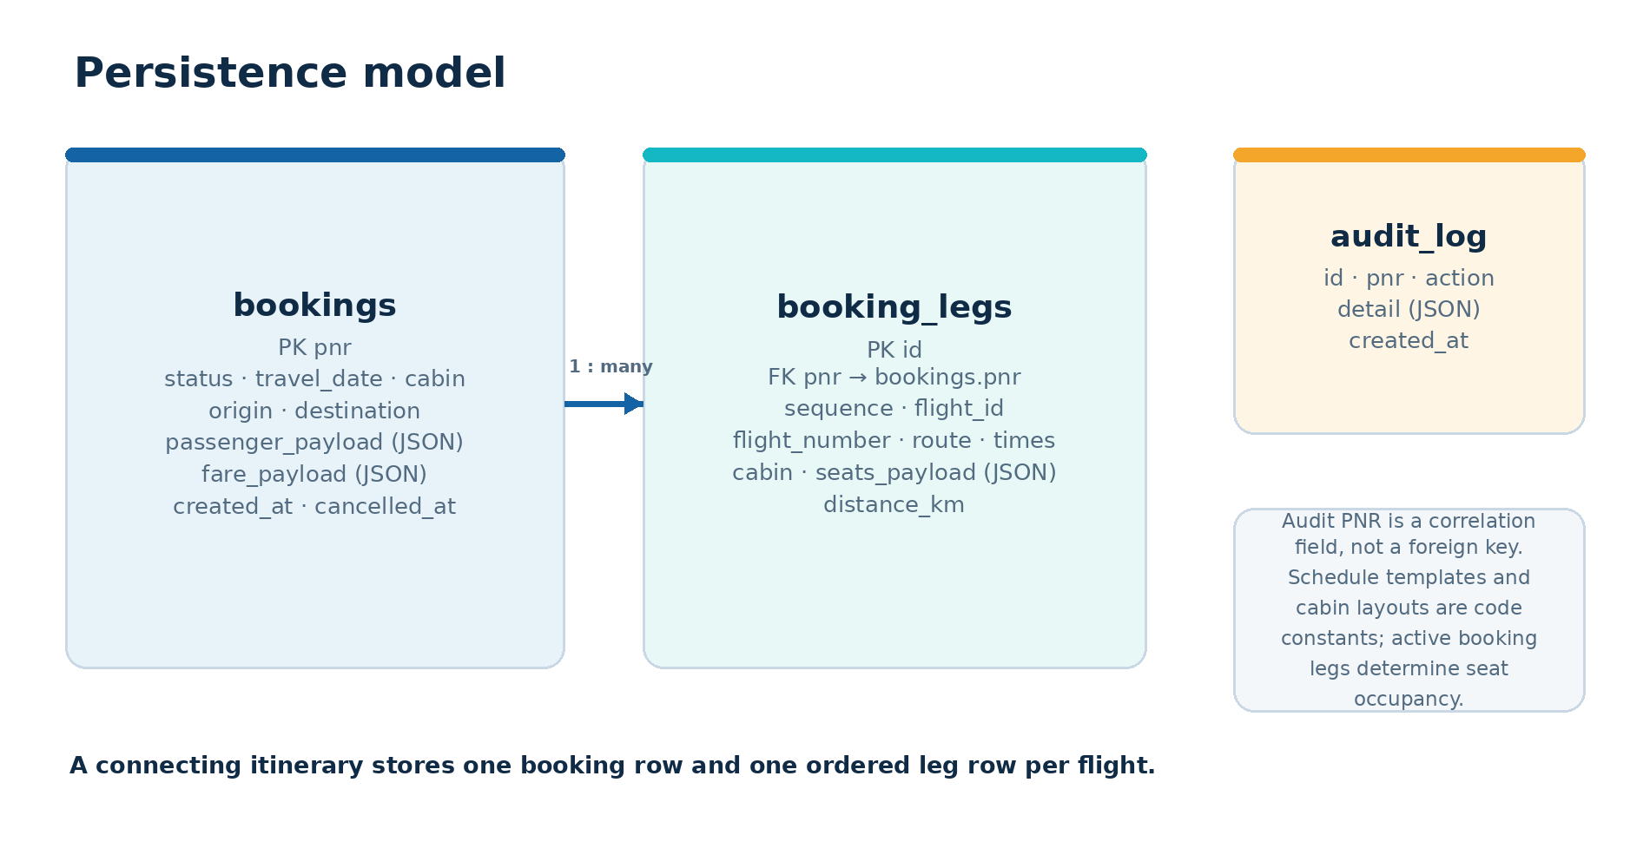
04 · DATA MODEL
One booking row, ordered rows for each leg
Cabin seat occupancy is derived from confirmed booking legs for a dated flight and cabin.
AeroReserve · Project Defence · Fictional sample platform
05 / 11

Slide 6
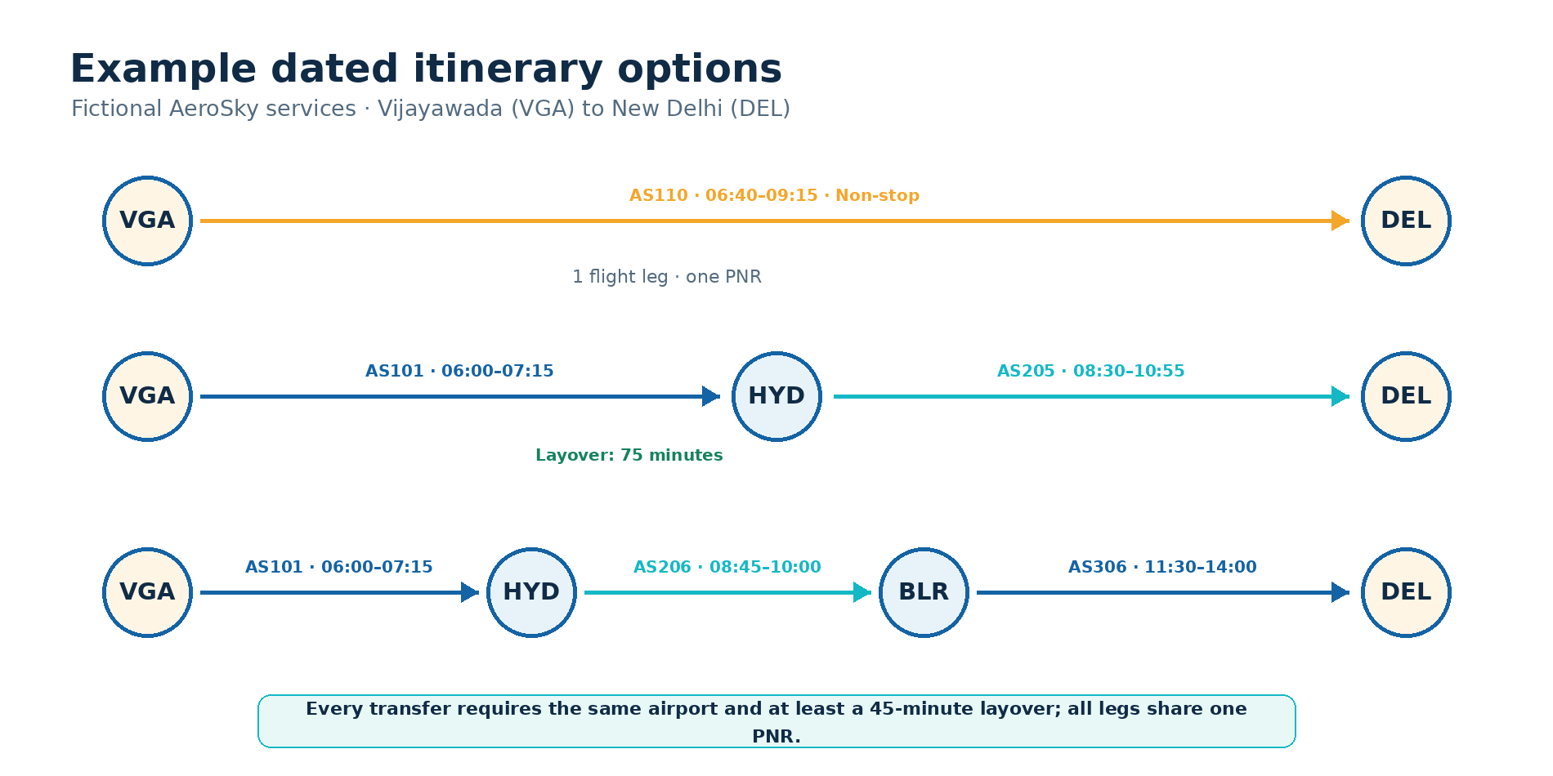
05 · ALGORITHMS
Bounded route search with a transfer-time rule
Search sequence
Build outgoing-flight map for the travel date.
Walk candidate paths to a maximum of 3 legs.
Reject airport cycles and broken airport joins.
Require next departure ≥ previous arrival + 45 min.
Sort by arrival time, stops, distance and flight IDs.
Small fictional network; depth is capped at three legs. No large-network performance claim.
AeroReserve · Project Defence · Fictional sample platform
06 / 11

Slide 7
06 · PRICING AND SEATS
Cabin-specific inventory, explainable policies
Allocation strategies
Illustrative Economy quote · 1 passenger
First-fit: earliest free labels in row order.
VGA–DEL base · 1,370 km × ₹3.80
₹5,206.00
Window-first: window seats, then row/column.
Illustrative tax · 5%
₹260.30
Service fee · ₹99 / passenger
₹99.00
Family-aware: same-row block off the aisle; otherwise first-fit.
TOTAL ₹5,565.30 · sample formula only
Seat counts per dated sample flight
Economy
36
Premium Economy
12
Business
8
First
4
A connecting booking receives one seat assignment per leg. Fare rates and tax are demo constants, not real fares/tax advice.
AeroReserve · Project Defence · Fictional sample platform
07 / 11

Slide 8
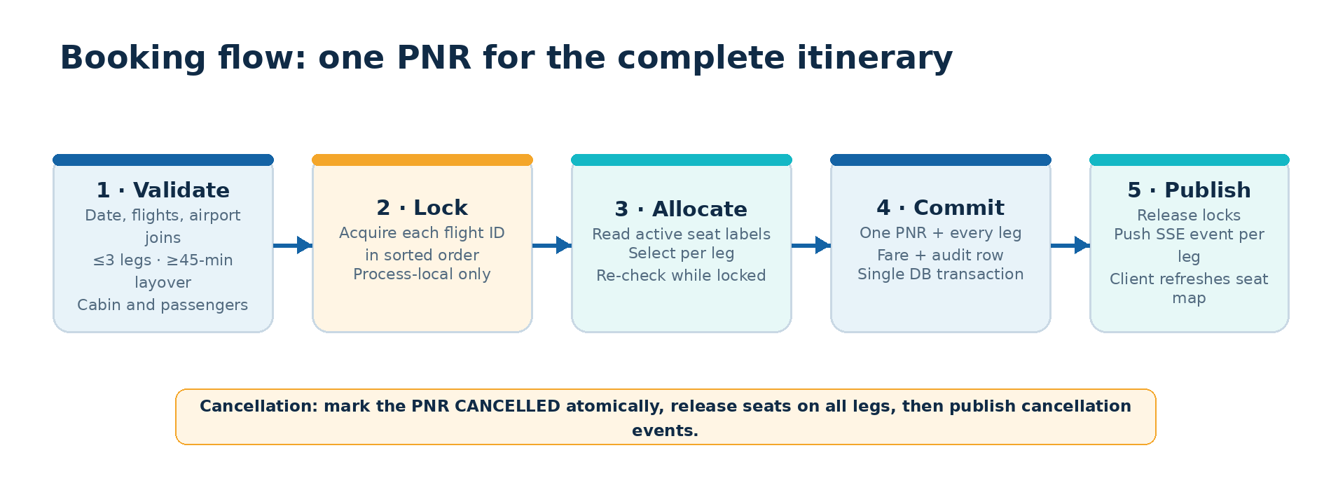
07 · BOOKING AND LIVE UPDATES
Validate → allocate → commit → publish
SSE snapshot + booking/cancellation event per flight leg
One PNR and one DB transaction cover the itinerary
AeroReserve · Project Defence · Fictional sample platform
08 / 11

Slide 9
08 · VERIFICATION
Test evidence, not production claims
45
93.1%
ruff
mypy
tests passed
branch-aware coverage
clean
strict · clean
Single-process seat race · 50 simultaneous threads
0
36 confirmed · all Economy seats
14 rejected
duplicate seat labels
End-to-end SSE snapshot then booking delta tested over Uvicorn.
Search, layover, cabin, quote, PNR and cancellation tests; Hypothesis properties.
Thread correctness in one process only. No multi-worker or PostgreSQL integration result.
AeroReserve · Project Defence · Fictional sample platform
09 / 11

Slide 10
09 · BOUNDARIES
What this demo does — and does not — claim
Working today
Explicitly not built
Route/date search · cabin seat maps · booking/cancellation
One PNR for 1–3 legs · live SSE updates
Zero-config SQLite demo
Live airline data · real pricing
Payment and ticket issue · passenger login
Multi-worker shared inventory guarantee
Next engineering steps
1
2
3
4
Shared seat rows
Integration tests
External services
Security
DB uniqueness / transaction locks
Postgres + multiple workers
Licensed schedule / fare source
Auth, privacy and payments review
AI-assisted work was tested/reviewed; PostgreSQL, Docker, remote CI and Windows launchers remain unverified.
AeroReserve · Project Defence · Fictional sample platform
10 / 11

Slide 11
10 · DEMONSTRATION
Run the demo · questions
Start locally
Eight-minute walkthrough
python -m pip install -e ".[dev]"
python -m uvicorn aerobooking.api:app --reload --host 0.0.0.0 --port 8000
1 · Search VGA → DEL
2 · Compare 0/1/2 stops
3 · Preview seats + fare
4 · Book one PNR
Open http://localhost:8000
5 · Show second-tab SSE
6 · Cancel and rerun tests
API documentation: http://localhost:8000/docs
Thank you
Questions?
AeroReserve is a fictional academic demo, not a live airline booking service.
AeroReserve · Project Defence · Fictional sample platform
11 / 11

