Slide 1


Video Analysis using OpenCV
Name: Neeraj Sharma
Section: ML
Roll No: 10
University Roll No: 2013397

Slide 2
Face based frame extraction from the video
Purpose: Face detection of a person from a long video and find the amount of time he/she is available in the event with Deep learning.

Slide 3
Frameworks and Technologies Used:
Python
Libraries:
a) OpenCV : for image and video processing like loading, resizing etc.
b) face_recognition: for face recognition and face detection.
c) tkinter: To develop Graphical User Interface(GUI).
d) numpy
e) datetime: for calculating time in hh:mm:ss format.

Slide 4
Face recognition is a series of several related problems:
1) First, look at a picture and find all the faces in it
2)Second, focus on each face and be able to that even if a face is turned in a weird direction or in bad lighting, it is still the same person.
3) Third, be able to pick out unique features of the face that you can use to tell it apart from other people— like how big the eyes are, how long the face is, etc.
4) Finally, compare the unique features of that face to all the people you already know.

Slide 5
Step 1: Finding all the Faces
To find faces in an image, we’ll start by making our image black and white because we don’t need color data to find faces.
Then we’ll look at every single pixel in our image one at a time. For every single pixel, we want to look at the pixels that directly surrounding it:

Slide 6
The end result is we turn the original image into a very simple representation that captures the basic structure of a face in a simple way:
Using this technique, we can now easily find faces in any image

Slide 7
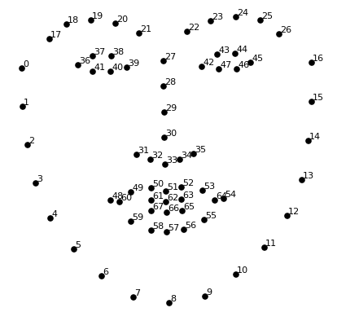
Step 2: Posing and Projecting Faces
We will try to warp each picture so that the eyes and lips are always in the sample place in the image. This will make it a lot easier for us to compare faces. The basic idea is we will come up with 68 specific points (called landmarks) that exist on every face — the top of the chin, the outside edge of each eye, the inner edge of each eyebrow, etc. Then we will train a machine learning algorithm to be able to find these 68 specific points on any face:

Slide 8
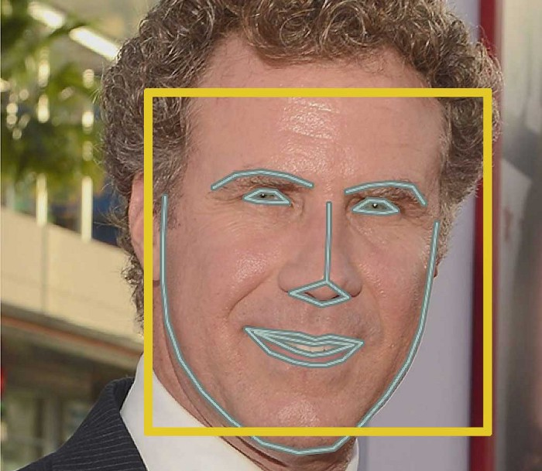
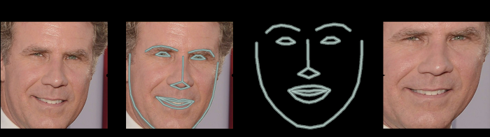
Here’s the result of locating the 68 face landmarks on our test image:
Now that we know were the eyes and mouth are, we’ll simply rotate, scale and shear the image so that the eyes and mouth are centered as best as possible.

Slide 9
Step 3: Encoding Faces: We are going to train it to generate 128 measurements for each face.
The training process works by looking at 3 face images at a time:
Load a training face image of a known person
Load another picture of the same known person
Load a picture of a totally different person
After repeating this step millions of times for millions of images of thousands of different people, the neural network learns to reliably generate 128 measurements for each person. Any ten different pictures of the same person should give roughly the same measurements.

Slide 10
Step 4: Finding the person’s name from the encoding
No fancy deep learning tricks are needed. We’ll use a simple linear SVM classifier, but lots of classification algorithms could work.
All we need to do is train a classifier that can take in the measurements from a new test image and tells which known person is the closest match. Running this classifier takes milliseconds. The result of the classifier is the name of the person.
After extracting matching frames, we can calculate the total time a person is present in the event.

Slide 11
Applications:
Video Summarization.
Calculate how much time a person is available in video.
Security and Surveillance.
Transport monitoring system.

Slide 12
Thank you

