Slide 1
NoSQL Databases types

Slide 2
Why are RDBMS not suitable for Big Data
RDBMSs assume that data are
  Dense
  Largely uniform (structured data)
Data coming from Internet are
  Massive and sparse
  Semi-structured or unstructured
With massive sparse data sets, the typical storage mechanisms and access methods get stretched

Slide 3
NoSQL Definition
  Next Generation Databases mostly addressing some of the points: being non-relational, distributed, open-source and horizontal scalable. The original intention has been modern web-scale databases. The movement began early 2009 and is growing rapidly. Often more characteristics apply as: schema-free, easy replication support, simple API, eventually consistent / BASE (not ACID), a huge data amount, and more.

Slide 4
NoSQL
NoSQL stands for:
  No Relational
  No RDBMS
  Not Only SQL
NoSQL is an umbrella term for all databases and data stores that don’t follow the RDBMS principles
  A class of products
  A collection of several (related) concepts about data storage and manipulation
  Often related to large data sets

Slide 5
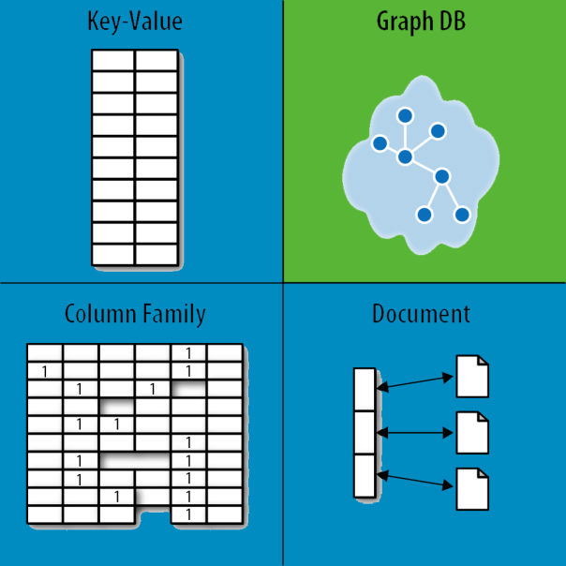
NoSQL Database Types
Discussing NoSQL databases is complicated
because there are a variety of types:
Sorted ordered Column Store
  Optimized for queries over large datasets, and store
  columns of data together, instead of rows
Document databases:
  pair each key with a complex data structure known as a document.
Key-Value Store :
  are the simplest NoSQL databases. Every single item in the database is stored as an attribute name (or 'key'), together with its value.
Graph Databases :
  are used to store information about networks of data, such as social connections.

Slide 6
NoSQL Database Types
Discussing NoSQL databases is complicated
because there are a variety of types:
Document databases:
  pair each key with a complex data structure known as a document.
Key-Value Store :
  are the simplest NoSQL databases. Every single item in the database is stored as an attribute name (or 'key'), together with its value.
Graph Databases :
  are used to store information about networks of data, such as social connections.

Slide 7
Document Databases (Document Store)
Documents
  Loosely structured sets of key/value pairs in documents, e.g., XML, JSON, BSON
  Encapsulate and encode data in some standard formats or encodings
  Are addressed in the database via a unique key
  Documents are treated as a whole, avoiding splitting a document into its constituent name/value pairs
Allow documents retrieving by keys or contents
Notable for:
  MongoDB (used in FourSquare, Github, and more)
  CouchDB (used in Apple, BBC, Canonical, Cern, and more)

Slide 8
Document Databases (Document Store)
The central concept is the notion of a "document“ which corresponds to a row in RDBMS.
A document comes in some standard formats like JSON (BSON).
Documents are addressed in the database via a unique key that represents that document.
The database offers an API or query language that retrieves documents based on their contents.
Documents are schema free, i.e., different documents can have structures and schema that differ from one another. (An RDBMS requires that each row contain the same columns.)

Slide 9
Document Databases, JSON
{
_id: ObjectId("51156a1e056d6f966f268f81"),
type: "Article",
author: "Derick Rethans",
title: "Introduction to Document Databases with MongoDB",
date: ISODate("2013-04-24T16:26:31.911Z"),
body: "This arti…"
},
{
_id: ObjectId("51156a1e056d6f966f268f82"),
type: "Book",
author: "Derick Rethans",
title: "php|architect's Guide to Date and Time Programming with PHP",
isbn: "978-0-9738621-5-7"
}

Slide 10
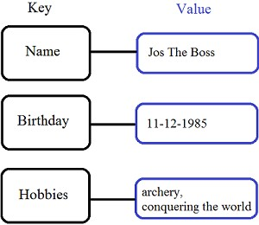
Key/Value stores
Store data in a schema-less way
Store data as maps
  HashMaps or associative arrays
  Provide a very efficient average running
  time algorithm for accessing data
Notable for:
  Couchbase (Zynga, Vimeo, NAVTEQ, ...)
  Redis (Craiglist, Instagram, StackOverfow,
  flickr, ...)
  Amazon Dynamo (Amazon, Elsevier,
  IMDb, ...)
  Apache Cassandra (Facebook, Digg,
  Reddit, Twitter,...)
  Voldemort (LinkedIn, eBay, …)
  Riak (Github, Comcast, Mochi, ...)

Slide 11
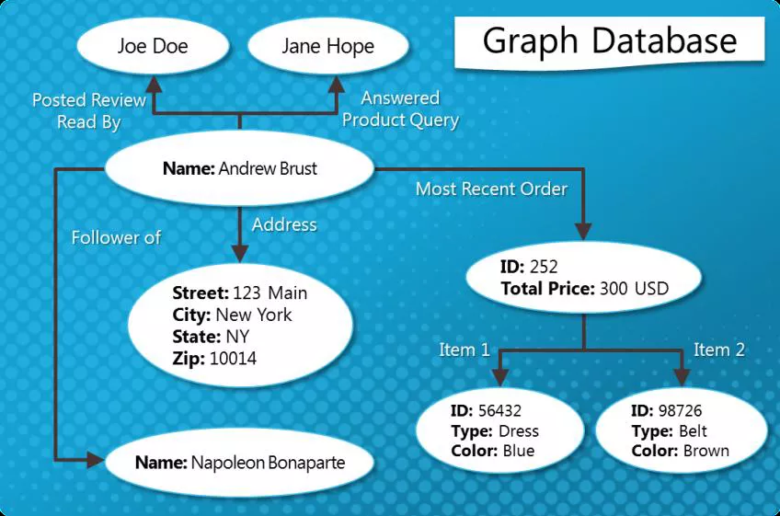
Graph Databases
Graph-oriented
Everything is stored as an edge, a node or an attribute.
Each node and edge can have any number of attributes.
Both the nodes and edges can be labelled.
Labels can be used to narrow searches.

Slide 12
Dealing with Big Data and Scalability
Issues with scaling up when the dataset is just too big
RDBMS were not designed to be distributed
Traditional DBMSs are best designed to run well on a “single” machine
  Larger volumes of data/operations requires to upgrade the server with faster CPUs or more memory known as ‘scaling up’ or ‘Vertical scaling’
NoSQL solutions are designed to run on clusters or multi-node database solutions
  Larger volumes of data/operations requires to add more machines to the cluster, Known as ‘scaling out’ or ‘horizontal scaling’
  Different approaches include:
    Master-slave
    Sharding (partitioning)

Slide 13
NoSQL Products/Projects
122 NoSQL Databases
Cassandra
CouchDB
Hadoop & Hbase
MongoDB
StupidDB
Etc.

Slide 14
NoSQL Distinguishing Characteristics
Large data volumes
  Google’s “big data”
Scalable replication and distribution
  Potentially thousands of machines
  Potentially distributed around the world
Queries need to return answers quickly
Mostly query, few updates
Asynchronous Inserts & Updates
Schema-less
ACID transaction properties are not needed – BASE
CAP Theorem
Open source development

Slide 15
Types of Next Generation Databases(SUMMARY)
Type | Description | Examples
Document Stores | Store data as JSON/BSON documents | MongoDB, CouchDB
Key-Value Stores | Data stored as key-value pairs | Redis, DynamoDB
Column-Family Stores | Store data in columns instead of rows | Apache Cassandra, HBase
Graph Databases | Focus on relationships using nodes & edges | Neo4j, ArangoDB
NewSQL | Combines RDBMS features with NoSQL scalability | Google Spanner, CockroachDB

Slide 16
BASE Transactions
Acronym contrived to be the opposite of ACID
  Basically Available,
  Soft state,
  Eventually Consistent
Characteristics
  Weak consistency – stale data OK
  Availability first
  Best effort
  Approximate answers OK
  Aggressive (optimistic)
  Simpler and faster

Slide 17
Brewer’s CAP Theorem
A distributed system can support only two of the following characteristics:
Consistency
Availability
Partition tolerance
The slides from Brewer’s July 2000 talk do not define these characteristics.

Slide 18
Consistency
all nodes see the same data at the same time
client perceives that a set of operations has occurred all at once More like Atomic in ACID transaction properties

Slide 19
Availability
  node failures do not prevent survivors from continuing to operate ,Every operation must terminate in an intended response

Slide 20
Partition Tolerance
  the system continues to operate despite arbitrary message loss ,Operations will complete, even if individual components are unavailable.

Slide 21
Column Store Comments
More efficient than row (or document) store if:
  Multiple row/record/documents are inserted at the same time so updates of column blocks can be aggregated
  Retrievals access only some of the columns in a row/record/document

Slide 22
NoSQL Summary
NoSQL databases reject:
  Overhead of ACID transactions
  “Complexity” of SQL
  Burden of up-front schema design
  Declarative query expression
  Yesterday’s technology
Programmer responsible for
  Step-by-step procedural language
  Navigating access path

Slide 23
Summary
SQL Databases
  Predefined Schema
  Standard definition and interface language
  Tight consistency
  Well defined semantics
NoSQL Database
  No predefined Schema
  Per-product definition and interface language
  Getting an answer quickly is more important than getting a correct answer

Slide 24
Web References
“NoSQL -- Your Ultimate Guide to the Non - Relational Universe!”
http://nosql-database.org/links.html
“NoSQL (RDBMS)”
http://en.wikipedia.org/wiki/NoSQL
PODC Keynote, July 19, 2000. Towards Robust. Distributed Systems. Dr. Eric A. Brewer. Professor, UC Berkeley. Co-Founder & Chief Scientist, Inktomi .
www.eecs.berkeley.edu/~brewer/cs262b-2004/PODC-keynote.pdf
“Brewer's CAP Theorem” posted by Julian Browne, January 11, 2009. http://www.julianbrowne.com/article/viewer/brewers-cap-theorem
“How to write a CV” Geek & Poke Cartoon http://geekandpoke.typepad.com/geekandpoke/2011/01/nosql.html

Slide 25
Web References
“Exploring CouchDB: A document-oriented database for Web applications”, Joe Lennon, Software developer, Core International.
http://www.ibm.com/developerworks/opensource/library/os-couchdb/index.html
“Graph Databases, NOSQL and Neo4j” Posted by Peter Neubauer on May 12, 2010 at: http://www.infoq.com/articles/graph-nosql-neo4j
“Cassandra vs MongoDB vs CouchDB vs Redis vs Riak vs HBase comparison”, Kristóf Kovács. http://kkovacs.eu/cassandra-vs-mongodb-vs-couchdb-vs-redis
“Distinguishing Two Major Types of Column-Stores” Posted by Daniel Abadi onMarch 29, 2010 http://dbmsmusings.blogspot.com/2010/03/distinguishing-two-major-types-of_29.html

Slide 26
Books
“CouchDB The Definitive Guide”, J. Chris Anderson, Jan Lehnardt and Noah Slater. O’Reilly Media Inc., Sebastopool, CA, USA. 2010
“Hadoop The Definitive Guide”, Tom White. O’Reilly Media Inc., Sebastopool, CA, USA. 2011
“MongoDB The Definitive Guide”, Kristina Chodorow and Michael Dirolf. O’Reilly Media Inc., Sebastopool, CA, USA. 2010

