Slide 1
AWT

Slide 2
AWT (Abstract Window Toolkit) is Java’s original platform-dependent GUI toolkit.
It provides basic UI components like buttons, text fields, labels, and event handling mechanisms.

Slide 3
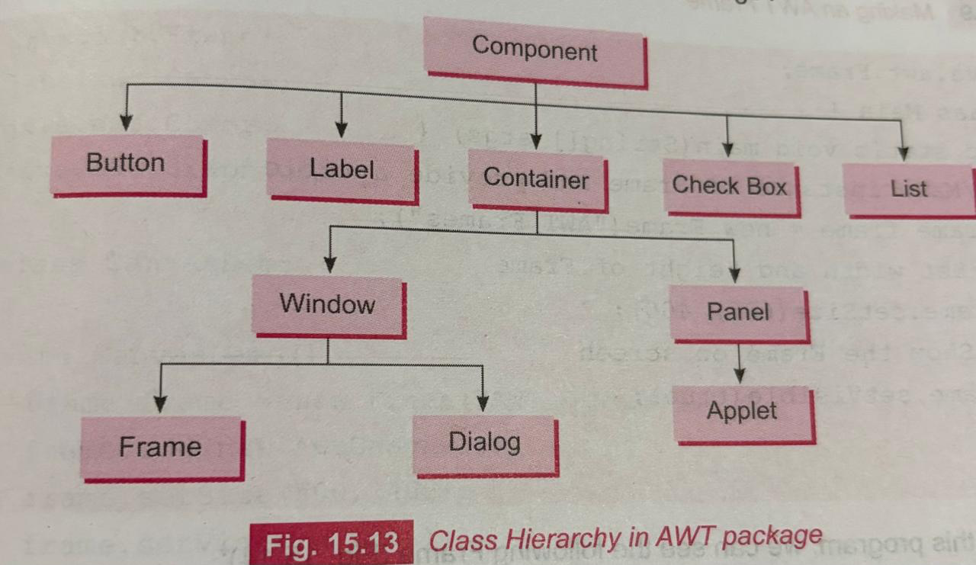

Slide 4
java.lang.Object
├── java.awt.Component
├── java.awt.Container
├── java.awt.Window
├── java.awt.Frame
├── java.awt.Dialog
├── java.awt.Panel
├── java.applet.Applet
├── java.awt.ScrollPane
├── java.awt.Canvas

Slide 5
Component: Base class for all UI elements (Button, Label, TextField, etc.).
Display of graphic object on the screen
Handles various keyboard and mouse events
Container: Holds components (Panel, Frame, Applet, etc.).
Window: A top-level container like Frame and Dialog.
Panel: A generic container inside a Frame or Window.
Applet: Used for embedding UI in web applications.

Slide 6
SWING
Swing is a more advanced GUI toolkit than AWT, introduced in Java 2 (JDK 1.2). It provides a richer set of UI components and greater flexibility.
Key Features of Swing
Lightweight: Does not rely on the OS's native UI components.
Always generate similar type of output irrespective of the underlying platform
Pluggable Look and Feel: Can be customized with themes.
More Components: Provides advanced UI elements like JTable, JTree, JTabbedPane, etc.
Event-Driven: Uses listeners to handle user interactions.

Slide 7
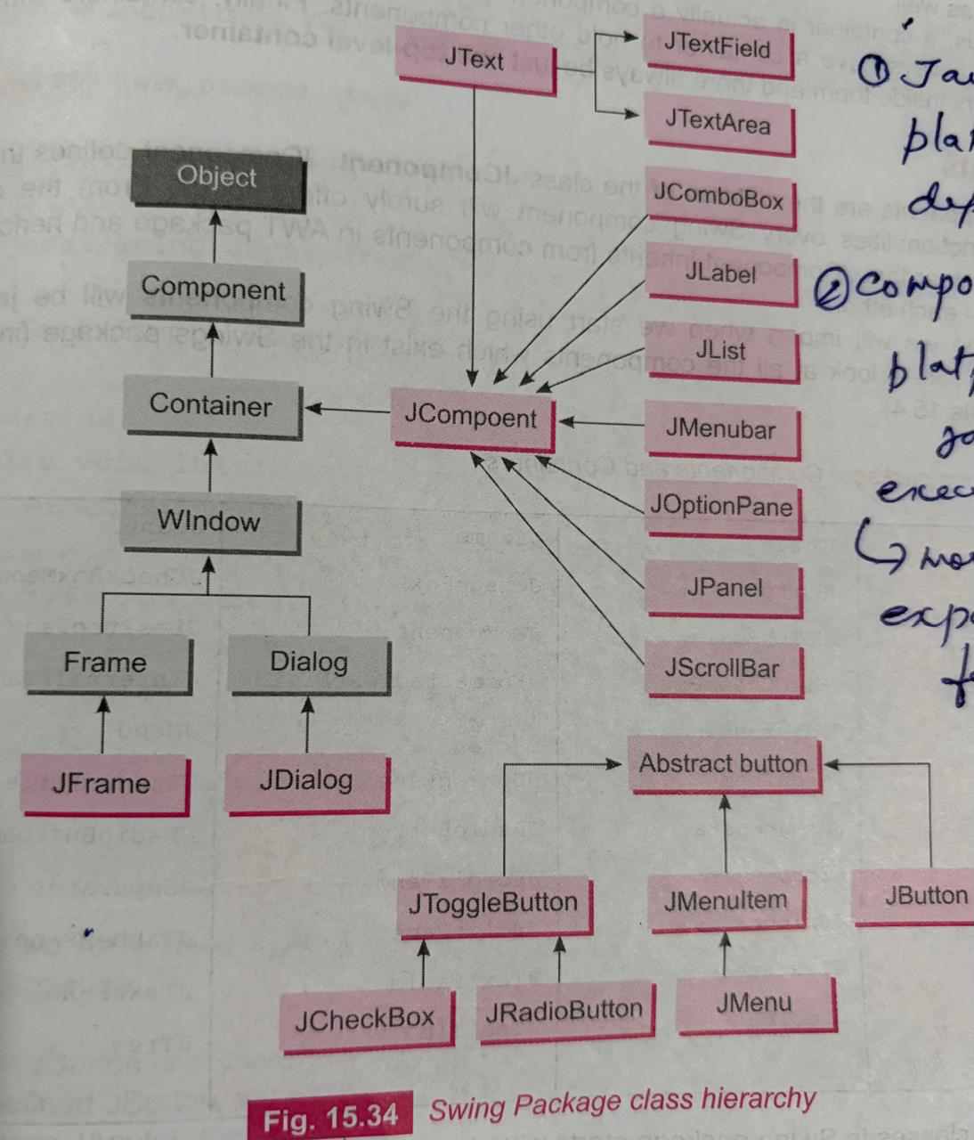

Slide 8
In Java GUI, components are of two types:
1. Heavyweight components (AWT)
Use native OS resources
Example: Buttons, TextFields in AWT are created using the OS (Windows, Linux, etc.)
Each component has its own peer (a native screen resource)
2. Lightweight components (Swing)
Written entirely in Java
Do not use native OS components
Drawn using Java code on a common container (like JFrame)
Only the top-level container (like JFrame) is heavyweight; all others are lightweight

Slide 9
SWING vs AWT
Features | AWT | Swing
Dependency | Uses native OS components | Lightweight, written in pure Java
Performance | Slower (relies on OS) | Faster (handles rendering internally)
Look & Feel | OS-dependent | Can be customized
Components | Basic UI elements | Advanced UI elements (tables, trees, etc.)
Extensibility | Limited | Highly extensible
Thread Safety | Not thread-safe | Partially thread-safe (uses Event Dispatch Thread)

Slide 10
JFrame (Top-Level Container)
JFrame is a standalone, top-level window with a title bar, minimize, maximize, and close buttons.
It is commonly used for GUI applications.
You can add components to a JFrame using its contentPane.

Slide 11
JApplet
JApplet is a Swing-based Applet used for embedding Java applications in web browsers.
Since applets are now deprecated, this class is rarely used.
Similar to JFrame, but meant for use within a browser.

Slide 12
JPanel (Lightweight Container)
JPanel (Lightweight Container)
JPanel is a general-purpose container that can group multiple components together.
Unlike JFrame, JPanel does not have its own window; it must be added to another container.
Used for better organization of GUI components.

Slide 13
Feature | JFrame | JPanel
Purpose | Acts as the main window of an application | Acts as a container inside a window
Type | Top-level container | Lightweight component
Execution | Can run independently | Cannot run independently
Package | javax.swing | javax.swing
Inheritance | Extends Frame (AWT) | Extends JComponent
Usage | Used to create GUI window | Used to organize/group components
Default Layout | BorderLayout | FlowLayout
Visibility | Needs setVisible(true) | Visible when added to a container
Examples | Main application window | Panels inside the window

Slide 14
JButton
JButton is a Swing component used to create a clickable button in a GUI application. It is part of the javax.swing package.
Key Features
Displays text, icon, or both
Generates an event when clicked
Supports ActionListener for handling events
Fully customizable (color, font, size, etc.)

Slide 15
JButton b1 = new JButton(); // empty button JButton b2 = new JButton("Click"); // button with text
JButton b3 = new JButton(new ImageIcon("img.png")); // button with image

Slide 16
What is ActionListener?
ActionListener is an interface used to handle button click events (and similar actions).
When a user clicks a button, an event is generated, and ActionListener handles it.
Step 1: Import package
import java.awt.event.*;
Step 2: Registering the listener
class MyClass implements ActionListener {
public void actionPerformed(ActionEvent e) {
System.out.println("Clicked");
}}
// In main:
btn.addActionListener(new MyClass());//Registering the Listener
addActionListener()
Method used to attach event handling to a component

Slide 17
JButton btn = new JButton("Click");
btn.addActionListener(new ActionListener() {
public void actionPerformed(ActionEvent e) {
System.out.println("Button Clicked");
}
});

Slide 18
new ActionListener()
Creating an anonymous class that implements ActionListener
public void actionPerformed(ActionEvent e)
This method:
is mandatory (must be overridden)
Executes when the event occurs (e.g., button click)

Slide 19
JButton btn = new JButton("Click");
btn.addActionListener(new ActionListener() {
public void actionPerformed(ActionEvent e) {
System.out.println("Button Clicked");
}
});

Slide 20
JLabel
JLabel is a Swing component used to display text, images, or both in a GUI. It is mainly used for showing information to the user (not for input).
JLabel is a non-editable display component in the javax.swing package.
JLabel l1 = new JLabel(); // empty label
JLabel l2 = new JLabel("Hello"); // label with text
JLabel l3 = new JLabel(new ImageIcon("img.png")); // label with image

Slide 21
JTextField in Java
JTextField is a part of the Swing package in Java (javax.swing.JTextField) used to create a single-line text input field.
It allows users to enter and edit a string of text. It's commonly used in forms or GUI applications where user input is required.
Key Features:
Allows single-line text input
Can set or get text using setText() and getText() methods
You can set the number of columns (visible width) when creating it
Supports action listeners for handling user actions like pressing Enter

Slide 22
JTextArea in Java Swing
JTextArea is a multi-line text component used to display or allow the user to enter multiple lines of text in a GUI application.
Key Features
Allows multiple lines of text
Supports editing (typing, deleting)
Can be used for displaying output
Often used with scroll bars

Slide 23
import javax.swing.*;
public class JTextAreaExample {
public static void main(String[] args) {
JFrame frame = new JFrame("JTextArea Example");
JTextArea ta = new JTextArea(5, 20);
ta.setText("This is a JTextArea\nYou can write multiple lines.");
frame.add(ta);
frame.setSize(300, 200);
frame.setDefaultCloseOperation(JFrame.EXIT_ON_CLOSE);
frame.setVisible(true);
}
}

Slide 24
Use of JScrollPane in Java
Use of JScrollPane in Java
In Swing, JScrollPane is used to add scrolling capability to components that might exceed the visible area, like JTextArea, JTable, JList, etc. It automatically adds vertical and/or horizontal scrollbars when needed.
Why use JScrollPane?
Some components, like JTextArea, can contain more content than the space available in the window. Wrapping them inside a JScrollPane ensures the user can scroll through all the content.

Slide 25
JCheckBox (Check Box)
JCheckBox allows the user to select or deselect an option.
Multiple checkboxes can be selected at the same time.
It's used when you want to offer multiple selections (e.g., selecting hobbies, skills, etc.).
JCheckBox cb1 = new JCheckBox("Java");
JCheckBox cb2 = new CheckBox("Python");
JCheckBox cb3 = new JCheckBox("Python", true);

Slide 26
cb1.setText("Java Programming");
String value = cb1.getText();
Sets the checkbox state.
cb1.setSelected(true); // Checked
if(cb1.isSelected()) {
System.out.println("Java selected");
}
addActionListener(ActionListener a)
Adds an action listener to handle events.

Slide 27
JRadioButton
JRadioButton allows the user to select only one option from a group. To enforce this, you use a ButtonGroup to group related radio buttons together. Selecting one will deselect the others in the group.
JRadioButton rb1 = new JRadioButton("Male");
JRadioButton rb2 = new JRadioButton("Female");
ButtonGroup group = new ButtonGroup();
group.add(rb1);
group.add(rb2);

Slide 28
Common example:
Gender: Male / Female
Payment: Cash / Card / UPI
Constructors
JRadioButton()
JRadioButton(String text)
JRadioButton(String text, boolean selected)
JRadioButton r1 = new JRadioButton("Male");
JRadioButton r2 = new JRadioButton("Female", true);

Slide 29
Layout Manager
In Java Swing, layout managers control how components (buttons, labels, text fields, etc.) are arranged within a container like a JFrame or JPanel.
Instead of manually setting size and position, layout managers automatically arrange components based on rules.

Slide 30
FlowLayout (default for JPanel)
Components are arranged in a row, like text in a paragraph.
When the row is full, it wraps to the next line.
You can set alignment (LEFT, CENTER, RIGHT).
frame.setLayout(new FlowLayout());

Slide 31
FlowLayout()
FlowLayout(int align)
FlowLayout(int align, int hgap, int vgap)

Slide 32
GridLayout
Divides the container into a grid of equal-sized cells (rows x columns).
Components are added row by row, left to right.
GridLayout(int rows, int cols)
GridLayout(int rows, int cols, int hgap, int vgap)

Slide 33
frame.setLayout(new GridLayout(2, 2)); // 2 rows, 2 columns
frame.add(new JButton("Button 1"));
frame.add(new JButton("Button 2"));
frame.add(new JButton("Button 3"));
frame.add(new JButton("Button 4"));

Slide 34
BorderLayout (default for JFrame)
Divides the container into five regions: NORTH, SOUTH, EAST, WEST, CENTER.
You can add one component to each region.

Slide 35
frame.setLayout(new BorderLayout());
frame.add(new JButton("Top"), BorderLayout.NORTH);
frame.add(new JButton("Bottom"), BorderLayout.SOUTH);
frame.add(new JButton("Left"), BorderLayout.WEST);
frame.add(new JButton("Right"), BorderLayout.EAST);
frame.add(new JButton("Center"), BorderLayout.CENTER);

