Slide 1
STREAMS

Slide 2
Streams in Java
Definition: A stream is a ordered sequence of data
Unidirectional movement of data
Sequential access to the data
A stream represents a uniform, easy to use, object oriented interface between the program and the input/output devices
Pipelining of streams
Two types of streams:
Byte Streams
Input Stream/Output Stream
Character Streams
Reader classes/Writer classes

Slide 3
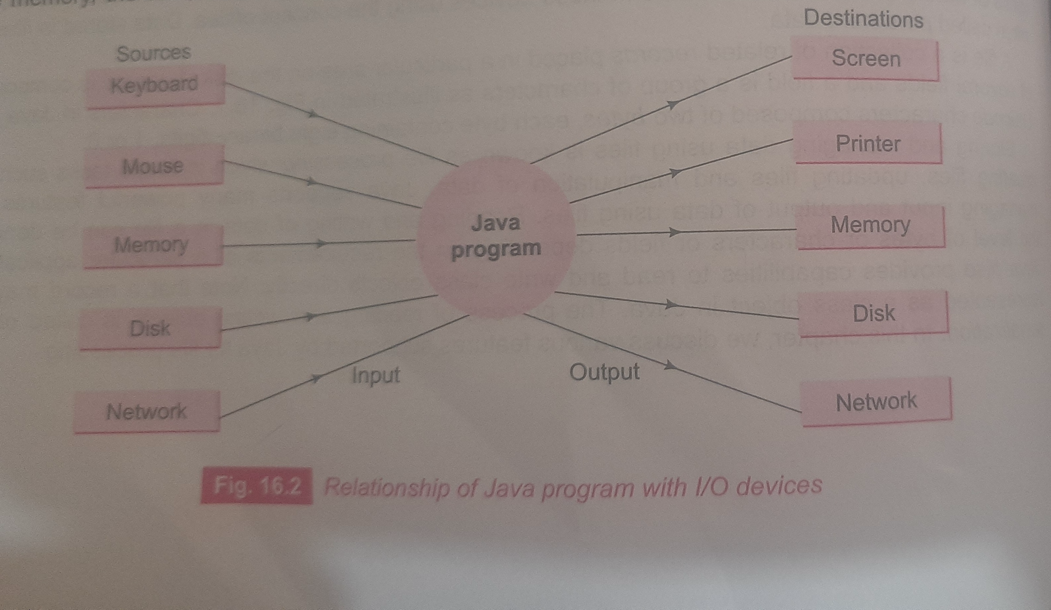

Slide 4
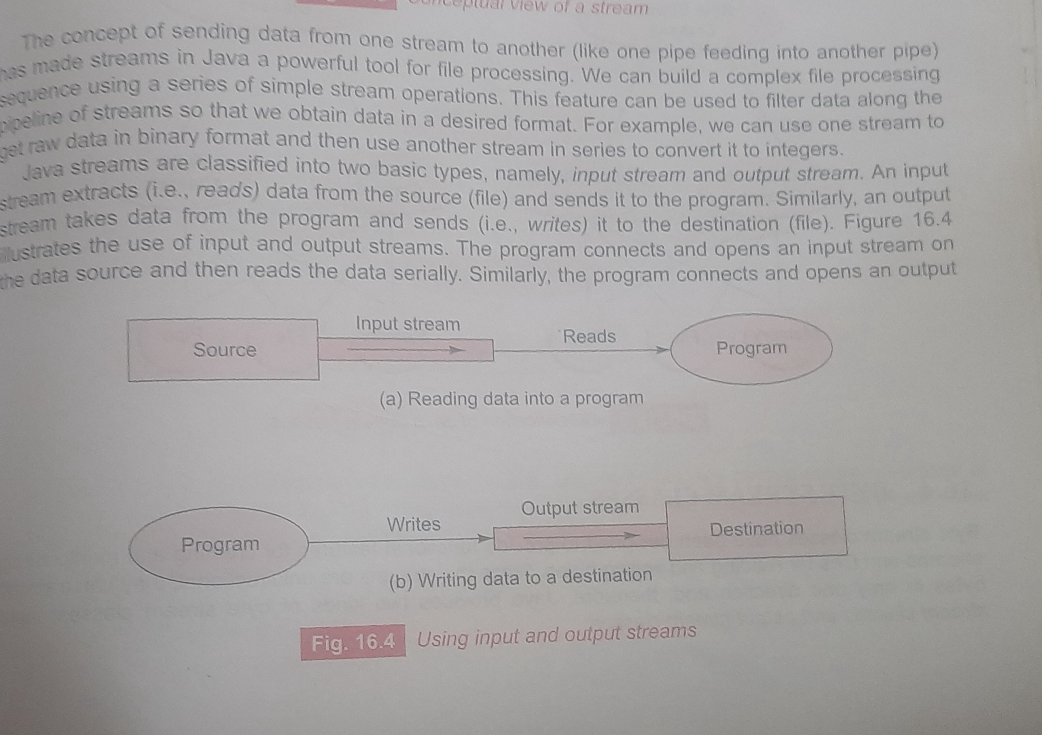

Slide 5
Byte streams
Used for reading and writing binary data
Key classes:
InputStream (abstract class)
FileInputStream
ByteArrayInputStream
OutputStream (abstract class)
FileOutputStream
ByteArrayOutputStream

Slide 6
Character streams
Used for reading and writing character data
Key classes:
Reader (abstract class)
FileReader
BufferedReader
Writer (abstract class)
FileWriter
BufferedWriter

Slide 7
Reading and Writing to console
System.in for input
System.out for output
import java.util.Scanner;
public class ConsoleIO {
public static void main(String[] args) {
Scanner scanner = new Scanner(System.in);
System.out.print("Enter your name: ");
String name = scanner.nextLine();
System.out.println("Hello, " + name + "!");
scanner.close();
}
}

Slide 8
File class
Java.io package includes File class for creating files and directories
Methods for creating a file
Opening a file
Closing a file
Deleting a file
Renaming
Getting the size etc

Slide 9
Input/output Exceptions
On creating files and performing I/O operations on them I/O related exceptions are thrown
EOFException
FileNotFoundException
InterruptedException
IOException

Slide 10
Creation of Files
Suitable name for the file (input.txt)
Data type to be stored-characters, bytes, primitive type
Purpose(reading,writing, updating)
Method of creating the file

Slide 11
Inilitializing File Stream objects
FileInputStream fis;
try
{
fis=new FileInputStream(“test.dat”)
}
catch(IOException e)
{
}

Slide 12
File infile;
infile=new infile(“test.dat”)
FileInputStream fis;
try
{
fis=new FileInputStream(infile)
}
catch(IOException e)
{
}

Slide 13
Reading and writing files
import java.io.*;
public class ReadFile {
public static void main(String[] args) throws IOException {
FileReader fr = new FileReader(”output.txt");
BufferedReader br = new BufferedReader(fr);
String line;
while ((line = br.readLine()) != null) {
System.out.println(line);
}
br.close();
}
}

Slide 14
import java.io.*;
public class WriteFile {
public static void main(String[] args) throws IOException {
FileWriter fw = new FileWriter("output.txt");
BufferedWriter bw = new BufferedWriter(fw);
bw.write("Hello, Java I/O!");
bw.close();
}
}

Slide 15
File reader
FileReader is a class in Java used for reading character files.
It reads data one character at a time, making it relatively slow for large files.
It does not have built-in buffering, meaning each read operation directly interacts with the file, leading to more I/O operations.

Slide 16
Buffered Reader
BufferedReader is a wrapper around FileReader that adds buffering capabilities.
It reads large chunks of data at once, reducing the number of I/O operations and improving efficiency.
Provides methods like readLine() for reading an entire line at a time, making it more convenient for text processing.

Slide 17
Reading and writing bytes
FileReader and FileWriter classes to read and write 16 bit characters
FileInputStream and FileOutputStream reads 8 bit bytes

Slide 18
public class FileCopyBytes { public static void main(String[] args) { FileInputStream fin = null; FileOutputStream fout = null; try { // Source file fin = new FileInputStream("source.txt"); // Destination file fout = new FileOutputStream("destination.txt"); int data; // Read and write byte by byte while ((data = fin.read()) != -1) { fout.write(data); }
}

Slide 19
catch (IOException e) { System.out.println("Error: " + e.getMessage());

Slide 20
import java.io.FileInputStream; import java.io.IOException; public class ReadBytesExample { public static void main(String[] args) { try { FileInputStream fin = new FileInputStream("input.txt"); int data; // Read byte by byte while ((data = fin.read()) != -1) { System.out.print((char) data); // convert byte to character } fin.close(); } catch (IOException e) { System.out.println("Error: " + e.getMessage()); } } }

Slide 21
import java.io.FileOutputStream; import java.io.IOException; public class WriteBytesExample { public static void main(String[] args) { try { FileOutputStream fout = new FileOutputStream("output.txt"); String data = "Hello, this is a byte stream example!"; byte[] bytes = data.getBytes(); // convert string to bytes fout.write(bytes); // write bytes to file fout.close(); System.out.println("Data written successfully!"); } catch (IOException e) { System.out.println("Error: " + e.getMessage()); } } }

Slide 22
Handling primitive data types
DataInputStream and DataOutputStream
Filter classes which act as wrappers on existing input and output streams for handling primitive types
FileInputStream fis=new FileInputStream (‘’text.dat”)
DataInputStream dis=new DataInputStream(fis)
Also for writing
FileOutputStream fos=new FileOutputStream (‘’text.dat”)
DataOutputStream dis=new DataOutputStream(fos)

Slide 23
import java.io.*;
public class DataStreamDemo {
public static void main(String[] args) {
try {
// Writing primitive data types
FileOutputStream fos = new FileOutputStream("data.txt");
DataOutputStream dos = new DataOutputStream(fos);
dos.writeInt(100);
dos.writeDouble(45.67);
dos.writeChar('A');
dos.writeBoolean(true);
dos.close();
fos.close();
}
}

Slide 24
// Reading primitive data types
FileInputStream fis = new FileInputStream("data.txt");
DataInputStream dis = new DataInputStream(fis);
int i = dis.readInt();
double d = dis.readDouble();
char c = dis.readChar();
boolean b = dis.readBoolean();
dis.close();
fis.close();
// Displaying values
System.out.println("Integer: " + i);
System.out.println("Double: " + d);
System.out.println("Character: " + c);
System.out.println("Boolean: " + b);
} catch (IOException e) {
System.out.println("Error: " + e);
}

Slide 25
What is Object Serialization?
What is Object Serialization?
Object serialization is the process of converting a Java object into a byte stream so that it can be:
Stored in a file
Sent over a network
Saved for later use
Deserialization = converting byte stream back into an object
Saving a student record into a file
Later reading it back exactly as it was
class Student implements Serializable {

Slide 26
Writing object to the file
ObjectOutputStream oos =
new ObjectOutputStream(new FileOutputStream("file.dat"));
oos.writeObject(obj);
Object → converted into bytes → stored in file

Slide 27
Reading Object ← File (Deserialization)
ObjectInputStream ois =
new ObjectInputStream(new FileInputStream("file.dat"));
Student s = (Student) ois.readObject();

Slide 28
import java.io.*; // Step 1: Create a class that implements Serializable class Student implements Serializable { int id; String name; double marks; Student(int id, String name, double marks) { this.id = id; this.name = name; this.marks = marks; } void display() { System.out.println(id + " " + name + " " + marks); } }

Slide 29
// Step 2: Main class public class ObjectFileDemo { public static void main(String[] args) { try { // Writing objects to file ObjectOutputStream oos = new ObjectOutputStream(new FileOutputStream("student.dat")); Student s1 = new Student(101, "Anu", 85.5); Student s2 = new Student(102, "Ravi", 78.0); oos.writeObject(s1); oos.writeObject(s2); oos.close(); System.out.println("Objects written to file");
}

Slide 30
catch (Exception e) { System.out.println(e); } } }

Slide 31
// Reading objects from file ObjectInputStream ois = new ObjectInputStream(new FileInputStream("student.dat")); System.out.println("Reading objects from file:"); Student s; try { while (true) { s = (Student) ois.readObject(); s.display(); } } catch (EOFException e) { // End of file reached } ois.close();

Slide 32
Random Access File
A Random Access File (RAF) in Java allows you to read and write data at any position in a file, unlike sequential files where you must read from the beginning.
It is handled using the class:
RandomAccessFile (from java.io package)
A file can be created and opened for random access by giving mode string as a parameter to the constructor when we open the file
‘r’ for reading only,’rw’ for reading and writing
Supports a file pointer that can be moved to arbitrary position in the file prior to reading and writing
seek () method
file.seek(long position)
position = number of bytes from the beginning of the file
seek(0)=beginning of the file
seek(file.length())=end of the file

Slide 33
import java.io.*;
class SeekDemo {
public static void main(String args[]) throws IOException {
RandomAccessFile file = new RandomAccessFile("data.dat", "rw");
file.writeInt(10); // 4 bytes
file.writeInt(20); // 4 bytes
file.writeInt(30); // 4 bytes
// Move pointer to second integer
file.seek(4);
int value = file.readInt();
System.out.println(value);
file.close();
}
}

