Slide 1

Restaurant Sentiment Analysis Project
Final Delivery Pres

Slide 2
Our deliverables to ABC Restaurant
Sentiment-based binary classification model (positive/ negative) for customer reviews received on business’ facebook page:
Idea is to build an inhouse customer support team,
to resolve customer issues through phone call,
ensuring they revisit.
Sentiment prediction for Fresh Reviews dataset (of 100)

Slide 3


Our approach
Assumptions
all numbers & special characters dropped
review language is english
Trained a classification model, for
predicting customer review as good/bad
using Naive Bayes classifier

Slide 4


Deliverable #1: Sentiment-based review classification model
72.8%
Model accuracy achieved
Zero or Minimal
Operational Cost to Business

Slide 5


Deliverable #2: Predicted sentiment labels for fresh dataset
Customer Review | Predicted Sentiment
Spend your money elsewhere. | 0
Their regular toasted bread was equally satisfying with the occasional pats of butter... Mmmm...! | 1
The Buffet at Bellagio was far from what I anticipated. | 1
And the drinks are WEAK, people! | 0
-My order was not correct. | 0
Also, I feel like the chips are bought, not made in house. | 1

Slide 6
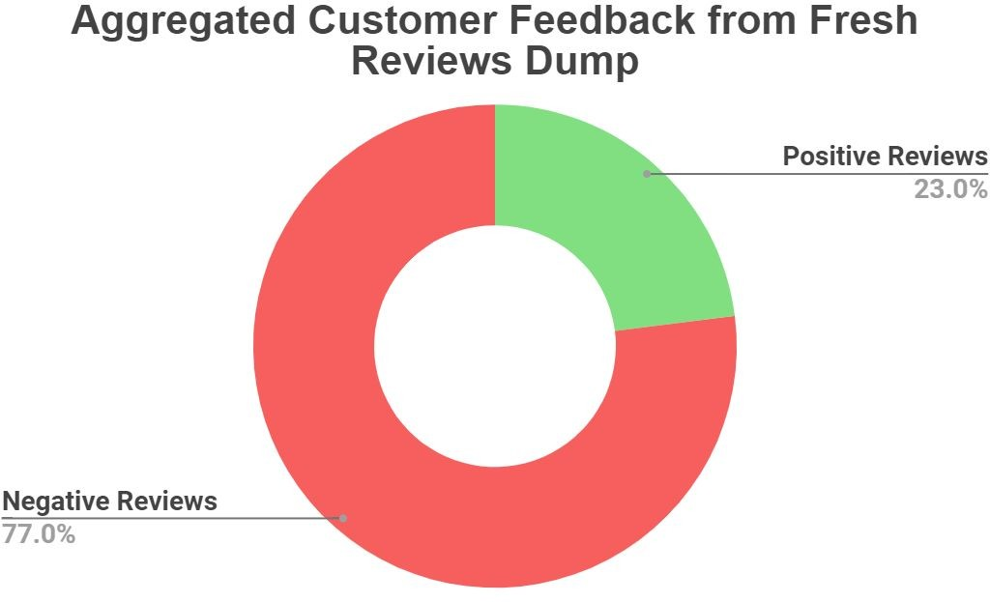
Insight: Majority of customers not happy

Slide 7
Immediate business intervention required on...
❏ Restaurant staff being rude
❏ Bad food (too much garlic/not fresh)
❏ Disliked concept/theme
❏ Slow service
❏ Overpriced drinks
❏ Cleanliness issues
❏ Live green caterpillar found

Slide 8


