Slide 1
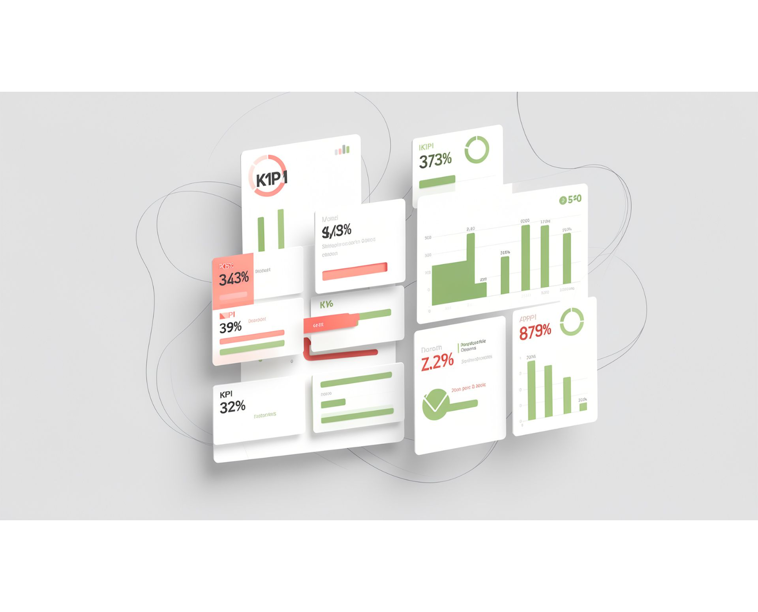
EDUPULSE
STUDENT RETENTION & DROPOUT ANALYTICS
STUDENT RECORDS | 4,424
DROPOUT RATE | 32.12%
GRADUATE | 49.93%
EduPulse
Turning student data into actionable insights
SQL | Python | Power BI | Statistical Analysis | n8n + AI

Slide 2



THE BUSINESS PROBLEM
Dropout is a business problem, not just an academic metric
Educational institutions need earlier visibility into academic and financial patterns associated with dropout.
What proportion of students graduate, remain enrolled, or drop out?
Which academic and financial patterns are associated with higher observed dropout rates?
How can validated findings become practical support actions?
2

Slide 3
FROM DATA TO DECISION
One dataset, one workflow, multiple decision lenses
4,424 cleaned student records from the UCI Student Dropout and Academic Success dataset
01
02
03
04
Data
Analysis
Validation
Dashboard
UCI Student Dropout and Academic Success dataset
SQL
Python · Pandas · NumPy · SciPy
Power BI
SQL business analysis answers the operational questions.
EDA, data quality, and statistical validation.
Turns the findings into an interactive three-page dashboard.
4,424 cleaned student records
3

Slide 4
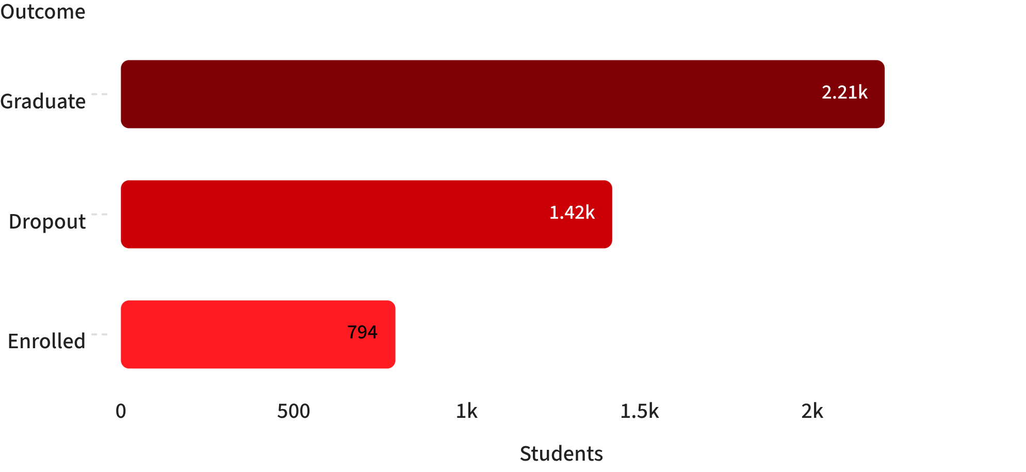
OUTCOME DISTRIBUTION
Half graduate, one-third dropout, one in six still enrolled
Outcome | Students | Share
Graduate | 2,209 | 49.93%
Dropout | 1,421 | 32.12%
Enrolled | 794 | 17.95%
Total population: 4,424 students
The observed population is led by graduates, with 1,421 students recorded as dropout.
4

Slide 5
KEY FINDINGS
Academic progress and financial friction separate risk groups
Lower academic progress and financial friction appear together in the highest-risk groups.
Academic progress
Financial friction
Driver | Lower-risk group | Higher-risk group
2nd-semester grade | 12.70 graduate | 5.90 dropout
Approved units | 6.18 graduate | 1.94 dropout
Driver | Lower-risk group | Higher-risk group
Tuition fee status | 24.7% up to date | 86.5% not up to date
Debtor status | 28.3% non-debtor | 62.0% debtor
Scholarship status | 12.2% holders | 38.7% non-holders
5

Slide 6
COMBINED SEGMENT
The clearest risk signal is a combined segment
Observed dropout rate
STATISTICAL VALIDATION
Academic progress | Fees up to date | Overdue tuition fees
Grade 8 or above | — | —
Grade below 8 | — | 97.0% observed dropout rate
Welch's t-tests, Chi-square tests, and Cramér's V examined differences and associations.
Tuition fee status
0.431
Cramér's V, strongest association among the three highlighted financial indicators.
Interpretation: association, not causation; the analysis does not predict an individual's future outcome.
6

Slide 7
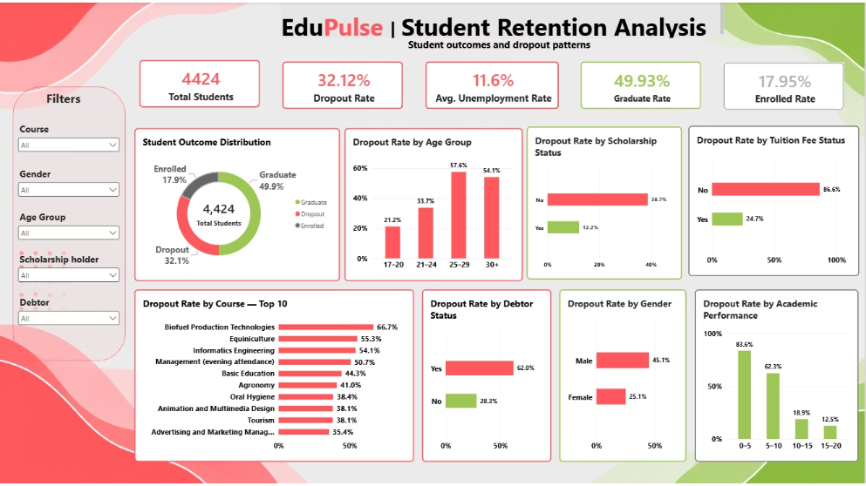
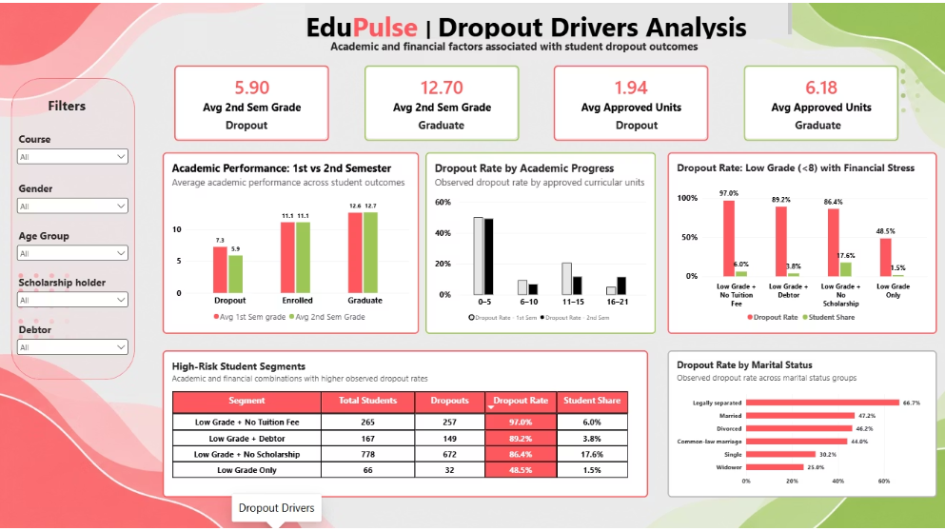
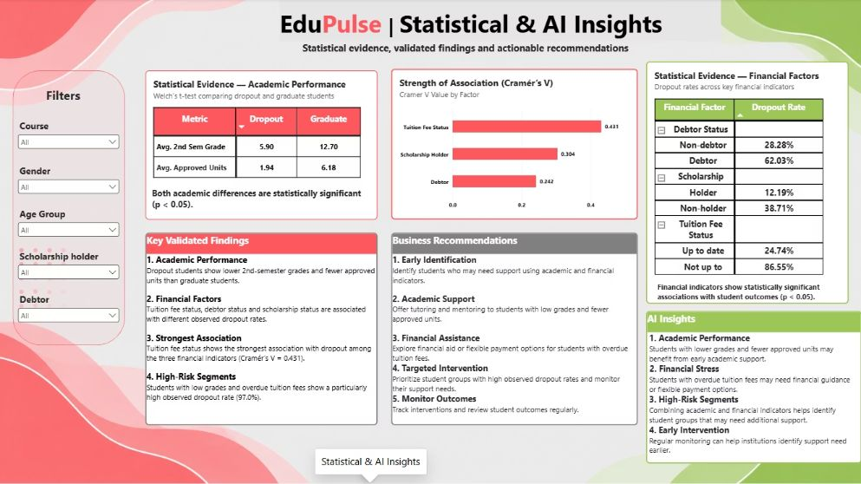
POWER BI WALKTHROUGH
The dashboard turns analysis into a decision surface
Executive Overview
Outcomes, dropout rate, age groups, and financial indicators.
Dropout Drivers
Academic performance, approved curricular units, and high-risk segments.
Statistical & AI Insights
Statistical evidence, Cramér's V, and business recommendations.
Strongest signal
Tuition fee status · Cramér's V = 0.431
Decision surface
From validated findings to business recommendations.
7

Slide 8
RECOMMENDATIONS
From validated analysis to action, automatically
1
2
3
SHARED STAGE
AI Business Report → n8n → AI → Gmail
Technical Data Quality Alert → notifier.py → Gmail
Python
Prepares data, checks quality, and produces validated results.
n8n receives the results through a webhook and routes the business-report path. AI interprets the evidence into business-friendly insights. Gmail delivers the AI report when the configured condition is met.
Issues are detected in the technical data quality path. Python SMTP sends technical anomaly alerts when issues are detected.
Recommendations
01
02
03
04
Early identification
Academic support for low grades and fewer approved units
Financial assistance or flexible payment options
Targeted intervention and outcome monitoring
8

Slide 9
EDUPULSE
Thank You
EduPulse turns student data into earlier, more targeted support.
Neeraj Singh · Data Analytics | SQL | Python | Statistics | Power BI | AI Automation
Next step: connect interventions to outcomes and evaluate impact.

