Slide 1
Prediction of hospital readmissions for patients with diabetes
Neeraj Kumar Reddy Panta
Ruchi Dilip Kukde

Slide 2
Hypothesis testing
Focus: Female and Male patients
Readmitted within 30 days
Readmitted after 30 days
Not reported to be readmitted
G1: Female patients
G2: Male patients

Slide 3
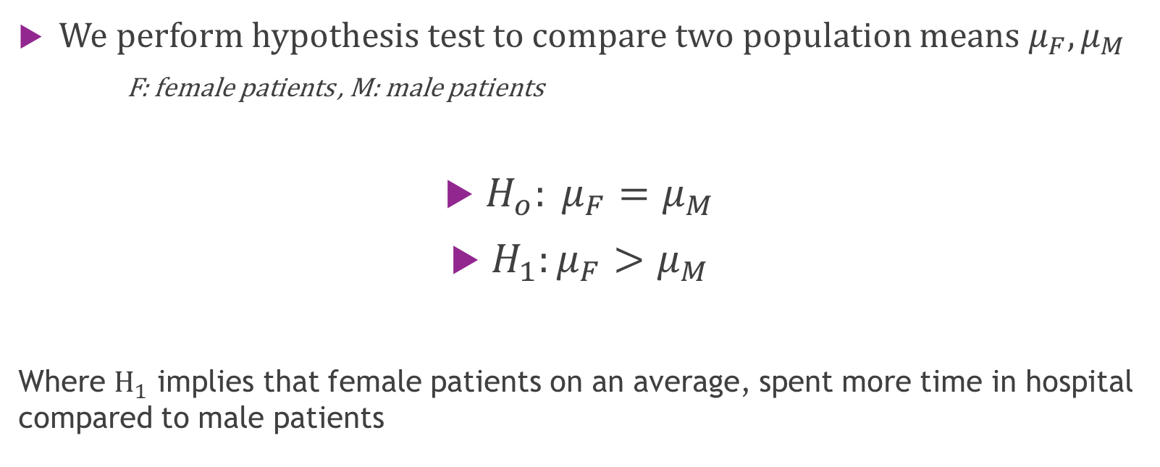
Hypothesis statement
We perform hypothesis test to compare two population means $μ_{F}, μ_{M}$
F: female patients , M: male patients
$H_{o}: μ_{F}=μ_{M}$
$H_{1}:μ_{F}>μ_{M}$
Where $H_{1}$ implies that female patients on an average, spent more time in hospital compared to male patients

Slide 4
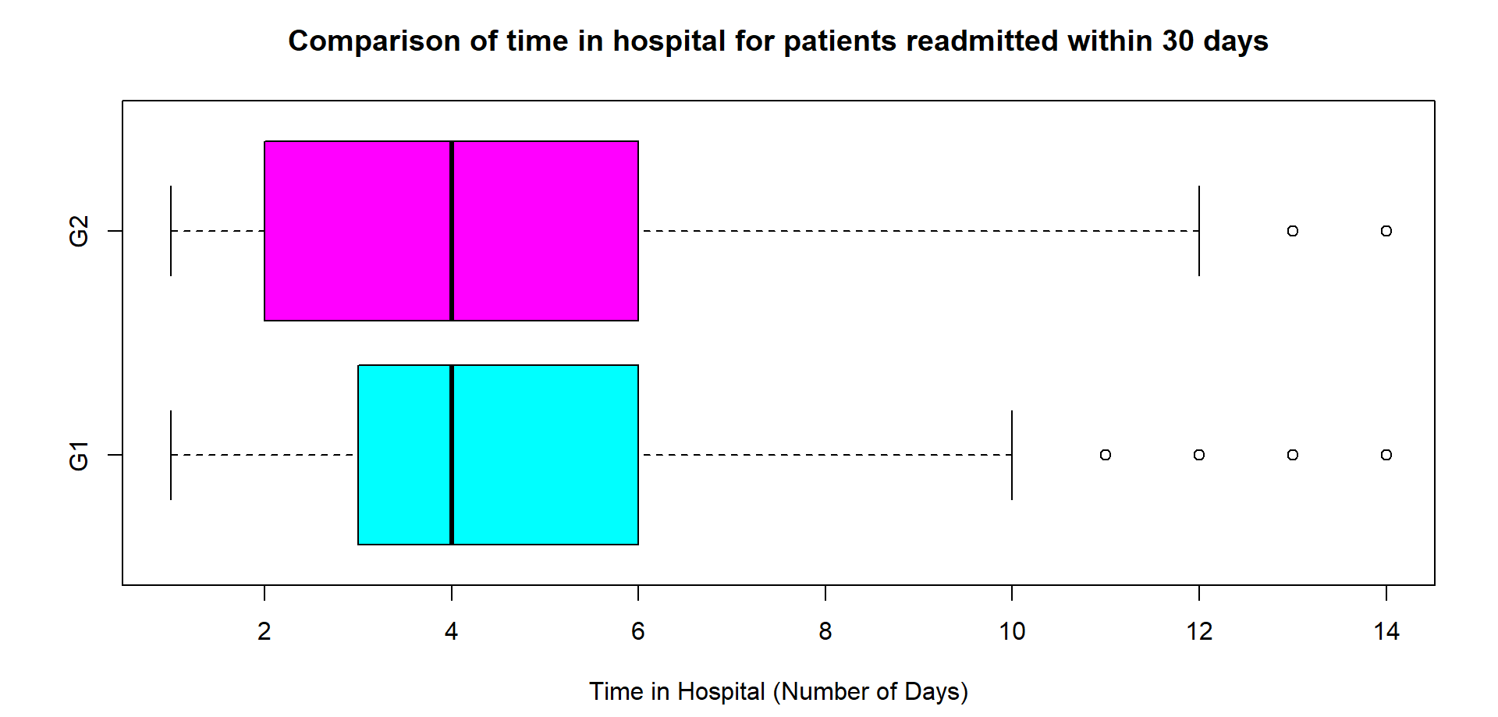
Visualization: Boxplots Patients readmitted within 30 days

Slide 5
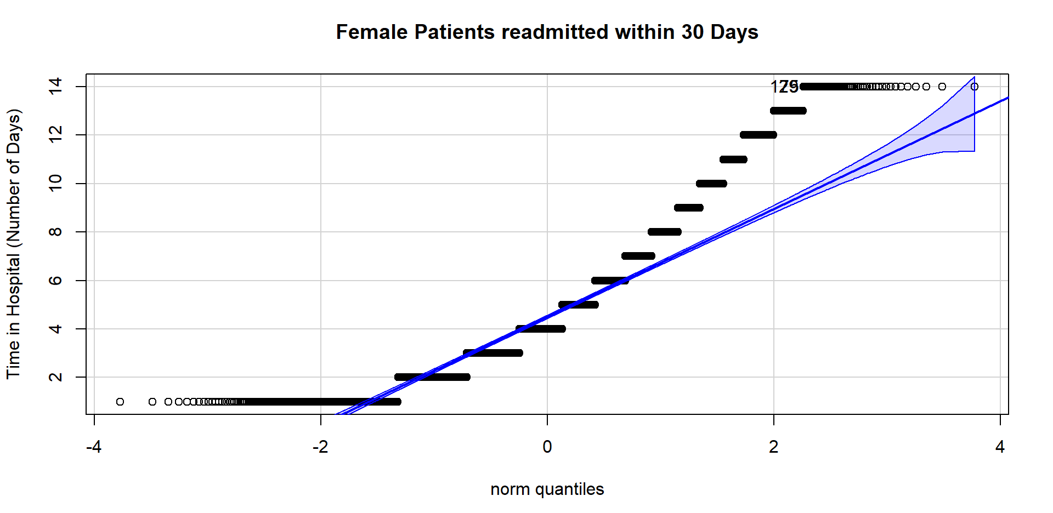
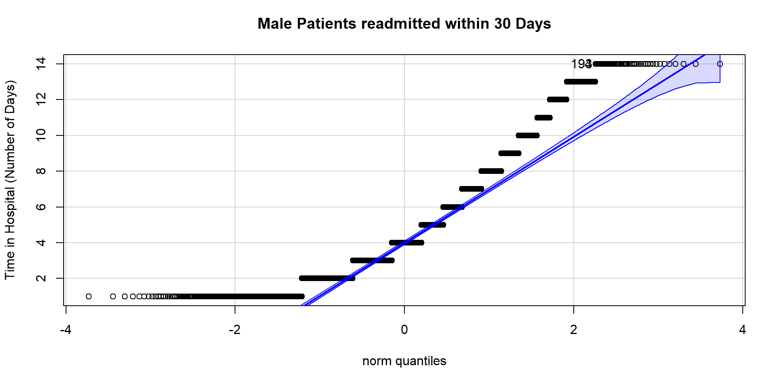

Slide 6
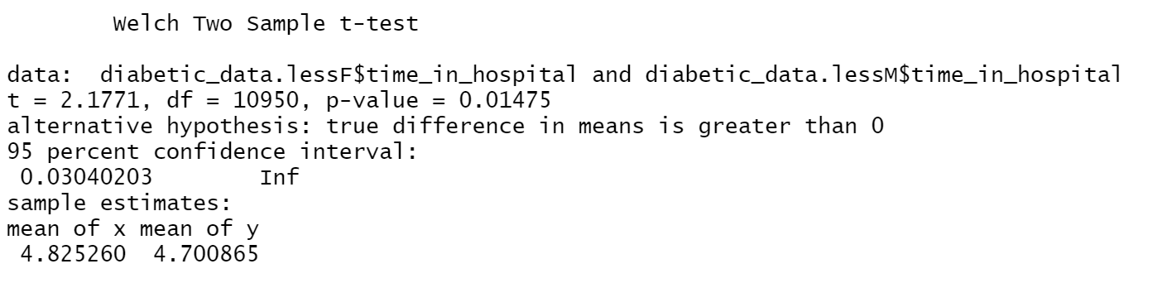

Test of Significance Patients readmitted within 30 days
For the test, $α=0.05$
Observations:
p-value= 0.01475
95% confidence interval does not contain ‘0’

Slide 7
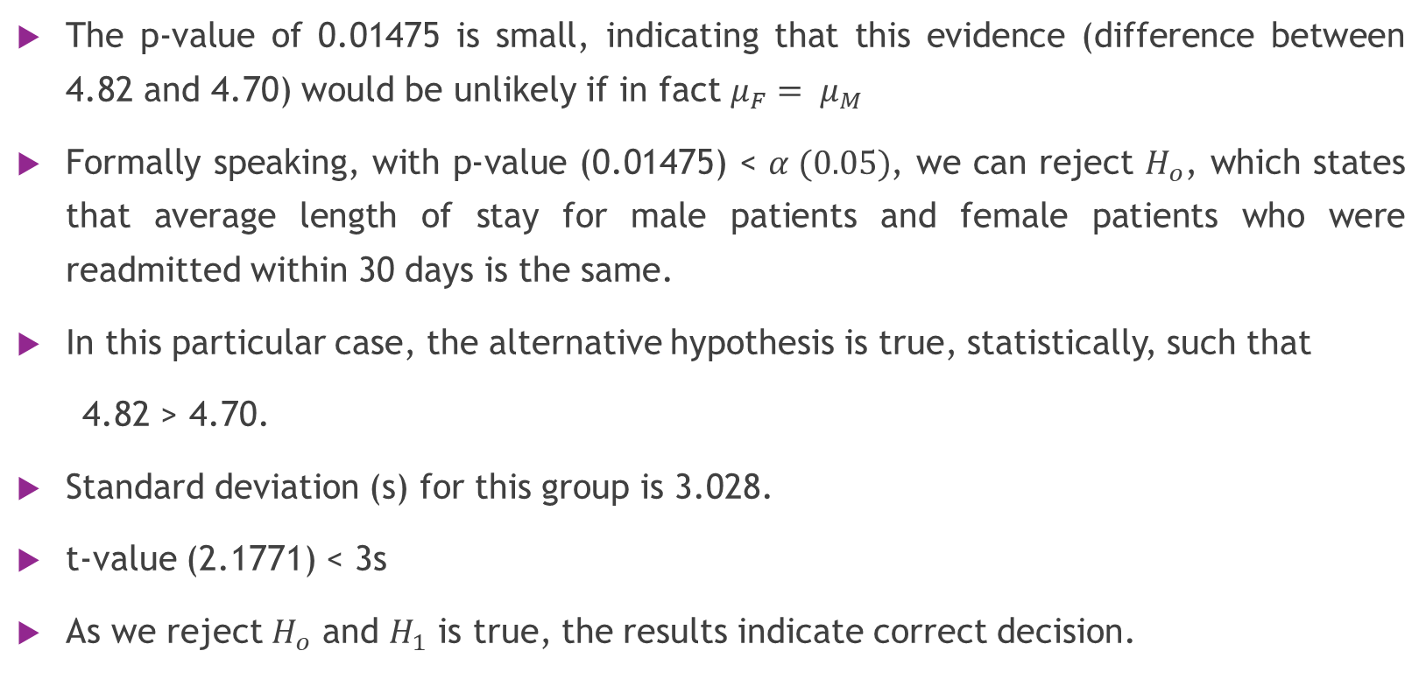
Results
The p-value of 0.01475 is small, indicating that this evidence (difference between 4.82 and 4.70) would be unlikely if in fact $μ_{F}= μ_{M}$
Formally speaking, with p-value (0.01475) < $α (0.05)$, we can reject $H_{o}$, which states that average length of stay for male patients and female patients who were readmitted within 30 days is the same.
In this particular case, the alternative hypothesis is true, statistically, such that
4.82 > 4.70.
Standard deviation (s) for this group is 3.028.
t-value (2.1771) < 3s
As we reject $H_{o}$ and $H_{1}$ is true, the results indicate correct decision.

Slide 8
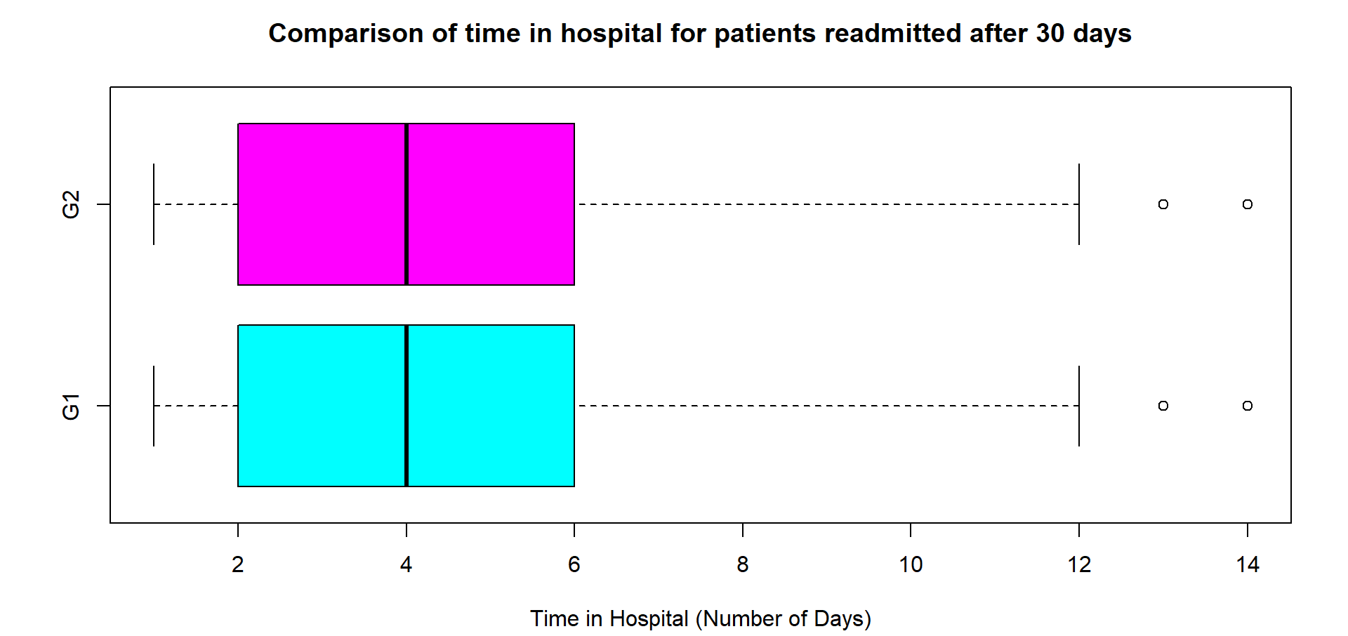
Visualization: Boxplots Patients readmitted after 30 days

Slide 9
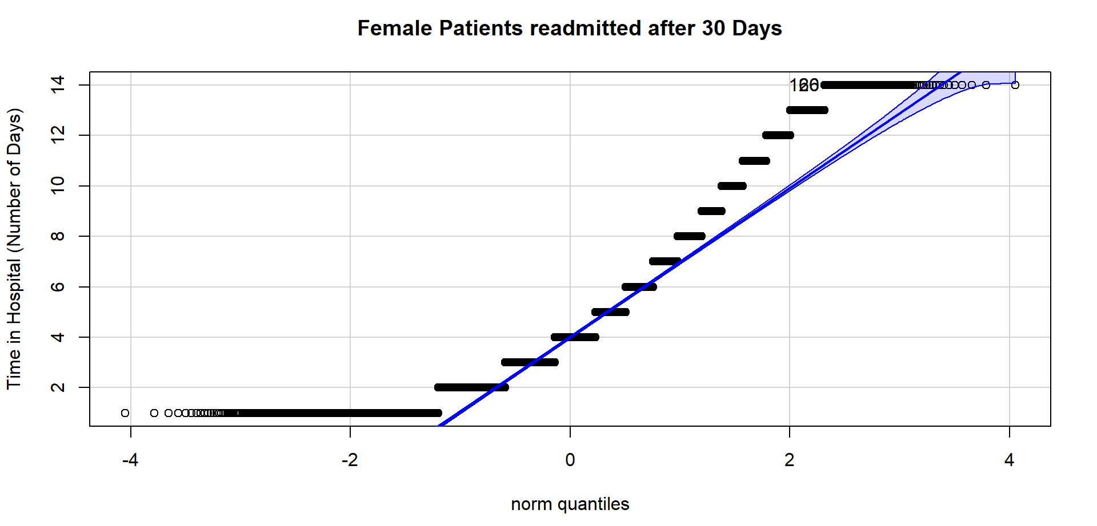
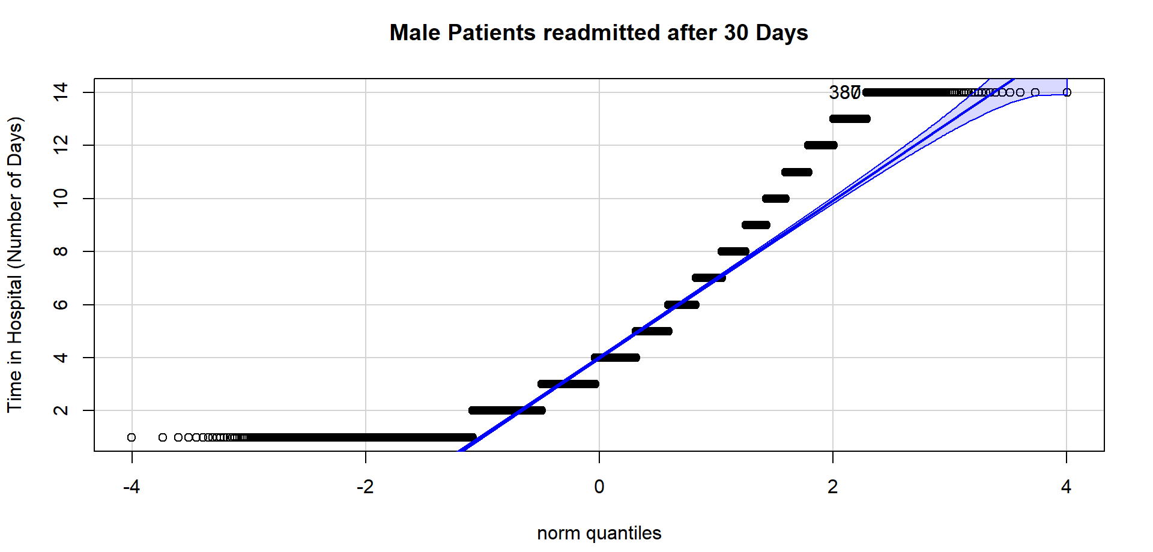

Slide 10
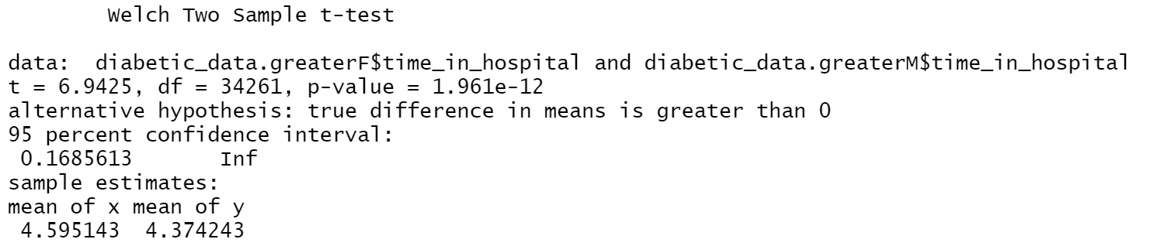

Test of Significance Patients readmitted after 30 days
For the test, $α=0.05$
Observations:
p-value= $1.96×{10}^{−12}$
95% confidence interval does not contain ‘0’

Slide 11
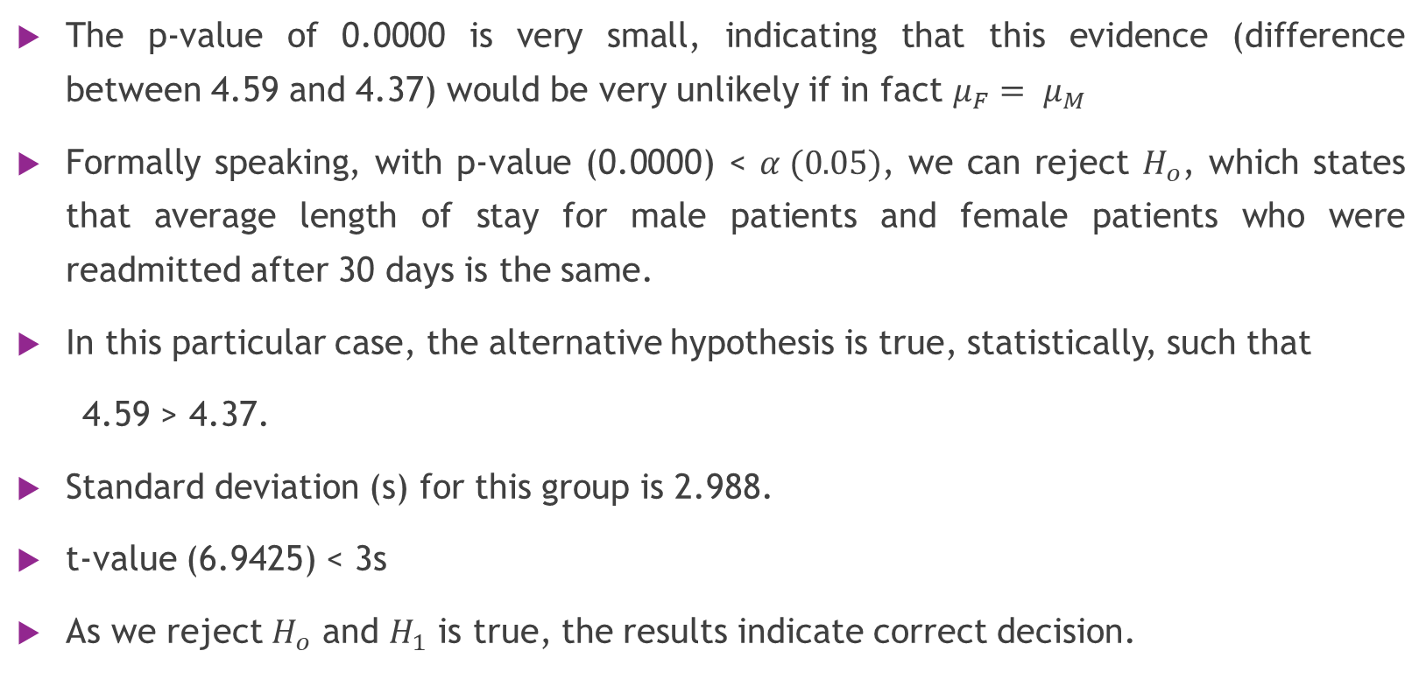
Results
The p-value of 0.0000 is very small, indicating that this evidence (difference between 4.59 and 4.37) would be very unlikely if in fact $μ_{F}= μ_{M}$
Formally speaking, with p-value (0.0000) < $α (0.05)$, we can reject $H_{o}$, which states that average length of stay for male patients and female patients who were readmitted after 30 days is the same.
In this particular case, the alternative hypothesis is true, statistically, such that
4.59 > 4.37.
Standard deviation (s) for this group is 2.988.
t-value (6.9425) < 3s
As we reject $H_{o}$ and $H_{1}$ is true, the results indicate correct decision.

Slide 12
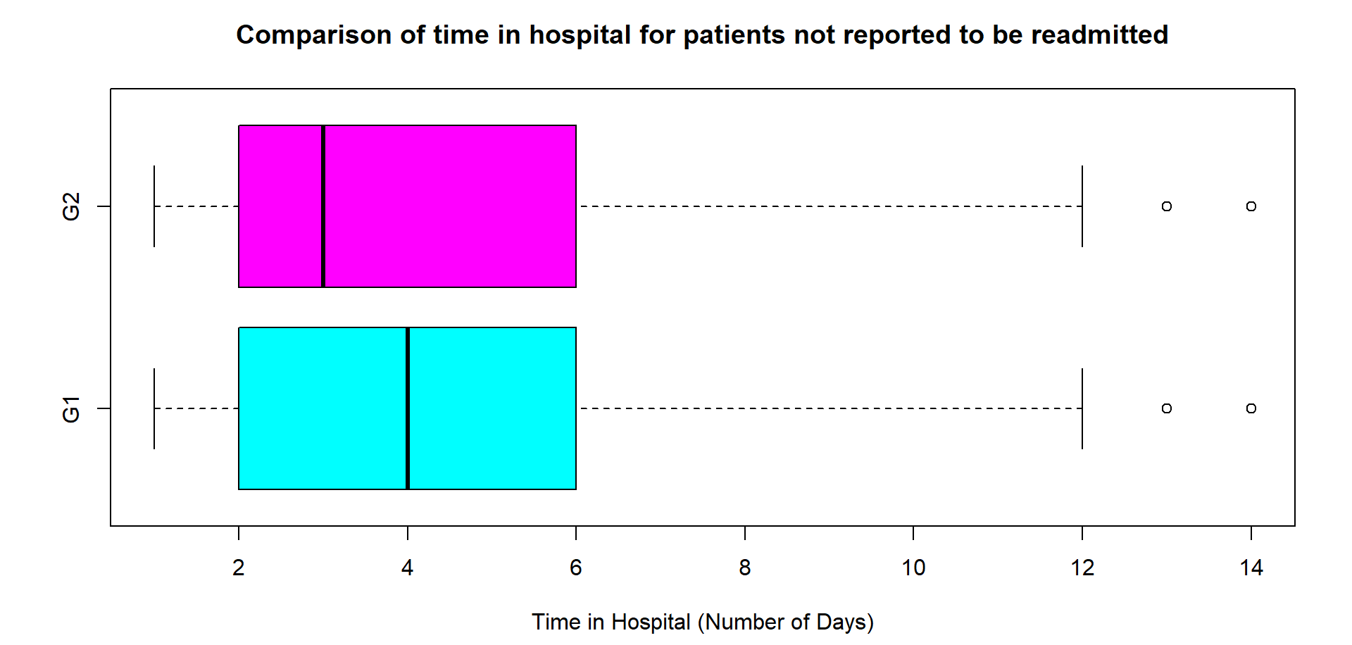
Visualization: Boxplots Patients who were not readmitted

Slide 13
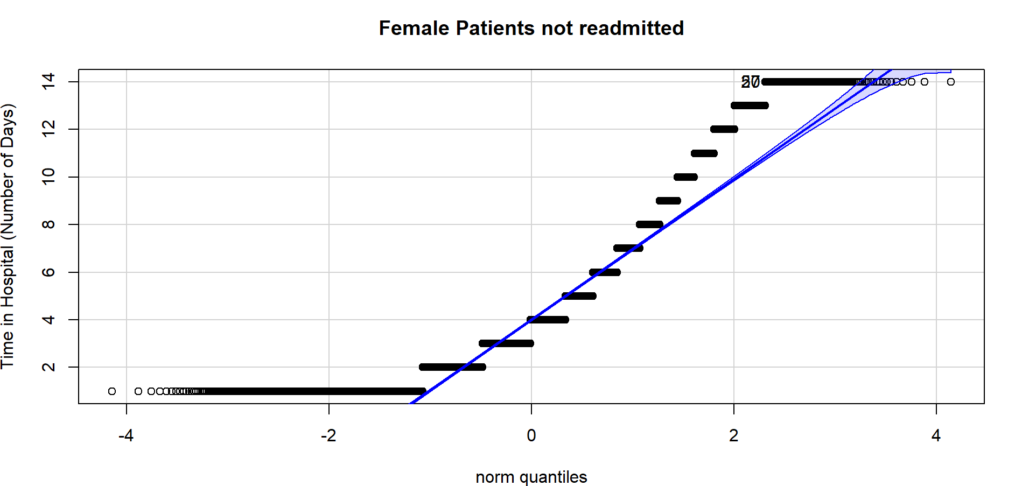


Slide 14
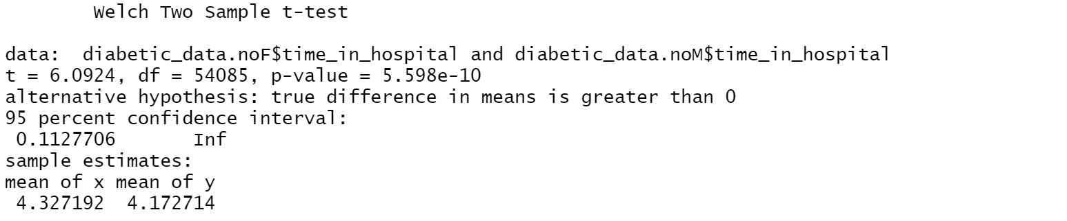

Test of Significance Patients not reported as readmitted
For the test, $α=0.05$
Observations:
p-value= $5.59×{10}^{−10}$
95% confidence interval does not contain ‘0’

Slide 15
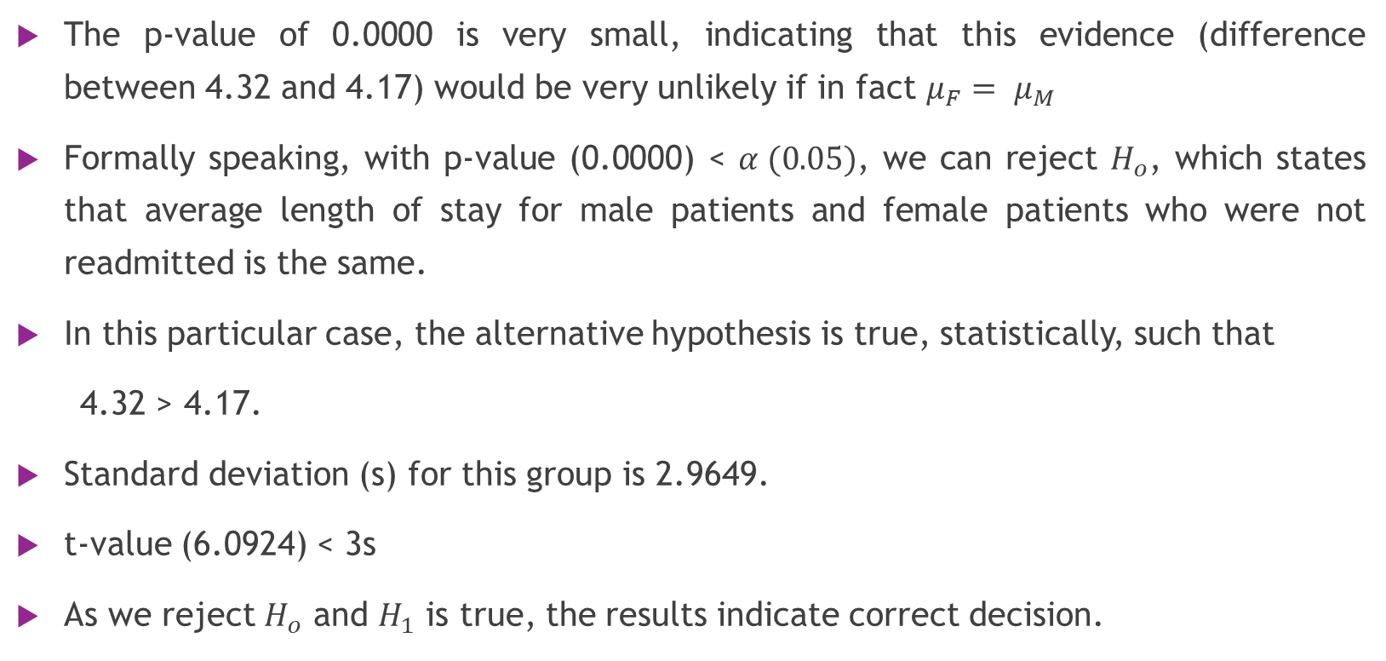
Results
The p-value of 0.0000 is very small, indicating that this evidence (difference between 4.32 and 4.17) would be very unlikely if in fact $μ_{F}= μ_{M}$
Formally speaking, with p-value (0.0000) < $α (0.05)$, we can reject $H_{o}$, which states that average length of stay for male patients and female patients who were not readmitted is the same.
In this particular case, the alternative hypothesis is true, statistically, such that
4.32 > 4.17.
Standard deviation (s) for this group is 2.9649.
t-value (6.0924) < 3s
As we reject $H_{o}$ and $H_{1}$ is true, the results indicate correct decision.

Slide 16
Practical Significance
Statistically, average length of stay for female patients is observed to be greater than male patients.
According to the dataset, length of stay in hospital is reported as number of days (integers).
Practically speaking, the average length of stay of 4.32 and 4.17 days would have to be perceived in the form of hours ( when the patient was discharged from the hospital) according to the context of the problem.

Slide 17
Thank you

