Slide 1
Linear Regression for diabetes patients re-admitted in hospital within 30 days
Neeraj Kumar Reddy Panta
Ruchi Dilip Kukde

Slide 2


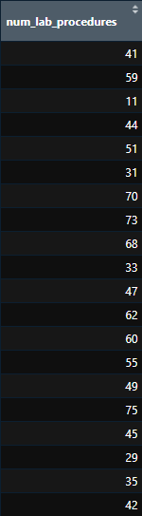
Linear Regression
Focus : Patients readmitted in hospital within 30 days.
Data used for regression is numeric
Units of Variables:
time_in_hospital: Days
num_medications : Count
num_lab_procedures: Count

Slide 3
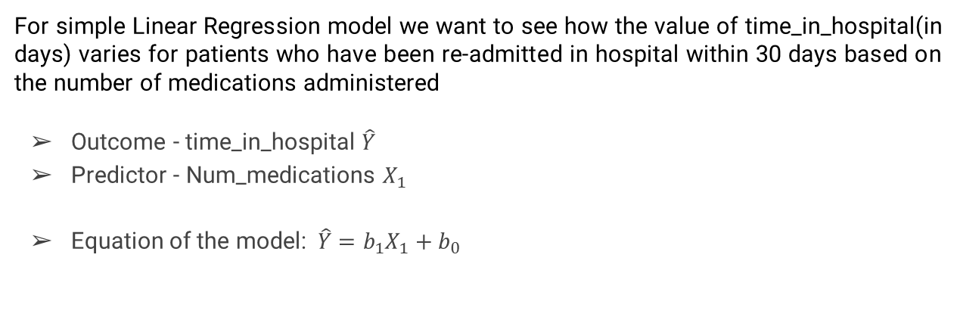
Simple Linear Regression Model Overview
For simple Linear Regression model we want to see how the value of time_in_hospital(in days) varies for patients who have been re-admitted in hospital within 30 days based on the number of medications administered
Outcome - time_in_hospital $\hat{Y}$
Predictor - Num_medications $X_{1}$
Equation of the model:$\hat{Y}=b_{1}X_{1}+b_{0}$

Slide 4
Preliminary Assessment for Simple Linear Regression Model

Slide 5
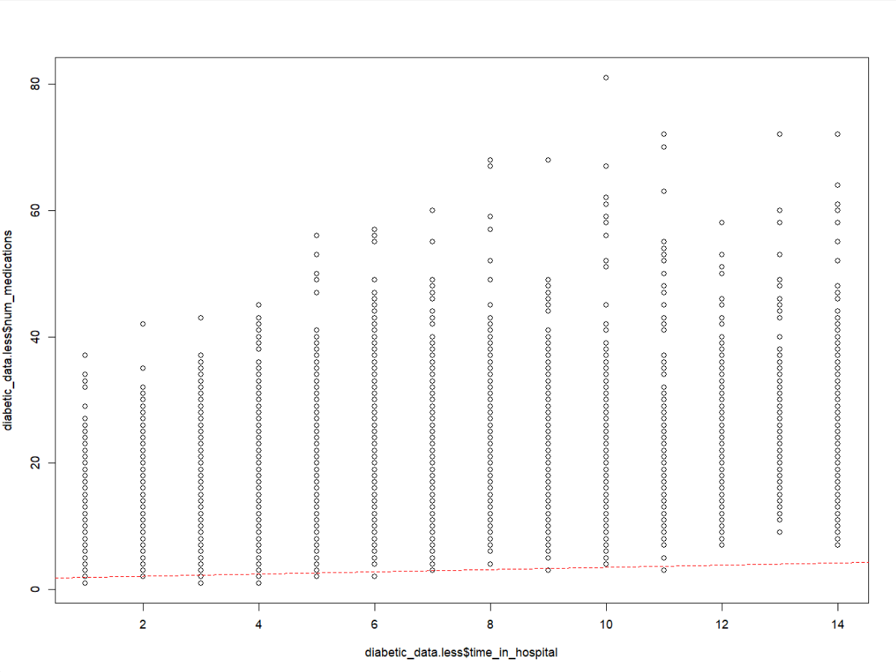
Verifying Linearity with Scatter Plot
Observation:
We cannot depict the relationship between the two variables time_in_hospital and num_medications as the variables are measured on a discrete scale, this presents us with a challenge.
However, there could still be a linear relationship which is difficult to observe using this display

Slide 6
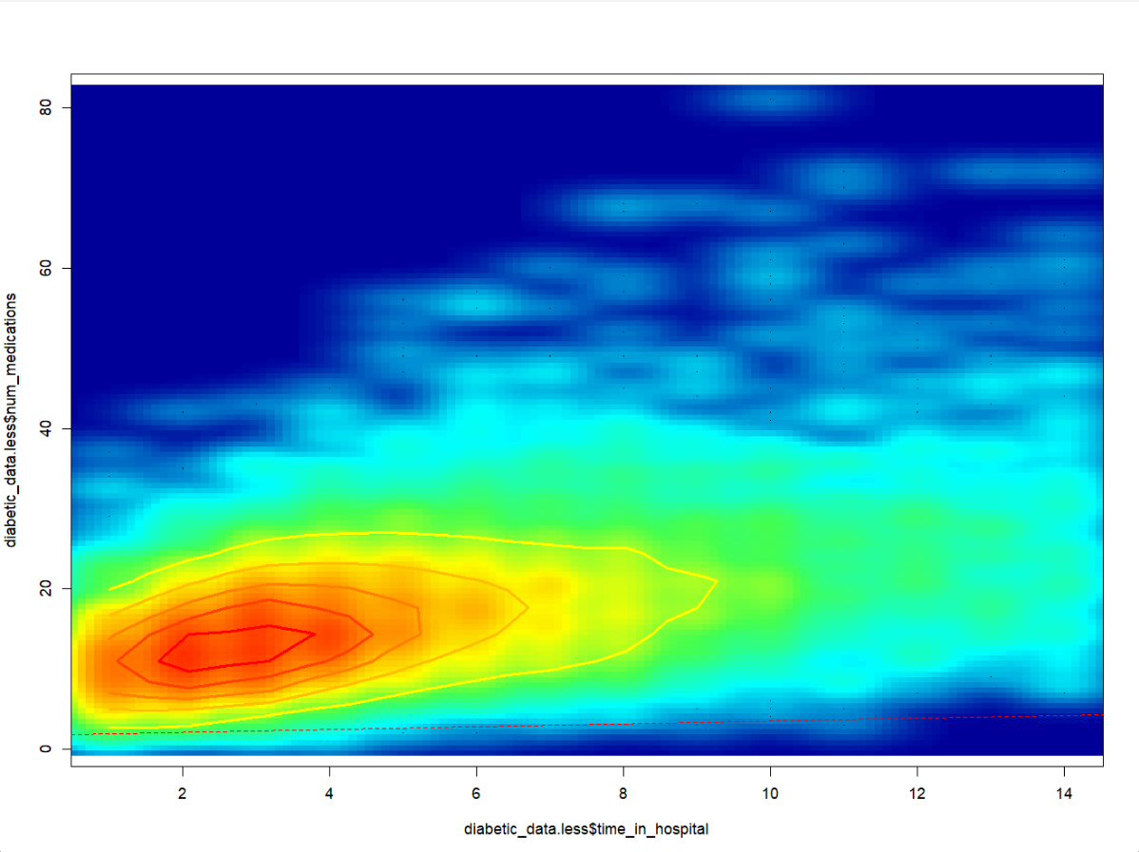
Verifying Linearity with Heat Map R Scatter Plot
We generate this graph using Heat Mapping along-with base R functions such as Smoothscatter and contour on a scatter plot
Looks like a positive correlation!
But it is better to compute the Pearson and Spearman correlation coefficients and then assess the strength
Notes:
Smoothscatter function a base R function that creates a smooth color kernel density estimation of an R scatterplot
contour function which is used for calculating and marking limits of density estimates of the variables on a scatter plot

Slide 7
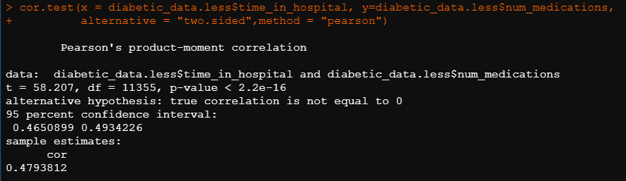
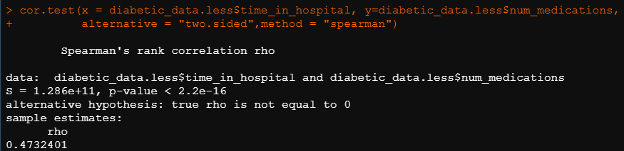
Pearson & Spearman correlation coefficient tests
Both Pearson and Spearman correlation coefficient tests for patients readmitted in hospital within 30 days show that there is a positive correlation between the variables time_in_hospital and num_medications.

Slide 8
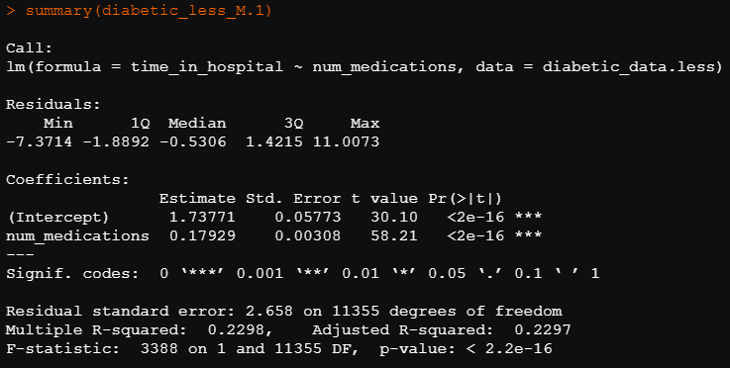
Output of Simple Regression Model
time_in_hospital = 0.17929 (num_medications) + 1.73771

Slide 9

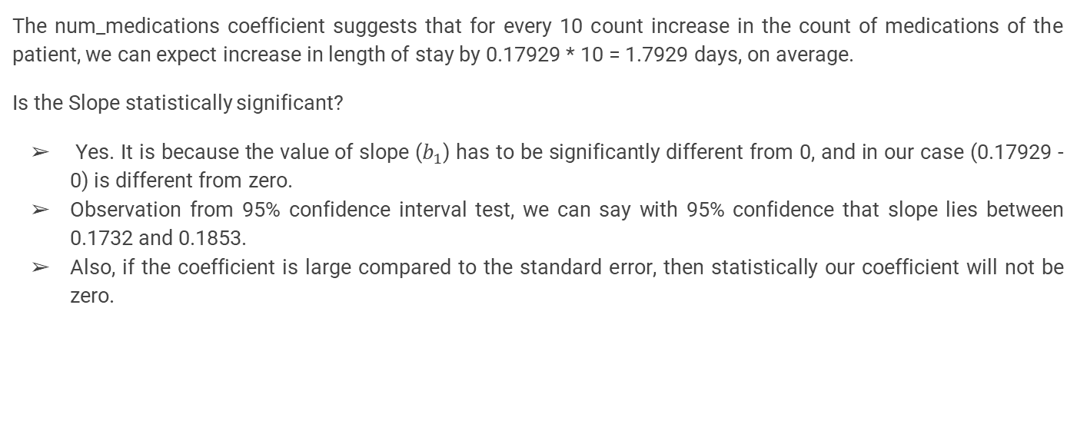
Interpreting the Output
The num_medications coefficient suggests that for every 10 count increase in the count of medications of the patient, we can expect increase in length of stay by 0.17929 * 10 = 1.7929 days, on average.
Is the Slope statistically significant?
Yes. It is because the value of slope ($b_{1}$) has to be significantly different from 0, and in our case (0.17929 - 0) is different from zero.
Observation from 95% confidence interval test, we can say with 95% confidence that slope lies between 0.1732 and 0.1853.
Also, if the coefficient is large compared to the standard error, then statistically our coefficient will not be zero.

Slide 10
Hypothesis Test for the slope Coefficient
H0:β=0
H1:β≠0
H0 : No Linear relationship between time_in_hospital and num_medications
H1: There is Linear relationship between time_in_hospital and num_medications

Slide 11
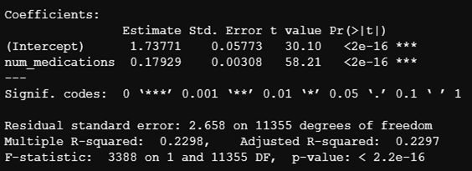
Summary shows that num_medications coefficient is 58.21 standard errors away from zero and it is pretty far from zero. The larger our t-statistic is the more certain we can be that the coefficient in not zero.
The p-value is calculated is using t-statistic from the t distribution and it also helps us understand how significant is our coefficient is to the model. In practical terms any p-value below 0.05 is significant. In our model, we can see that Intercept and num_medications have p-value of 2e-16 which is extremely small and it is even below 0.001. We can conclude that the coefficients in this model are not zero.
The residual Standard error is a measure of how well the model fits the data. From our model summary, we can see that on average, the actual values are 2.658 Days away from regression line.
The F-statistic and overall p-value help us determine the result of our Hypothesis test. It is common for the F-statistic to be close to 1 if we have lot of predictors. However for smaller models, a larger F-statistic and a small p-value generally indicates that null hypothesis should be rejected and it clearly indicates that the coefficient in the model isn’t zero.

Slide 12
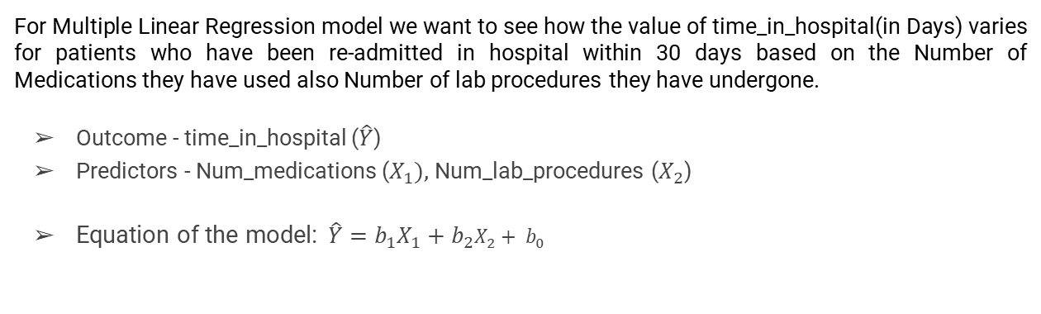
Multiple Linear Regression Model Overview
For Multiple Linear Regression model we want to see how the value of time_in_hospital(in Days) varies for patients who have been re-admitted in hospital within 30 days based on the Number of Medications they have used also Number of lab procedures they have undergone.
Outcome - time_in_hospital ($\hat{Y}$)
Predictors - Num_medications ($X_{1}),$Num_lab_procedures ($X_{2}$)
Equation of the model:$\hat{Y}=b_{1}X_{1}+b_{2}X_{2}+ b_{0}$

Slide 13
Preliminary Assessment for Multiple Linear Regression Model

Slide 14
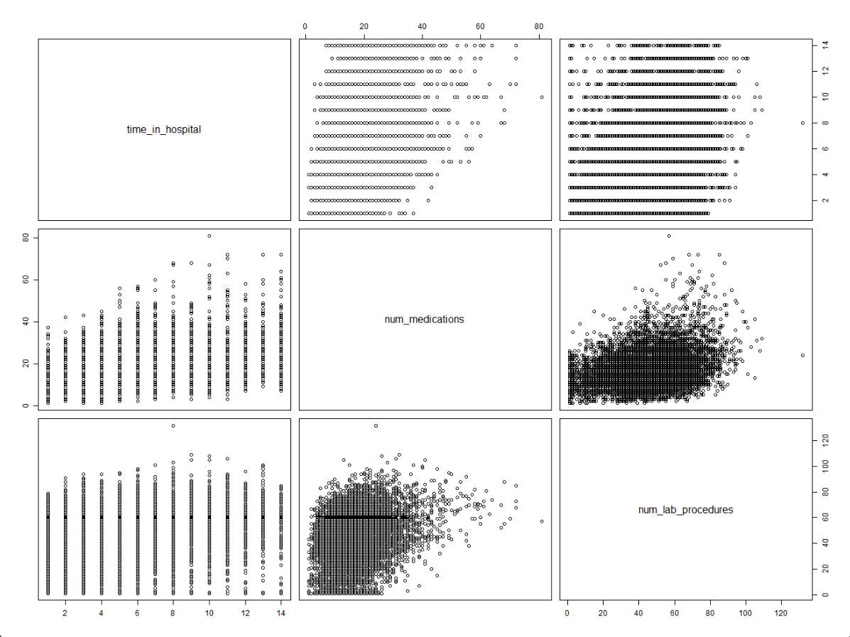
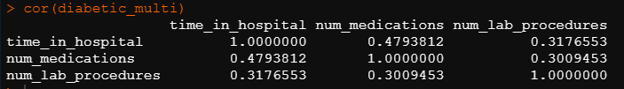
Verifying Linearity with Scatter Plot
We already know from simple linear regression that time_in_hospital has a moderate positive correlation with num_procedures, but we don’t know what is the relation between the other variables.
With function (cor) we can identify correlation between multiple variables,

Slide 15
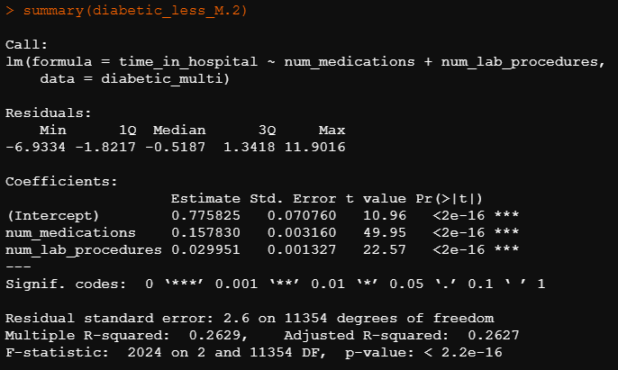
Output of Multiple Linear Regression Model
time_in_hospital = 0.1578 (Num_medications) + 0.0299 (Num_lab_procedures ) + 0.7758

Slide 16

Interpreting the output
In this case the p-value of F-statistic is <2.2e-16, which is highly significant, this means at least one of the predictor variables is significantly related to the outcome variable.
It can be seen that change in number of num_medications and num_lab_procedures, the time_in_hospital of a patient is associated.
For instance, for 10 count increase in the number of medications taken by the patient, we can expect an increase of 0.1578 * 10 = 1.578 days of patient staying in hospital (when the num_lab_procedures are constant)
Confidence interval of the model coefficients can be extracted as follows:

Slide 17
Goodness of Fit?
The adjusted R-squared value for multiple regression model is 0.2627, meaning that 26.27% of the variance in measure of days can be predicted by num_medications and num_lab_procedures number count.
This model is better than the simple linear model with only num_medications which had an adjusted R-squared of 0.2297.
The RSE gives us a measure of error of prediction. Multiple linear regression model gives an error rate of 54% , which is better than the simple linear regression model where the RSE was 0.558 (i.e. 55.8% error rate).

Slide 18
Thank You

