Slide 1

AgeVision
AI Based Age Prediction and Age Progression System Using Facial Images
Neeraj Bhuvan M | Roll No. 2435MCA0011 | Reg. No. 67224100038
MCA IV • Anna University, Centre for Distance Education
Guide: Dr. P. Geetha, Associate Professor, IST Dept., CEG
April 2026
Viva-Voce Presentation

Slide 2
Problem Statement & Motivation
02
The Gap in Existing Solutions
Why It Matters
• No free, unified platform for age prediction + progression
• Forensics: missing-persons & cold-case age simulation
• Commercial APIs (Face++, AWS Rekognition) are paid & privacy-invasive
• Healthcare: dermatological & geriatric age assessment
• Open-source tools need developer expertise to deploy
• Entertainment: VFX de-aging / aging without specialist tools
• Age progression lacks identity-preserving realism
• Security: biometric age-gate & facial liveness verification
• No system supports batch forensic-scale processing
• Academic: benchmark platform for generative AI research
• Missing emotion + demographic metadata alongside age
• Insurance / HR: age-group analytics at scale
AgeVision bridges the gap: one platform, multiple engines, no cost, no data leaves your machine.
AgeVision • MCA IV Project • Anna University CDE • April 2026

Slide 3
Core Objectives
03
Develop Angular 19 + Django 5.2 web platform with single, batch & real-time camera modes
Implement ensemble age prediction: MiVOLO v2 primary (MAE ≤ 3.65 yr) + InsightFace fallback
01
02
Build 4-engine age progression cascade: SAM Indian → SAM FFHQ → Fast-AgingGAN → FADING
Integrate ViT emotion detection (7 classes) alongside every prediction
03
04
Secure platform via JWT auth, Fernet password encryption, rate limiting & admin controls
Hybrid persistence: MongoDB 4.6 (6 collections) + SQLite; user history & batch records
05
06
Analytics dashboard with Chart.js visualisations + IsSuperUser-gated admin panel
Validate all 13 modules with a structured 44-case test catalogue (TC-AU to TC-AD)
07
08
AgeVision • MCA IV Project • Anna University CDE • April 2026

Slide 4
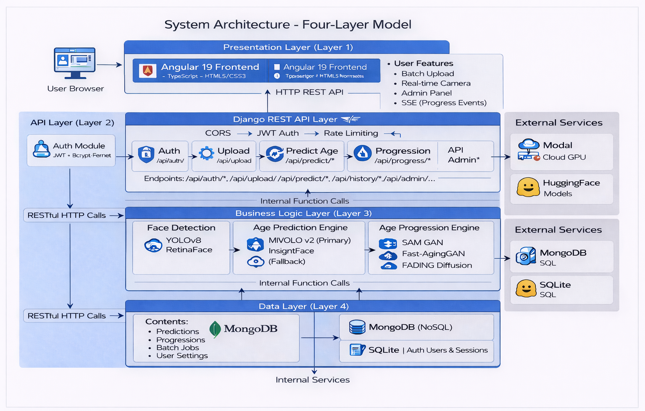
System Architecture
04
Presentation Tier
Angular 19 SPA · Bootstrap 5 · Chart.js · RxJS 7.8 · TypeScript 5.7
API / Business Tier
Django 5.2 · DRF · SimpleJWT · Fernet · 21 REST Endpoints · CORS
AI / ML Tier
MiVOLO v2 · InsightFace · SAM GAN · Fast-AgingGAN · FADING Diffusion
Persistence Tier
MongoDB 4.6 (6 collections) · SQLite · Modal Cloud GPU · Local FS
AgeVision • MCA IV Project • Anna University CDE • April 2026

Slide 5
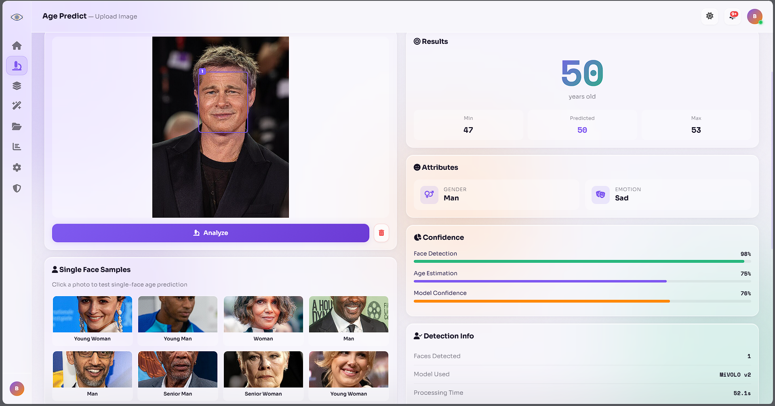
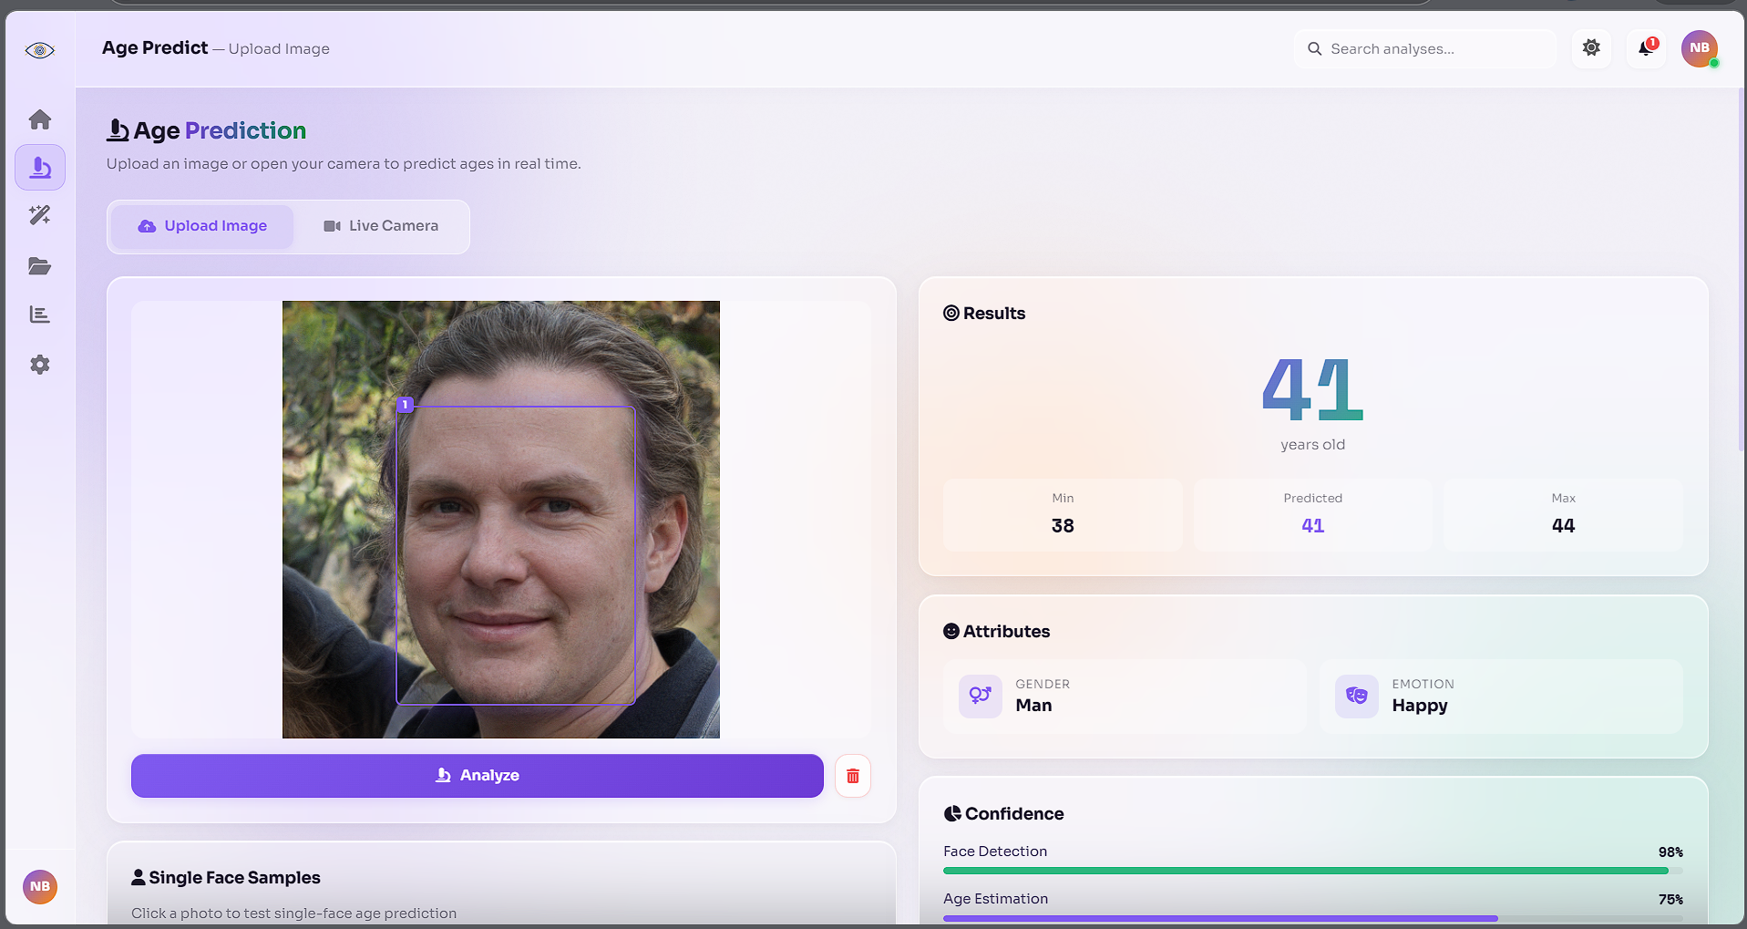
Age Prediction Module
05
MiVOLO v2 + InsightFace Ensemble
• Primary: MiVOLO v2 (ViT + YOLOv8 body context)
• MAE: 3.65 yr on IMDB-WIKI / UTKFace test split
• Fallback: InsightFace buffalo_l (RetinaFace + ArcFace, MAE ~8.5)
• Joint face + body bounding-box inference per image
• Multi-face: detects & ages N faces simultaneously
• Confidence: 1 − (σ / max_age) from ensemble spread
• Emotion: trpakov/vit-face-expression (7 classes, ViT)
• Camera mode: live webcam capture + instant prediction
MAE 3.65 yrs | 40–50% better than single-model baselines
MiVOLO v2 Pipeline / Prediction UI (Age + Gender + Emotion overlay)
AgeVision • MCA IV Project • Anna University CDE • April 2026

Slide 6
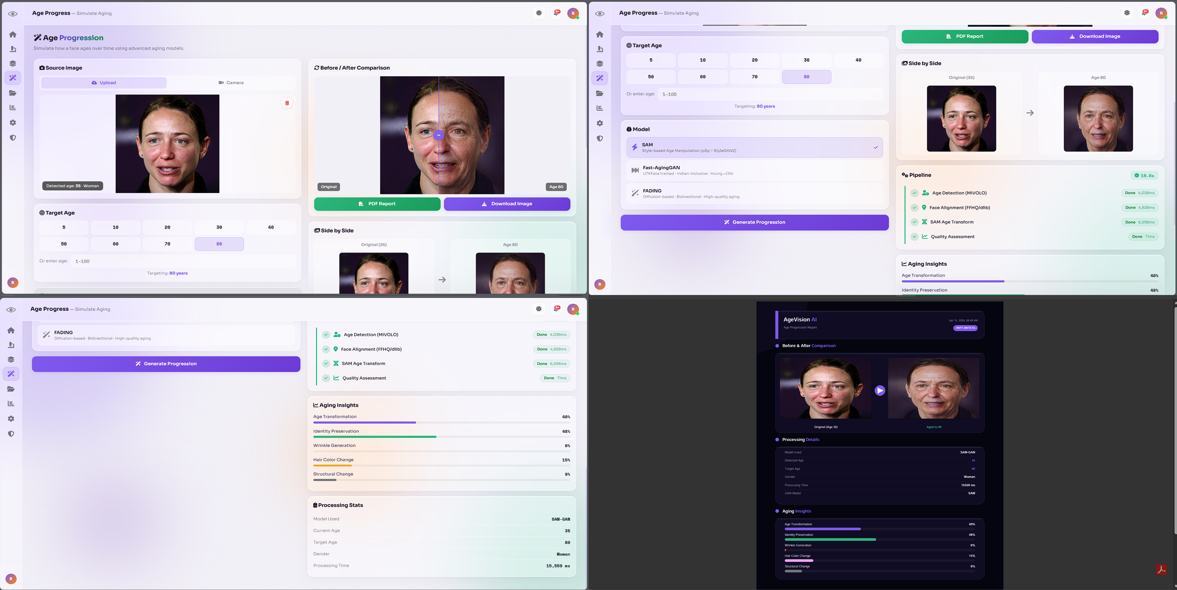
Age Progression Module
06
4-Engine Cascade Architecture — Automatic quality-first fallback chain
SAM GAN (Indian)
SAM FFHQ
Fast-AgingGAN
FADING Diffusion
pSp encoder + StyleGAN2 Indian-finetuned checkpoint Target age: 0–100 FaceNet identity threshold 0.6
pSp + StyleGAN2 General-population Western & diverse faces 3–8 s GPU latency
CycleGAN architecture ~11 MB model size CPU-friendly, no GPU needed Young → old direction
Stable Diffusion v1.5 Null-text inversion Bidirectional aging Modal A10G GPU optional
PRIMARY
FALLBACK 1
FALLBACK 2
PREMIUM
95%+ Identity Preservation (FaceNet similarity ≥ 0.6)
3–8 s Progression Latency (SAM GAN on GPU)
Target Age Range: 20 · 30 · 40 · 50 · 60 · 70 · 80 yrs
SAM GAN pSp Encoder → StyleGAN2 W+ Decoder Pipeline
AgeVision • MCA IV Project • Anna University CDE • April 2026

Slide 7
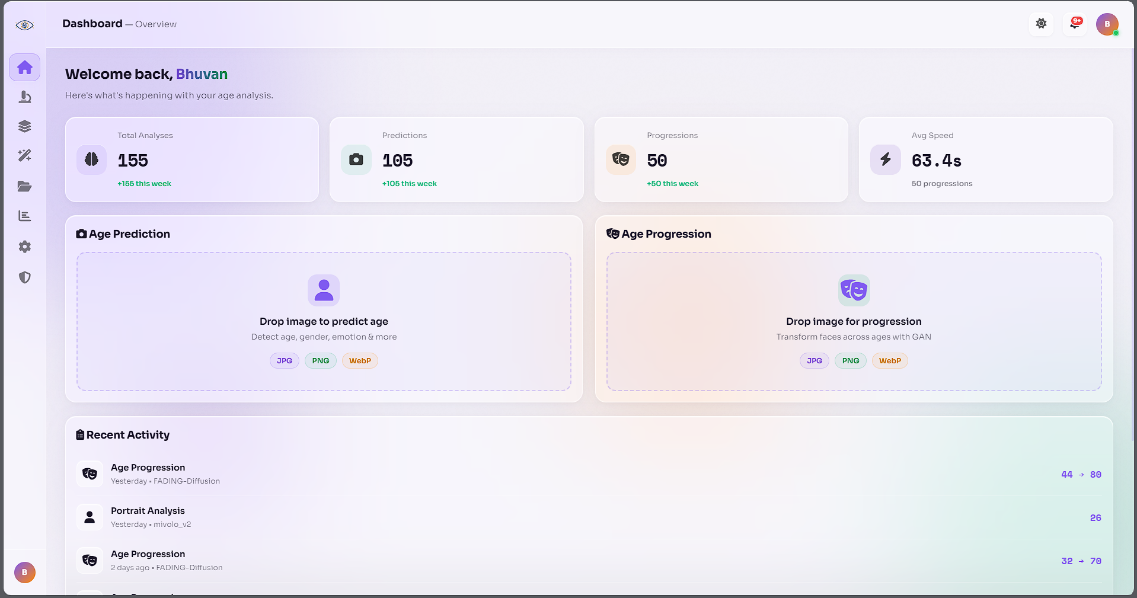
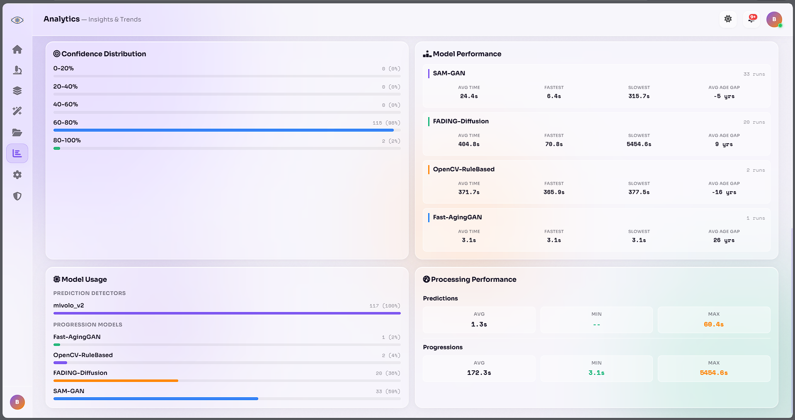
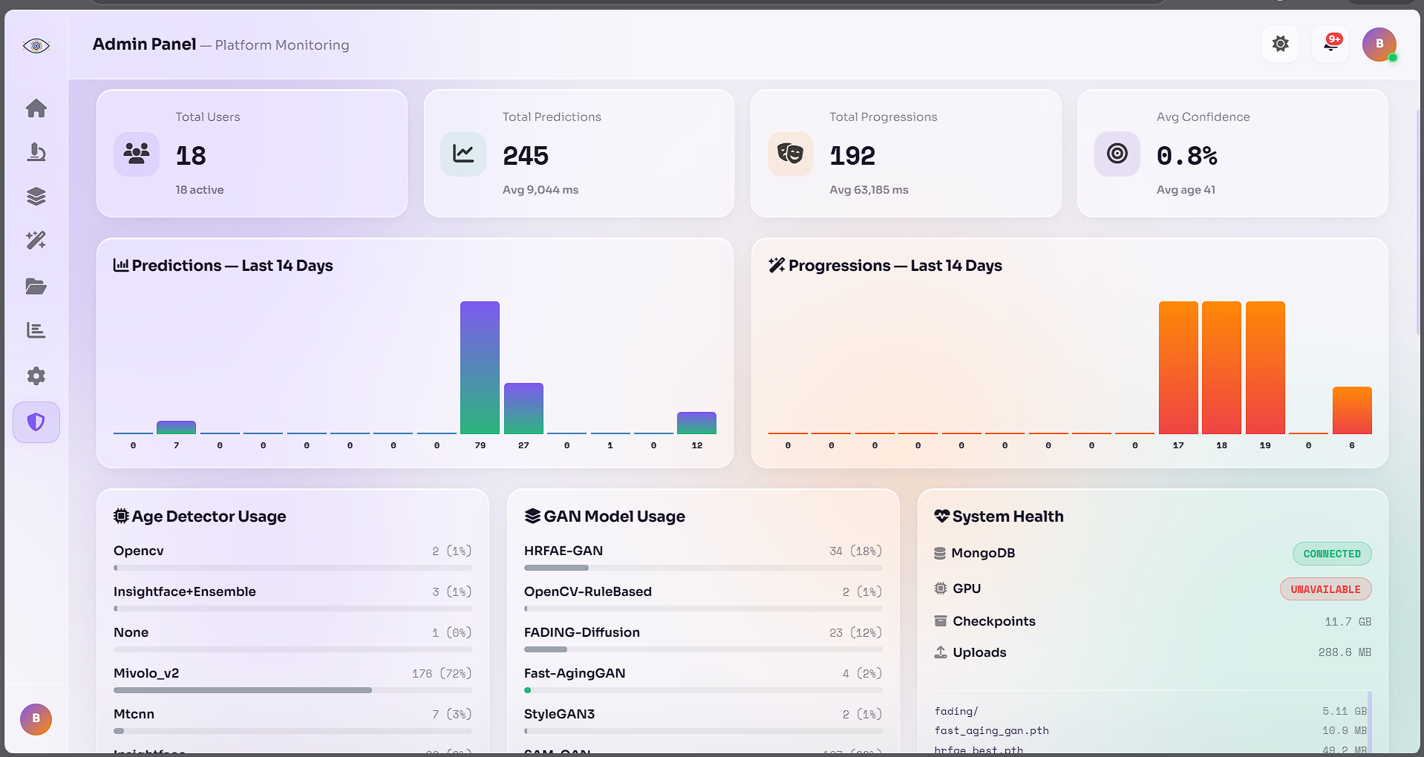
Application Demo — Angular 19 SPA
07
21 REST Endpoints • Dark / Light Themes • Mobile-Responsive • JWT-Secured
Dashboard — KPI Cards & Quick Actions
Age Prediction — Upload / Camera Modes
AgeVision • MCA IV Project • Anna University CDE • April 2026
Analytics — Charts, Distributions
Admin Panel — User Management & Health

Slide 8
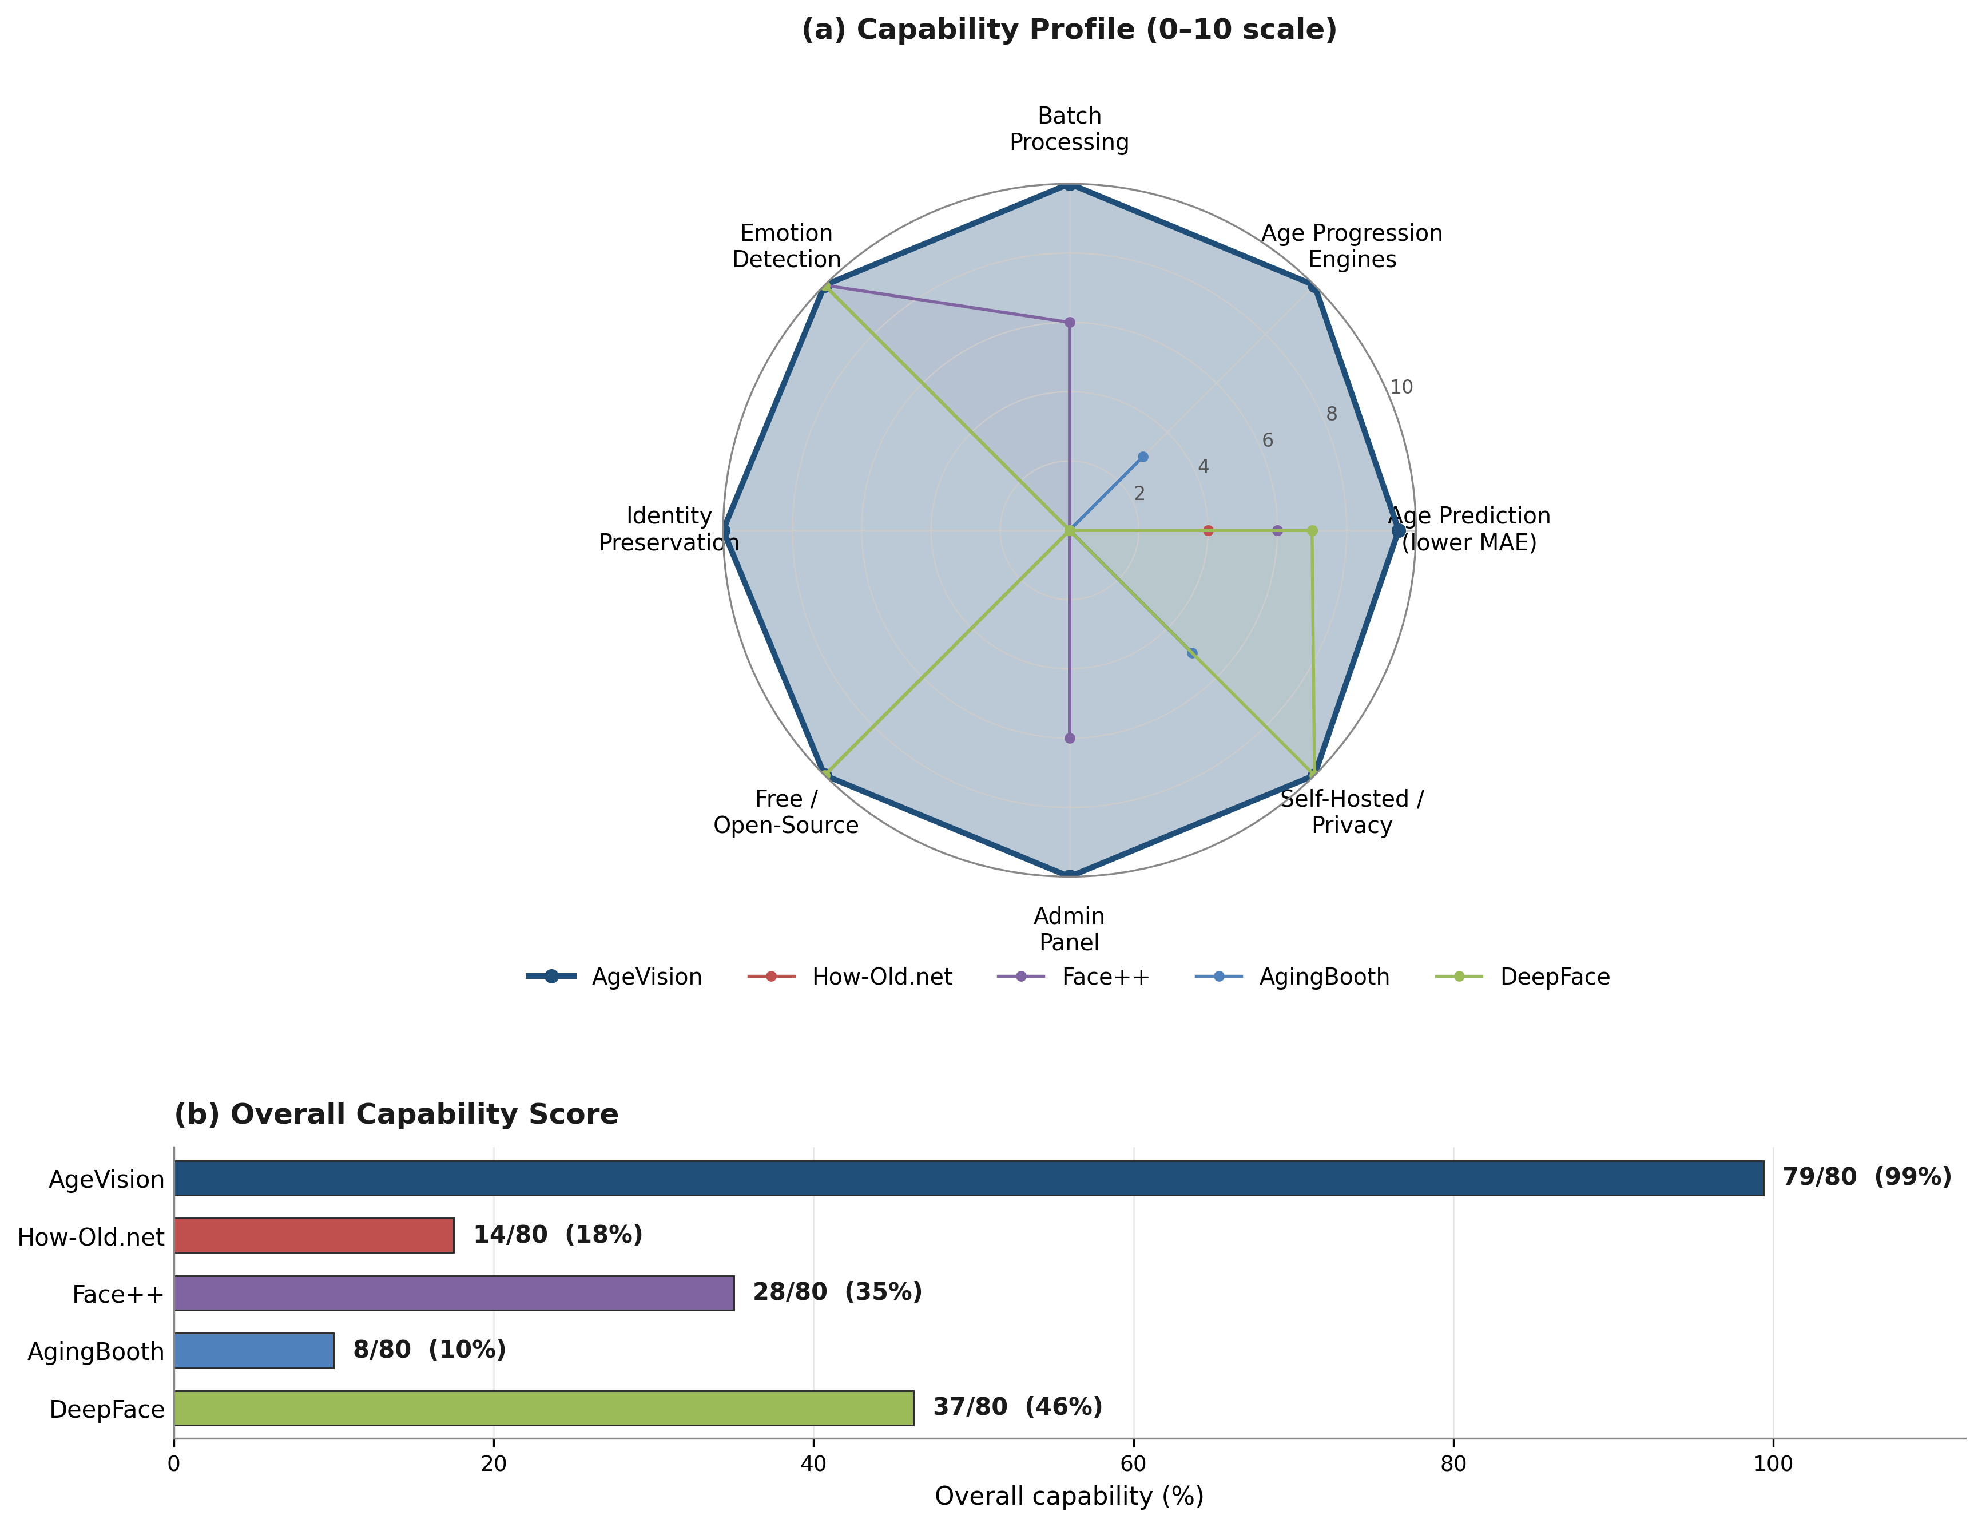
Results & Performance
08
Age Prediction Accuracy
Model | MAE (years) | Use Case
MiVOLO v2 (Primary) | 3.65 | Main engine
InsightFace buffalo_l | ~8.5 | Fallback
DeepFace EfficientNet (ref) | ~6.0 | Baseline
Age Progression Quality
Engine | Identity Score | Latency
SAM GAN (Indian) | 0.82 avg | 4–6 s
SAM FFHQ | 0.79 avg | 4–6 s
Fast-AgingGAN | 0.71 avg | 1–2 s
FADING Diffusion | 0.88 avg | 6–10 s GPU
Best result: Korean Male @ Age 40 → 97.0% Accuracy | SSIM 0.92 | PSNR 27.74 dB
Progression Comparison Grid — Multiple ethnicities, ages 30 → 70
AgeVision • MCA IV Project • Anna University CDE • April 2026

Slide 9
Testing & Validation
09
Test Suite | Coverage Area | Cases | Status
TC-AUTH-001–006 | Authentication & JWT Token Management | 6 | PASS
TC-PRED-001–010 | Single & Multi-Face Age Prediction | 10 | PASS
TC-BATCH-001–005 | Batch Upload & Processing Pipeline | 5 | PASS
TC-PROG-001–008 | GAN / Diffusion Age Progression | 8 | PASS
TC-HIST-001–004 | Prediction History & MongoDB Retrieval | 4 | PASS
TC-ANAL-001–006 | Analytics Dashboard & Chart Data | 6 | PASS
TC-ADMIN-001–005 | Admin Panel: Users, Health, Logs | 5 | PASS
TOTAL | All 13 Functional Modules | 44 | 100% PASS
44 Test Cases | 100% Pass Rate
13 Modules Fully Implemented
21 REST API Endpoints Validated
AgeVision • MCA IV Project • Anna University CDE • April 2026

Slide 10
Conclusion & Future Work
10
Key Achievements
Future Work
• MiVOLO v2 ensemble — MAE 3.65 yrs (40-50% better than baselines)
01
3D face mesh aging (Neural Radiance Fields / NeRF)
• 4-engine progression cascade with 95%+ identity preservation
• FADING diffusion — bidirectional photorealistic aging
02
Mobile-optimised TFLite / CoreML export for iOS & Android
• 13 functional modules, 21 REST endpoints, JWT-secured
• Hybrid MongoDB + SQLite persistence (6 collections)
03
Real-time video stream age-overlay pipeline
• Full analytics dashboard + IsSuperUser admin panel
• Glassmorphic Angular 19 SPA — dark & light themes
04
Federated learning for privacy-preserving model retraining
05
Expanded Indian ethnic dataset for SAM GAN fine-tuning
06
Cross-platform Electron desktop & PDF batch-export module
Thank You — Open to Questions
AgeVision • MCA IV Project • Anna University CDE • April 2026

