Slide 1
Computer
A computer is an electronic device that accepts data (input), processes it according to instructions (a program), stores it, and produces meaningful information (output).
A computer is an electronic device that accepts data (input), processes it according to instructions (a program), stores it, and produces meaningful information (output).
Notes:
Tell the story lazy boy

Slide 2
Characteristics of Computer
Speed – Performs millions or billions of calculations per second.
Accuracy – Produces correct results if given correct instructions and data.
Storage Capacity – Can store a large amount of data.
Automation – Can perform tasks automatically once programmed.
Versatility – Used for education, business, entertainment, medicine, engineering, and more.
Reliability – Can work continuously without getting tired.
Diligence – Does not lose concentration or become fatigued.
Notes:
History

Slide 3
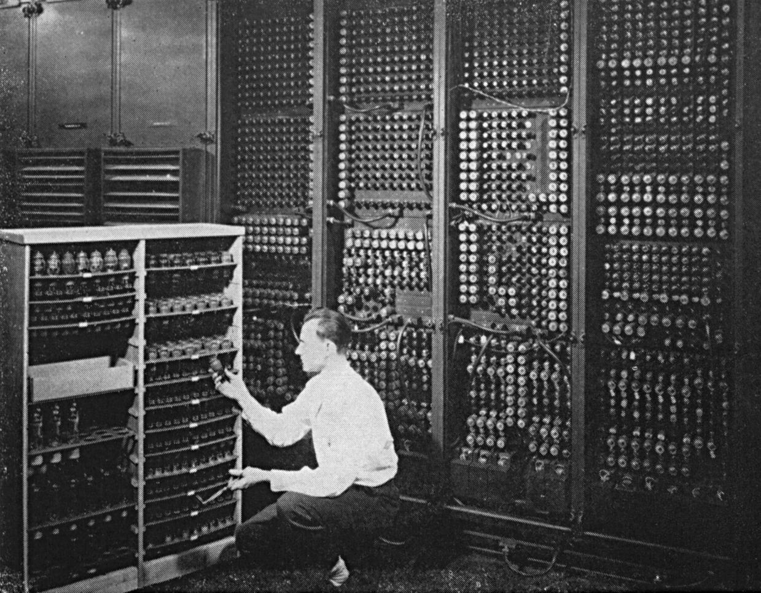
History Computer
The quick brown fox jumps over the lazy dog. The quick brown fox jumps over the lazy dog. The quick brown fox jumps over the lazy dog. The quick brown fox jumps over the lazy dog. The quick brown fox jumps over the lazy dog. The quick brown fox jumps over the lazy dog. The quick brown fox jumps over the lazy dog. The quick

Slide 4
Difference Between RAM and ROM
RAM
ROM
Operating Systems
(Windows, Linux, macOS)
Microsoft Word
Google Chrome
Python, Java, etc.
Operating Systems
(Windows, Linux, macOS)
Microsoft Word
Google Chrome
Python, Java, etc.

Slide 5
Rohan

Slide 6
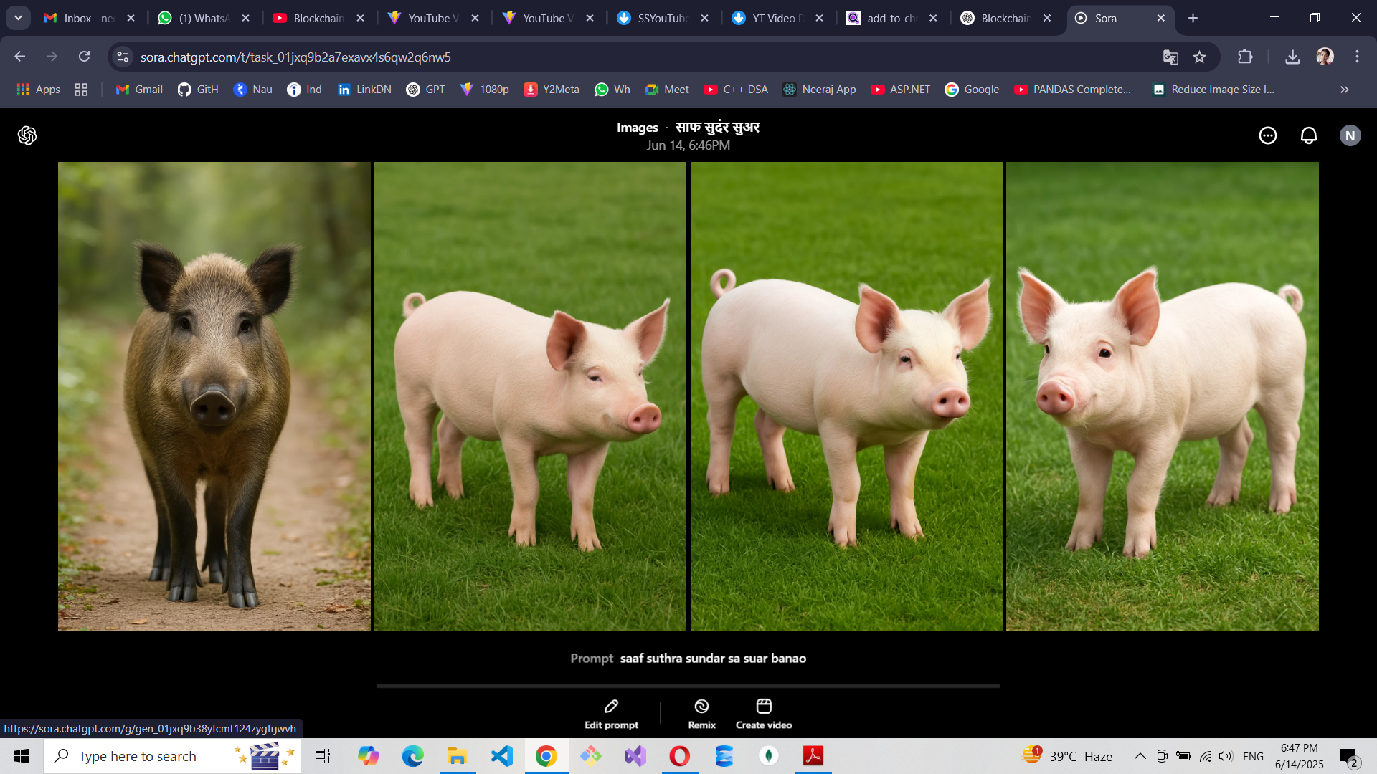

Slide 7
Hindi
English
Maths

Slide 8

$$\sim !≪≤∃∃∇∇℉≠{\left(x+a\right)}^{n}=\sum_{k=0}^{n}{\left({n \atop k}\right)x^{k}a^{n−k}}$$
The quick brown fox jumps over the lazy dog. The quick brown fox jumps over the lazy dog. The quick brown fox jumps over the lazy dog. The quick brown fox jumps over the lazy dog. The quick brown fox jumps over the lazy dog.
The quick brown fox jumps over the lazy dog. The quick brown fox jumps over the lazy dog. The quick brown fox jumps over the lazy dog. The quick brown fox jumps over the lazy dog. The quick brown fox jumps over the lazy dog.
The quick brown fox jumps over the lazy dog. The quick brown fox jumps over the lazy dog. The quick brown fox jumps over the lazy dog. The quick brown fox jumps over the lazy dog. The quick brown fox jumps over the lazy dog.

