Slide 1
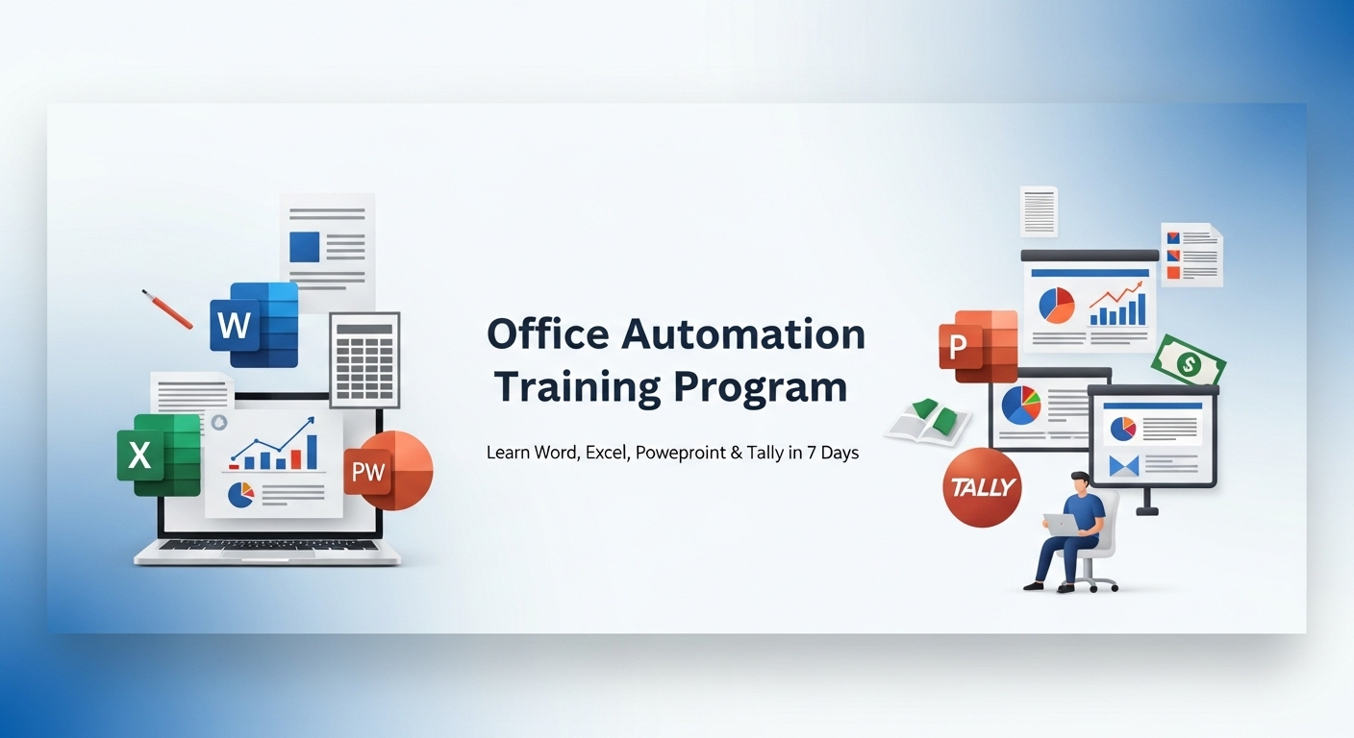



Shri Siddhi Vinayak Group of Institutions (SSVGI), Bareilly
Basic To Advance Level

Slide 2
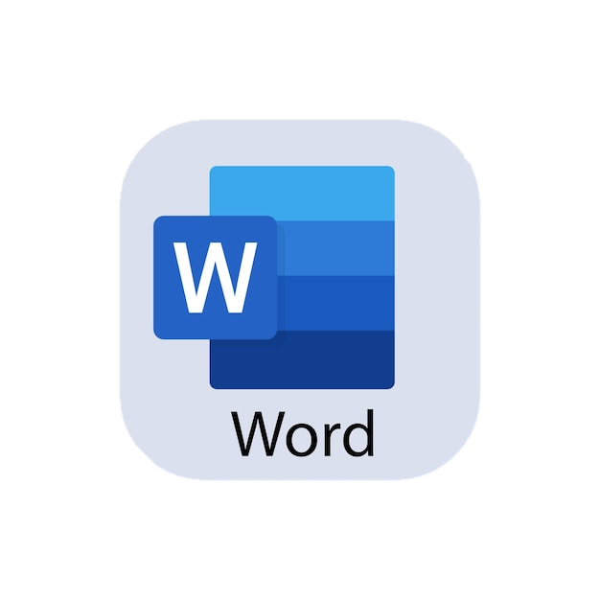
What is MS Word
Microsoft Word is a word processing software used to create, edit, and format documents
What can we do?
Create resumes, letters, reports
Add images, tables, and designs
Real-Life Examples
Resume , Office letters & applications
Notices in schools/colleges
Project reports
Interesting Facts
MS Word is one of the most used office tools in the world
Almost every job requires basic Word knowledge
Used in schools, offices, government work everywhere

Slide 3
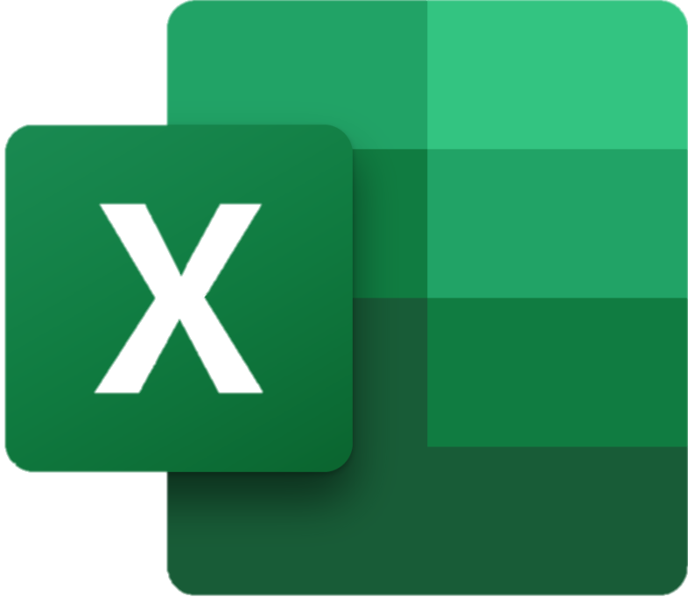
What is MS Excel?
Microsoft Excel is a spreadsheet software used to store, calculate, and analyze data.
Why do we use it?
To perform calculations quickly
To create reports and charts
Real-Life Examples
Student marksheet, Salary calculation
Shop sales record, Attendance sheet
Interesting Facts 🔥
Excel can handle thousands of rows of data
Big companies use Excel for data analysis
Learning Excel increases job opportunities

Slide 4

What is PowerPoint
PowerPoint is a presentation software used to create slides for presenting ideas.
Why do we use it?
To present information visually
To explain ideas clearly
Real-Life Examples
School/college presentations
Business meetings, Project presentations
Seminar and training sessions
Interesting Facts
A good presentation can impress people easily
Used in almost every professional field
Visual learning is more effective than reading

Slide 5

What is Tally?
Tally is an accounting software used to manage financial records of a business.
Why do we use it?
To manage money transactions
To reduce manual work
Real-Life Examples
Shop billing system
Salary and expense tracking
Small business management
Interesting Facts
Tally is widely used in India
Many accountants and shop owners use Tally daily

Slide 6
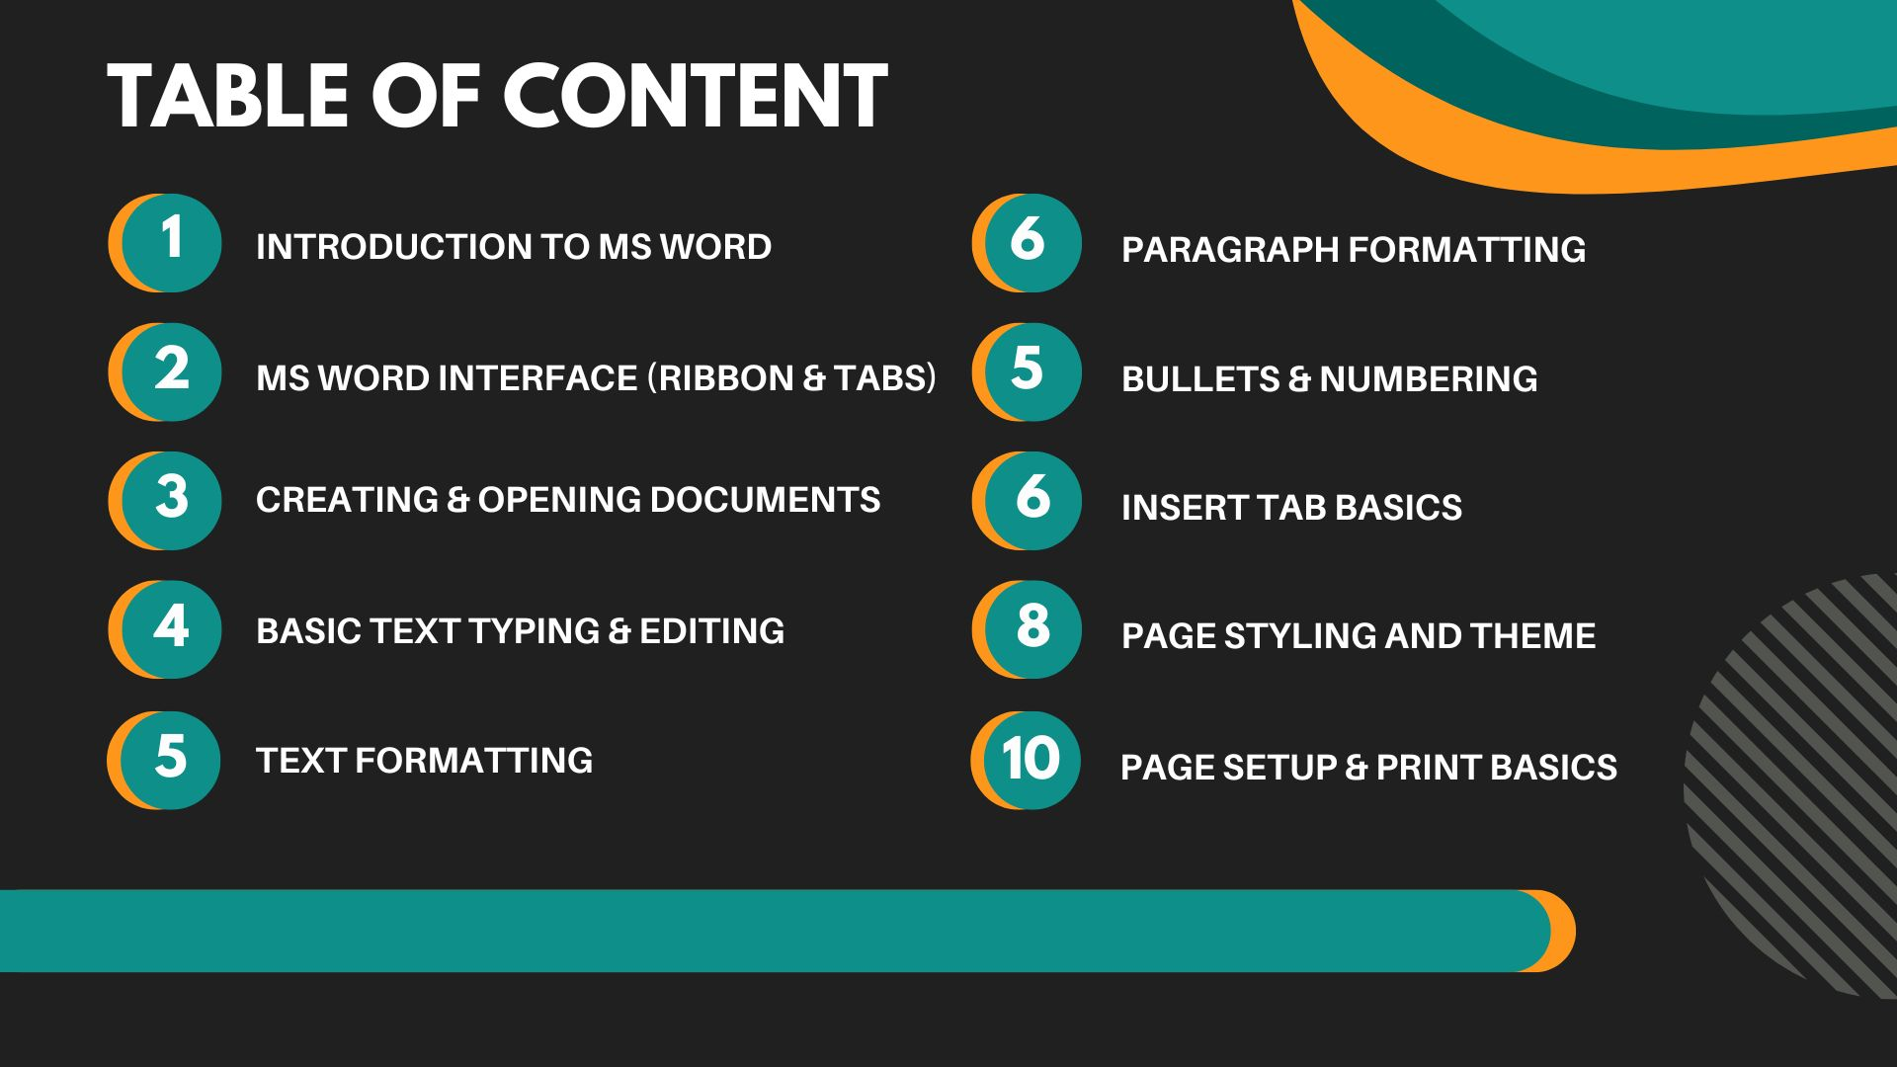

Slide 7
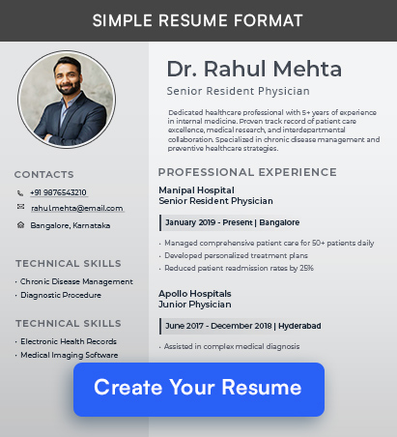
Task 1 : Create A Resume

Slide 8
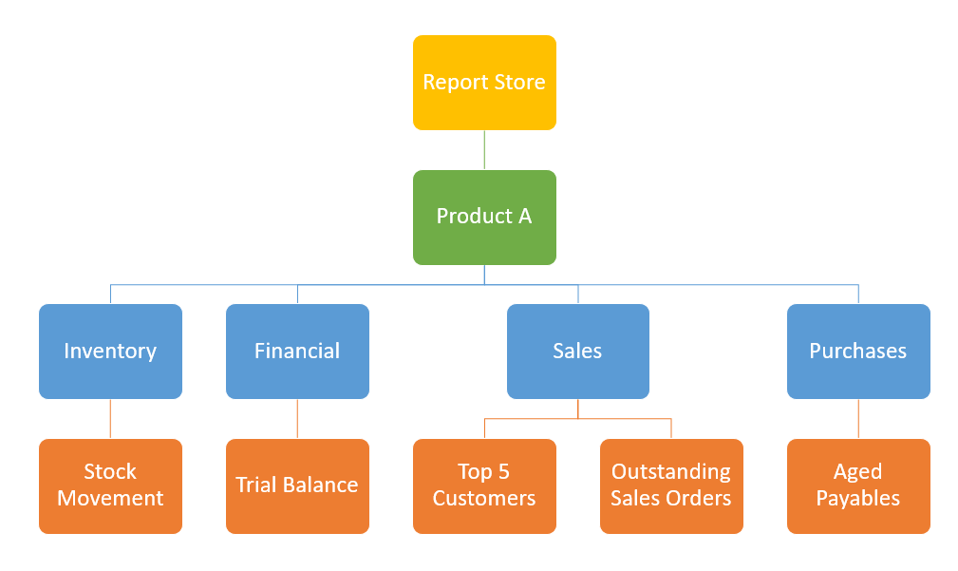
Task 2 : Create A Hierarchy

Slide 9
Task 3 : Do Mail Merge With One
Any one Example

