Slide 1




Shri Siddhi Vinayak Group of Institutions (SSVGI), Bareilly
Basic To Advance Level

Slide 2
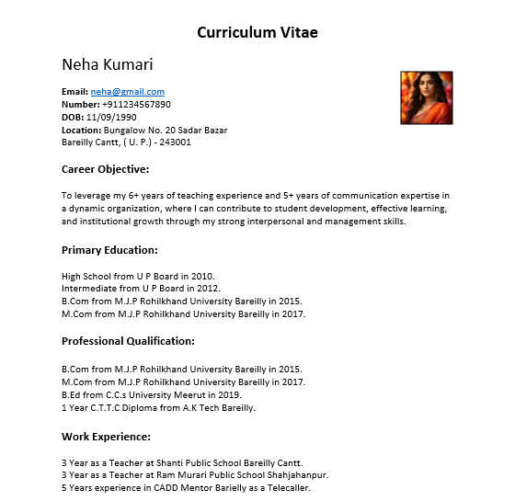
Task 1 : Create A Resume

Slide 3
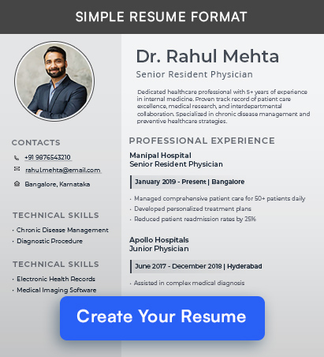
Task 2 : Create A Resume

Slide 4
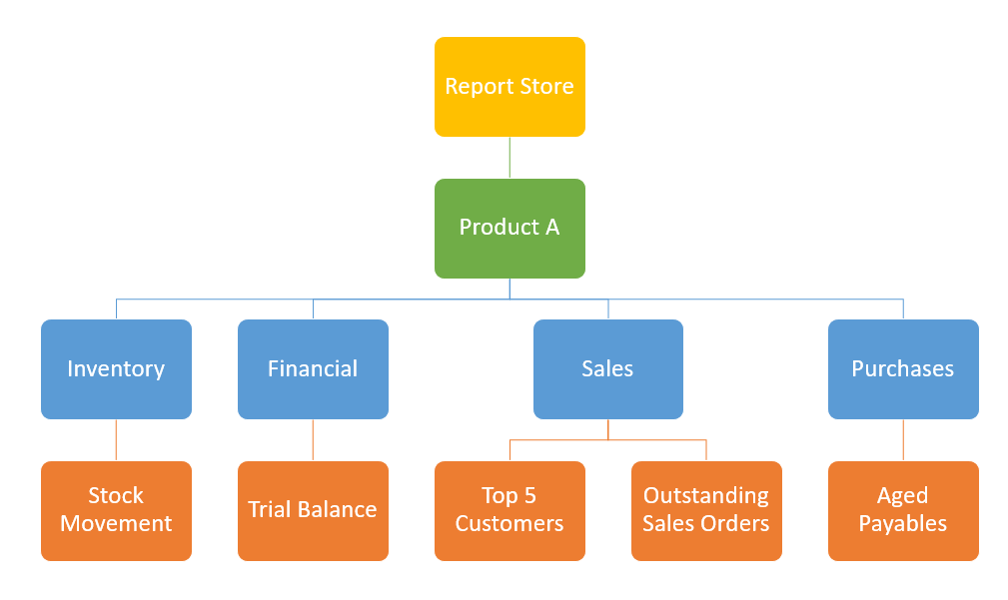
Task 3 : Create A Hierarchy

Slide 5
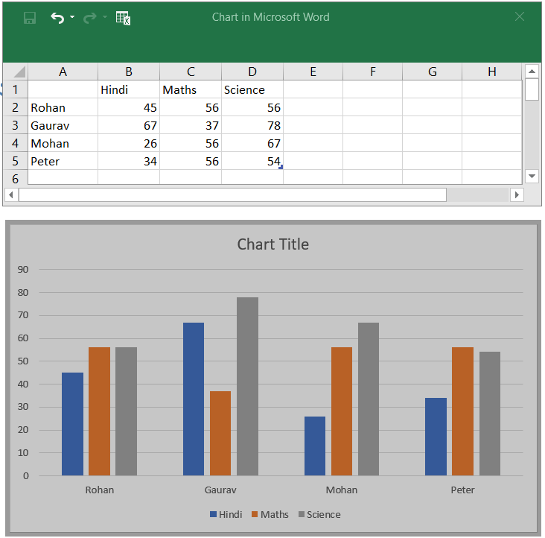
Task 4 : Create A Chart

Slide 6
Task 5 : Do Mail Merge With One
Any one Example

Slide 7
To,
The Manager,
Cadd Mentor Bareilly
Subject: Application for Leave
Respected Sir/Madam,
My name is <<Rohan>>. I am writing this application to request leave due to personal reasons.
Kindly grant me leave. You can contact me if needed on my phone number <<1234567890>> or email <<rohan@rohan.com>>.
I shall be thankful to you.
Yours sincerely,
<<Rohan>>

