Slide 1
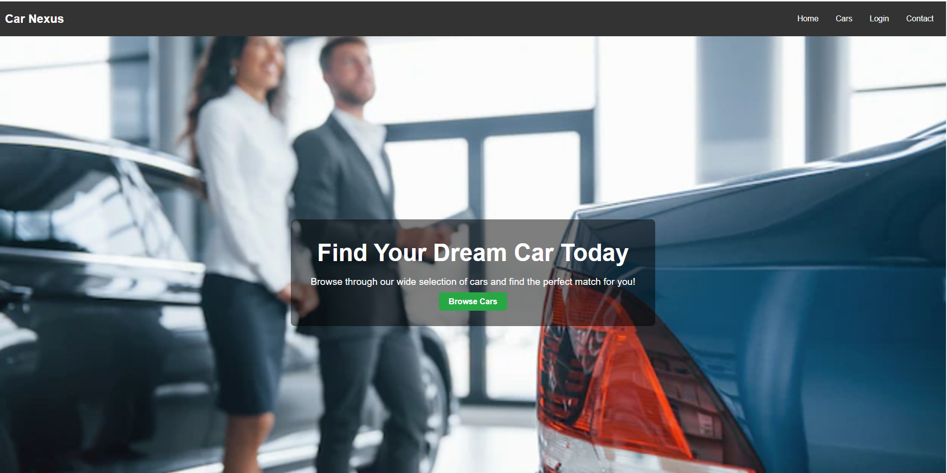
CAR NEXUS WEBSITE
ICT Project
BCS-F

Slide 2
OUR TEAM
Neeraj Khemani Ammar Kamran
Atta-ur-Rehman
Abdur Rafay

Slide 3
OVERVIEW
Site Content Summary
The website offers an engaging home page with featured cars, promotions, and easy navigation to various sections like car listings and contact details.
Features
The cars page provides a detailed catalog of vehicles with options to explore pricing and features.
WEBSITE
OVERVIEW

Slide 4




CAR NEXUS WEBSITE KEY FEATURES
Home Page
Log-in Page
Cars Page
Contact Page

Slide 5



CAR NEXUS WEBSITE KEY FEATURES
Home Page:
The home page showcases features of webpage, and easy navigation, with a prominent link to the car page where visitors can explore specifications, pricing options for each model.
Car Page :
The car page features a wide range of vehicles, showcasing detailed information on prices, specifications, and key features.
Contact Page:
Provides users with an easy way to get in touch through a link to social media handles.

Slide 6

Contact Details
support@carnexus.com

